Slide 1
Unit 9
Application of Thermodynamics

Slide 2
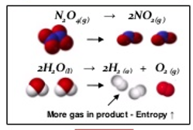
9.1 Entropy
Entropy: a measure of how dispersed the energy of a system is at a specific temperature.
Entropy increases when matter and/or energy becomes more dispersed or spread out (freer to move)
Changes that result in a +ΔS:
Increasing moles
Increasing temperature
Increasing volume
Solid to liquid to gas
Forming more complicated molecules. (More moles of electrons)
Learning Objective: Identify the sign and relative magnitude of the entropy change associated with chemical or physical processes.

Slide 3
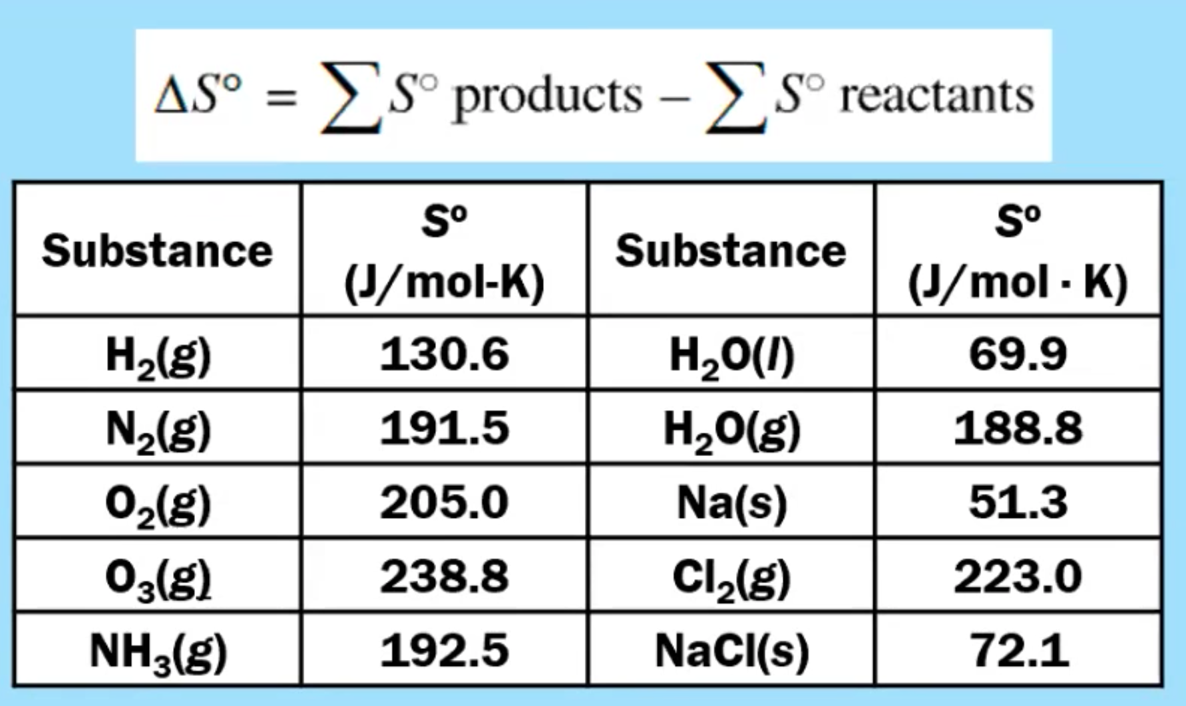
9.2 Absolute Entropy & Entropy Change
Entropy change can be calculated from the absolute entropies of the reactants and products.
*Although ΔH_{f} of an element (s, l or g) in its standard state is zero, absolute entropy are NOT zero!
Only a pure crystal at absolute zero would have an entropy of zero.
Learning Objective: Calculate the entropy change for a chemical or physical process based on the absolute entropies of the species involved in the process.

Slide 4
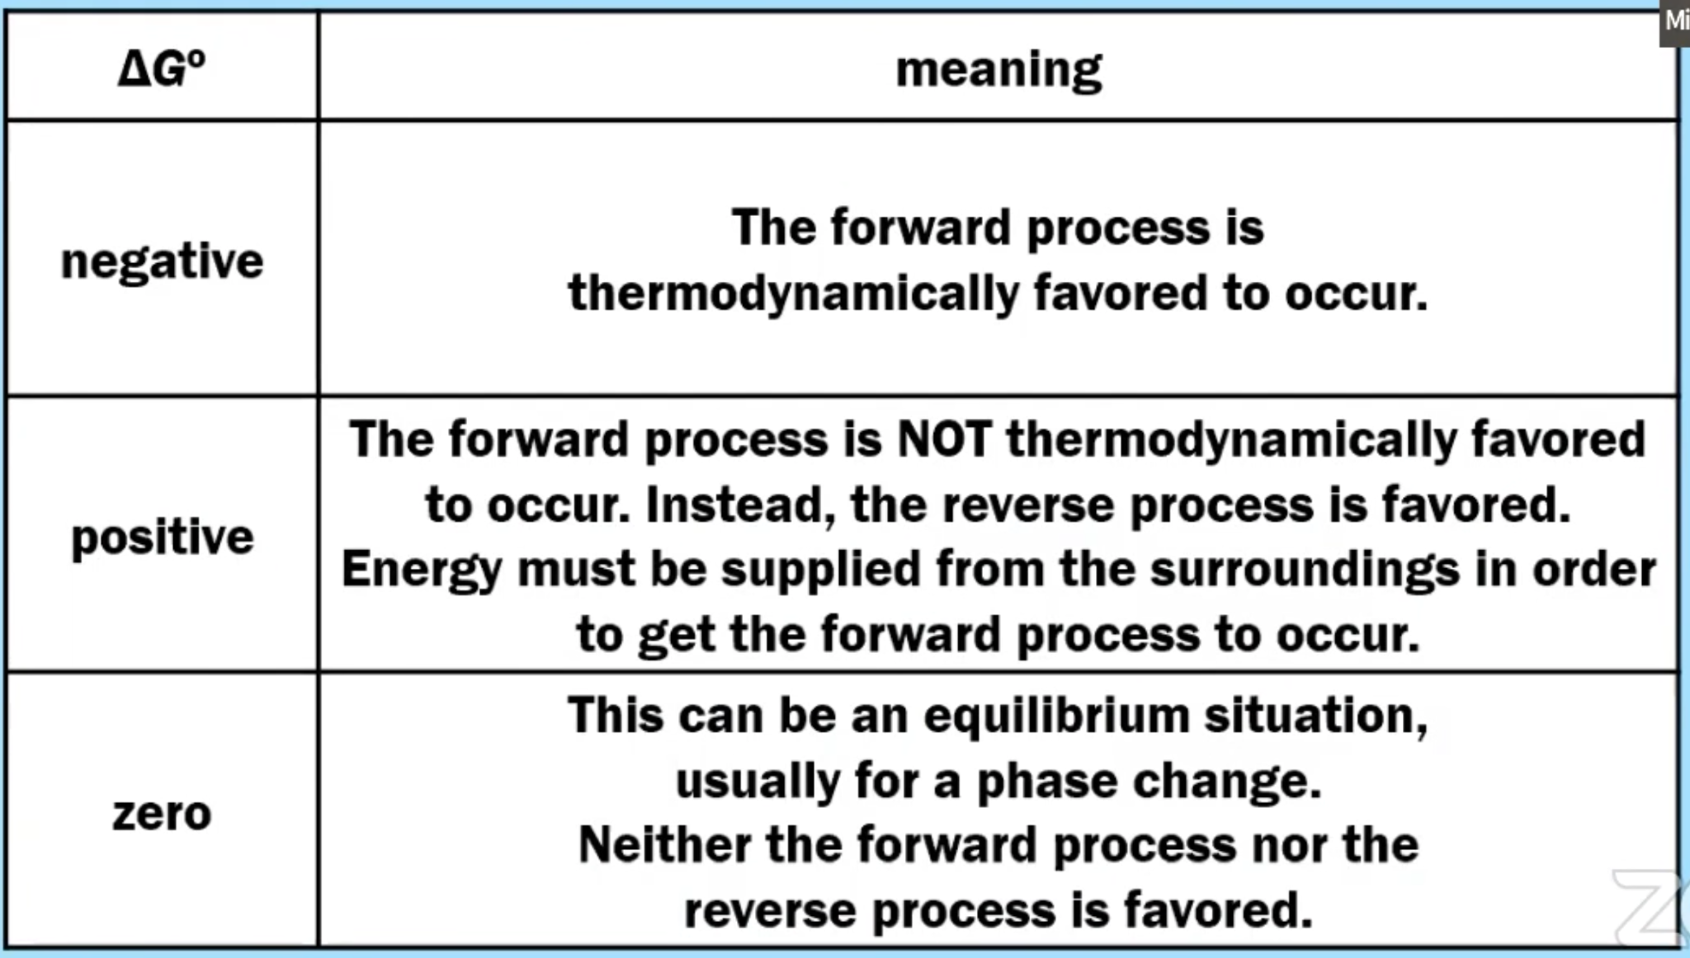
9.3 Free Energy &
Thermodynamic Favorability
Free energy (ΔG) measures the thermodynamic favorability.
ΔG° < 0: process is thermodynamically favorable (this says NOTHING about the rate of reaction)
Learning Objective: Explain whether a physical or chemical process is thermodynamically favored based on the evaluation of ΔG°

Slide 5
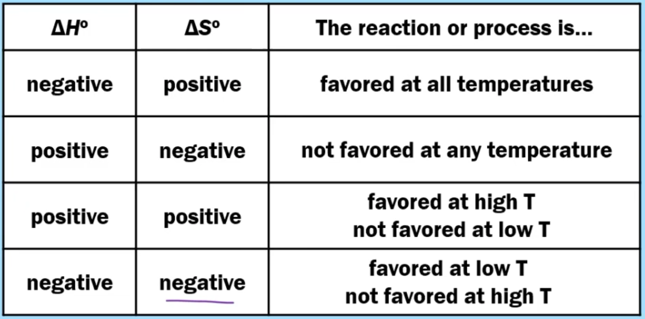
9.3 Predicting Favorability
Entropy is typically given in J/K so you MUST convert to kJ!
Nature favors low energy & high entropy!
Learning Objective: Explain whether a physical or chemical process is thermodynamically favored based on the evaluation of ΔG°

Slide 6
9.4 Thermodynamic & Kinetic Control
Many processes that are thermodynamically favored do not occur at a measurable rate.
These processes are under kinetic control. If the activation energy is high, the rate will be slow, but the reaction can still proceed toward the products.
Learning Objective: Explain, in terms of kinetics, why a thermodynamically favored reaction might not occur at a measurable rate.

Slide 7
9.5 Free Energy & Equilibrium
Products are favored!
Reactants are favored!
If ΔG° is near zero, K will be close to 1.
Learning Objective: Explain whether a process is thermodynamically favored using the relationships between K, ΔG°, and T.

Slide 8
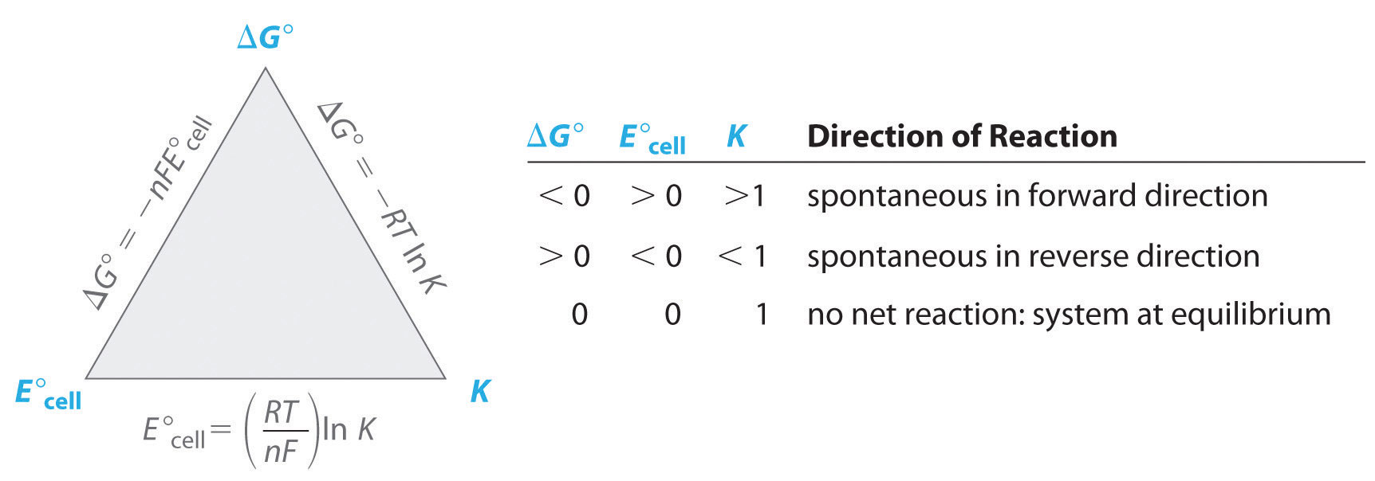
How can I calculate ΔG?

Slide 9
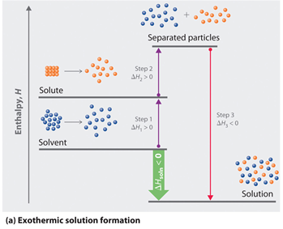
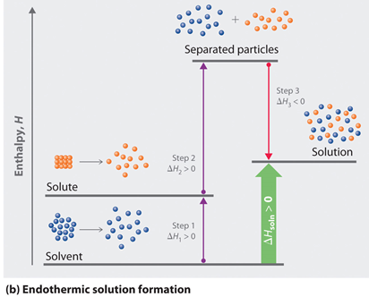
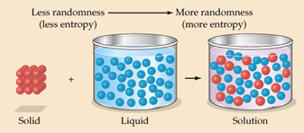
7.14 Salt dissolution: ∆H and ∆S
The enthalpy (∆H_{soln}) of dissolution is dependent upon the intermolecular forces of the solute and solvent.
Breaking solute & solvent interactions is always endothermic.
Forming a solution is always exothermic.
The entropy (∆S_{soln}) of dissolution generally increases the disorder of the system.
Learning Objective: Explain the relationship between the solubility of a salt and changes in the enthalpy and entropy that occur in the dissolution process.

Slide 10
7.14 Entropy in Solutions
Do NOT say “like dissolves like.” You’ll, like... get no points.
DO refer to LDF’s, hydrogen bonding and dipole-dipole interactions
Generally speaking. There are exceptions

Slide 11
9.6 Coupled Reactions
An external source of energy can be used to make a thermodynamically unfavorable reaction occur.
Electricity can be used to drive an electrolytic cell or charge a battery
Light to drive the overall conversion of carbon dioxide to glucose in photosynthesis.
Learning Objective: Explain the relationship between external sources of energy or coupled reactions and their ability to drive thermodynamically unfavorable processes.

Slide 12
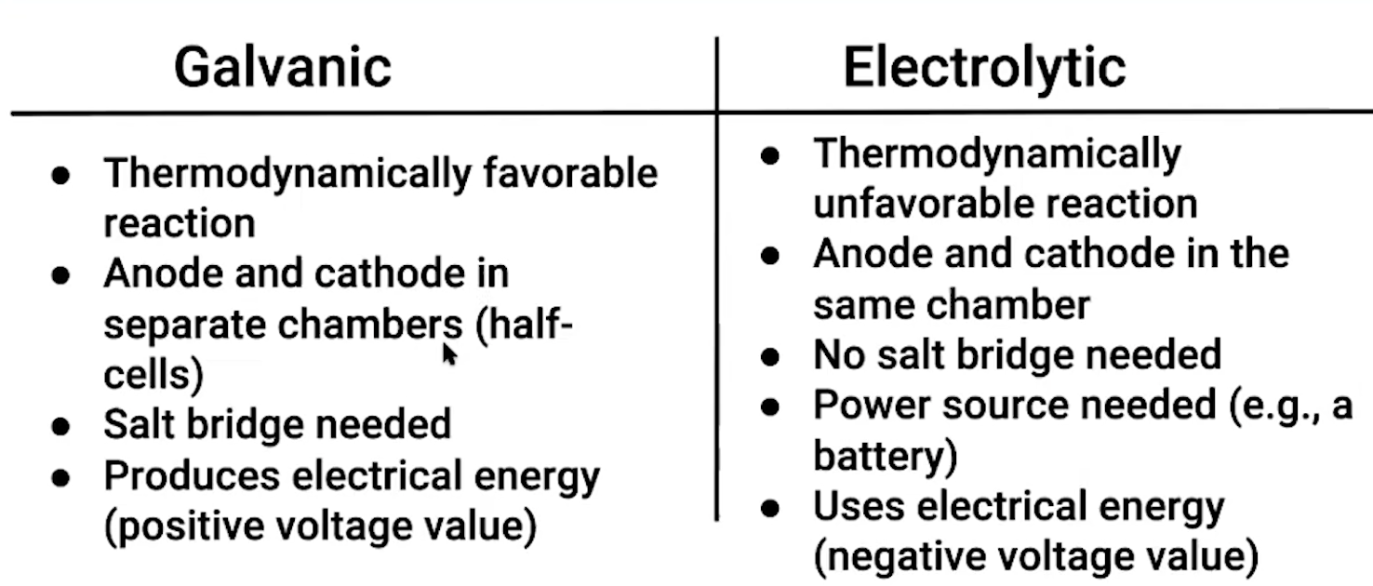
9.7 Galvanic (Voltaic) and Electrolytic Cells
Electrons flow from the anode to the cathode
Anode decreases in mass & cathode increases in mass
Learning Objective: Explain the relationship between the physical components of an electrochemical cell and the overall operational principles of the cell.

Slide 13
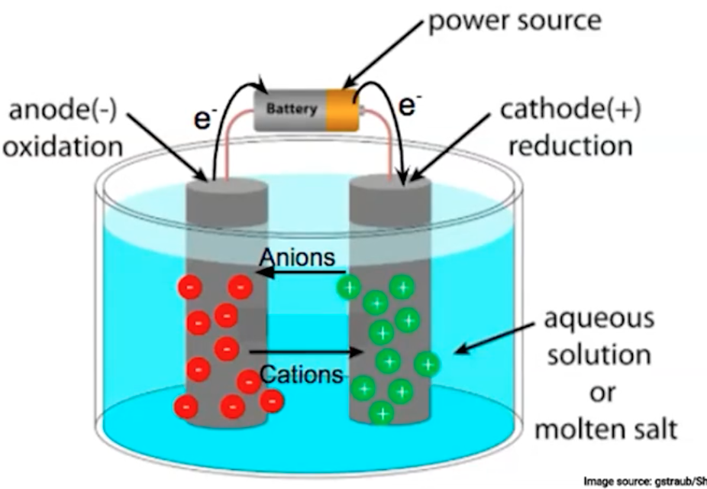
9.7 Galvanic (Voltaic) and Electrolytic Cells
Learning Objective: Explain the relationship between the physical components of an electrochemical cell and the overall operational principles of the cell.

Slide 14
9.8 Cell Potential and Free Energy
Eº_{cell} = Eº_{red} + Eº_{ox}
Voltaic/galvanic cells always have a positive cell potential. (Always thermodynamically favorable)
Electrolytic cells always have a negative cell potential. (Never thermodynamically favorable)
The greater the difference between the two, the greater the voltage of the cell.
Identify the oxidation and reduction half-reactions
The more positive the reduction potential, the more likely to be reduced
Electrical potential does not depend on the amount of substance reacting. Do NOT multiply the values of the half-reaction potentials by the coefficients in the overall cell reaction.
Learning Objective: Explain whether an electrochemical cell is thermodynamically favored, based on its standard cell potential and the constituent half-reactions within the cell

Slide 15
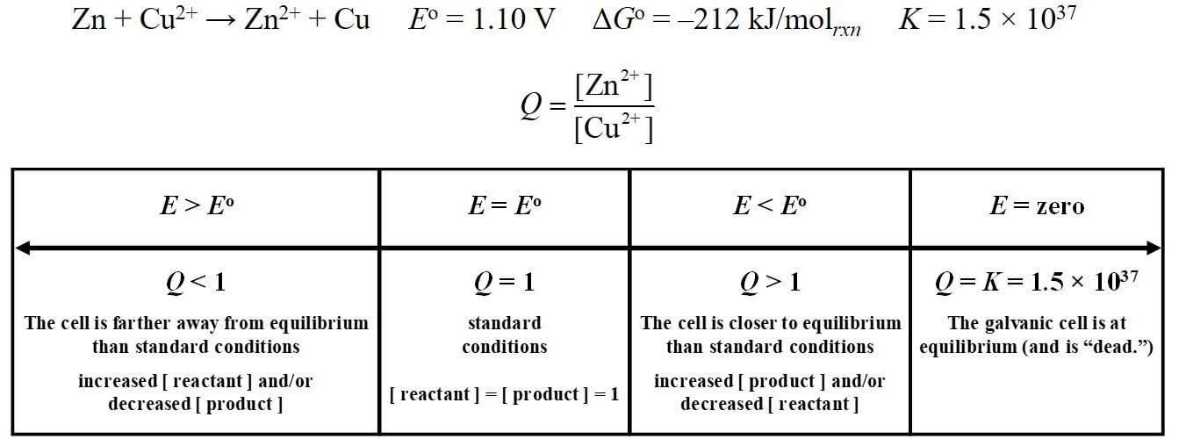
9.9 Cell Potential Under Nonstandard Conditions
In a real system under nonstandard conditions, the cell potential will vary depending on the concentration of the active species. The cell potential is the driving force toward equilibrium; the farther the reaction is from equilibrium, the greater the magnitude of the cell potential.
Learning Objective: Explain the relationship between deviations from standard cell potential and changes in the cell potential.

Slide 16
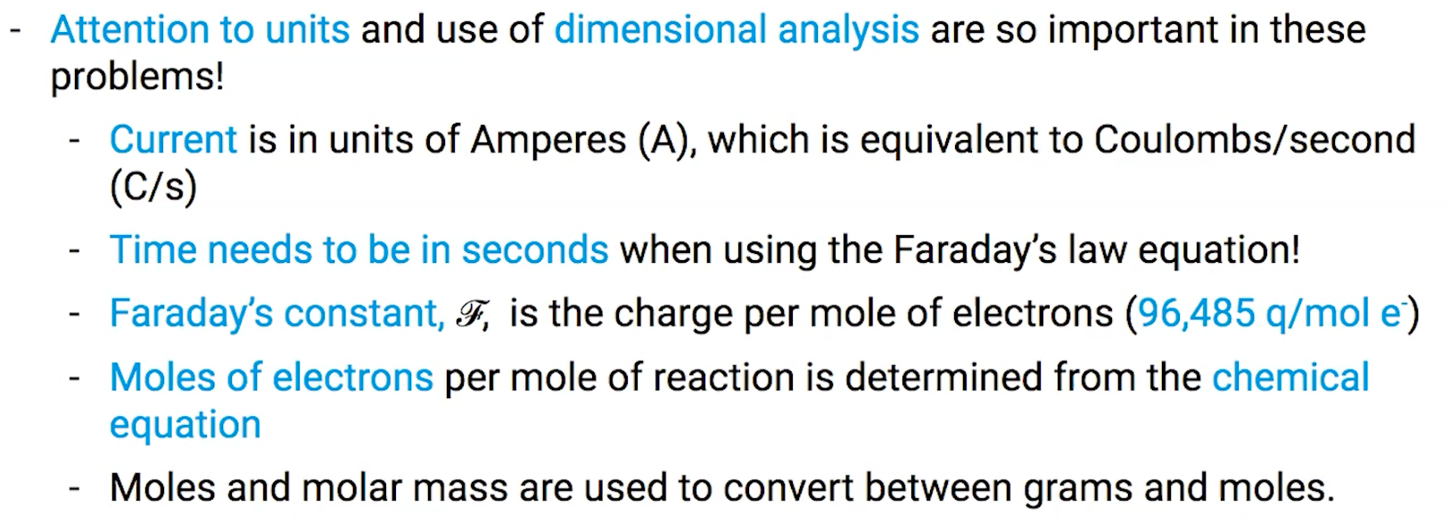
9.10 Electrolysis & Faraday’s Law
Faraday's laws can be used to determine the stoichiometry of the redox reaction occurring in an electrochemical cell with respect to the following:
Number of electrons
Transfer mass of material deposited on or removed from an electrode
Current (I = q/t) - current is C/s
Time elapsed
Charge of ionic species
Learning Objective: Calculate the amount of charge flow based on changes in the amounts of reactants & products in an electrochemical cell.

