Slide 1
Unit 8 Part II: Acids and Bases
Pure water has an equal concentration of the hydronium ion H₃O⁺ (aq) and the hydroxide ion OH–(aq) because it self-ionizes:
2H₂O(l) ↔ H₃O⁺ (aq) + OH–(aq)
Acids and Bases are substances that disrupt the balance of the hydronium ion and the hydroxide ion in a water solution.

Slide 2
Properties of Acids & Bases
An acid is any substance that releases hydrogen ions, H⁺, into water (making more hydronium ions.) (H30>OH in the solution)
Acids have a sour taste; lemons, limes, and vinegar are acidic.
A base is a substance that releases hydroxide ions, OH –, into water, and therefore hydroxide ion concentration is greater than hydronium ion.
Bases have a slippery, soapy feel. Also have a bitter taste.
A salt is an ionic compound that comes from anion of an acid and cation of a base and is produced from a neutralization reaction.
Can be neutral, acidic, or basic when reacting with water molecules.

Slide 3
Salt Hydrolysis
Hydrolyzing salts that come from:
a strong acid + a weak base = acidic
a weak acid + a strong base = basic
a strong acid + a strong base = neutral salt
“Strong” refers to the degree of ionization or dissociation.

Slide 4
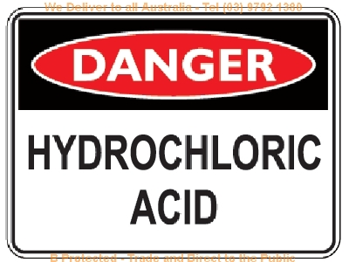
Strong Acids
HCl Hydrochloric acid
HBr Hydrobromic acid
HI Hydroiodic acid
HNO₃ Nitric acid
H₂SO₄ Sulfuric acid
HClO₃ Chloric acid
HClO₄ Perchloric acid

Slide 5
Strong Bases
Group 1a:
Group 2a:
LiOH
NaOH
KOH
RbOH
CsOH
Ca(OH)₂
Sr(OH)₂
Ba(OH)₂

Slide 6
Salt Hydrolysis
To see if the resulting salt is acidic or basic, check the “parent” acid and base that formed it. Practice on these:
HCl + NaOH
H₂SO₄ + NH₄OH
H₂S + KOH
NaCl, a neutral salt
(NH₄)₂SO₄, acidic salt
K₂S, basic salt

Slide 7
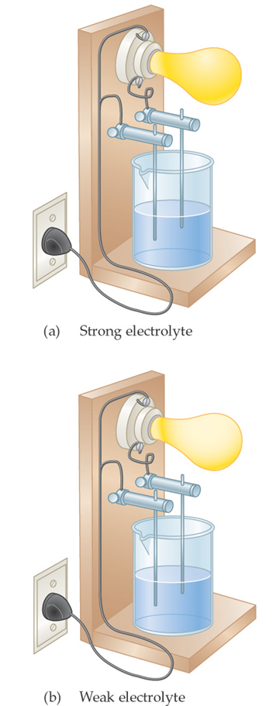
Electrolyte Strength
Strong acids and bases are strong electrolytes. (Dissociate completely in solution)
Weak acids and bases are weak electrolytes. (Do not dissociate completely)

Slide 8
Acid/Base Neutralization
Recall that an acid and a base react with each other in a neutralization reaction.
When an acid and a base react, water and a salt are produced.
This a type of double replacement reaction.
For example, nitric acid reacts with sodium hydroxide to produce sodium nitrate and water:
HNO₃(aq) + NaOH(aq) → NaNO₃(aq) + H₂O(l)

Slide 9
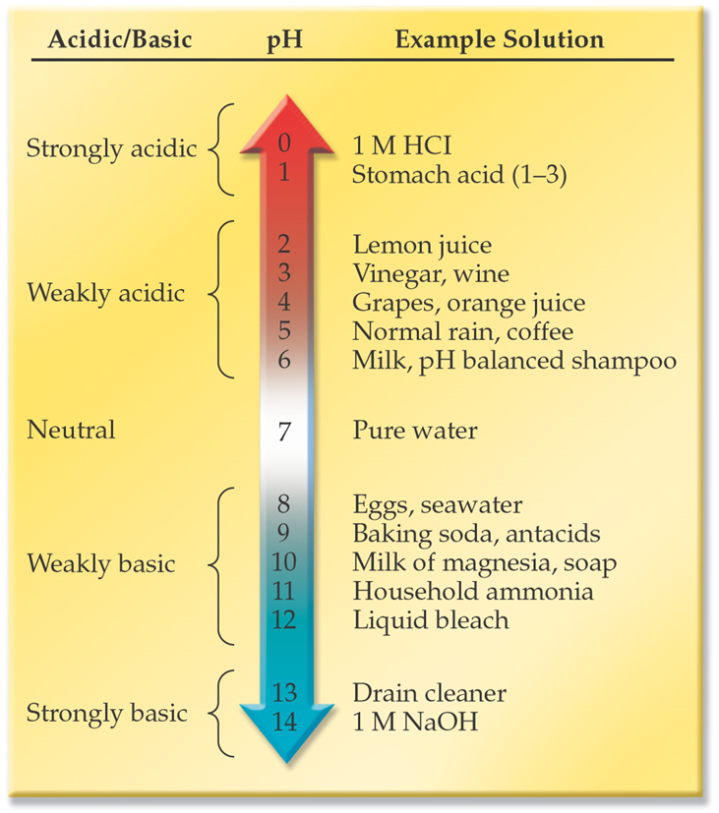
The pH Scale
A pH value expresses the acidity or basicity of a solution.
Most solutions have a pH between 0 and 14.
Acidic solutions have a pH less than 7.
As a solution becomes more acidic, the pH decreases.
Basic solutions have a pH greater than 7.
As a solution becomes more basic, the pH increases.

Slide 10
Arrhenius Acids and Bases
Svante Arrhenius proposed the following definitions for acids and bases in 1884:
An Arrhenius acid is a substance that ionizes in water to produce hydrogen ions.
An Arrhenius base is a substance that dissociates in water to release hydroxide ions.
For example, HCl is an Arrhenius acid and NaOH is an Arrhenius base.

Slide 11
Strengths of Acids & Bases
The strength of an Arrhenius acid is measured by the degree of ionization in solution.
The acid HCl ionizes into H⁺ and Cl– ions in solution.
The strength of an Arrhenius base is measured by the degree of dissociation in solution.
Dissociation is the process where cations and anions in an ionic compound separate in solution.
A formula unit of NaOH dissociates into Na⁺ and OH– ions in solution.

Slide 12
Arrhenius Acids in Solution
All Arrhenius acids have a hydrogen atom bonded to the rest of the molecule by a polar bond. This bond is broken when the acid ionizes.
Polar water molecules help ionize the acid by pulling the hydrogen atom away:
HCl(aq) + H₂O(l) → H₃O⁺(aq) + Cl–(aq) (~100%)
HC₂H₃O₂(aq) + H₂O(l) ← → H₃O⁺(aq) + C₂H₃O₂–(aq) (~1%)
The hydronium ion, H₃O⁺, is formed when the aqueous hydrogen ion attaches to a water molecule.

Slide 13
BrØnsted-Lowry Acids and Bases
This definition includes a lot more substances than Arrhenius acids and bases.
Substances that are only BrØnsted-Lowry acids and bases are not strong, and therefore when they react with each other they reach equilibrium with their conjugates.

Slide 14
BrØnsted-Lowry Definition
Acids are any substance that can donate a proton (H⁺)
Bases are any substance that can accept a proton (H⁺)
HF(g) + H₂O(l) ↔ H₃O⁺(aq) + F⁻(aq)
Acid
Proton Donor
Base
Proton Acceptor

Slide 15
Conjugate Pairs
These reversible reactions have an acid and base on both sides
Pairs that differ by only one proton (H⁺) are called conjugates.
HF(g) + H₂O(l) ↔ H₃O⁺(aq) +Fˉ(aq)
Acid
Base
Conjugate
Acid
Conjugate
Base

Slide 16
A stronger acid will make a weaker conjugate base
A weaker acid will make a stronger conjugate base.
Same for strong & weak bases.

Slide 17
What about H₂O? Acid or Base?
HCl(g) + H₂O(l) ↔ H₃O⁺(aq) + Cl⁻(aq)
Acid
Base
Conjugate
Acid
Conjugate
Base
NH₃(g) + H₂O(l) ↔ NH₄⁺(aq) + OH⁻(aq)
Acid
Conjugate
Acid
Conjugate
Base
Base

Slide 18
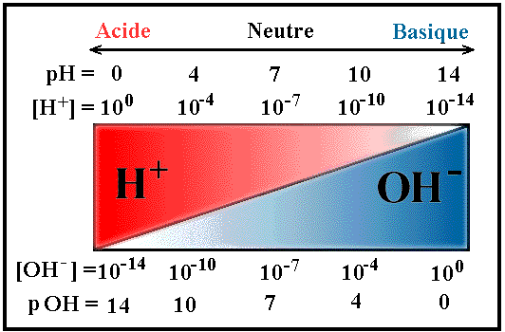
pH and pOH
Acid
Neutral
Base

Slide 19
The pH Concept
pH is a measure of the acidity of a solution.
A neutral solution has a pH of 7, an acidic solution has a pH less than 7, and a basic solution has a pH greater than 7.
The pH scale uses powers of 10 to express the hydrogen/hydronium ion concentration.
Mathematically: pH = –log[H⁺]
[H⁺] is the molar hydrogen/hydronium ion concentration

Slide 20
Calculating pH
What is the pH if the hydrogen ion concentration in a vinegar solution is 0.001 M?
pH = –log[H⁺]
pH = –log(0.001)
pH = – ( –3) = 3
The pH of the vinegar is 3, so the vinegar is acidic.

Slide 21
Calculating [H⁺] from pH
If we rearrange the pH equation for [H⁺], we get:
[H⁺] = 10^{–pH}
Milk has a pH of 6. What is the concentration of hydrogen ion in milk?
[H⁺] = 10^{–pH} = 10^{–6} = 0.000001 M
[H⁺] = 1 × 10^{–6} M.

Slide 22
Advanced pH Calculations (need calculator)
What is the pH of blood with [H⁺] = 4.8 × 10^{–8} M?
pH = –log[H⁺] = –log(4.8 × 10^{–8}) = – (–7.3)
pH = 7.3
What is the [H⁺] in orange juice with a pH of 2.75?
[H⁺] = 10^{–pH} = 10^{–2.75} = 0. 00178 M
[H⁺] = 1.78 × 10^{–3} M

Slide 23
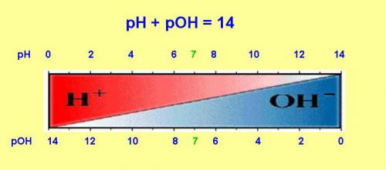
The pOH Concept
pH is a measure of the acidity of a solution.
pOH can also be used to measure the acidity of a solution.
Remember, as the concentration of
hydronium ion goes up, the
concentration of the hydroxide ion
goes down.

Slide 24
The pOH Concept
In an aqueous solution, [H⁺][OH⁻] = 1.0 × 10⁻¹⁴.
This is the ionization constant of water, K_{w}.
pH + pOH = 14
In pure water, pH and pOH are both 7 (at 25 degrees Celsius)
All aqueous solutions have a pH and a pOH.
The lower the pH of a solution, the higher the pOH of that same solution.

Slide 25
Example #1
The [OH⁻] of an aqueous solution is 1.0 x 10⁻⁹ M.
What is the pOH?
What is the pH?
What is the [H₃O⁺]
Is this solution acidic or basic?

Slide 26
Example #1 answers
pOH = 9
pH = 5
[H₃O⁺] = 1.0 x 10⁻⁵ M
The aqueous solution is acidic.

Slide 27
Example #2 (calculator very helpful)
The pOH of an aqueous solution is 2.7.
What is the [OH⁻] ?
What is the pH?
What is the [H₃O⁺]
Is this solution acidic or basic?

Slide 28
Example #2 answers
The pOH of an aqueous solution is 2.7.
The [OH⁻] = 2.0 x 10⁻³ M
The pH = 11.3
The [H₃O⁺] = 5.0 x 10⁻¹² M
The aqueous solution is basic.

Slide 29
More about Neutralization Reactions
Recall, an acid neutralizes a base to produce a salt and water. (Double replacement reaction.)
HCl(aq) + NaOH(aq) → NaCl(aq) + H₂O(l)
The reaction produces the aqueous salt NaCl.
Using the equation: M_{A}V_{A} = M_{B}V_{B}
An unknown concentration of acid or base can be found if both volumes and the concentration of the other solution are known. This is done with a titration.

Slide 30
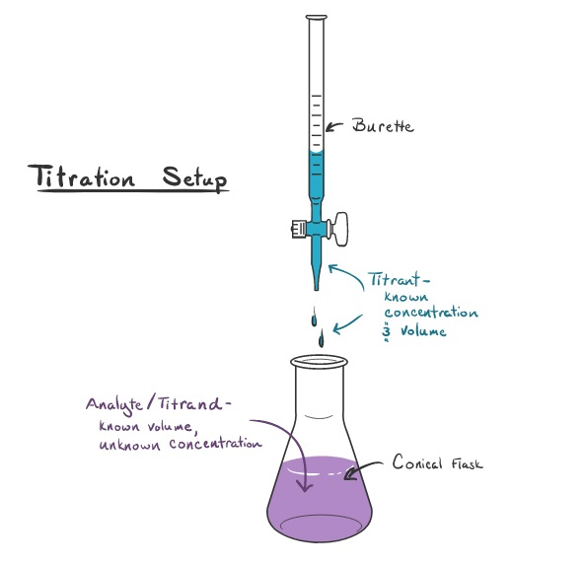
Acid-Base Titrations
A titration is used to analyze an acid solution using a solution of a base (or vice versa.)
A measured volume of base is added to the acid solution using a buret. The moles of base that are added is then also the number of moles of acid. An indicator will change color at the stoichiometric endpoint of the titration.

Slide 31
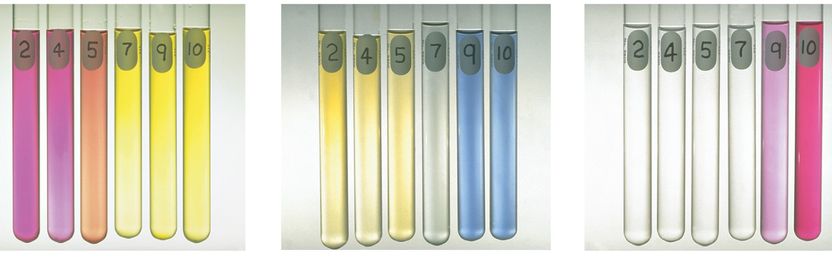
Acid-Base Indicators
A solution that changes color as the pH changes is an acid-base indicator.
Shown below are the three indicators at different pH values.
Methyl Red Bromothymol Blue Phenolphthalein

Slide 32
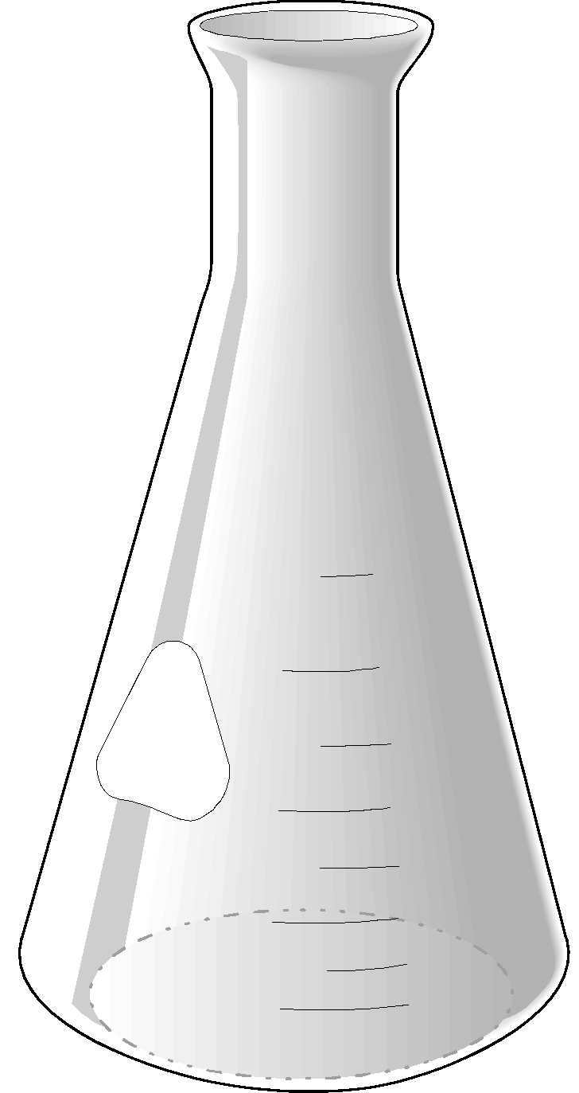
Titration
Notice the color changes from clear to pink when one drop past the equivalence point is added. This is the end point.
The equivalence point is undetectable, but the end point can be seen because of the color change. That is the best that can be done!
The number of moles of hydroxide and hydronium ions are now the same.
The acid’s concentration can now be calculated because
M = mol/L.

Slide 33
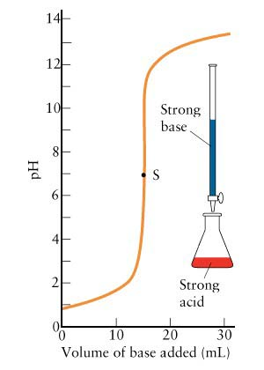
Titration Curve Interpretation Practice
What is in the buret?
What is in the Erlenmeyer flask?
What values were known before the titration is started?
What values will be found once the stoichiometric end point is reached?
What is the pH of the solution in the flask when the endpoint is reached?
How much strong base was added to the flask to reach the stoichiometric endpoint?
What happens to the pH of the solution if more strong base is added after the stoichiometric endpoint has been reached?
What is the purpose of this titration?

Slide 34
Titration Curve Answers
A strong base.
A strong acid.
3) The concentration of the base and the volume of the acid.
4) First the volume of base that needs to be added and then the concentration of the acid.
5) pH = 7
6) 15 mL
7) It rapidly rises and levels off at around 13.
8) The purpose is to find the concentration of the acid which was previously unknown.

Slide 35
Titration Problem (1:1 ratio)
Consider the titration of acetic acid with sodium hydroxide. A 10.0 mL sample of acetic acid requires 37.55 mL of 0.223 M NaOH. What is the concentration of the acetic acid?
HC₂H₃O₂(aq) + NaOH(aq) → NaC₂H₃O₂(aq) + H₂O(l)
Using M_{A}V_{A} = M_{B}V_{B}
M_{A} = M_{B}V_{B} / V_{A}
M_{A} = (0.223 M )(37.55 mL) / 10.0 mL
M_{A} = 0.837M

Slide 36
Titration Problem (not 1:1 ratio)
A volume of 50.0 mL of 1.20 M H₃PO₄ neutralizes 45.5 mL of a Ca(OH)₂ solution. What is the molarity of the Ca(OH)₂ solution?
Balanced equation:
2 H₃PO₄ (aq) + 3Ca(OH)₂ (aq) → Ca₃(PO₄ )₂ (aq) + 6H₂O (l)
n_{B}M_{A}V_{A} = n_{A}M_{B}V_{B}
M_{B} = n_{B}M_{A}V_{A} / n_{A}V_{B}
M_{B} = 3(1.20 M)(50.0 mL)/2(45.5 mL)
M_{B} = 1.98 M

Slide 37
Titrations of Polyprotic Acids
In these cases there is an equivalence point for each dissociation.

