Slide 1
Unit 8 Lesson #1
Ionic Equations, Solutions & Concentrations

Slide 2
Dissolution
process by which an ionic solid breaks into ions as it dissolves in a polar liquid, such as water

Slide 3
We can write these solutions as ions if they dissolve (aqueous)
NaCl(s) → Na⁺(aq) + Cl⁻(aq)

Slide 4
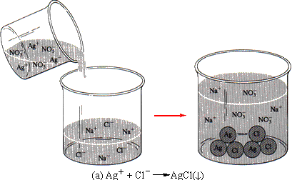
Precipitation
process by which ions leave a solution and form a precipitate
(insoluble in water)
Ag⁺(aq) + Cl⁻(aq) → AgCl(s)

Slide 5
Show all the aqueous ionic compounds as the separate ions they really are.
AgNO₃(aq) + NaCl(aq) → AgCl(s) + NaNO₃(aq)
Ag⁺(aq)
+ NO₃⁻(aq)
+ Na⁺(aq)
+ Cl⁻(aq)
→ AgCl(s)
+ Na⁺(aq)
+ NO₃⁻(aq)
AKA total or complete ionic equations

Slide 6
Writing Ionic Equations
Step 1 – Balance the equation
Cu(NO₃)₂(aq) + NaOH(aq) → Cu(OH)₂(s) + NaNO₃(aq)
Cu(NO₃)₂(aq) + 2NaOH(aq) → Cu(OH)₂(s) + 2NaNO₃(aq)
If there is more than one of an ion, you must write it as a coefficient in the ionic equation
Step 2 – Write all aqueous compounds as ions
Cu²⁺(aq)
+ 2NO₃⁻(aq)
+ 2Na⁺(aq)
+ 2OH⁻(aq) →
Cu(OH)₂(s) +
2Na⁺(aq) +
2NO₃⁻(aq)

Slide 7
Spectator Ions
Ions which do not participate directly in a reaction in solution, they just “watch”, therefore they remain unchanged
Cu²⁺(aq) + 2NO₃⁻(aq) + 2Na⁺(aq) + 2OH⁻(aq) →
Cu(OH)₂(s) + 2Na⁺(aq) + 2NO₃⁻(aq)

Slide 8
Which ions are just watching the show?
Na⁺ and NO₃⁻

Slide 9
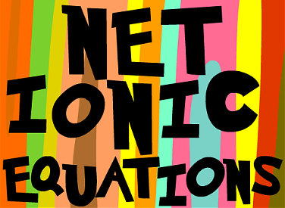
Includes only those components of the solution that undergo a change (spectator ions are removed)
Writing Net Ionic Equations
Step 1 – Begin with Ionic Equation
Ag⁺(aq) + NO₃⁻(aq) + Na⁺(aq) + Cl⁻(aq) → AgCl(s) + Na⁺(aq) + NO₃⁻(aq)
Step 2 – Cross out spectator ions
Ag⁺(aq) + NO₃⁻(aq) + Na⁺(aq) + Cl⁻(aq) → AgCl(s) + Na⁺(aq) + NO₃⁻(aq)
= Net Ionic Equation
Ag⁺(aq) + Cl⁻(aq) → AgCl(s)

Slide 10
Write the complete and net ionic equations for the following equations.
1. Mg(s) + NiSO₄(aq) → Ni(s) + MgSO₄(aq) (single replacement)
Complete: Mg(s) + Ni²⁺(aq) + SO₄²⁻(aq) → Ni(s) + Mg²⁺(aq) + SO₄²⁻(aq)
Net: Mg(s) + Ni²⁺(aq) → Ni(s) + Mg²⁺(aq)
2. MgCl₂(aq) + 2AgNO₃(aq) → 2AgCl(s) + Mg(NO₃)₂(aq) (double replacement)
Complete: Mg²⁺(aq) + 2Cl⁻ (aq) + 2Ag⁺ + 2NO₃⁻(aq) → 2AgCl(s) +
Mg²⁺(aq) + 2NO₃⁻(aq)
Net: 2Cl⁻ (aq) + 2Ag⁺(aq) → 2AgCl(s)

Slide 11
Properties of Solutions
Homogeneous mixtures
Particles are very small.
Particles are evenly distributed.
Particles do not separate from solution upon standing.
Solute is the thing being dissolved.
Solvent is the thing doing the dissolving.
A substance that dissolves is soluble.
A substance that does not dissolve is insoluble.
Notes:
Particles must be small enough to not interfere with light waves.

Slide 12
Colligative Properties
On adding a solute to a solvent, the properties of the solvent are modified.
Vapor pressure decreases
Melting point decreases
Boiling point increases
Osmosis is possible (osmotic pressure)
These changes are called COLLIGATIVE PROPERTIES. They depend only on the NUMBER of solute particles relative to solvent particles, not on the KIND of solute particles.

Slide 13
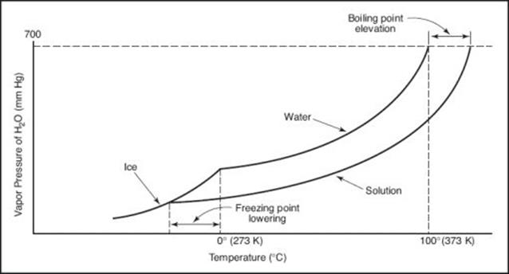
Colligative Properties

Slide 14
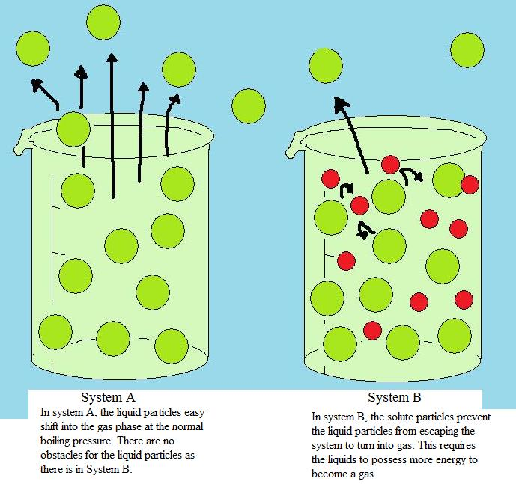
The solution on the right has a higher boiling point, lower melting point, AND lower vapor pressure. The red solute particles make it harder for the solution to boil, freeze, and evaporate. The more particles, the greater the impact

Slide 15
Types of Solutions
Solid Solutions (Alloys)
Gaseous Solutions
Liquid Solutions
solvent must be liquid, solute can be anything
if liquid solvent is water then aqueous solution
two liquids that dissolve in each other are miscible, if not soluble they are immiscible.

Slide 16
Solution Formation
Water molecules surround each ion and remove it from the crystal. (Dissolving)

Slide 17
Factors Affecting the Rate of Dissolving
Surface Area
more area for water to work on removing
Sugar cubes take longer to dissolve than granular sugar (video)
Stirring
moves the water molecules that are already surrounding ions away from the crystal, exposing “new” surfaces to be dissolved (video)

Slide 18
Factors Affecting the Rate of Dissolving
Temperature
Solvent particles are moving faster so they surround the solute quicker and carry it into solution quicker (video)
Pressure
Only affects solubility of gases
The pressure in a container will actually force gas particles into solution.
A soda is a wonderful example of this, as soon as pressure is released, gas starts to leave the solution

Slide 19
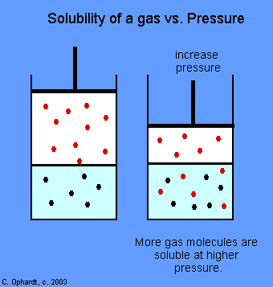

Slide 20
Saturation
There is usually a limit on the amount of solute that can be dissolved
Saturated solutions contain as much solute as possible.
Unsaturated solutions can dissolve more solute
Supersaturated solutions have dissolved more solute than normally possible.
Notes:
Supersaturated solutions are unstable and will return to the saturation if given enough activation energy.

Slide 21
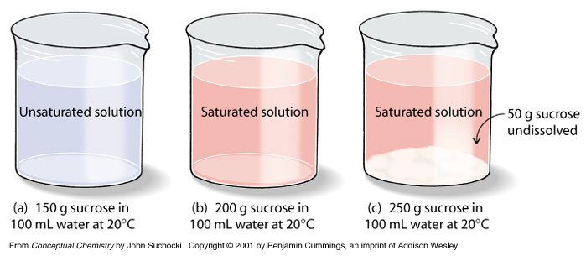

Slide 22
Solubility
Solubility is the saturation point for a particular solute and solvent at a given temperature.
Temperature effect:
Most solids dissolve better in hot temperatures.
Gas particles dissolve better in cold temperatures.

Slide 23
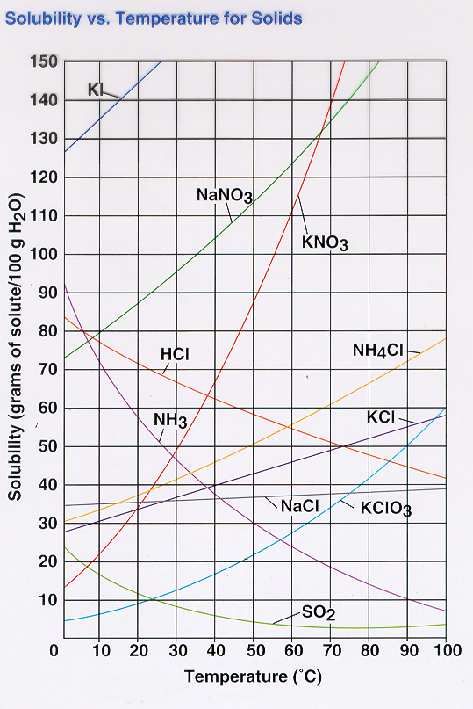
Solubility Curve
Note the y-axis. This graph tells us how much (in grams) of a solute will dissolve in 100 g (or 100 mL) of H₂O at a given temperature

Slide 24
Example problem (easy)
How much sodium nitrate (NaNO₃) would be able to dissolve in 100 mL of water at:
50 °C ?
About 115 g
18 °C ?
About 87 g

Slide 25
Example Problem (moderate)
If a solution had 92 grams of potassium nitrate (KNO₃) dissolved in 100 mL of water at 80°C , would it be unsaturated, saturated, or supersaturated?
Unsaturated, that point would be below the line.
Below the line = unsaturated
On the line = saturated
Above the line = supersaturated

Slide 26
Example Problem (difficult)
If you had 150 mL of water at 35°C how many grams of SO₂ would you need to dissolve to have a saturated solution?
About 12 grams

