Slide 1
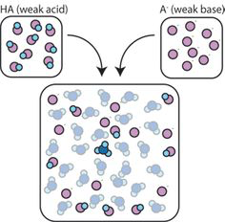
Unit 8
Acids and Bases

Slide 2
General Overview
8.1 Introduction to Acids and Bases
8.2 pH and pOH of Strong Acids and Bases
8.3 Weak Acid and Base Equilibria
8.4 Acid-Base Reactions and Buffers
8.5 Acid-Base Titrations
8.6 Molecular Structure of Acids and Bases
8.7 pH and pK_{a}
8.8 Properties of Buffers
8.9 Henderson-Hasselbalch Equation
8.10 Buffer Capacity

Slide 3
8.1 Introduction to Acids & Bases
Equations that you must be able to use: (* = on the equation sheet)
pH = -log[H₃O⁺]* (Remember that H₃O⁺ and H⁺ are used interchangeably)
pOH = -log[OH⁻]*
[H⁺] = 10^{-pH}
[OH⁻] = 10^{-pOH}
K_{w} = [H₃O⁺][OH⁻] = 1.0x10⁻¹⁴ at 25°C*
pK_{w} = 14 = pH + pOH at 25°C*
pK_{a} = -log(K_{a})*
Other important information:
In pure water, pH = pOH. This is the definition of a neutral solution!!
At 25°C pK_{w}=14, so pH = pOH = 7.0
K_{w} is temperature dependent, so the pH of pure, neutral water will deviate from 7.0 at temperatures other than 25°C
Learning Objective: Calculate the values of pH and pOH, based on K_{w} and the concentration of all species present in a neutral solution of water

Slide 4
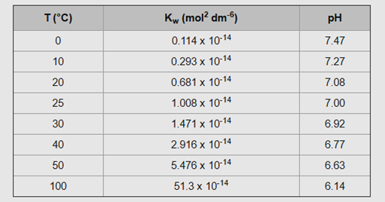
8.1 K_{w} and Temperature
Heat +
The dissociation of water is endothermic. An increase of energy will shift the reaction to the right, increasing the forward reaction, and increase the value of K_{w}.
As T increases, pH of pure water decreases. The water is NOT becoming more acidic. A solution is only acidic if [H+] > [OH-].
At 50°C, the pH of pure water is 6.63, which is defined as “neutral”, when [H⁺] = [OH⁻]. A solution with a pH of 7 at this temperature is slightly basic b/c it is higher than the neutral value of 6.63.

Slide 5
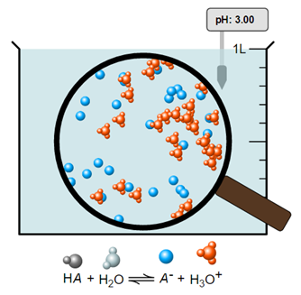
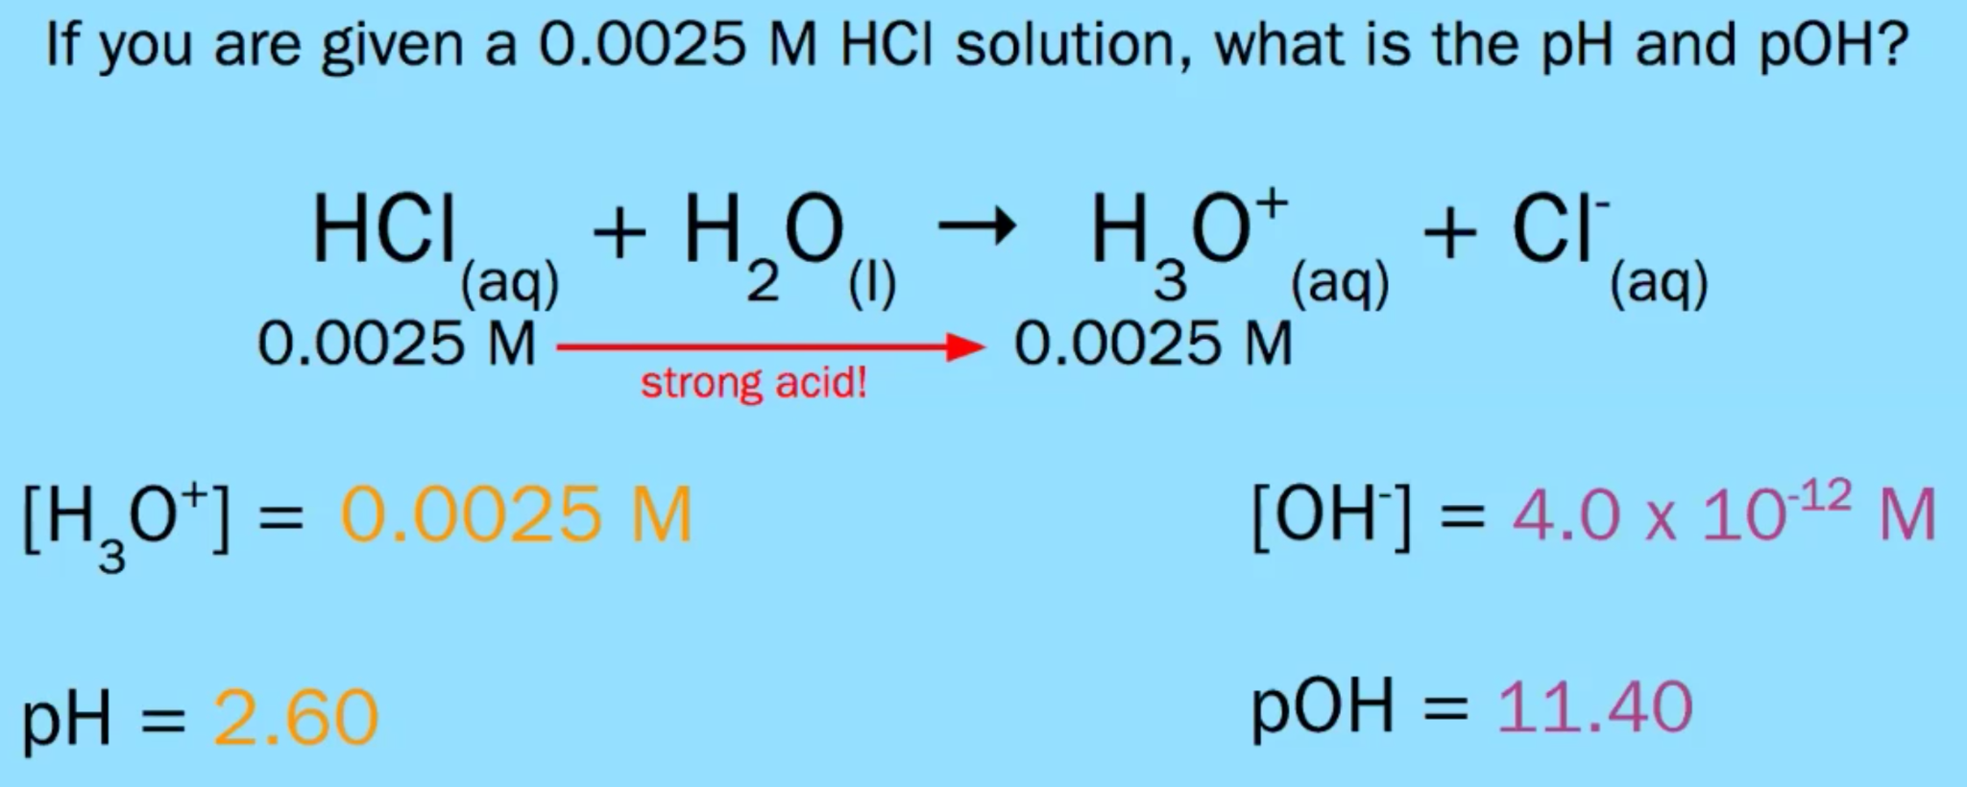
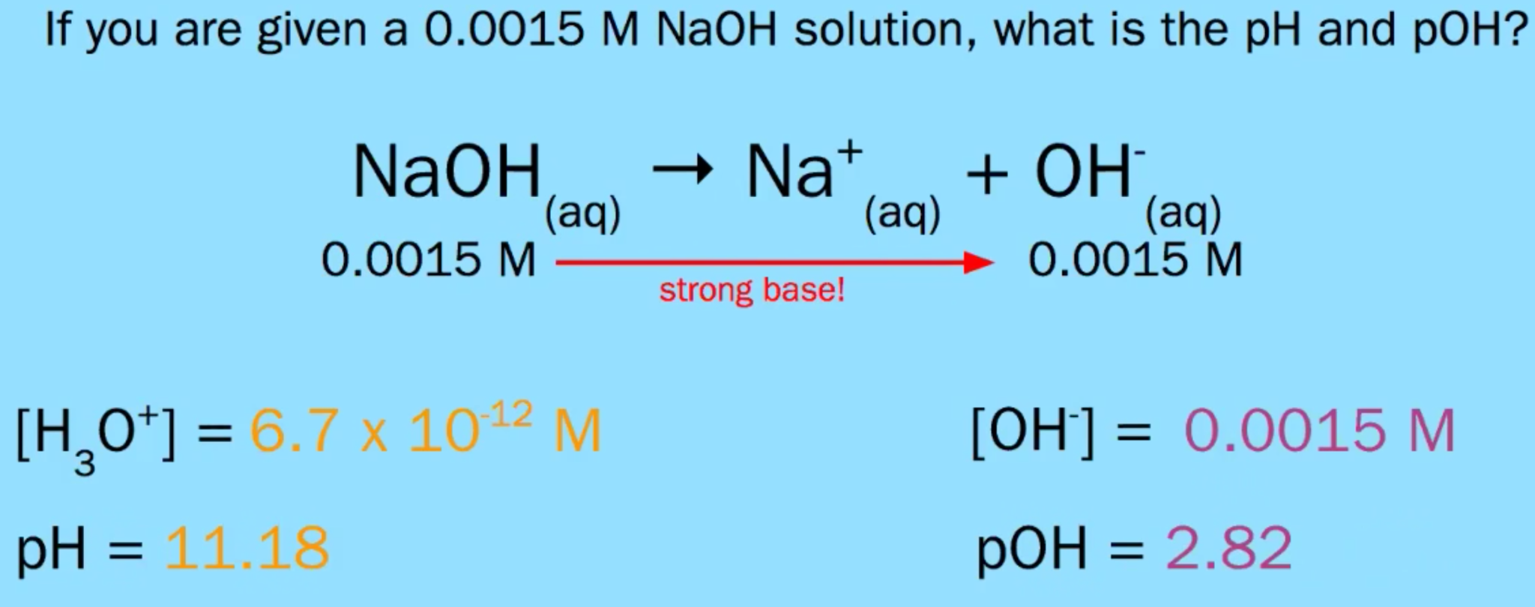
8.2 pH and pOH of Strong Acids & Bases
Strong acids (HCl, HBr, HI, HClO₃, HClO₄, H₂SO₄, and HNO₃) completely ionize to produce H⁺ in solution.
(100% ionization!)
Strong bases (group 1 and 2 hydroxides) completely dissociate into solution to produce hydroxide ions.
Learning Objective: Calculate the pH and pOH based on concentrations of all species in a solution of a strong acid or base.

Slide 6
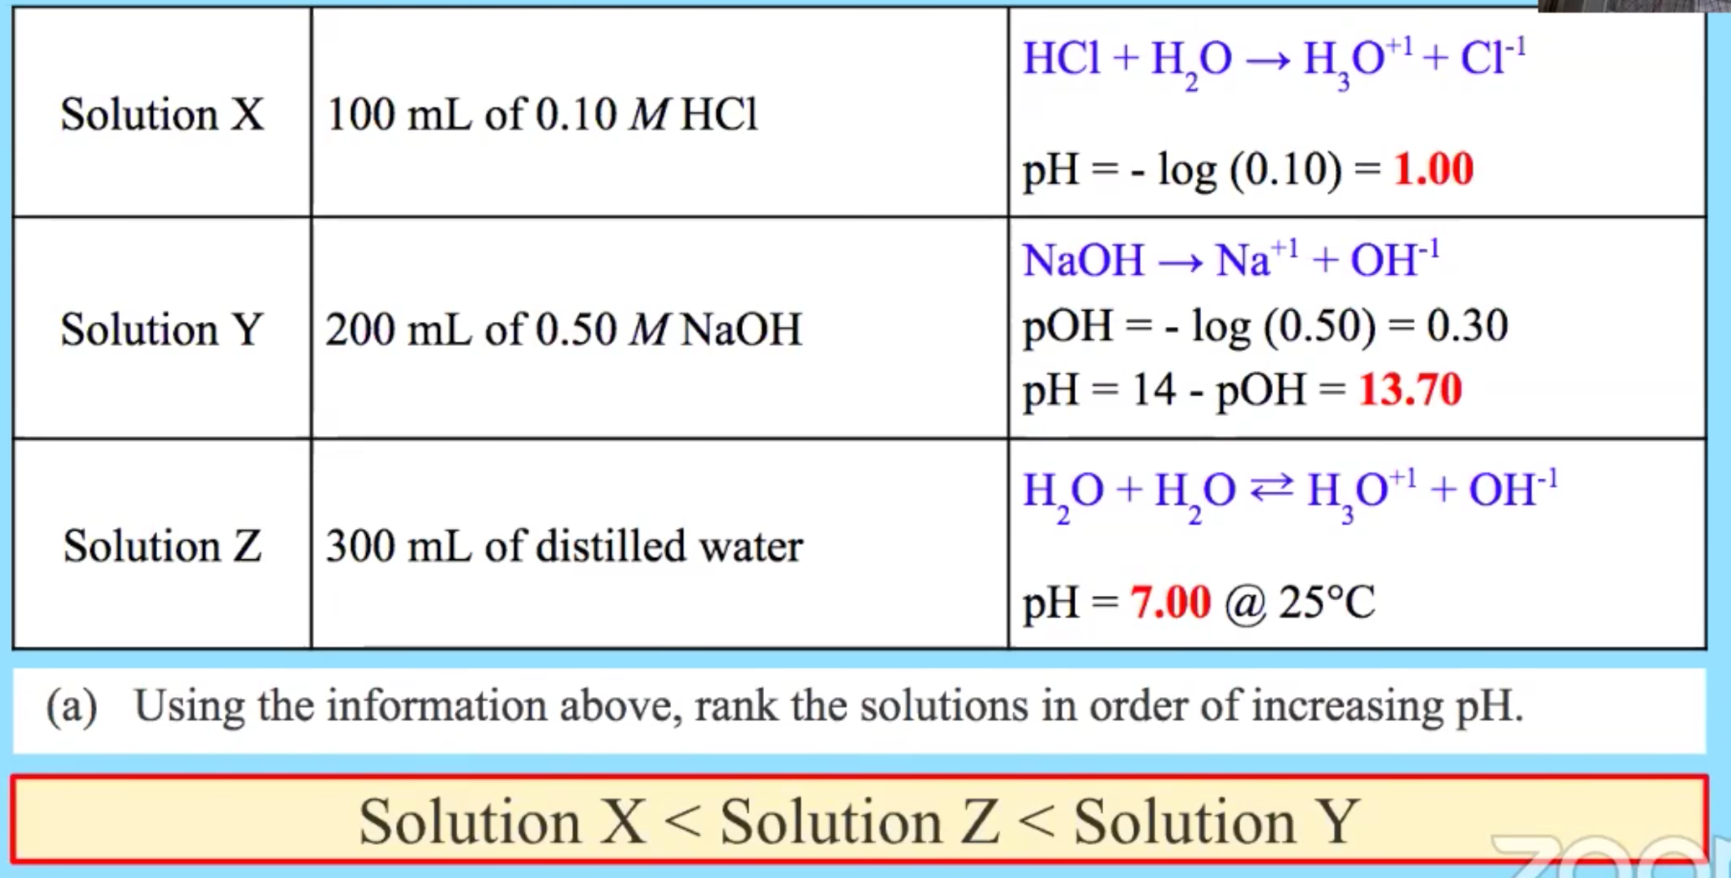
8.2 pH and pOH of Strong Acids & Bases
Learning Objective: Calculate the pH and pOH based on concentrations of all species in a solution of a strong acid or base.

Slide 7
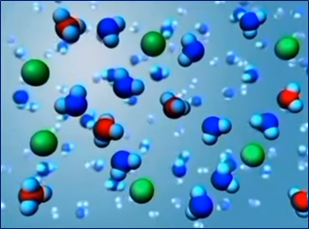
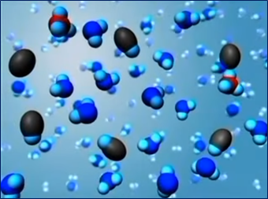
8.2 Acid/Base Particulates

Slide 8
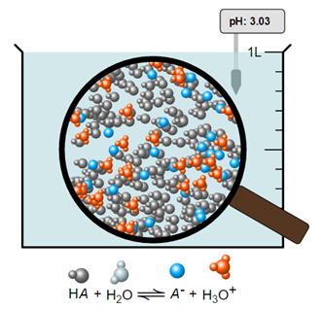
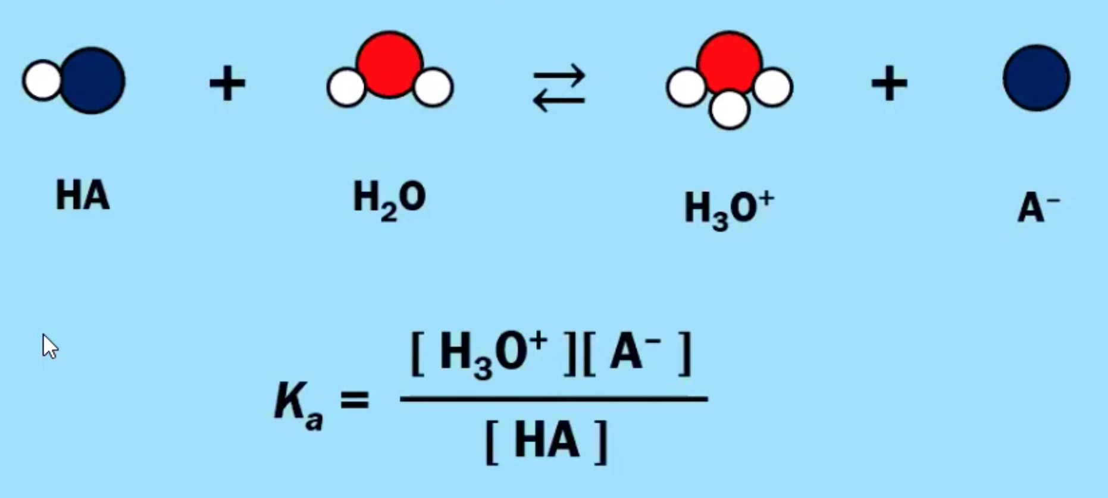
8.3 Weak Acid Equilibria
pH= 3.00
Weak acids react with water to produce hydronium ions. However, molecules of weak acid will only partially ionize (usually less than 5%).
The concentration of H₃O⁺ is much less than the initial concentration of the acid, and the vast majority of the acid molecules remain in-tact and do not ionize.
This is a particulate picture of a weak acid whose [HA] = 1.00M and K_{a} = 1.00x10⁻⁶.
pH is a measure of the [H⁺] in solution. More moles of a weak acid are needed to achieve equivalent [H⁺] values of a strong acid of the same pH, since a weak acid only partially ionizes.
Learning objective: Explain the relationship among pH, pOH, and concentrations of all species in a solution of a monoprotic weak acid or weak base.

Slide 9
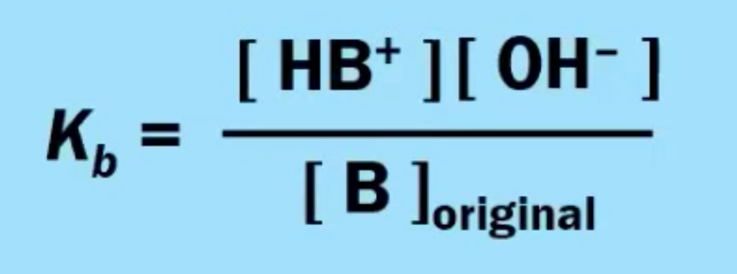
8.3 Weak Base Equilibria
Weak bases react with water to produce hydroxide ions. However, just a small percentage of the molecules of a weak base will ionize this way. A majority of the base molecules remain un-ionized.
Learning objective: Explain the relationship among pH, pOH, and concentrations of all species in a solution of a monoprotic weak acid or weak base.

Slide 10
8.3 Percent Ionization
The percent ionization of a weak acid (or weak base) can be calculated from its pK_{a} (pK_{b}) and the initial concentration of the acid (or base).
THIS IS NOT ON THE EQUATION SHEET - KNOW THESE FORMULAS!!
The larger the magnitude of K_{a}, the stronger the acid (and the more it ionizes).
The smaller the value of pK_{a}, the stronger the acid (the more it ionizes).
Learning objective: Explain the relationship among pH, pOH, and concentrations of all species in a solution of a monoprotic weak acid or weak base.

Slide 11
8.3 Percent Ionization
Learning objective: Explain the relationship among pH, pOH, and concentrations of all species in a solution of a monoprotic weak acid or weak base.

Slide 12
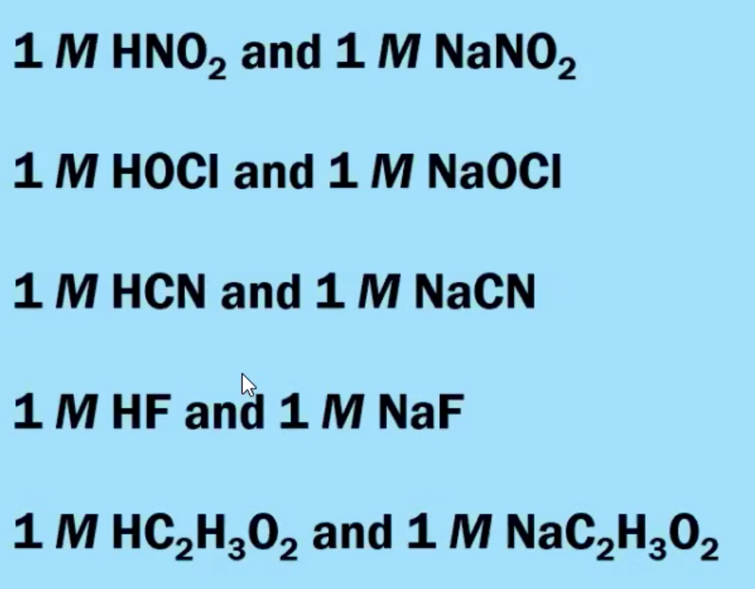
8.4 Acid-Base Reactions & Buffers
A buffer is a solution that resists changes in pH when a small amount of strong acid or strong base is added to the solution.
Typically a buffer solution contains a weak acid and its conjugate base. (Differ by one proton!)
We need a weak acid/base combination for a buffer, so strong acids won’t work!
The conjugate comes from a salt!
Examples of buffer solutions
Learning Objective: Explain the relationship among the concentrations of major species in a mixture of weak and strong acids and bases.

Slide 13
8.4 Acid-Base Reactions & Buffers
When a strong acid and a strong base are mixed, they react quantitatively in a reaction represented by the equation:
H⁺(aq) + OH⁻(aq) → H₂O(l).
The pH of the resulting solution may be determined from the concentration of excess reagent. (Use stoich!!)
When a weak acid and a strong base are mixed, they react quantitatively in a reaction represented by the equation:
HA(aq) + OH⁻(aq) ⇄ A⁻(aq) + H₂O(l)
If the weak acid is in excess, then a buffer solution is formed, and the pH can be determined from the equilibrium expression (K_{a}). If the strong base is in excess, then the pH can be determined from the moles of excess hydroxide ion and the total volume of solution. If they are equimolar, then the (slightly basic) pH can be determined from the equilibrium represented by the equation:
A⁻(aq) + H₂O(l) ⇄ HA(aq) + OH⁻(aq)
Learning Objective: Explain the relationship among the concentrations of major species in a mixture of weak and strong acids and bases.

Slide 14
8.4 Acid-Base Reactions & Buffers
When a weak base and a strong acid are mixed, they react quantitatively in a reaction represented by the equation:
B⁻(aq) + H₃O⁺(aq) ⇄ HB⁺(aq) + H₂O(aq)
If the weak base is in excess, then a buffer solution is formed, and the pH can be determined from the equilibrium expression (K_{b}). If the strong acid is in excess, then the pH can be determined from the moles of excess hydronium ion and the total volume of solution. If they are equimolar, then the (slightly acidic) pH can be determined from the equilibrium represented by the equation:
HB⁺(aq) + H₂O(aq) ⇄ B⁻(aq) + H₃O⁺(aq)
When a weak acid and a weak base are mixed, they will react to an equilibrium state whose reaction may be represented by the equation:
HA(aq) + B(aq) ⇄ A⁻(aq) + HB⁺(aq)
Learning Objective: Explain the relationship among the concentrations of major species in a mixture of weak and strong acids and bases.

Slide 15
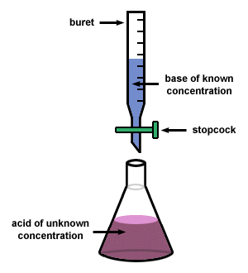
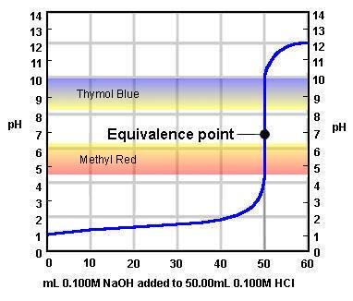
8.5 Acid-Base Titrations
An acid-base reaction can be carried out under controlled conditions in a titration. A titration curve, plotting pH against the volume of titrant added, is useful for summarizing results from a titration.
At the equivalence point, the stoichiometric molar ratio is reached.
(Moles of titrant equals the moles of analyte. THIS IS HOW WE CAN FIND THE CONCENTRATION OF AN UNKNOWN!)
Learning Objective: Explain results from the titration of a mono- or polyprotic acid or base solution, in relation to the properties of solution and its components

Slide 16
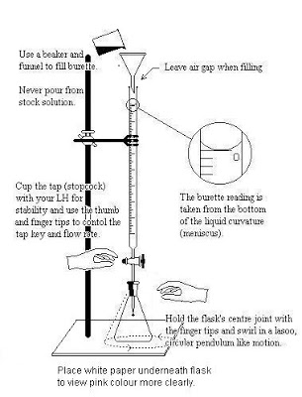
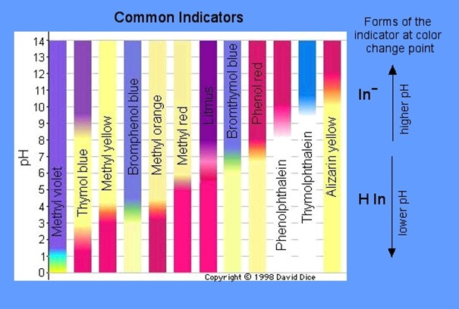
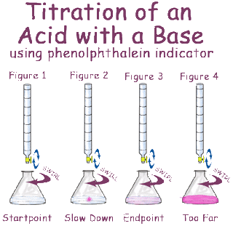
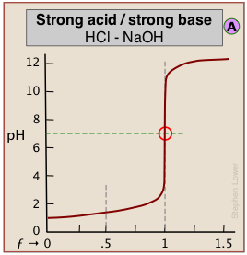
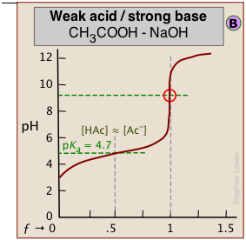
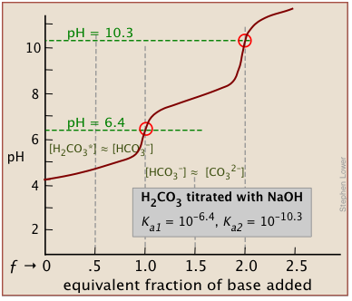
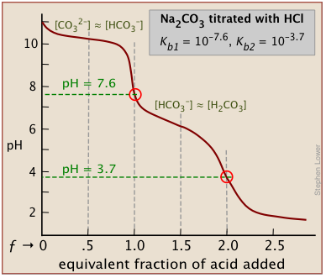
LAB: Titration- Acid/Base
Assumption: Endpoint is equivalence point
This is not true – we actually “overshoot” before indicator changes
Possible Sources of Error:
Overshoot Endpoint
Moles of titrant (and therefore analyte) too high
Not reading to bottom of meniscus
Moles of titrant too low
Concentration of titrant not what expected
Be sure to rinse buret with titrant first to control for this
Strength of Acids affects shape of graph:
Polyprotic acids have multiple end points:

Slide 17
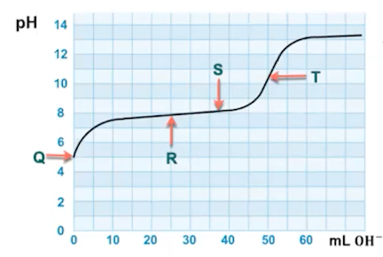
8.5 Acid-Base Titrations (Weak)
Point R: At the halfway or half-equivalence point, there are equal concentrations of each species in the conjugate acid-base pair, for example, for a weak acid [HA] = [A⁻]. Because pH = pK_{a} when the conjugate acid and base have equal concentrations, the pK_{a} can be determined from the pH at the half equivalence point in a titration.
AT THE HALFWAY POINT, pH = pK_{a}
Point T: At the equivalence point, the stoichiometric molar ratio is reached.
(Moles of titrant equals the moles of analyte. THIS IS HOW WE CAN FIND THE CONCENTRATION OF AN UNKNOWN!)
Learning Objective: Explain results from the titration of a mono- or polyprotic acid or base solution, in relation to the properties of solution and its components

Slide 18
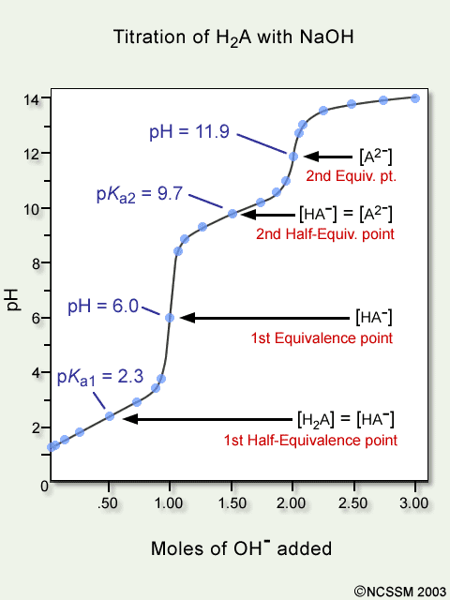
8.5 Polyprotic Titrations
For polyprotic acids, titration curves can be used to determine the number of protons.
This illustration shows the titration curve of a polyprotic weak acid with a strong base.
Learning Objective: Explain results from the titration of a mono- or polyprotic acid or base solution, in relation to the properties of solution and its components

Slide 19
Math with Titrations
THINK ABOUT WHAT YOU HAVE IN THE CONTAINER AND HOW IT MIGHT AFFECT PH!!

Slide 20
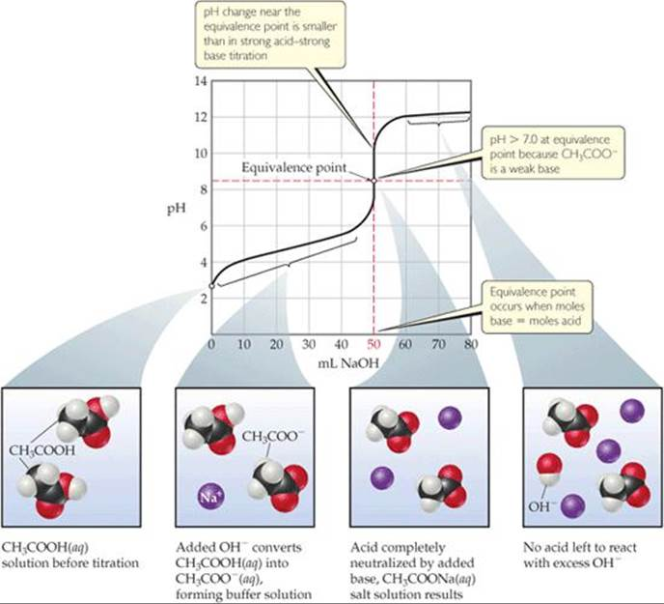
Acid/Base Reaction Species
Ask yourself:
Is it strong? Weak? A salt? A buffer? What will it do in water?
Deal w/strong A/B first. These will react to completion with the available species.

Slide 21
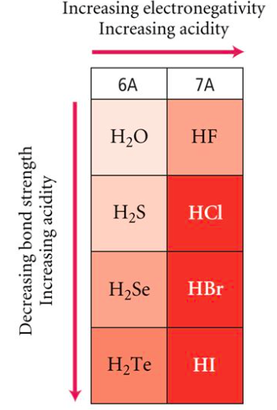
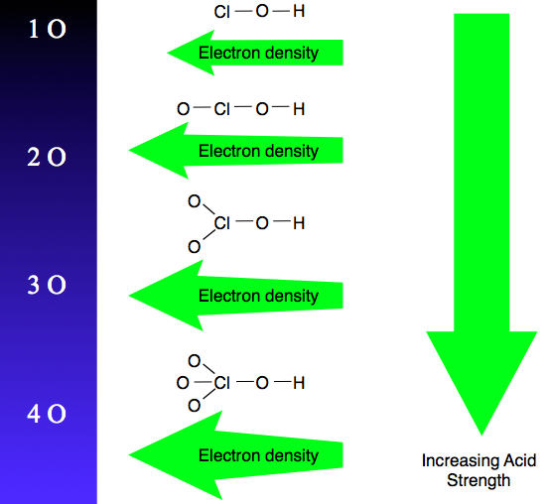
8.6 Molecular Structure
Binary Acid Strength
Oxyacid Strength
The stronger the acid, the weaker the conjugate base. These conjugate bases are stabilized by EN, inductive effects, resonance, or a combination.
The increased number of oxygen atoms pulls negative charge away from the O-H bond, weakening the attraction of the proton for the electron pair and thus strengthening the acid.
The greater the size of the negative ion, the weaker its attraction for the proton, and so the stronger the acid, and the weaker the conjugate base. HI is the strongest binary acid.

Slide 22
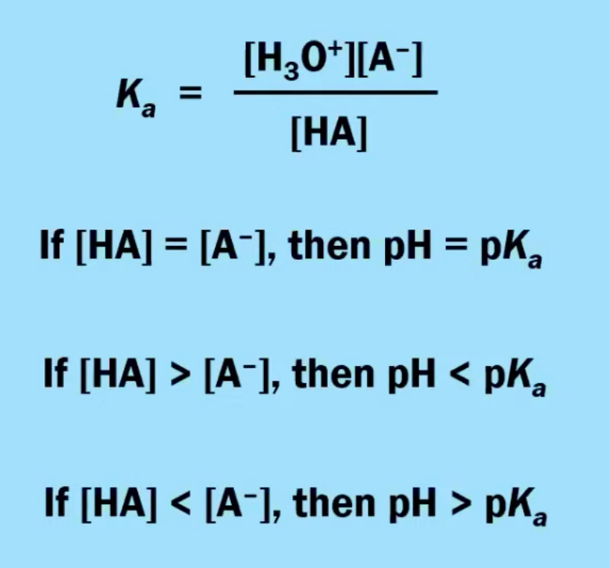
8.7 pH and pK_{a}
The protonation state of an acid or base (i.e., the relative concentrations of HA and A⁻) can be predicted by comparing the pH of a solution to the pK_{a} of the acid in that solution.
When solution pH < acid pK_{a}, the acid form has a higher concentration than the base form.
When solution pH > acid pK_{a} , the base form has a higher concentration than the acid form.
Acid-base indicators are substances that exhibit different properties (such as color) in their protonated versus deprotonated state, making that property respond to the pH of a solution.
Learning Objective: Explain the relationship between the predominant form of a weak acid or base in solution at a given pH and the pK_{a} of the conjugate acid or the pK_{b} of the conjugate base.

Slide 23
8.8 Properties of Buffers
A buffer solution contains a large concentration of both members in a conjugate acid-base pair. The conjugate acid reacts with added base and the conjugate base reacts with added acid. These reactions are responsible for the ability of a buffer to stabilize pH.
Two methods to create a buffer:
Mix two solutions together: one solution that contains the weak acid (HA) and another solution that contains the conjugate base (A⁻)
Start with a solution of a weak acid (HA) then add a strong base until HALF of the weak acid has been neutralized
Learning Objective: Explain the relationship between the ability of a buffer to stabilize pH and the reactions that occur when an acid or a base is added to a buffered solution.

Slide 24
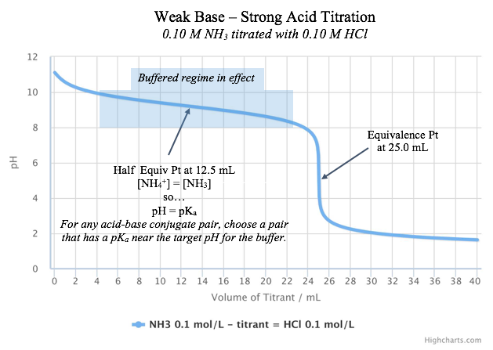
How to Build a Buffer:
Getting the pH correct:
The pH of a buffer is primarily determined by the pKa of the weak acid in the conjugate acid-base pair.
When both species in the conjugate acid-base pair have equal concentrations, the pH of the buffer is equal to the pKa.
Choose a conjugate acid-base pair that has a pKa closest to the pH you desire and then adjust concentrations to fine tune from there.
Learning Objective: Explain the relationship between the ability of a buffer to stabilize pH and the reactions that occur when an acid or a base is added to a buffered solution.

Slide 25
8.8 The Buffer Mechanism
A buffer is able to resist pH change because the two components (conjugate acid and conjugate base) are both present in appreciable amounts at equilibrium and are able to neutralize small amounts of other acids and bases (in the form of H₃O⁺ and OH⁻) when they are added to the solution. Take, for example, a fluoride buffer made from hydrofluoric acid and NaF. A model fluoride buffer would contain equimolar concentrations of HF and NaF. Since they are a weak acid and a weak base, respectively, the amount of hydrolysis is minimal and both buffer species are present at, effectively, their initial supplied concentrations.
If a strong acid is added to the HF/F⁻ buffer, then the the added acid will react completely with the available base, F⁻. This results in a nearly unchanged [H₃O⁺] and a nearly unchanged pH.
H₃O⁺_{(aq)} + F⁻_{(aq)} → HF_{(aq)} + H₂O_{(l)}
If a strong base is added to the HF/F⁻ buffer, then the added base will react completely with the available acid, HF. This results in a nearly unchanged [H₃O⁺] and a nearly unchanged pH.
HF_{(aq)} + OH⁻_{(aq)} → F⁻_{(aq)} + H₂O_{(l)}
The slight shift in pH after challenge is governed by the hydrolysis equilibrium of HF, based on the new HF and F⁻ concentrations:
HF_{(aq)} + H₂O_{(l)} ⇌ F⁻_{(aq)} + H₃O⁺_{(aq)}
Learning Objective: Explain the relationship between the ability of a buffer to stabilize pH and the reactions that occur when an acid or a base is added to a buffered solution.

Slide 26
8.8 The Buffer Mechanism
Learning Objective: Explain the relationship between the ability of a buffer to stabilize pH and the reactions that occur when an acid or a base is added to a buffered solution.

Slide 27
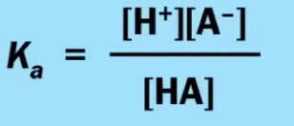
8.9 Henderson-Hasselbalch Equation
The pH of the buffer is related to the pK_{a} of the acid and the concentration ratio of the conjugate acid-base pair. This relation is a consequence of the equilibrium expression associated with the dissociation of a weak acid.
Adding small amounts of acid or base to a buffered solution does not significantly change the ratio of [A⁻]/[HA] and thus does not significantly change the solution pH.
The change in pH on addition of acid or base to a buffered solution is therefore much less than it would have been in the absence of the buffer.
Learning Objective: Identify the pH of a buffer solution based on the identity and concentrations of the conjugate acid-base pair used to create the buffer.

Slide 28
8.9 Henderson-Hasselbalch Equation
Learning Objective: Identify the pH of a buffer solution based on the identity and concentrations of the conjugate acid-base pair used to create the buffer.

Slide 29
8.10 Buffer Capacity
Increasing the concentration of the buffer components (while keeping the ratio of these concentrations constant) keeps the pH of the buffer the same but increases the capacity of the buffer to neutralize added acid or base.
When a buffer has more conjugate acid than base, it has a greater buffer capacity for addition of added base than acid. (pH < pK_{a})
When a buffer has more conjugate base than acid, it has a greater buffer capacity for addition of added acid than base. (pH > pK_{a})
A buffer is only effective as long as it has sufficient amounts of both members of the conjugate acid-base pair to allow equilibrium to shift during a stress.
Learning Objective: Explain the relationship between the buffer capacity of a solution and the relative concentrations of the conjugate acid and conjugate base components of the solution.

