Slide 1
Heat
Unit 7 Lesson 1

Slide 2
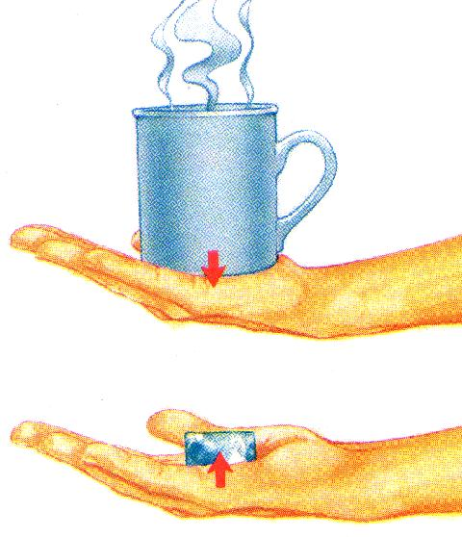
Cup gets cooler while hand gets warmer
Heat (q) → thermal energy that transfers between objects due to temperature differences.
Heat ALWAYS flows from a warmer object to a cooler object.
-q
+q
Heat will continue to flow until the temperature of both objects is the same (thermal equilibrium reached).
+q
-q
The unit of measurement for heat is Joules (J)
Ice gets warmer while hand gets cooler

Slide 3
Specific Heat (c_{p}) → amount of energy it takes to raise the temperature of 1g of a substance by 1°C
Substance | Specific Heat (J/g°C)
Water | 4.18
Aluminum | 0.897
Gold | 0.129
Ethanol | 2.44
Every substance has its own specific heat because it has a different arrangement of atoms
The spec. heat of many substances can be found in your ref. pack.

Slide 4
Things that heat up or cool off fast have low specific heats. (do not take much energy to change the temp)
Things that heat up or cool off slowly have high specific heats. (take a lot of energy to change the temp)
C_{p (water)} = 4.18 J/g°C
C_{p (sand)} = 0.830 J/g°C

Slide 5
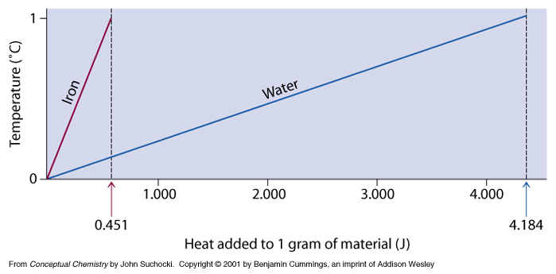

Slide 6
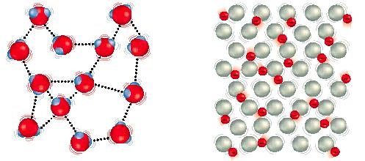
Why does water have such a high specific heat?
H bonds that hold one water molecule to another water molecule are strong so it takes a lot of energy to break the bonds. Metals have weak bonds (remember the “sea of e⁻) and do not need as much energy to break them.
water metal
The high specific heat of water helps moderate global climate because the water in the ocean resists changes in temperature

Slide 7
How do you calculate heat (change in thermal energy)?
Heat is measured in Joules
Mass is measured in grams
(T_{final} – T_{initial})
q = m ● c_{p} ● ΔT
Temp is measured in ºC
(heat)
(mass)
(change in
temperature)
(constant
of specific heat)

Slide 8
Example:
A residential water heater raises the temperature of 125,000 grams of liquid water from 25.0ºC to 55.0ºC. How much heat was applied?
q = m c_{p} ΔT
q = (125,000 g) (4.18 J/g°C) (30.0°C)
q = ?
m = 125,000 g
q = 15,675,000 J
C_{p} = 4.18 J/g°C
ΔT = T_{f} – T_{i}
= 55.0°C – 25.0°C
= 30.0°C
q = 15,700,000 J

Slide 9
Example:
A 10.0 gram piece of Titanium metal is heated from 27.5ºC to 1660.0ºC. How many joules of heat must have been applied?
q = m c_{p} ΔT
q = (10.0 g) (0.523 J/g°C) (1632.5°C)
q = ?
m = 10.0 g
q = 8,537.975 J
LOOK in your ref. packet!
C_{p} =
0.523 J/g°C
q = 8,540 J
ΔT = T_{f} – T_{i}
= 1660.0°C – 27.5°C
= 1632.5°C

Slide 10
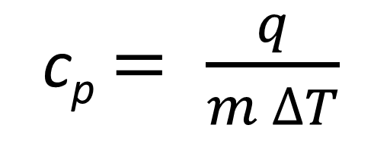
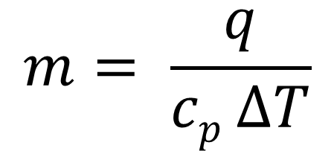
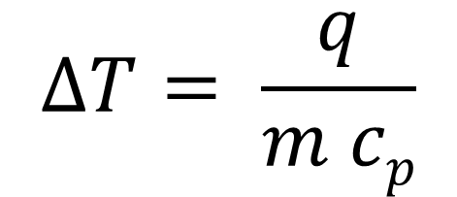
Heat equation (q = m c_{p} ΔT) variations:
Solve for mass
Solve for specific heat
Solve for change in temperature
q = m c_{p} ΔT
q = m c_{p} ΔT
q = m c_{p} ΔT
c_{p} ΔT
c_{p} ΔT
m ΔT
m ΔT
m c_{p}
m c_{p}
$$m= \frac{q}{cp ∆T}$$
c_{p} $= \frac{q}{m ∆T}$
$$∆T= \frac{q}{m cp}$$
If asked to solve for T_{f} or T_{i}, solve for ΔT.
ΔT = T_{f} - T_{i}

Slide 11
Example:
A 352 g sample of an unknown substance was heated from 40.0°C to 100.0°C. In the process, the substance absorbed 8120 J of energy. What is the specific heat of the substance? ID the unknown.
q = m c_{p} ΔT
c_{p} $= \frac{q}{m ∆T}$
c_{p} $= \frac{8120 J}{(352 g)( 60.0°C)}$
q = 8120 J
m = 352 g
c_{p} = 0.38446 J/g°C
C_{p} = ?
ΔT = T_{f} – T_{i}
= 100°C – 40.0°C
= 60.0°C
c_{p} = 0.384 J/g°C
copper

Slide 12
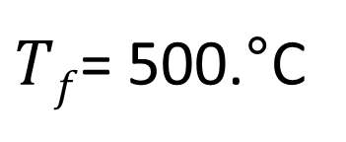
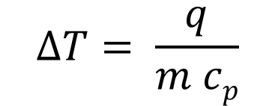
Example:
****If asked to solve for T_{f} or T_{i}, solve for ΔT. ΔT = T_{f} - T_{i}
A 4.50 g nugget of pure gold absorbed 276 J of heat. What was the final temperature of the gold if the initial temperature was 25.0°C?
$$∆T= \frac{q}{m cp}$$
$$∆T= \frac{276 J}{(4.50g) (0.129 J/g°C)}$$
q = m c_{p} ΔT
q = 276 J
$∆T$ = 475.45°C
m = 4.50 g
475.45°C = T_{f} – 25.0°C
LOOK in your ref. packet!
C_{p} =
0.129 J/g°C
T_{i} = 25.0°C
T_{f} = ?
$Tf$= 500.°C

Slide 13
Calorimetry

Slide 14
Calorimetry → process of measuring the amount of heat absorbed or released by a substance/chemical reaction
A calorimeter is a device that can measure how much heat is released or absorbed.
allows for experimental determination of q

Slide 15
If the water heats up, the system (sample) released energy (-q)
q_{system} = -
q_{water} = +
The heat absorbed by the surroundings is equal to, but has the opposite sign of, the heat released by the system so:
+q
-q
q_{sys} = - (q_{water} )

Slide 16
If the water cools, the system (sample) absorbed energy (+q)
q_{system} = +
q_{water} = -
-q
+q

Slide 17
Steps to solve calorimetry problems:
1. Calculate q_{water}
q_{water} = mc_{p}ΔT
2. Calculate q_{system}
q_{system} = - q_{water}

Slide 18
Example:
When a 4.25-g sample of solid NH₄NO₃ dissolves in 60.0 g of water in a calorimeter, the temperature drops from 21.00°C to 16.90°C. Calculate the heat change for the solution process.
q_{water} = m c_{p} ΔT
q_{water} = (60.0 g) (4.18 J/g°C) (-4.10°C)
q = ?
q_{water} = -1028 J
m = 60.0 g
q_{water} = -1030 J
C_{p} = 4.18 J/g°C
q_{system} = - q_{water}
ΔT = T_{f} – T_{i}
= 16.90°C – 21.00°C
= -4.10°C
q_{sys} = 1030 J

Slide 19
Example:
When 25.0 mL of water containing 0.025 mol HCl at 25.00°C is added to 25.0 mL of water containing 0.025 mol NaOH at 25.00°C in a calorimeter, a reaction occurs. Calculate the heat change during this reaction if the highest temperature observed is 32.00°C.
**Assume the densities of the solutions are 1.00 g/mL. ex. 10g = 10mL**
q_{water} = m c_{p} ΔT
q_{water} = (50.0 g) (4.18 J/g°C) (7.00°C)
q = ?
q_{water} = 1463 J
m = 50.0 g (25.0+25.0)
q_{water} = 1460 J
C_{p} = 4.18 J/g°C
q_{system} = - q_{water}
ΔT = T_{f} – T_{i}
= 32.00°C – 25.00°C
= 7.00°C
q_{sys} = -1460 J

Slide 20
The q_{system} that is calculated using data from a calorimeter may be used to calculate the specific heat of a metal and ID an unknown metal.
Example:
A 12.48 g sample of an unknown metal, heated to 99.00 °C was then plunged into 50.0 mL of 25.00 °C water. The temperature of the water rose to 28.75 °C. Identify and find the specific heat of the unknown.
1. Identify all variables
metal data
q = ?
water data
q = ?
ΔT = 28.75°C-99.00°C
= -70.25°C
m = 50.0 g
m = 12.48 g
ΔT =28.75°C - 25.00°C
= 3.75°C
C_{p} = 4.18 J/g°C
C_{p} = ?

Slide 21
2. Solve for q_{water}
q_{water} = (50.0 g) (4.18 J/g°C) 3.75°C)
q_{water} = 783.75 J
q_{water} = 784 J
3. Solve for q_{system} (In this case system is the metal)
q_{system} = - q_{water}
q_{metal} = - q_{water}
q_{metal} = -784 J

Slide 22
4. Use q_{metal} to solve for specific heat
metal data
c_{p} $= \frac{q}{m ∆T}$
q =
-784 J
ΔT = 28.75°C-99.00°C
= -70.25°C
m = 12.48 g
C_{p} = ?
c_{p} $= \frac{−784 J}{(12.48 g)(−70.25°C)}$
C_{p} = 0.894 J/g°C
5. Use reference packet and c_{p} to identify the metal
aluminum

