Slide 1
Unit 7
Equilibrium

Slide 2
General Overview
7.1 Introduction to Equilibrium
7.2 Direction of Reversible Reactions
7.3 Reaction Quotient and Equilibrium Constant
7.4 Calculating the Equilibrium Constant
7.5 Magnitude of the Equilibrium Constant
7.6 Properties of the Equilibrium Constant
7.7 Calculating the Equilibrium Concentrations
7.8 Representations of Equilibrium
7.9 Introduction to Le Chatelier’s Principle
7.10 Reaction Quotient and Le Chatelier’s Principle
7.11 Introduction to Solubility Equilibrium
7.12 Common-Ion Effect
7.13 pH and Solubility
7.14 Free Energy of Dissolution (this will be covered with Unit 9)

Slide 3
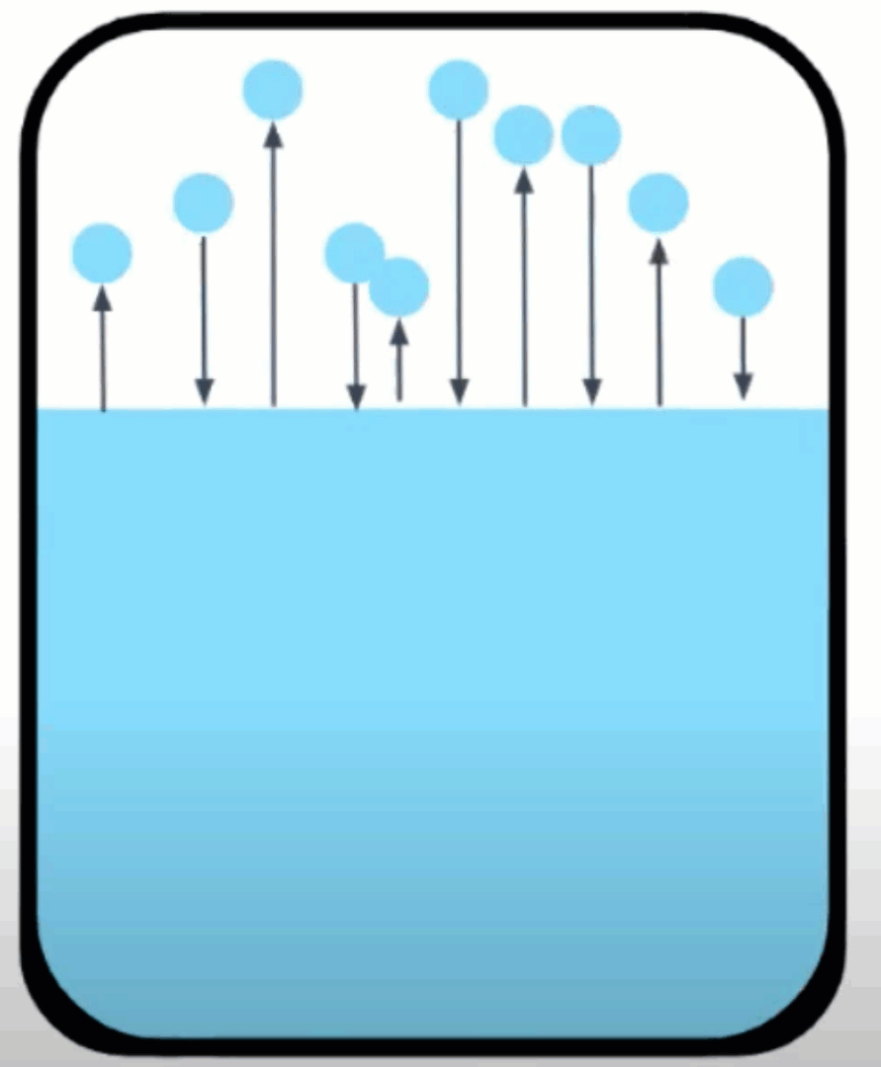
7.1 What is chemical equilibrium?
Many observable processes are reversible like evaporation and condensation of water or dissolution and precipitation of a salt.
We’ve seen the proton transfer of acid/base reactions at equilibrium.
Systems that have reached the state where the rates of the forward reaction and the reverse reaction are constant and equal.
It is a dynamic process where reactants continuously form products and vice versa, but the net amounts of reactants and products remain constant.
No observable changes
occur. THE REACTION
DOES NOT STOP!
Learning Objective: Explain the relationship between the occurrence of a reversible chemical or physical process, and the establishment of equilibrium, to experimental observations.

Slide 4
7.1 What is chemical equilibrium?
When equilibrium is reached:
Reactants and products are simultaneously present
The concentrations or partial pressures of all species remain constant
No observable changes occur in the system
The equilibrium state is dynamic The forward and reverse processes continue to occur at equal rates, resulting in no net observable change.
The proportions of products and reactants formed in a system at a specific temperature that has achieved equilibrium is represented by K, the equilibrium constant.
Learning Objective: Explain the relationship between the occurrence of a reversible chemical or physical process, and the establishment of equilibrium, to experimental observations.

Slide 5
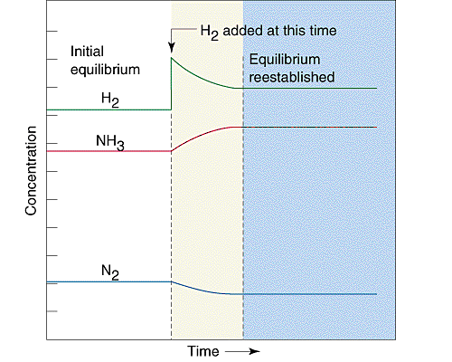
7.2 Direction of Reversible Reactions
Kinetics examines the rate at which reactions proceed. Rate laws are used to describe how reactant concentrations affect a reaction’s rate. Rate constants (k) in rate law expressions are determined experimentally at a given temperature.
Equilibrium describes the state at which the rates of the forward reaction and the reverse reaction are constant and equal.
If the rate of the forward reaction is greater than the reverse reaction, then there is a net conversion of reactants to products. If the rate of the reverse reaction is greater than that of the forward reaction, then there is a net conversion of products to reactants. An equilibrium state is reached when these rates are equal.
In the graph to the right, after equilibrium has been achieved, additional hydrogen gas is added to the system. The system then consumes both H₂ and N₂ to form additional NH₃ molecules, eventually re-establishing equilibrium.
Learning Objective: Explain the relationship between the direction in which a reversible reaction proceeds and the relative rates of the forward and reverse reactions.

Slide 6
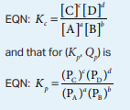
7.3 Q and K
K (equilibrium constant) represents the relative amounts of products to reactants at equilibrium at a given temperature.
Q (reaction progress) describes the relative amounts of products to reactants present at any point in the reaction at a given temperature.
Q and K only include substances that are gases or in aqueous solutions. No solids or liquids are ever included in these expressions.
Similar reactions will have related K values at the same temperature.
Pay attention to which K is being referenced! K_{c} means concentration but K_{p} means pressure!
Learning Objective: Represent the reaction quotient Q_{c} or Q_{p} , for a reversible reaction, and the corresponding equilibrium expressions K_{c} = Q_{c} or K_{p} = Q_{p} .

Slide 7
7.4 Calculating K
Equilibrium constants can be determined using experimental concentrations of reactants and products at equilibrium.
Steps: 1) Write an equilibrium expression (pay attention to K_{c} vs K_{p}!!) 2) Determine equilibrium molar concentrations or partial pressures for all substances in expression 3) Substitute quantities into equilibrium expression and solve.
Learning Objective: Calculate K_{c} or K_{p} based on experimental observations of concentrations or pressures at equilibrium.

Slide 8
7.5 Magnitude of K
For many reactions involving aqueous solutions, K is either very large (favoring the forward reaction) or very small (favoring the reverse reaction)
A VERY large K proceeds essentially to completion (like a stoichiometry problem)
The size of K can be used to describe the relationship between the numbers of reactant and product particles present at equilibrium.
Learning Objective: Explain the relationship between very large or very small values of K and the relative concentrations of chemical species at equilibrium

Slide 9
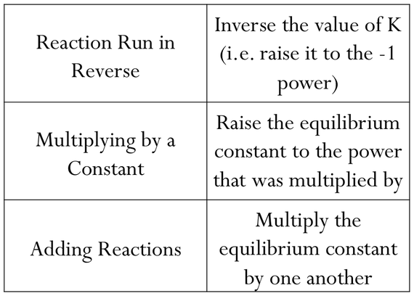
7.6 Properties of K
Since Q and K are calculated in the same manner, these manipulations apply to Q as well.
Learning Objective: Represent a multistep process with an overall equilibrium expression, using the constituent K expressions for each individual reaction.

Slide 10
7.7 Calculating Equilibrium Concentrations
Equilibrium concentrations can be calculated using a K expression, the K constant, and initial concentrations or partial pressures of substances.
Steps: 1) Write an equilibrium expression for the reaction 2) Set up an ICE table and fill in “initial” quantities (must be moles or pressure!) 3) Determine “changes” in the system in terms of x needed for the system to achieve equilibrium 4) Determine the “equilibrium” values for the system by adding the “initial” and “change” values together 5) Solve for x using the K expression and the “equilibrium” values. Verify if the change in initial concentrations is negligible using the 5% rule. 6) Determine all equilibrium quantities using the value of x
Learning Objective: Identify the concentrations or partial pressures of chemical species at equilibrium based on the initial conditions and the equilibrium constant.

Slide 11
7.8 Representations of Equilibrium
Use particle diagrams to determine when equilibrium is reached
COUNT!!
Learning Objective: Represent a system undergoing a reversible reaction with a particulate model.

Slide 12
7.9 Le Chatelier’s Principle
This principle is used to describe changes that occur in a system that has achieved equilibrium. There are three factors that can cause shifts in a system at equilibrium: concentration, pressure, and temperature.
Change | Direction System Shifts to Reestablish Equilibrium
Adding a reactant | Shifts towards products
Adding a product | Shifts towards reactants
Removing a reactant | Shifts towards reactants
Removing a product | Shifts towards products
Increasing pressure (decreasing volume) | Shifts toward less gas molecules
Decreasing pressure (increasing volume) | Shifts towards more gas molecules
Adding an inert gas | No effect
Increasing the temperature | Endothermic: shifts towards products Exothermic: shifts towards products
Decreasing the temperature | Endothermic: shifts towards reactants Exothermic: shifts towards products
Learning Objective: Identify the response of a system at equilibrium to an external stress, using Le Châtelier's principle.

Slide 13
7.9 Le Chatelier’s Principle
This principle is used to describe changes that occur in a system that has achieved equilibrium. There are three factors that can cause shifts in a system at equilibrium: concentration, pressure, and temperature.
If a chemical system is already at equilibrium and the concentration of any substance in the mixture is…
Increased, the system reacts to consume that substance.
Decreased, the system reacts to produce some of that substance
If a solution is diluted, the concentration of the solution decreases, so the reaction counteracts the stress by increasing the concentration
Learning Objective: Identify the response of a system at equilibrium to an external stress, using Le Châtelier's principle.

Slide 14
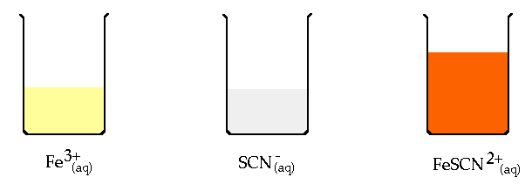
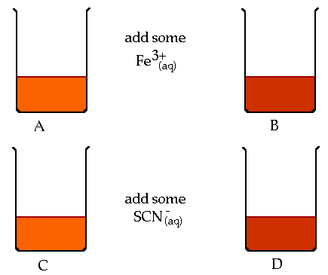
7.9 Experimentally Examining Le Chatelier’s Principle
Systems at equilibrium can be examined using Le Chatelier’s Principle by measuring its properties, including pH, temperature, solution color (absorbance)
Fe⁺³(aq) + SCN⁻(aq) FeSCN²⁺(aq)
Learning Objective: Identify the response of a system at equilibrium to an external stress, using Le Châtelier's principle.

Slide 15
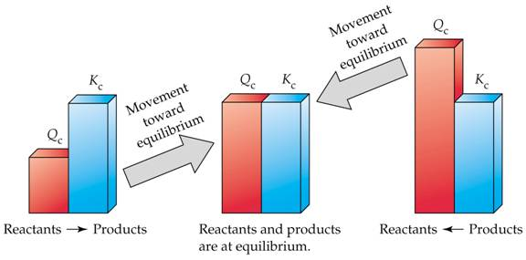
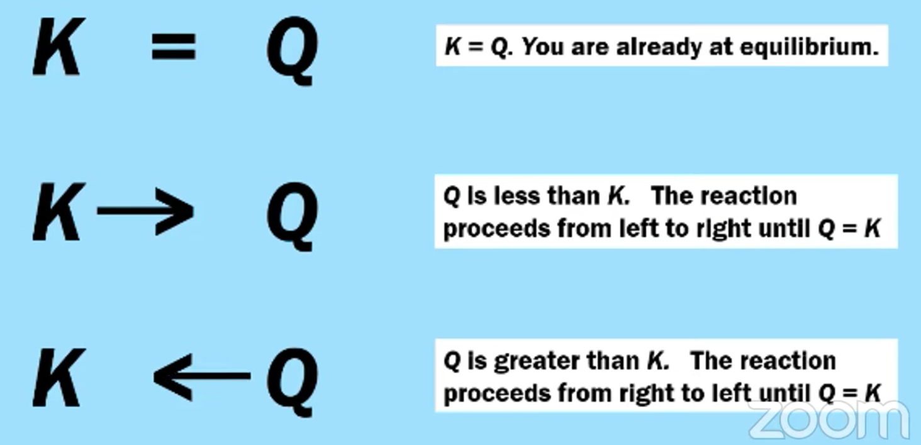
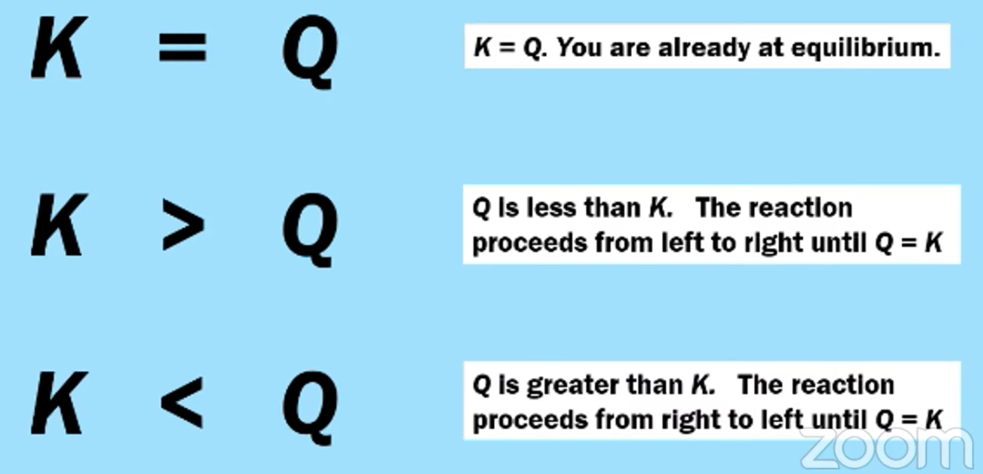
7.10 Q vs. K
Equilibrium is reacted when the rates of the forward reaction and the rates of the reverse reaction are equal, which is when Q is equal to K.
Comparing Q to K enables us to determine if a chemical system has achieved equilibrium or will need to move towards reactants or products to reach equilibrium.
- if Q < K, the reaction will proceed in the forward direction until Q = K - if Q > K, the reaction will proceed in the reverse direction until Q = K - if Q = K, the reaction is at equilibrium, and the concentrations of reactants and products remain constant
Learning Objective: Explain the relationships between Q, K, and the direction in which a reversible reaction will proceed to reach equilibrium.

Slide 16
7.10 Changes to Q and K for a System at Equilibrium
Some changes that occur to a system at equilibrium will affect the reaction’s current position (Q). Others will affect the value of K
Change | Direction System Shifts to Reestablish Equilibrium | Effect on Q or K
Adding a reactant | Shifts towards products | Q decreases
Adding a product | Shifts towards reactants | Q increases
Removing a reactant | Shifts towards reactants | Q increases
Removing a product | Shifts towards products | Q decreases
Increasing pressure (decreasing volume) | Shifts toward less gas molecules | Q can increase, decrease, or remain the same depending on ratio of gas molecules between reactants & products
Decreasing pressure (increasing volume) | Shifts towards more gas molecules
Adding an inert gas | No effect | Q doesn’t change
Increasing the temperature | Endothermic: shifts towards products Exothermic: shifts towards reactants | Endothermic: K increases Exothermic: K decreases
Decreasing the temperature | Endothermic: shifts towards reactants Exothermic: shifts towards products | Endothermic: K decreases Exothermic: K increases
Learning Objective: Explain the relationships between Q, K, and the direction in which a reversible reaction will proceed to reach equilibrium.

Slide 17
7.10 K and Temperature

Slide 18
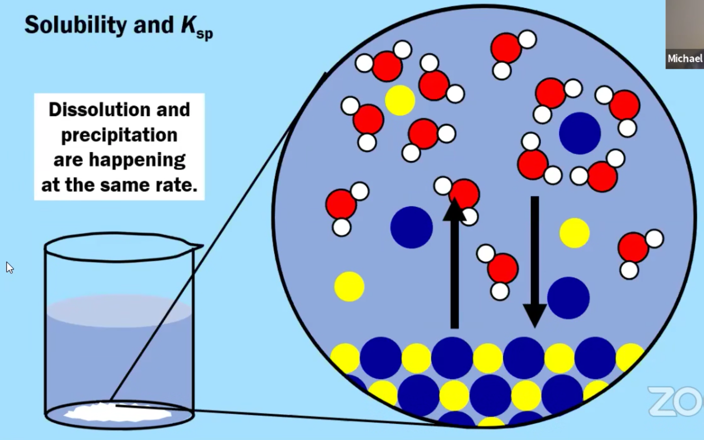
7.11 K_{sp} and Solubility Calculations
The dissolution of a salt is a reversible process whose extent can be described by K_{sp}, the solubility-product constant.
If K_{sp} is greater than 1, the salt is soluble.
Learning Objective: Calculate the solubility of a salt based on the value of Ksp for the salt.

Slide 19
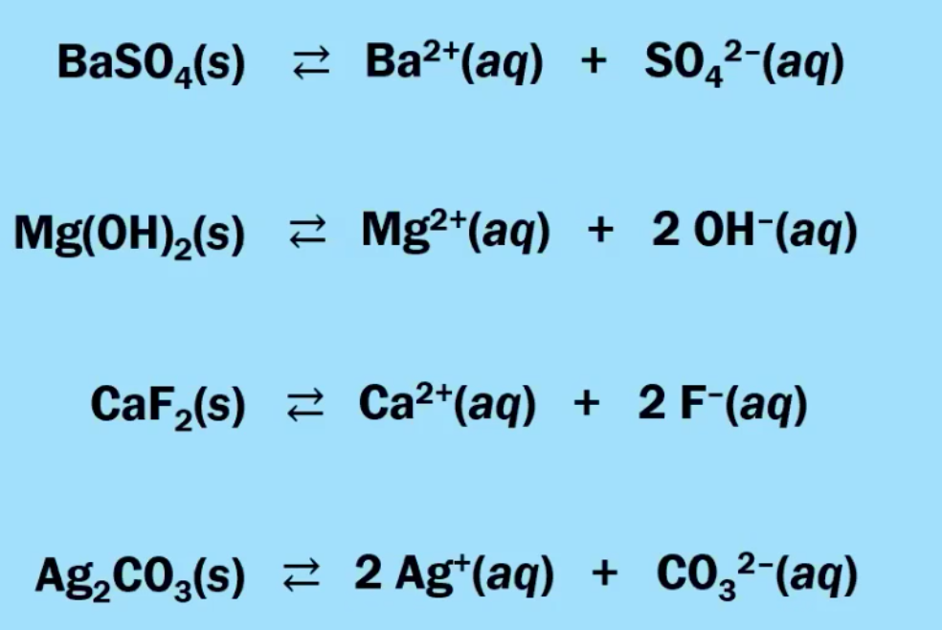
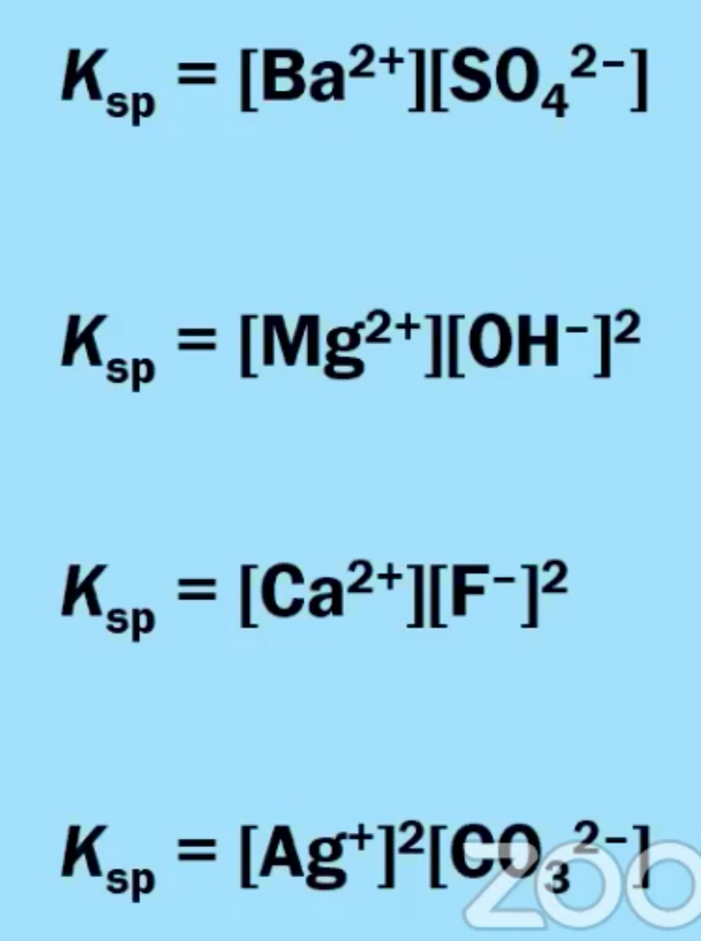
7.11 K_{sp} and Solubility Calculations
Remember that the lower the K_{sp}, the less soluble the substance.
Learning Objective: Calculate the solubility of a salt based on the value of Ksp for the salt.

Slide 20
7.11 Calculating Solubility
Solubility and K_{sp} are related to each other, but they are NOT the same thing!!
Learning Objective: Calculate the solubility of a salt based on the value of Ksp for the salt.

Slide 21
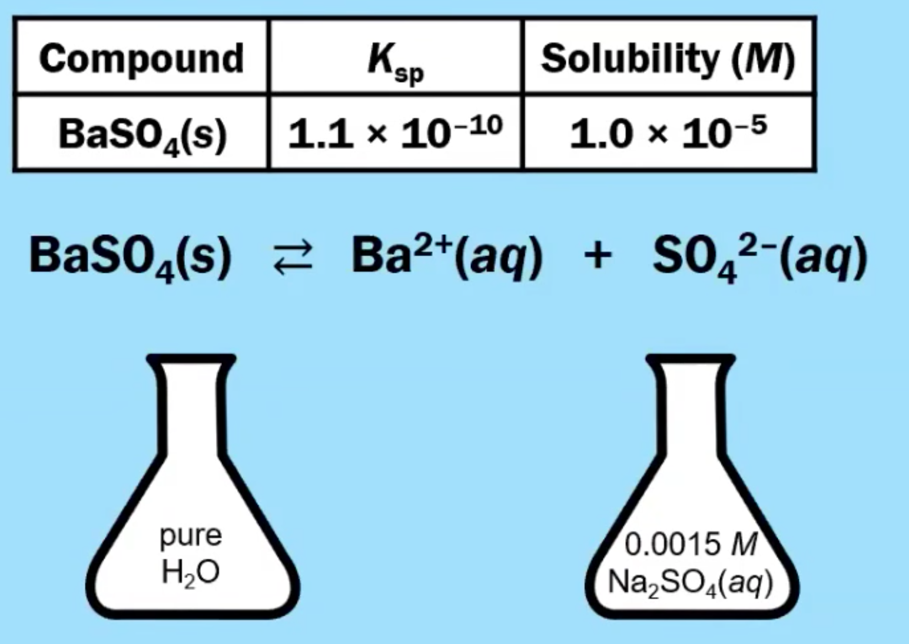
7.12 Common Ion Effect
In contrast, the solubility of a sparingly soluble salt may be decreased greatly by the addition of a common ion. For example, if MgCl₂ is added to a saturated Mg(OH)₂ solution, additional Mg(OH)₂ will precipitate out. The additional Mg²⁺ ions will shift the original equilibrium to the left, thus reducing the solubility of the magnesium hydroxide.
The solubility of an ionic solid is reduced when it is dissolved into a solution that already contains one of the ions present in the ionic solid.
Learning Objective: Identify the solubility of a salt, and/or the value of Ksp for the salt, based on the concentration of a common ion

Slide 22
7.13 pH and Solubility
Learning Objective: Identify the qualitative effect of changes in pH on the solubility of a salt.

Slide 23
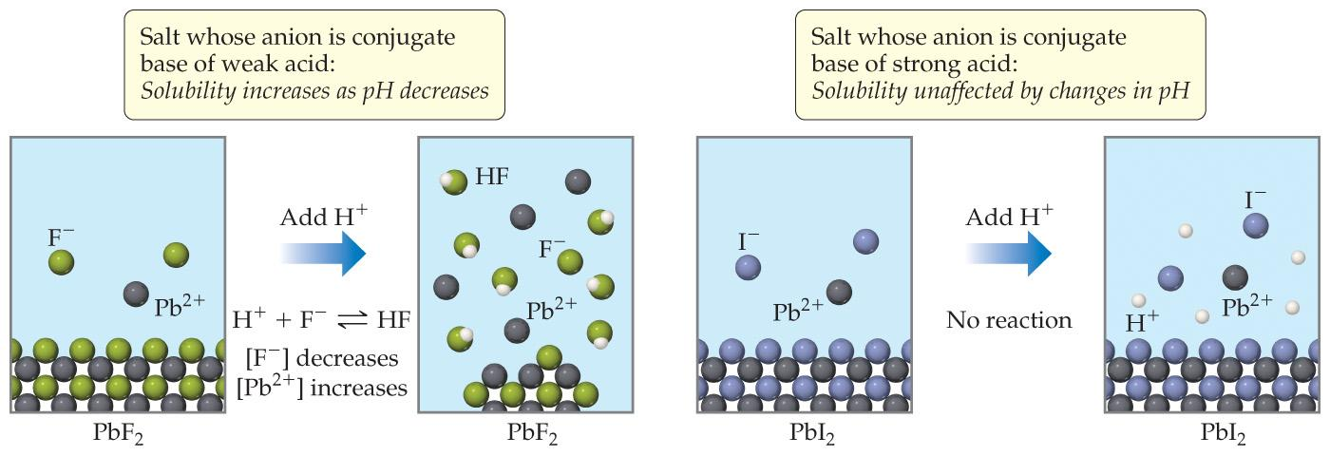
7.13 pH and Solubility
The solubility of a sparingly soluble hydroxide can be increased by the addition of an acid. For example, the hydroxide salt Mg(OH)₂ is relatively insoluble in water:
Mg(OH)_{2(s)} ⇌ Mg²⁺_{(aq)} + 2OH⁻_{(aq)} With K_{sp}=5.61×10⁻¹²
When acid is added to a saturated solution that contains excess solid Mg(OH)₂, the following reaction occurs, removing OH− from solution:
H⁺_{(aq)} + OH⁻_{(aq)}→H₂O_{(l)}
The overall equation for the reaction of Mg(OH)₂ with acid is thus
Mg(OH)_{2(s)} + 2H⁺_{(aq)} ⇌ Mg²⁺_{(aq)} + 2H₂O_{(l)}
As more acid is added to a suspension of Mg(OH)₂, the equilibrium shown in the above equation is driven to the right, so more Mg(OH)₂ dissolves.
Learning Objective: Identify the qualitative effect of changes in pH on the solubility of a salt.

Slide 24
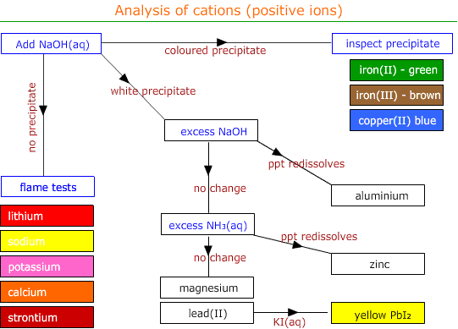
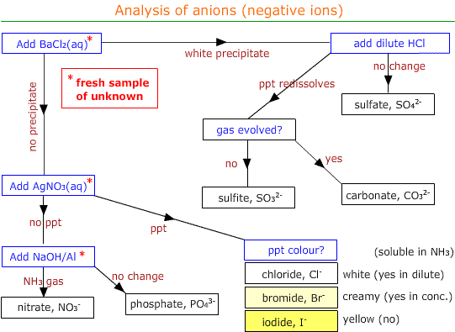
Qualitative Analysis
Remember that the lower the K_{sp}, the less soluble the substance. Qualitative analysis then also allows a ranking of salts by K_{sp}, and demonstrates the effect of pH on solubility.

