Slide 1
Unit 4
Chemical Reactions

Slide 2
General Overview
4.1 Introduction for Reactions
4.2 Net Ionic Equations
4.3 Representations of Reactions
4.4 Physical and Chemical Changes
4.5 Stoichiometry
4.6 Introduction to Titration
4.7 Types of Chemical Reactions
4.8 Introduction to Acid-Base Reactions
4.9 Oxidation-Reduction (Redox) Reactions

Slide 3
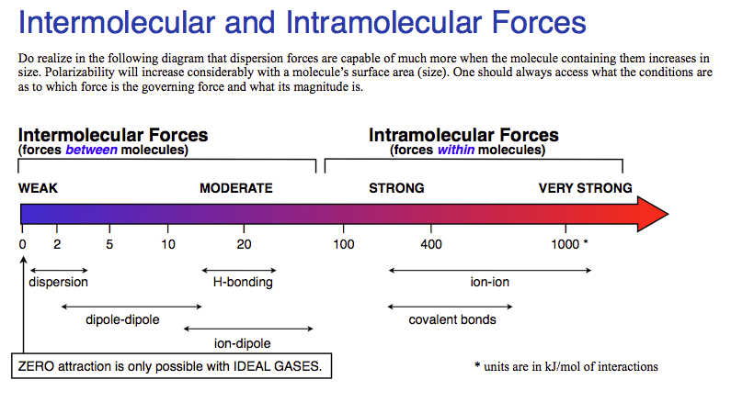
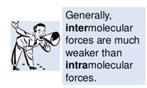
4.1 & 4.4 Introduction to Reactions & Physical/Chemical Changes
A physical change occurs when a substance undergoes a change in properties, but doesn’t produce a new substance. Phase changes are the most common. It involves intermolecular changes. A formation of a mixture is also a physical change.
A chemical change produces new substances. Bonds are broken and new bonds are formed! The intramolecular forces are changed.
Production of heat or light
Formation of a gas
Formation of a precipitate
Color change
REMEMBER:
Intermolecular forces are broken during a phase change!!
Learning Objective: Identify evidence of chemical and physical changes in matter. Explain the relationship between macroscopic characteristics and bond interactions for: Chemical processes & Physical processes

Slide 4
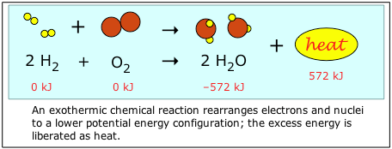
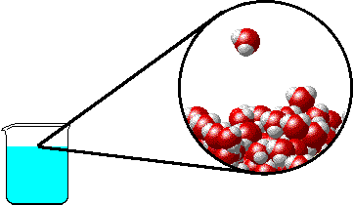
4.1 Evidence of Chemical Change
Note: it is a common misconception that boiling water makes O₂ and H₂ gas. Notice that the water molecule stays intact as the water boils. Covalent bonds are not broken with this physical change- only intermolecular attractions (hydrogen bonds) between water molecules.
Chemical Changes:
Production of a gas:
2KClO₃ _{(s)} + heat → 2KCl _{(s)} + 3O_{2 (g)}
Formation of a precipitate:
AgNO₃) _{(aq)} + KCl _{(aq)} → AgCl _{(s)}+ 2KNO_{3 (aq)}
Change in color:
Two white solids react to produce a mixture of a yellow and a white solid when shaken forcefully!
Pb(NO₃)_{2 (s)} + 2KI _{(s)} → PbI₂ _{(s)}+ 2KNO_{3 (s)}
Production of heat*:
2 Mg _{(s)} + O_{2 (s)} → 2MgO _{(s)} + heat
*can also include the absorption of heat
Physical Changes:
may produce similar visible evidence (i.e. boiling water creates “bubbles,” but bonds are not broken and reformed. No new substances are made.

Slide 5
4.2 Net Ionic Equations
Every process can be represented by a balanced equation. Remember mass is always conserved.
Spectator ions should not be included in your balanced equations.
Remember, the point of a Net Ionic Reaction is to show only those ions that are involved in the reaction. Chemists are able to substitute reactants containing the same species to create the intended product.
You only need to memorize that compounds with potassium, nitrate, ammonium, and sodium ions are soluble.
Complete Molecular: | AgNO₃ (aq) + KCl (aq) ⎯→ AgCl (s) + KNO₃ (aq)
Complete Ionic : | Ag⁺(aq) + NO₃⁻(aq) + K⁺(aq) + Cl⁻(aq) ⎯→ AgCl (s) + K⁺(aq) + NO₃⁻(aq)
Net Ionic : | Ag⁺(aq) + Cl⁻(aq) ⎯→ AgCl (s)
Learning Objective: Represent changes in matter with a balanced chemical or net ionic equation: For physical changes; for given information about the identity of the reactants and/or products; for ions in a given chemical reaction

Slide 6
4.2 Net Ionic Equations
All strong electrolytes are separated into their ions: soluble ionic compound, strong acids and strong bases
A molecular substance (weak electrolyte), weak acid/weak base, gases, liquids, solids, does not dissociate into ions
Learning Objective: Represent changes in matter with a balanced chemical or net ionic equation: For physical changes; for given information about the identity of the reactants and/or products; for ions in a given chemical reaction

Slide 7
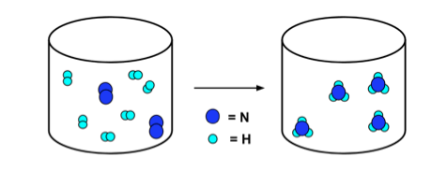
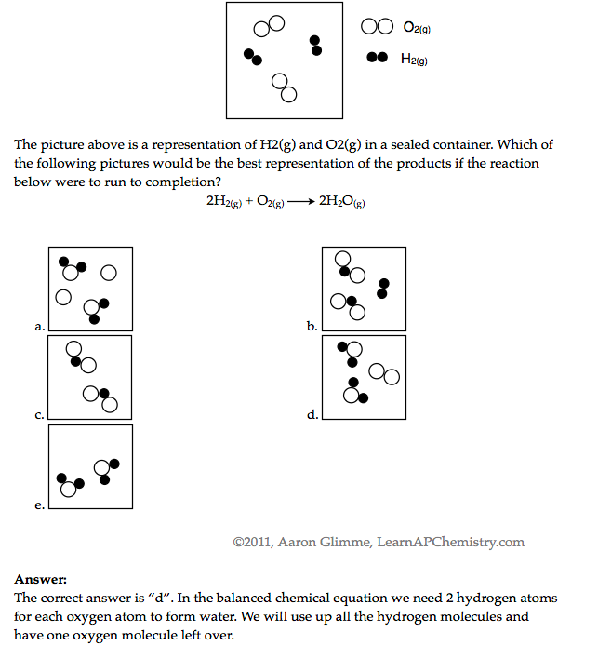
4.3 Representations of Reactions
N₂ + 3H₂ → 2NH₃
Balanced chemical equations can be translated into particle representations.
Remember when we use particle diagrams to COUNT the particles! The law of conservation of mass will always hold true. Pay attention to limiting reactants, etc.
Learning Objective: Represent a given chemical reaction or physical process with a consistent particulate model.

Slide 8
4.5 Stoichiometry: Use Mole Ratio in balanced equation to calculate moles of unknown substance
If we want to convert from one substance to another, we must use the mole ratio!
When in doubt, go to moles!!!
Molar volume (22.4L = 1 mol) is used when gases are at STP.
Density is a conversion factor between mass and volume.
Molarity is a conversion between moles and liters.
Learning Objective: Explain changes in the amounts of reactants and products based on the balanced reaction equation for a chemical process.

Slide 9
4.5 Stoichiometry: Useful Equations
If we want to convert from one substance to another, we must use the mole ratio!
When in doubt, go to moles!!!
Molar volume (22.4L = 1 mol) is used when gases are at STP.
Density is a conversion factor between mass and volume.
Molarity is a conversion between moles and liters.
Learning Objective: Explain changes in the amounts of reactants and products based on the balanced reaction equation for a chemical process.

Slide 10
Stoich: Limiting Reactants
Al₂S₃ + 6 H₂O ---> 2Al(OH)₃ + 3 H₂S
15.00 g aluminum sulfide and 10.00 g water react
Identify the Limiting Reactant
15.00g Al₂S₃ x (1mol/ 150.158 g) x (3 mol H₂S/1mol Al₂S₃) x (34g/mol H₂S ) = 10.19 g H₂S created if all Al₂S₃ was used
10g H₂0 x (1mol/ 18.015 g) x (3mol H₂S/ 6mol H₂O) x (34g/mol) = 9.44g H₂S created if all H₂O was used
H₂0 is limiting, because it makes the least amount of product (it runs out first)
b) What is the maximum mass of H₂S which can be formed from these reagents?
Theoretical Yield
10.00 g H₂0 x (1mol/ 18.015 g) x (3/6) x (34 g/mol ) = 9.44 g H₂S produced
c) How much excess reactant is left in the container?
15.00 g – 13.892 g = 1.11g Al₂S₃
**Dimensional Analysis is not the only way to solve these problems. You can also use BCA tables (modified ICE charts), which may save time on the exam!

Slide 11
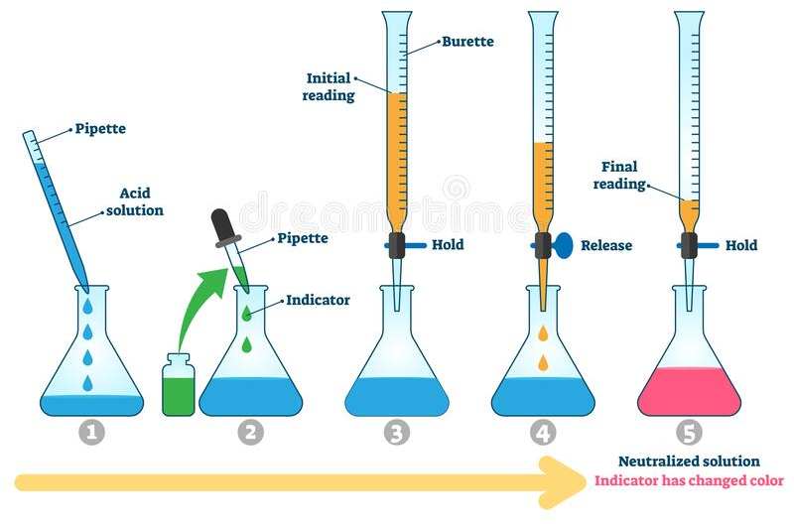
4.6 Introduction to Titration
Why are titrations used?
Determine the concentration of an analyte in solution.
Steps in a titration:
Rinse the buret with small amounts of the titrant
The titrant is slowly added to the buret.
A measured volume of the analyte is added to an erlenmeyer flask and placed under the buret.
If an indicator is being used in the titration, several drops of indicator will be added to the analyte
Titrant is slowly added to the flask from the buret until the end point is reached
The end point is detected when the color of the indicator changes or the desired pH is detected by the pH meter
From the amounts of titrant and analyte used, the concentration of the analyte can be determined
Important Vocabulary:
Analyte: substance of unknown concentration
Titrant: substance of known concentration that reacts specifically with the analyte
Buret: laboratory glassware used to add small volumes of liquid to a solution
Equivalence point: when the analyte is totally consumed by the titrant
Indicated by a change in a property (such as color) - this is the end point
Learning Objective: Identify the equivalence point in a titration based on the amounts of the titrant and analyte, assuming the titration reaction goes to completion.

Slide 12
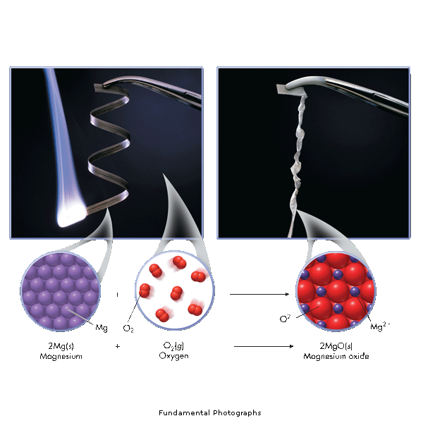
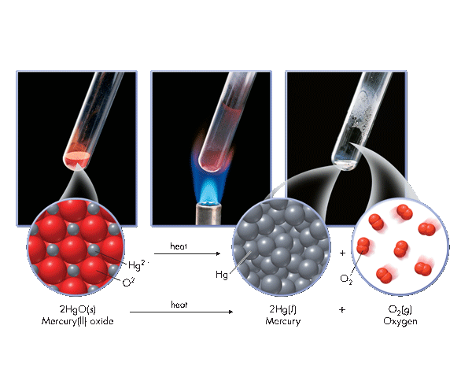
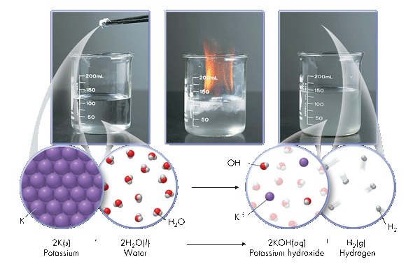
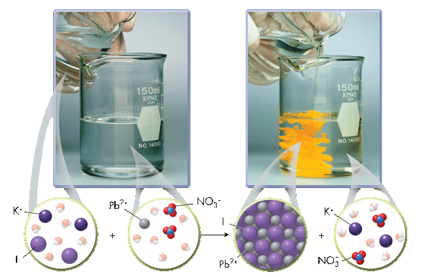
4.7 Types of Chemical Reactions
Synthesis
A + B → AB
Decomposition
AB → A + B
Single Displacement
A + BC → AC + B
Double Displacement
AB + CD→ AD + CB
These are a review from Honors Chem
Learning Objective: Identify a reaction as acid-base, oxidation-reduction, or precipitation.

Slide 13
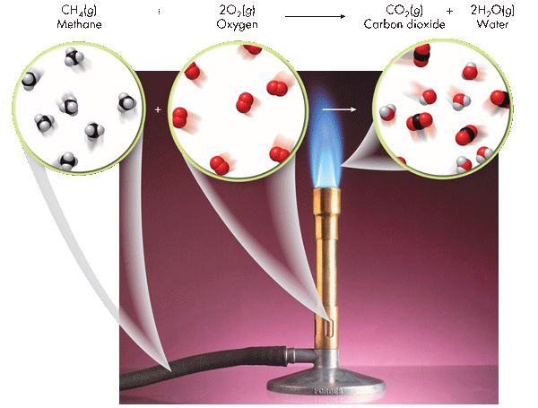
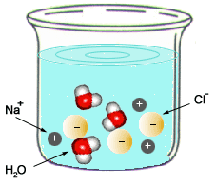
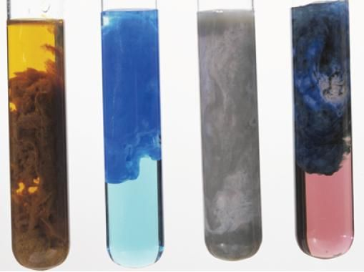
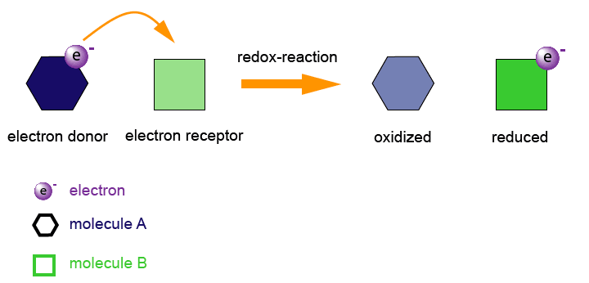
4.7 Types of Chemical Reactions
Combustion
C_{x}H_{x} + O₂ → CO₂ + H₂O
Acid-Base (Neutralization)
HA + BOH → H₂O + BA
Combustion is an important subclass of redox reactions, in which a species reacts with oxygen gas. In the case of hydrocarbons, carbon dioxide and water are products of complete combustion.
Acid-base reactions involve transfer of one or more protons between chemical species.
Oxidation-Reduction
A ⁺ + e⁻ → A
B → B + e⁻
Precipitation
AB (aq) + CD (aq) → AD (aq) + CB (s)
Precipitation reactions frequently involve mixing ions in aqueous solution to produce an insoluble or sparingly soluble ionic compound. All sodium, potassium, ammonium, and nitrate salts are soluble in water
Oxidation-reduction reactions involve transfer of one or more electrons between chemical species, as indicated by changes in oxidation numbers of the involved species.
Learning Objective: Identify a reaction as acid-base, oxidation-reduction, or precipitation.

Slide 14
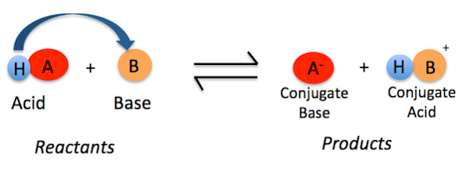
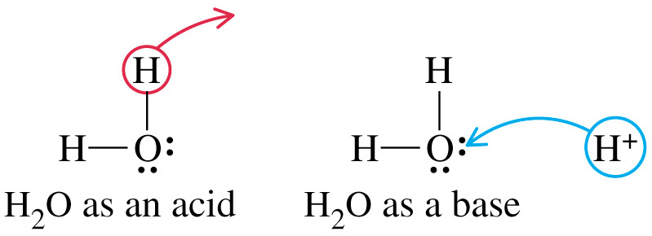
4.8 Bronsted-Lowry Acids & Bases
According to Bronsted-Lowry (B.L.) an acid is a "proton donor" and a base is a “proton acceptor”. The proton here is shown as a hydrogen.
The acid’s conjugate base is the anion.
The base’s conjugate acid now has the proton (hydrogen ion).
Compare CA or CB strength based on the strength of acids or bases it originates from.
Amphoteric nature of water
Water plays an important role in many reactions. Water can act as both an acid & a base.
H₂O ⇄ H⁺ + OH⁻
2H₂O ⇄ H₃O⁺ + OH⁻
Learning Objective: Identify species as BrønstedLowry acids, bases, and/or conjugate acid-base pairs, based on proton-transfer involving those species.

Slide 15
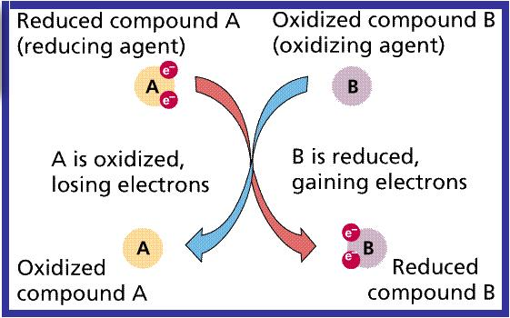
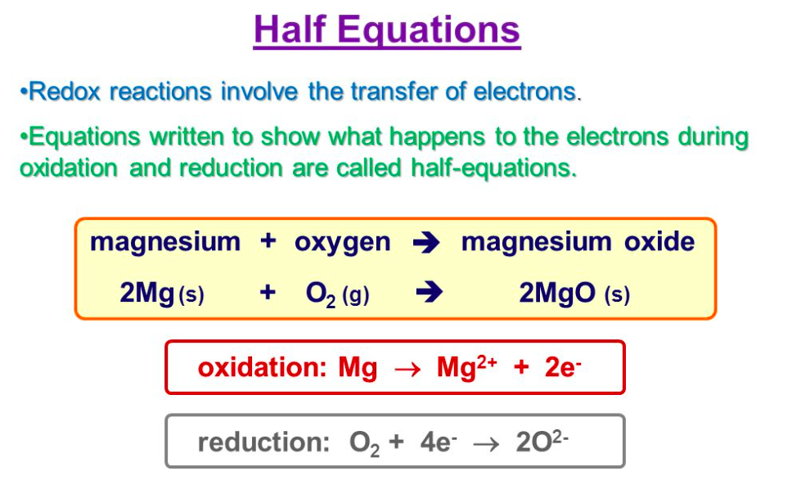
4.9 Redox Reactions
When an electron is transferred, it is called a redox reaction.
When something is reduced, it gains electrons. (Remember it is a reduction in oxidation #).
The oxidation is the loss of electrons, so if an atom is oxidized it loses its electron to another atom.
There must always be oxidation with reduction! If one molecule is oxidized, another molecule must be reduced and vice versa: the electron must go somewhere.
Electrons are transferred from the substance that is oxidized to the substance that is reduced.
You can assign oxidation numbers to every atom in the reactants and products to determine oxidation or reduction.
OILRIG

Slide 16
4.6/4.9 Redox Titrations
A redox titration (also called an oxidation-reduction titration) can accurately determine the concentration of an unknown analyte by measuring it against a standardized titrant. A common example is the redox titration of a standardized solution of potassium permanganate (KMnO₄) against an analyte containing an unknown concentration of iron (II) ions (Fe²⁺). The balanced reaction in acidic solution is as follows:
MnO₄⁻ + 5Fe²⁺ + 8H⁺ → 5Fe³⁺ + Mn²⁺ + 4H₂O
In this case, the use of KMnO₄ as a titrant is particularly useful, because it can act as its own indicator; this is due to the fact that the KMnO₄ solution is bright purple, while the Fe²⁺ solution is colorless. It is therefore possible to see when the titration has reached its endpoint, because the solution will remain slightly purple from the unreacted KMnO₄

Slide 17
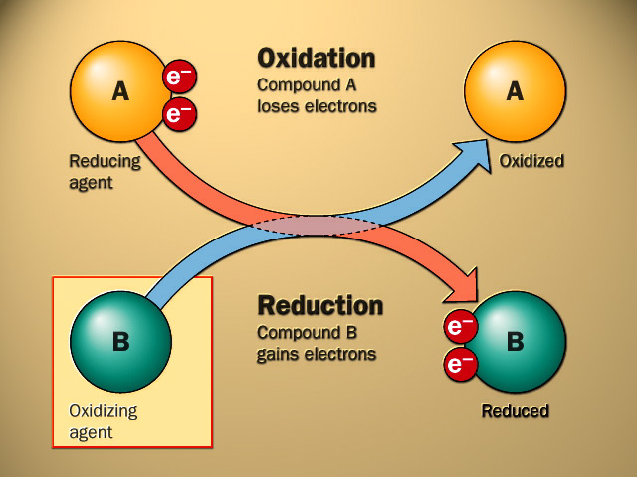
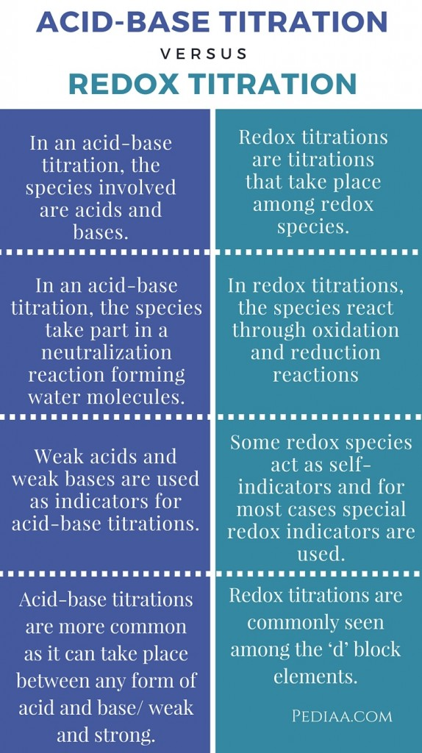
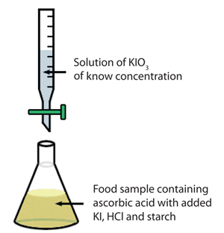
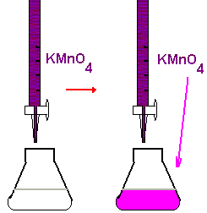
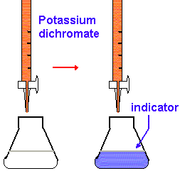
4.6/4.9 REDOX Titration
Applications/Methods of REDOX Titrations:
Vitamin C Content
Concentration of a redox species
Back Titrations
Done when the endpoint can be hard to ID – add an excess, and then back titrate to determine how much is in excess

