Slide 1
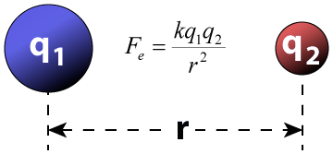
Unit #1
Atomic Structure and Properties

Slide 2
General Overview of Unit 1
1.1 Molar Mass
1.2 Mass Spectroscopy
1.3 Elemental Composition of Pure Substances
1.4 Composition of Mixtures
1.5 Atomic Structure and Electron Configurations
1.6 Photoelectron Spectroscopy
1.7 Periodic Trends
1.8 Valence Electrons

Slide 3
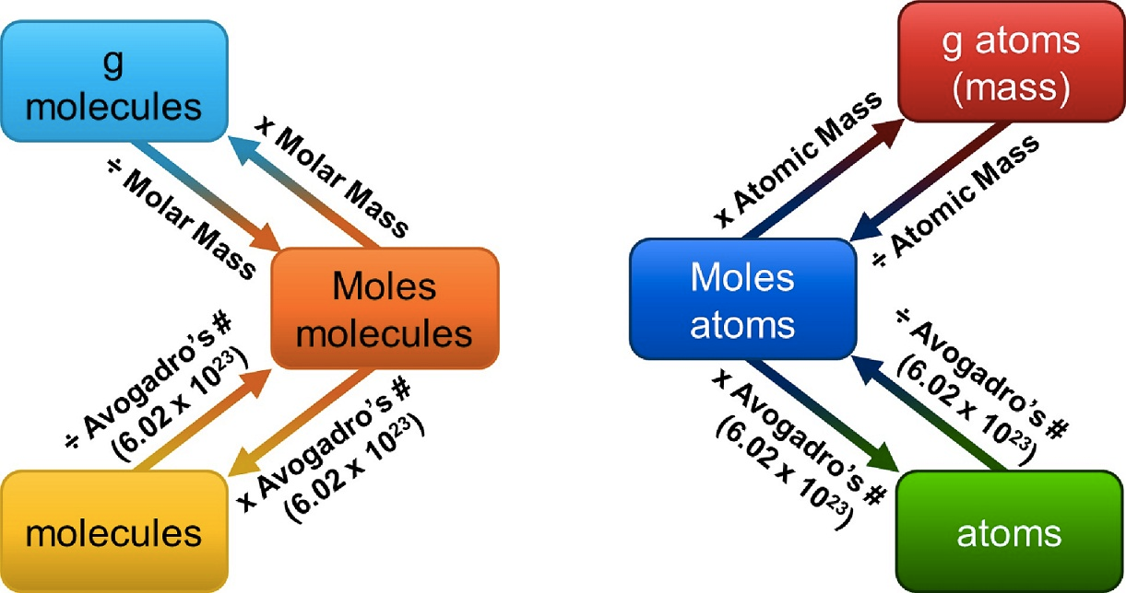
1.1 Mole Calculations
Source
1 mole = 6.02 x 10²³ representative particles
1 mole = molar mass of a substance
1 mole = 22.4 L of a gas at STP
Video
Learning Objective: Calculate quantities of a substance or its relative number of particles using dimensional analysis and the mole concept

Slide 4
1.2 Mass Spectrometry - evidence for isotopes
Mass spectrometry shows
that elements have isotopes
The mass spectrum of a sample containing a single element can be used to determine the identity of the isotopes of that element and the relative abundance of each isotope in nature.
The average atomic mass of an element can be estimated from the weighted average of the isotopic masses using the mass of each isotope and its relative abundance.
For this mass spectrum of zirconium, we can tell it’s mass spec because we see abundance on the y-axis and mass or mass/charge on the x-axis.
Learning Objective: Explain the quantitative relationship between the mass spectrum of an element and the masses of the element’s isotopes.

Slide 5
1.3 Ratio of Masses in a Pure Sample
H₂O
All elements and molecules are made up of atoms
Substances with the same atomic makeup will have same average masses
The ratio of masses in any pure sample is always the same
Molecules with the same atomic makeup (ex: H₂O) will have the same ratio of average atomic masses
H₂O₂ ratio would be different than H₂O due to the different chemical makeup
Learning Objective: Explain the quantitative relationship between the elemental composition by mass and the empirical formula of a pure substance.

Slide 6
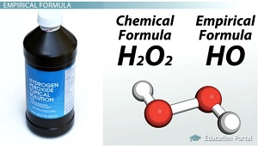
1.3 Composition of Pure Substances and/or Mixtures
Percent mass can be used to determine the composition of a substance
% mass can also be used to find the empirical formula
The empirical formula is the simplest formula of a substance
It is a ratio between the moles of each element in the substance
Quick steps to solve!
% to mass, mass to moles, divide by the smallest and multiply ‘til whole!)
The molecular formula is the actual formula of a substance
It is a whole number multiple of the empirical formula
Learning Objective: Explain the quantitative relationship between the elemental composition by mass and the empirical formula of a pure substance.

Slide 7
1.4 Identifying Purity of a Substance
Source
Impurities in a substance can change the percent composition by mass
If more of a certain element is added from an impurity, then the percent mass of that element will increase and vice versa
When heating a hydrate, the substance is heated several times to ensure the water is driven off
Then you are simply left with the pure substance and no excess water
Video
Learning Objective: Explain the quantitative relationship between the elemental composition by mass and the composition of substances in a mixture.

Slide 8
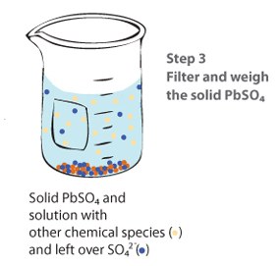
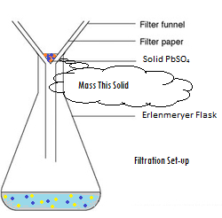
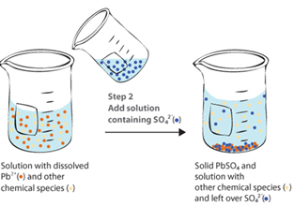
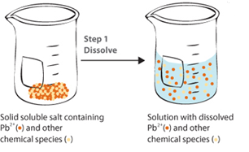
1.4 Elemental Analysis: Gravimetric Analysis
What It Determines:
amount of analyte by mass measurements
% composition
empirical formulas
How It Can Be Done:
Dehydration of a hydrate
Forming a precipitate, which is then isolated and massed
Analysis:
Remember to ALWAYS go to moles!
use mole ratios to convert between various components
Possible Source of Error | Contamination in solid | Incomplete Precipitation | Solid not fully dehydrated
Impact on Results | measured mass too large | Lose ion in filtrate – mass too small | measured mass too large

Slide 9
1.5 Electronic Structure of the Atom: Electron Configurations
Electrons in occupy orbitals whose energy level depends on the nuclear charge and average distance to the nucleus
Electrons can be thought of as being in “shells (energy levels)” and “subshells (sublevels).
Inner electrons are called core electrons, and outer electrons are called valence electrons.
Electron configurations & orbital diagrams indicate the arrangement of electrons with the lowest energy:
Electrons occupy lowest available energy levels
A maximum of two electrons may occupy an energy level
In orbitals of equal energy, electrons maximize parallel unpaired spins
Learning Objective: Represent the electron configuration of an element or ions of an element using the Aufbau principle.

Slide 10
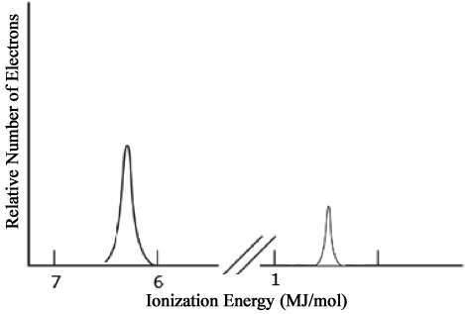
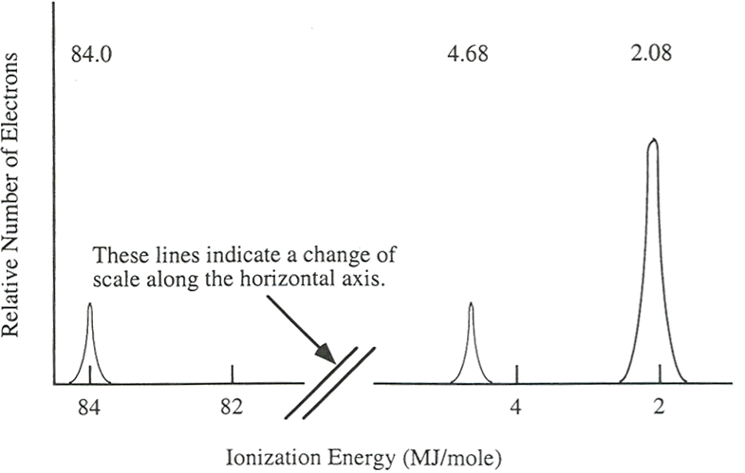
1.6: Electronic Structure of the Atom: Photoelectron Spectroscopy (PES)
Li
1s²
PES uses high-energy (X-ray) photon to excite random e– from atom
KE of ejected electron indicates binding energy (coulombic attraction) to nucleus
Direct measurement of energy and number of each electron
Lower energy levels have higher BE
Signal size proportional to number of e– in energy level
Elements with more protons have stronger coulombic attraction, higher BE at each energy level
Always look at the x-axis to see where the higher energy is!
2s¹
Ne
2p⁶
1s²
2s²
Learning Objective: Explain the relationship between the photoelectron spectrum of an atom or ion and: The electron configuration of the species or the interactions between the electrons and the nucleus.

Slide 11
Justifying Periodic Trends
You HAVE to be able to explain trends on the AP exam. Not just “because it increases as you move down a group”.
Use Coulomb’s Law! (Talk about the attraction between the protons in the nucleus and the VALENCE electrons)
Atomic Radius
Ionic Radius
Ionization energy
Remember Coulomb’s Law
focuses on charge and distance.
You should look at distance
between the protons in the
nucleus and the valence
electrons first, and then look at
charge second.

Slide 12
1.7 Periodic Trends
The following explains these trends:
Electrons attracted to the protons in the nucleus of an atom
The closer a valence electron is to a nucleus, the more strongly it is attracted (Coulomb’s law)
The more protons in a nucleus (effective nuclear charge), the more strongly it attracts electrons
Electrons are repelled by other electrons in an atom. If valence electrons are shielded from nucleus by other electrons, you will have less attraction of the nucleus (again Coulomb’s law-greater the atomic radius, the greater the distance)
Learning Objective: Explain the relationship between trends in atomic properties of elements and electronic structure and periodicity.

Slide 13
Electronic Structure of the Atom: 1st Ionization Energy
1st Ionization Energy Energy (IE) indicates the strength of the coulombic attraction of the outermost, easiest to remove, electron to the nucleus:
X(g) + IE X⁺(g) + e–
1st IE generally increases across a period and decreases down a group
IE generally increases as #protons increases in same energy level
IE decreases as e– in higher energy level: increased shielding, e– farther from nucleus
Learning Objective: Explain the relationship between trends in atomic properties of elements and electronic structure and periodicity.

Slide 14
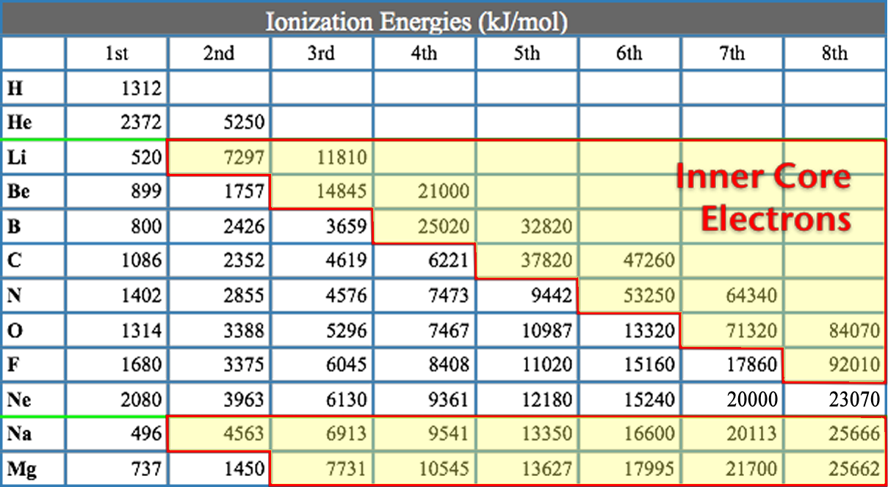
Electronic Structure of the Atom: Higher Ionization Energies
2nd & subsequent IE’s increase as coulombic attraction of remaining e–’s to nucleus increases
X⁺ + IE X²⁺ + e–
X²⁺ + IE X³⁺ + e–
Large jump in IE when removing less-shielded core electrons
Learning Objective: Explain the relationship between trends in atomic properties of elements and electronic structure and periodicity.

Slide 15
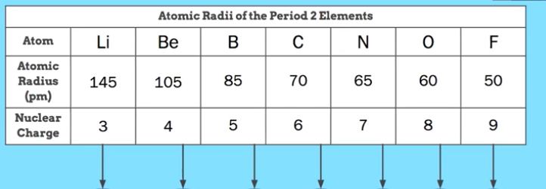
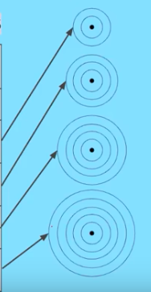
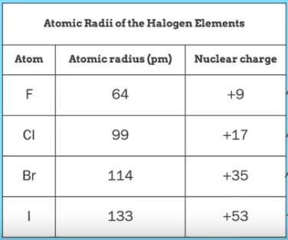
Atomic Radius
Moving across a period, radius decreases
Why? → Effective nuclear charge increases so there is a stronger attractions between the protons in the nucleus and the valence electrons, resulting in a smaller radius
Moving down a group/family, radius increases
Why? → Moving down a group, the number of protons does increase, but so does the number of principal energy levels. The valence electrons are in a higher principal energy level, which is farther from the nucleus.
Learning Objective: Explain the relationship between trends in atomic properties of elements and electronic structure and periodicity.

Slide 16
Ionic Radius
Cations are generally SMALLER than the atom that it came from.
Why? → They have LOST electrons (valence electrons) but maintain the same number of protons in the nucleus attracting the valence electrons. There is more of an attractive force due to a higher proton to electron ratio.
Anions are generally LARGER than the atom that it came from.
Why? → They have GAINED valence electrons but maintain the same number of protons in the nucleus attracting the valence electrons. There is less of an attractive force due to a lower proton to electron ratio.
Learning Objective: Explain the relationship between trends in atomic properties of elements and electronic structure and periodicity.

Slide 17
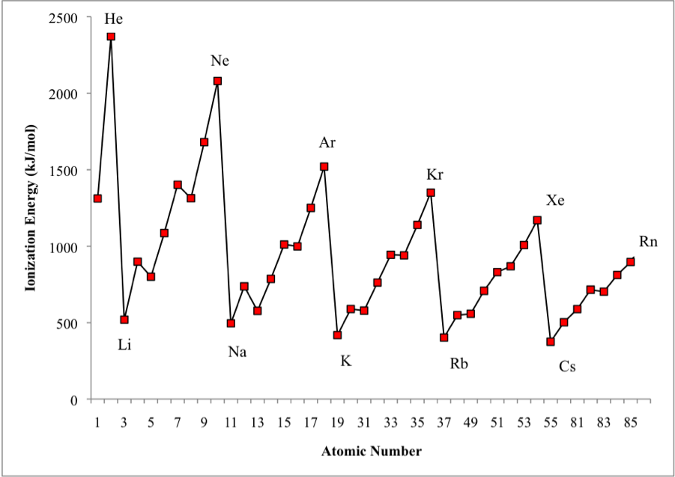
Shell Model is consistent with Ionization Energy Data
The patterns shown by the IE graph can be explained by Coulomb’s law
As atomic number increases, we’d expect the ionization energy to constantly increase
Graph shows that this is NOT observed. WHY NOT?
The data implies that a shell becomes full at the end of each period
Therefore the next electron added must be in a new shell farther away from the nucleus.
This is supported by the fact that the ionization energy drops despite the addition positive charge in the nucleus

Slide 18
Electronic Structure of the Atom: 1st Ionization Energy Irregularities
1st Ionization Energy Energy (IE) decreases from Be to B and Mg to Al
Electron in 2p or 3p shielded by 2s² or 3s² electrons, decreasing coulombic attraction despite additional proton in nucleus.
Same effect seen in 3d¹⁰-4p, 4d¹⁰-5p and 5d¹⁰-6p
1st Ionization Energy decreases from N to O and P to S
np⁴ contains first paired p electrons, e–-e– repulsion decreases coulombic attraction despite additional proton

Slide 19
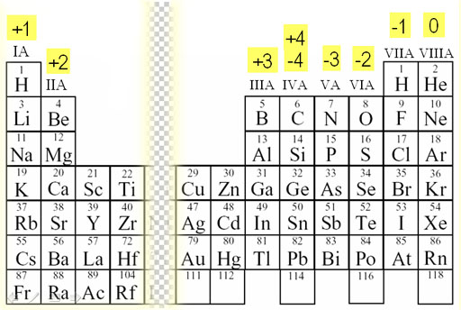
1.8 Chemical Reactivity
Using Trends
Reactivity tends to increase as you go down a group for metals and up a group for non-metals.
The easier it is to remove an electron from a metal, the more reactive it is
The higher the electron affinity, the easier it is to add an electron, and the more reactive the nonmetal
Elements in the same group form similar compounds
MgCl₂ and MgBr₂
Charges are based on the number of valence electrons and location on the periodic table
Learning Objective: Explain the relationship between trends in the reactivity of elements and periodicity

Slide 20
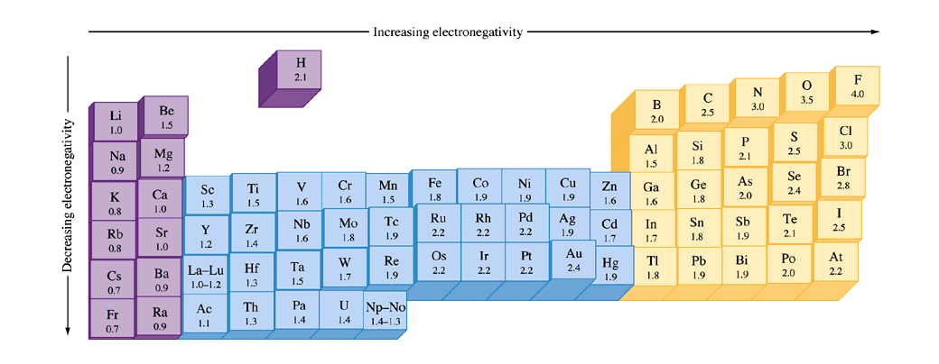
Bonding and Electronegativity
Differences in electronegativities lead to different types of bonding*:
0.0 – 0.4: Bond is generally considered nonpolar
0.5 – 1.7: Bond is generally considered polar
> 1.7: Bond is generally considered ionic
Electronegativities are assigned values and are relative to fluorine. Electronegativity is a function of shielding / effective nuclear charge.
*Values presented are one possibility – other scales exist.

Slide 21
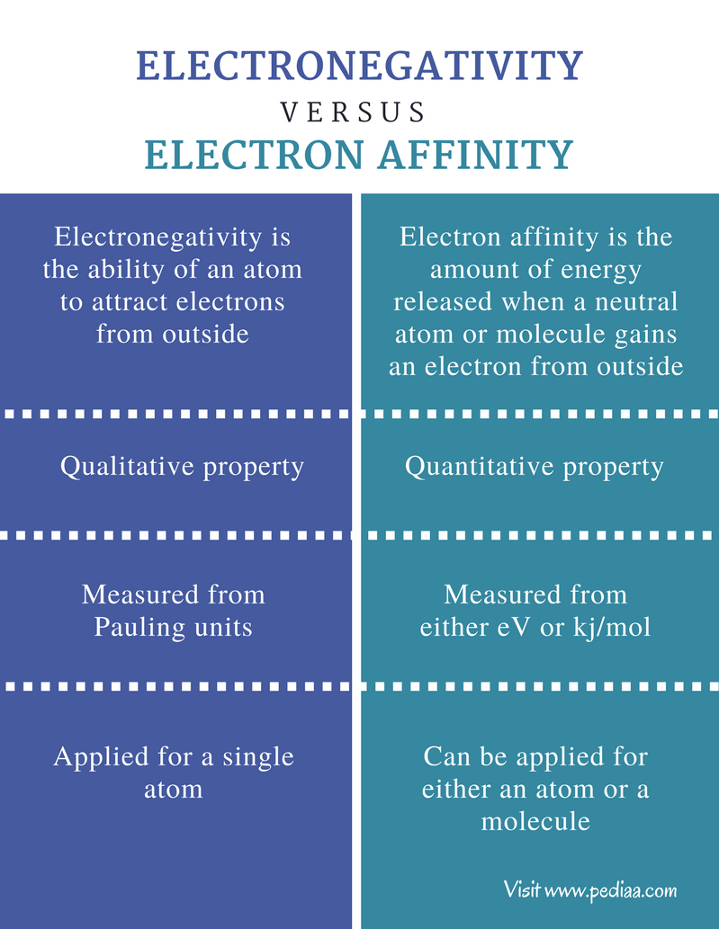

Slide 22
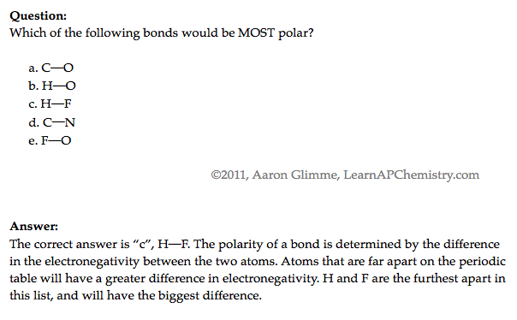
Ranking Bond Polarity

