Slide 1
UNIT 8: Water Pollution & Other Issues
AP Environmental Science
Westlake High School

Slide 2
WATER POLLUTION is
Any physical, biological, or chemical change in water quality that adversely affects living organisms can be considered pollution.
Point Sources - Discharge pollution from specific locations.
Factories, power plants, oil wells
Non-Point Sources - Scattered or diffuse, having no specific location of discharge.
Agricultural fields, feedlots, golf courses

Slide 3
Major Categories of Water Pollutants
Inorganic Chemicals
Organic Chemicals
Sediment
Oxygen-Demanding Waste
Infectious Agents
Plant Nutrients
Radioactive Material
Heat

Slide 4
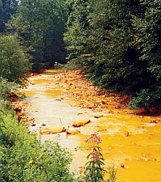
Heavy Metal Pollutants (Inorganic)
Mercury (Hg), Lead (Pb), Cadmium (Cd), Nickel (Ni)
They are highly persistent and tend to bioaccumulate in food chains.
They tend to be toxic
Biggest sources:
Mercury released from incinerators & coal-burning power plants.
Mine drainage and leaching.

Slide 5
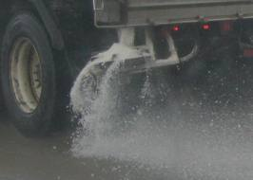
Other Inorganic Pollutants
Nonmetallic Salts
Biggest source is road salt used during the winter.
When the snow melts, the salt runs off into nearby rivers or lakes.
Acids and Bases
Changes the pH of the water.
Aquatic organisms are very sensitive to pH changes.

Slide 6
Organic Chemicals
Organic compounds are complex molecules that contain carbon.
Two most important sources of toxic organic chemicals in water are:
Improper disposal of industrial and household wastes.
Runoff of pesticides from private lawns and farms.

Slide 7
Organic Chemicals
PCBs are one of the biggest and most persistent examples of organic chemical pollution
Used for multiple electronic, wiring, adhesive, and lubrication applications.
PCBs are…
Mutagenic
Endocrine disruptors (mimic estrogen)
Carcinogenic

Slide 8
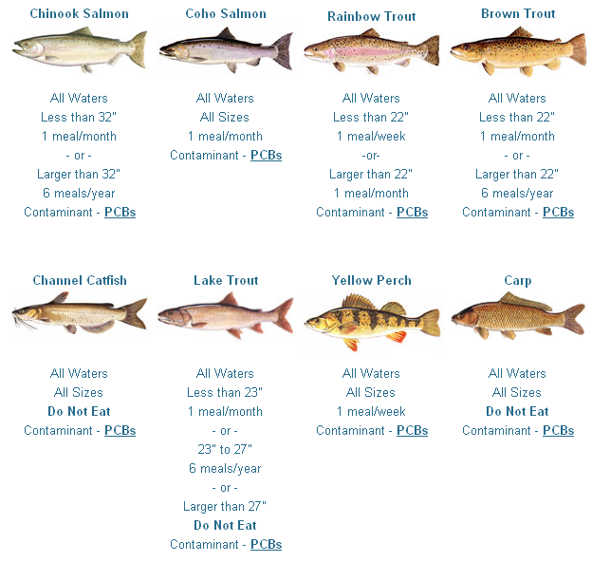
This is a guide to Lake Michigan fish.
The fish with the highest level of contamination tend to be larger or bottom-feeders.

Slide 9
Sediment Pollution
Sediment is soil and rock particles that have entered water due to erosion.
Erosion is normal, but can be accelerated by human activities.
Sediment is beneficial (nourishes plants found in floodplains) in small amounts but can be harmful (smother aquatic life) when there is too much.

Slide 10
Thermal Pollution
Thermal pollution is dumping water into a river, lake, or sea that is either much warmer or much colder than normal.
Oxygen levels in water decreases as temperatures increase.

Slide 11
Groundwater Contamination
Groundwater is highly susceptible to pollution due to its location underground.
Example sources:
Leftover mining waste
Radioactive waste
Organic waste (manure)
Unsealed municipal waste (landfills)
Electricity generation waste (fossil fuels)
Oil and gas drilling

Slide 12
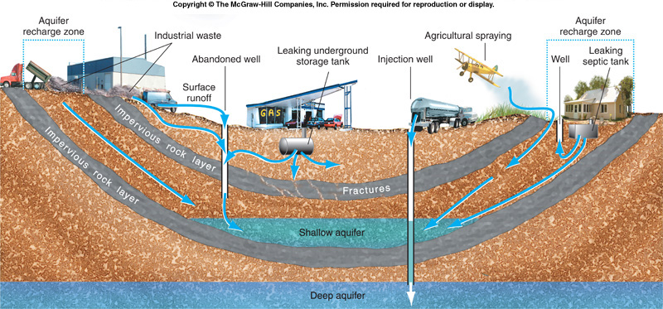
Groundwater Pollution

Slide 13
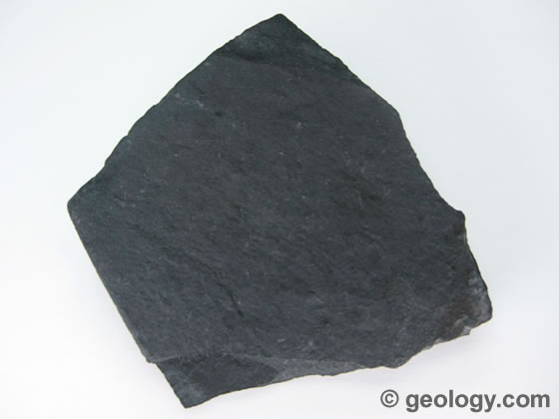
Hydraulic Fracturing
Hydraulic fracturing, or “fracking”, is a controversial technique used to extract natural gas from rock formations that are not very permeable.
Examples: Shale
and coal beds.

Slide 14
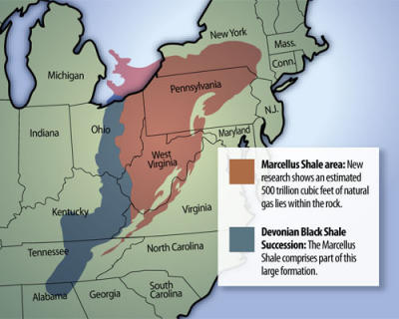
Natural Gas Deposits
Fracturing has become an increasingly popular tool for extracting natural gas, especially with the discovery of the methane-rich Marcellus Shale.

Slide 15
The Fracturing Process
Fracturing fluid is pumped into a narrow hole drilled into the rock formation.
The pressure created from this fluid causes the rock formation to crack.
Sand is injected afterwards to fill the cracks, because it is more permeable and allows the methane to seep out.
Most of the mixture injected into the rock formation is rock and sand, however…

Slide 16
Fracturing Fluid
A number of hazardous chemicals are also present in the fracturing fluid.
These include carcinogens and endocrine disruptors.
In a study published in 2010, the EPA discovered contaminants in groundwater.
The gas industry claims that it is impossible for these fluids to enter groundwater.

Slide 17
2005 Energy Policy Act
The EPA has been unable to investigate contamination due to fracturing for two reasons:
The 2005 Energy Policy Act provides the industry exemption from the Clean Water and Drinking Water Acts.
The specific chemicals used in fracturing are protected under copyright law as trade secrets.

Slide 18
Incidents Resulting from Fracturing
Methane gas has entered drinking water supplies in Dimock, PA.
Caused a water well explosion.
A well explosion in Clearfield, PA sent 35,000 gallons of fracturing fluid into the surrounding forests.
Another well in Leroy, PA experienced a leak and entered the groundwater.

Slide 19
Impaired Waters
Impaired waters are rivers, lakes, and estuaries that cannot fully support their aquatic biological communities.
Top three causes:
Excess sediment
Nutrients (nitrogen and phosphorous)
Pathogenic microorganisms

Slide 20
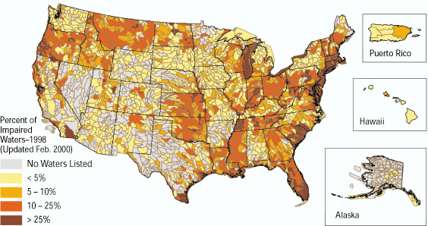
Water Quality Today
Source: US EPA
http://pubs.usgs.gov/fs/FS-130-01/

Slide 21
Water Testing Standards
The EPA requires that local water treatment plants provide yearly reports to residents listing any contaminants found in the drinking water supply.
Must be tested for microbes several times a day.
Bottled water has much less strict requirements.

Slide 22
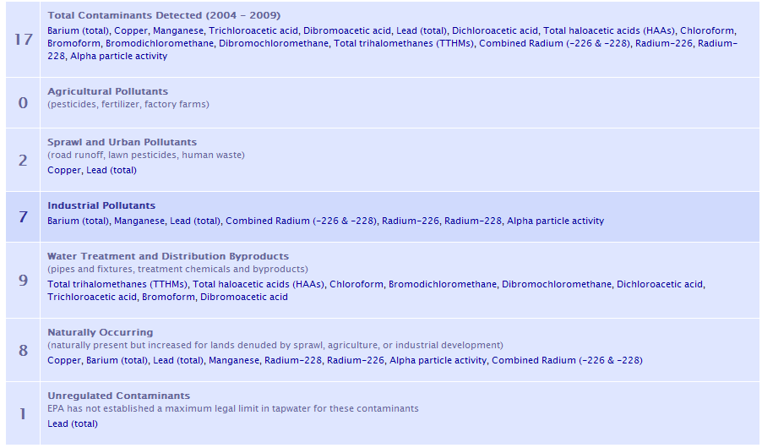
Tap Water Quality
Source: Environmental Working Group; www.ewg.org

Slide 23
Local Tap Water Contaminants
Chlorine treatment byproducts – Bromodichloromethane,Dibromochloromethane, haloacetic acids, bromoform, chloroform
Formed when chlorine reacts with organic matter found in water.
Legal limit for these pollutants is 100 parts per billion.
LD50 of chloroform is about 900mg/kg.

Slide 24
Bottled Water?
Spring water – From an underground source.
Purified water – Treated with distillation, ozonation, or reverse osmosis.
Mineral water – Naturally contains certain amounts of minerals from the source.
Sparkling water – Naturally containing carbon dioxide
Artesian water – Source is a confined aquifer.
Municipal water – Tap water.

Slide 25
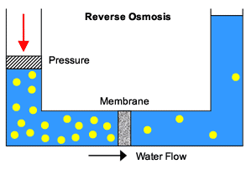
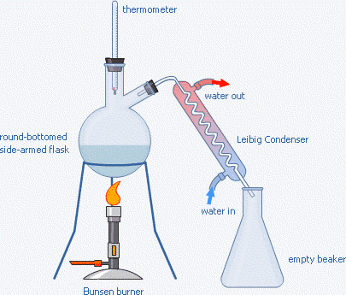
Water Filtration
Reverse Osmosis - Pressurized water is sent through a selective membrane filter.
Distillation – Water is boiled; Steam is collected and bottled.
Ozonation – Ozone is bubbled through water to kill microorganisms.

Slide 26
Gold Mining
Of all the metals that are mined, gold may be the most polluting.
Heap Leaching – A mining process that extracts precious metals (such as gold) by pouring a cyanide solution over the ore.
The cyanide dissolves the gold or silver in the crushed ore.
The liquid is collected and the metals are extracted from it.
The cyanide is reused and the ore is dumped.

Slide 27
Heap Leaching

Slide 28
Ocean Pollution
In spring 2010, a beached whale died off the coast of Seattle.
Inside the whale’s stomach was found…
A pair of sweatpants
A golf ball
20 plastic bags
Surgeon’s gloves
Duct tape
Plastic pieces
Did not play a role in whale’s death

Slide 29
Ocean Pollution
The two biggest ocean pollutants:
Oil
Plastics
Estimated 6 million metric tons of plastic bottles, packaging material, and other litter tossed from ships into the ocean annually.
Plastic bottles gradually break down into smaller pieces.
They never fully decompose because they are synthetic and not found in nature.

Slide 30
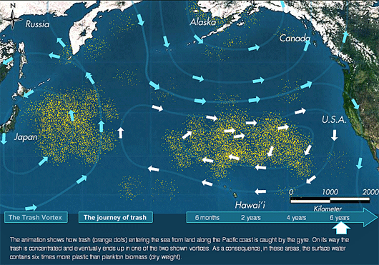
Ocean Pollution

Slide 31
Ocean Pollution
Most of the oil in the ocean comes from nonpoint sources.
The biggest one is people dumping used motor oil from their cars into the sink or storm drains.
Cause more long-term buildup.
The biggest point source is oil spills or leaks from oil platforms or tankers.
The point sources are much more concentrated and cause much more short-term damage.

Slide 32
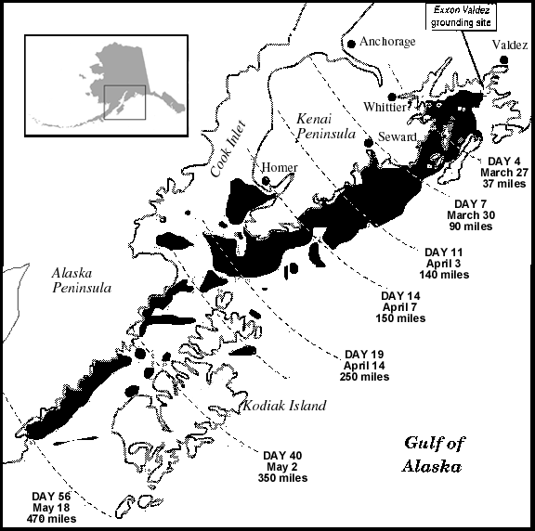
Oil Spills
Exxon Valdez (1989) – One of the worst incidents of water pollution to ever occur.
High volume of oil spilled
Remote location and a poor cleanup response
Thousands of sea birds, sea mammals, and fish were killed.

Slide 33
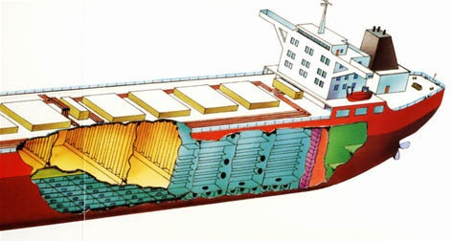
Exxon Valdez and Tanker Design
Resulted in the Oil Pollution Act of 1990
Mandated a double-hull design for oil supertankers by 2015.
Would have reduced the oil spilled by Exxon Valdez by 60%

Slide 34
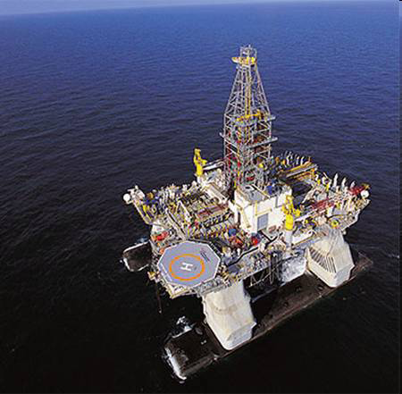
Deep Water Horizon
The Deepwater Horizon was a floating oil rig in the Gulf of Mexico contracted to British Petroleum.
An explosion occurred on this rig in April of 2010, resulting in the worst oil spill ever.

Slide 35
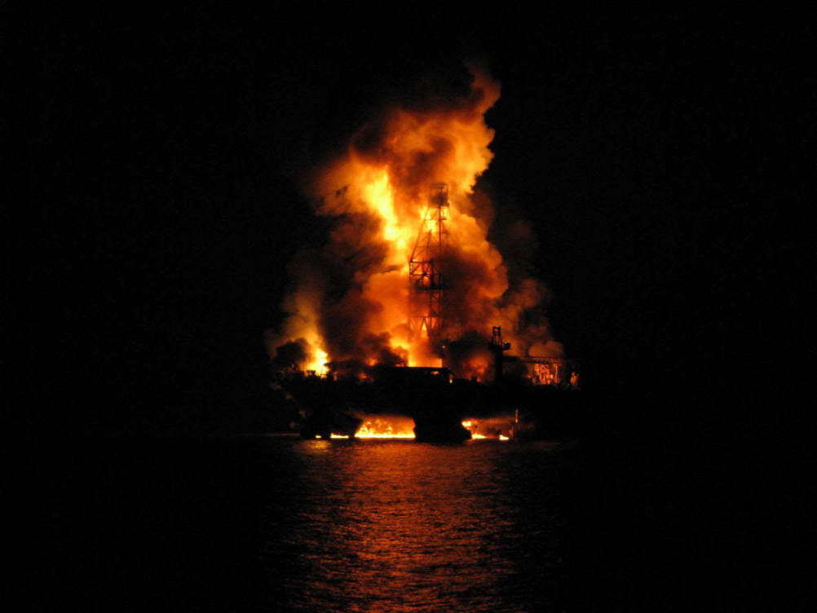
Deep Water Horizon
The rig was working drilling and preparing a well deep in the seabed of the Gulf of Mexico when a sudden surge of oil and natural gas traveled up through the rig, causing a blowout at the surface.

Slide 36
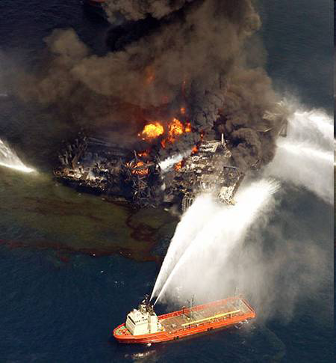
Deepwater Horizon
Even as the flames were contained, the oil continued to gush out at a rate of about 60,000 barrels per day.

Slide 37
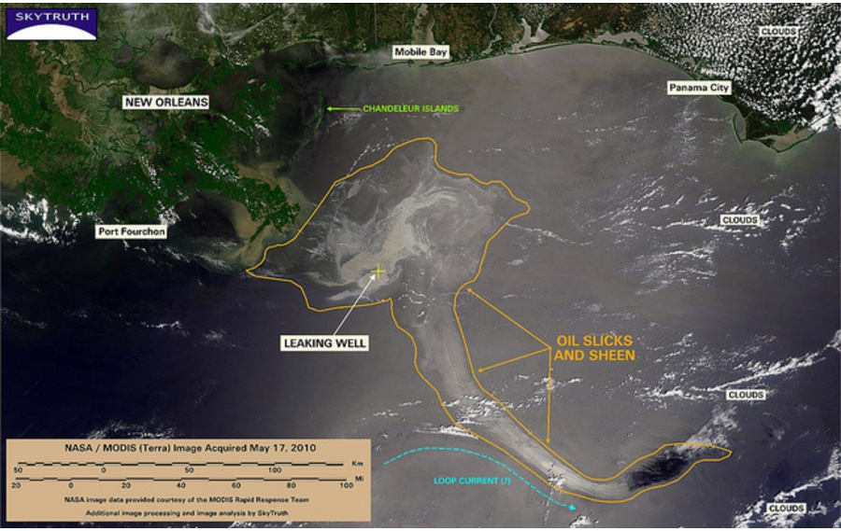
Deepwater Horizon

Slide 38
Aftermath
Damage from the oil spill was the most intense in three areas:
The beaches of the nearby states, especially Louisiana, Missisippi, and Alabama.
Underwater; Oil plumes stretched as long as 10 miles in some spots.
The sea floor; Oil and residue 2-5 inches thick has been recorded in some areas.

Slide 39
Laws and Lawsuits
BP reported actual cleanup costs of $3.12 billion.
The Oil Pollution Act of 1990 also limited the BP’s liability for non-cleanup costs to $75 million unless gross negligence can be proven.
BP estimates that its total costs of cleanup, recovery, litigation, and restitution will be about $40 billion.

Slide 40
Infectious Agents
Main source of waterborne pathogens is untreated and improperly treated human waste.
Animal wastes from feedlots and fields is also an important source of pathogens.
In developed countries, sewage treatment plants and pollution-control devices have greatly reduced pathogens.
Coliform bacteria - Intestinal bacteria.
Escherichia coli (E. coli)

Slide 41
Oxygen-Demanding Wastes
Water with an oxygen content > 6 ppm will support desirable aquatic life.
Water with < 2 ppm oxygen will support mainly detritivores and decomposers.
Oxygen is added to water by diffusion from wind and waves, and by photosynthesis from green plants, algae, and cyanobacteria.
Oxygen is removed from water by respiration and oxygen-consuming processes.

Slide 42
Oxygen-Demanding Wastes Cont’d
Biochemical Oxygen Demand - Amount of dissolved oxygen consumed by aquatic microorganisms.
Dissolved Oxygen Content - Measure of dissolved oxygen in the water.
Effects of oxygen-demanding wastes on rivers depend on volume, flow, and temperature of river water.
Oxygen Sag - Oxygen levels decline downstream from a pollution source as decomposers metabolize waste materials.

Slide 43
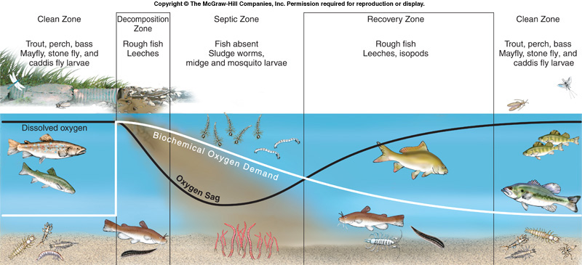
Oxygen Sag

Slide 44
Plant Nutrients and Cultural Eutrophication
Oligotrophic - Bodies of water that have clear water and low biological productivity.
Eutrophic - Bodies of water that are rich in organisms and organic material.
Eutrophication - Process of increasing nutrient levels and biological productivity.
Cultural Eutrophication - Increase in biological productivity and ecosystem succession caused by human activities.

Slide 45
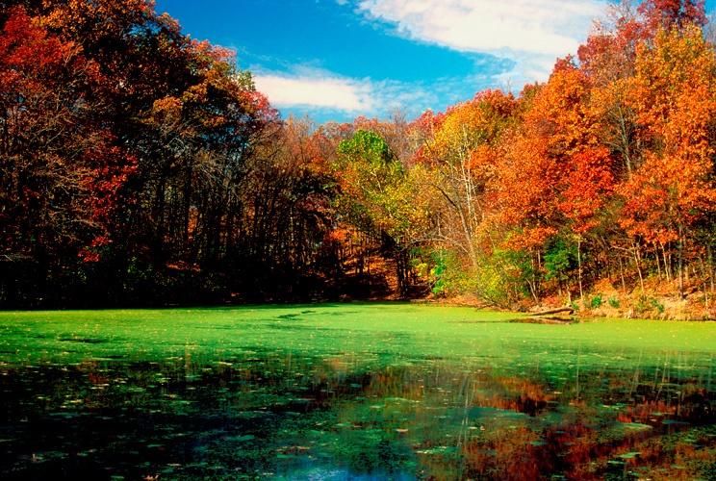

Slide 46
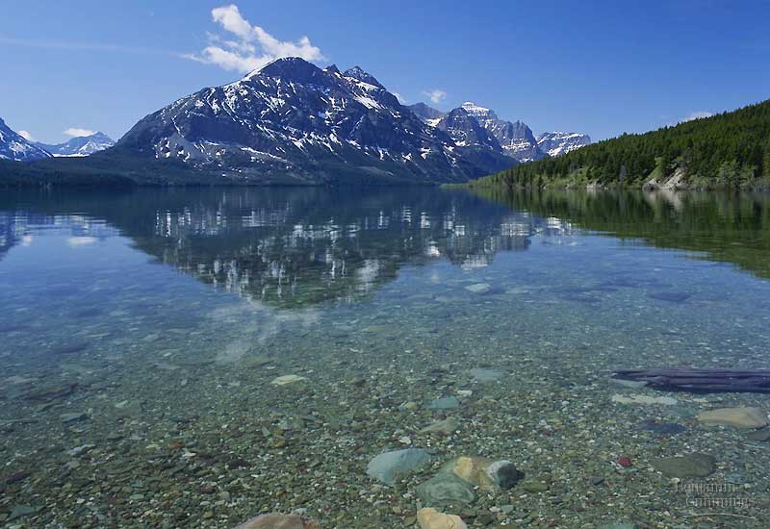

Slide 47
WATER LEGISLATION
Clean Water Act
Enacted in 1972, amended in 1977 and 1987.
Covers only “relatively permanent” waters, including streams, oceans, rivers, and lakes.
Point-source pollutants cannot be discharged into waters without permits from their state.
Does not address non-point pollutants.

Slide 48
POLLUTION CONTROL
Source Reduction
Cheapest and most effective way to deal with pollution is avoid producing it or releasing it into the environment.

