Slide 1
Heating &
Cooling Curves
Unit 7: Lesson #3

Slide 2
Heating/Cooling Curves:
Show the change of state over time that occurs with the addition or removal of heat energy

Slide 3
What happens when you add heat to a solid?
HEATING curve for water
Temp
Heat can be transferred even if there is no change in state
100
0
Ice at –30.0°C absorbs heat but stays SOLID while temperature rises to 0°C.
Time

Slide 4
What happens as a solid melts?
HEATING curve for water
During a phase change, the temperature remains CONSTANT. This is because the heat being added is used to break IMFs holding the molecules together not to raise the temperature.
Temp
100
0
At 0°C ice begins to melt
Time

Slide 5
What happens when you add heat to a liquid?
HEATING curve for water
Temp
100
Water remains a LIQUID as it absorbs heat and goes from 0°C to 100°C.
0
Time

Slide 6
What happens a liquid begins to change to a gas?
HEATING curve for water
Temp
100
At 100°C water begins to boil. The temperature will be constant until phase change is complete.
0
Time

Slide 7
What happens you add heat to gas?
HEATING curve for water
Temp
100
After 100°C, the temperature of steam will continue to increase as heat is added.
0
Time

Slide 8
HEATING curve
Temp
boiling
gas
100
liquid/gas
Heating curves are endothermic as they absorb/gain heat.
liquid
melting
0
solid/liquid
solid
Time

Slide 9
What happens to Kinetic energy (KE) & potential energy (PE) at each stage of the curve?
HEATING curve
During a phase, KE is increasing (temp is increasing).
Temp
PE
KE
100
KE constant
KE
During a phase change, KE is constant and PE is increasing.
PE
0
KE constant
KE
Time

Slide 10
Calculating heat for each segment of the heating curve for water.
Temp
100
The temperature of the ice is increasing.
The specific heat for ice is 2.05 J/g°C.
0
LOOK in your ref. packet!
q₁ = mc_{p}ΔT
Time

Slide 11
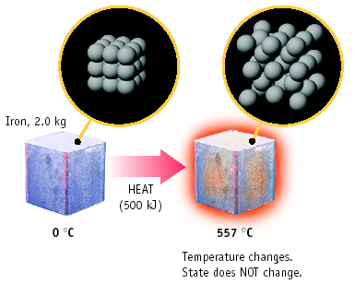
Calculate the amount of energy it takes to heat iron from 0°C to 557°C. (remains a solid the entire time)
LOOK in your ref. packet for C_{p} for iron
q = mc_{p}ΔT
q = (2000 g) (0.449 J/g°C) (557°C)
q = 500,000 J
= 5.0 x 10 ⁵J

Slide 12
Calculating heat for each segment of the heating curve for water.
Temp
100
A phase change occurs at a constant temperature. Use the heat of fusion since ice is melting. H_{f} (water) = 334 J/g
q₂ = m·H_{f}
0
LOOK in your ref. packet!
q₁ = mc_{p}ΔT
Time

Slide 13
Calculating heat for each segment of the heating curve for water.
Temp
100
q₃ = mc_{p}ΔT
The temperature of the water is increasing.
The specific heat for water is 4.18 J/g°C.
q₂ = m·H_{f}
0
LOOK in your ref. packet!
q₁ = mc_{p}ΔT
Time

Slide 14
Calculating heat for each segment of the heating curve for water.
Temp
q₄ = m·H_{v}
100
q₃ = mc_{p}ΔT
A phase change occurs at a constant temperature. Use the heat of vaporization. H_{v} (water) = 2260 J/g
q₂ = m·H_{f}
0
LOOK in your ref. packet!
q₁ = mc_{p}ΔT
Time

Slide 15
Calculating heat for each segment of the heating curve for water.
Temp
q₅ = mc_{p}ΔT
q₄ = m·H_{v}
100
q₃ = mc_{p}ΔT
The temperature of the steam is increasing.
The specific heat for steam is 2.02 J/g°C.
q₂ = m·H_{f}
0
LOOK in your ref. packet!
q₁ = mc_{p}ΔT
Time

Slide 16
Calculating heat for each segment of the heating curve for water.
Temp
q₅ = mc_{p}ΔT
q₄ = m·H_{v}
100
q₃ = mc_{p}ΔT
Use q = mc_{p}ΔT when the temperature is changing. Use q = m·H_{f} or q = m·H_{v} when there is a phase change.
q₂ = m·H_{f}
0
q₁ = mc_{p}ΔT
Time

Slide 17
Calculating heat for each segment of the heating curve for water.
Temp
q₅ = mc_{p}ΔT
q₄ = m·H_{v}
100
q₃ = mc_{p}ΔT
The total amount of heat absorbed is the sum of all five equations:
q_{tot}= q₁+q₂+q₃+q₄+q₅
q₂ = m·H_{f}
0
q₁ = mc_{p}ΔT
Time

Slide 19
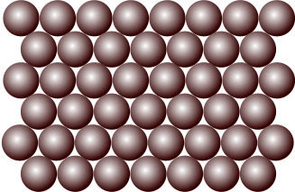
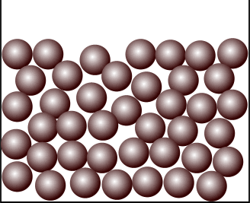
NOTICE! It takes more time (longer line) & energy for vaporization of water to occur than melting. WHY? Look at the pictures to the right. ☺
Temp
q₄ = m·H_{v}
100
H_{f} (water) = 334 J/g
H_{v} (water) = 2260 J/g
q₂ = m·H_{f}
0
Time

Slide 20
COOLING curve
Cooling curves are exothermic as they release/lose heat.
Temp
gas
condensation
100
liquid/gas
liquid
H_{v} may be used to determine amount of heat released during condensation
freezing
0
solid/liquid
solid
Time
H_{f} may be used to determine amount of heat released during freezing

Slide 21
What happens to Kinetic energy (KE) & potential energy (PE) at each stage of the curve?
COOLING curve
Temp
KE
During a phase, KE is decreasing (temp is decreasing).
PE
100
KE constant
KE
During a phase change, KE is constant and PE is decreasing.
PE
0
KE constant
KE
Time

Slide 22
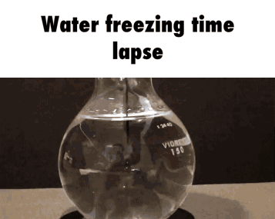
How much heat is released when 275 grams of water freezes?
q = m·H_{f}
q = (275 g)(334 J/g)
q = 91,850 J
q = 91.9 kJ

