Slide 1
Unit 4 Chapter 7 Lecture #3
Periodic Properties of the Elements

Slide 2
Photoelectron Spectroscopy (PES):
-determines energy needed to eject electrons; Utilizes the photoelectric effect
-Use UV or X-ray photon with energy larger than the binding energy (Ionization energy) of the atoms
-E of Photon (hv)-E absorbed by atom= E binding
-PES data reinforces the shell model of the atom

Slide 3
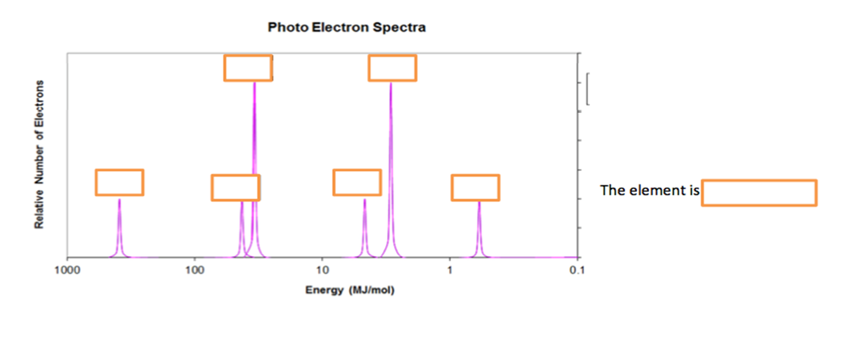

Slide 4
elements in a group/family have similar outer configuration
valence shell (highest occupied energy level i.e. “n” value”)
valence electrons: electrons in highest occupied energy level
Review how to count/determine valence electrons
Na, Ar, Al, S, I
The properties of the elements follow certain patterns, or TRENDS, due to the patterns in the electron configurations, which allow predictions of element properties.

Slide 5
noble gases: outer s and p sublevels are filled
representative elements: s and p sublevels are filling
transition metals: d sublevel is filling
inner transition metals: f sublevel is filling
metals vs. nonmetals
metal: valence shell mostly empty
non-metal: valence shell mostly full

Slide 6
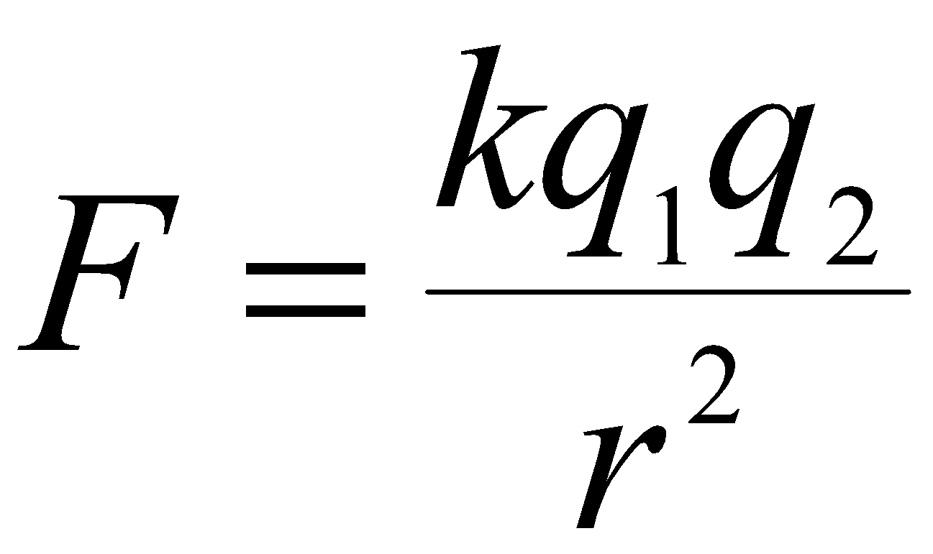
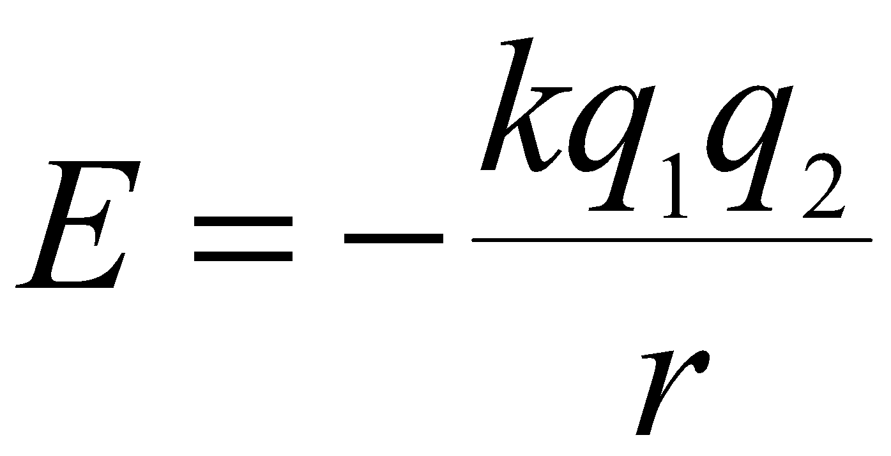
Coulomb’s Law and Nuclear Charge
F = electrostatic force E = energy
q = charge q = charge
r = distance from nucleus r = distance from nucleus
k = constant k = constant
larger charge = stronger force larger charge = bigger energy change
larger distance = weaker force larger distance = smaller energy change

Slide 7
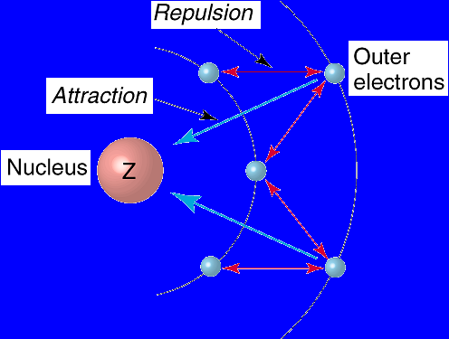
Inner electrons repel outer electrons, partially counteracting
attraction of protons in nucleus
electron–electron repulsion effect is called shielding
*Full energy levels provide shielding between the nucleus and valence electrons.

Slide 8
Effective Nuclear Charge ( Z_{eff} ): the net nuclear charge felt by an electron
Z_{eff} is lower than actual nuclear charge due to shielding.
Z_{eff} increases toward nucleus : ns > np > nd > nf

Slide 9
Increases across (left to right) within a period
-electrons feel greater force from nucleus
-more energy required to remove electron
-words to use: same energy level, more protons, similar shielding => greater (Coulombic or electrostatic) force of attraction
“Decreases” down (top to bottom) within a group
-electrons feel less force from nucleus
-less energy required to remove electron
-words to use: higher energy level, further from nucleus, more shielding => weaker (Coulombic or electrostatic) force of attraction

Slide 10
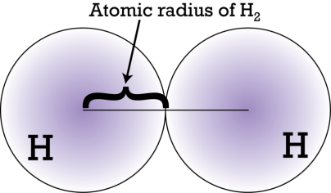
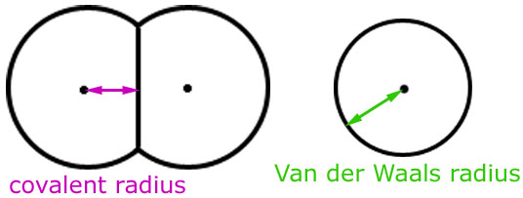
Atomic Radius: “size” of the atom (see diagrams)
across row (left to right) ➔ DECREASES
Rationale:
down group (top to bottom) ➔ INCREASES
Rationale:

Slide 11
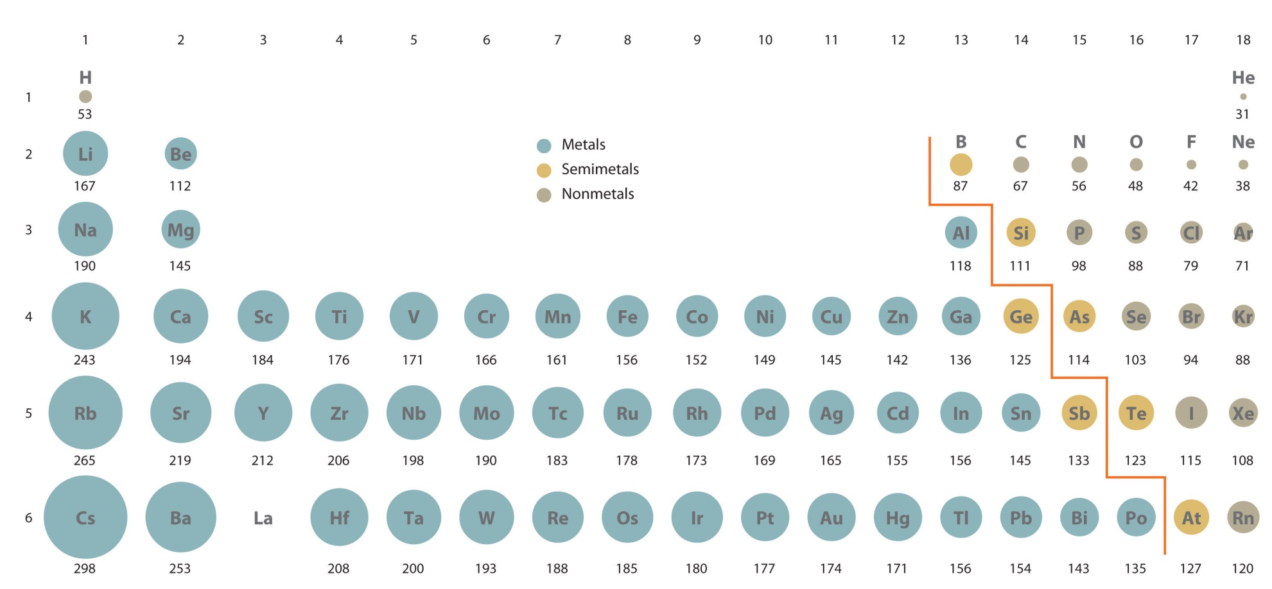

Slide 12
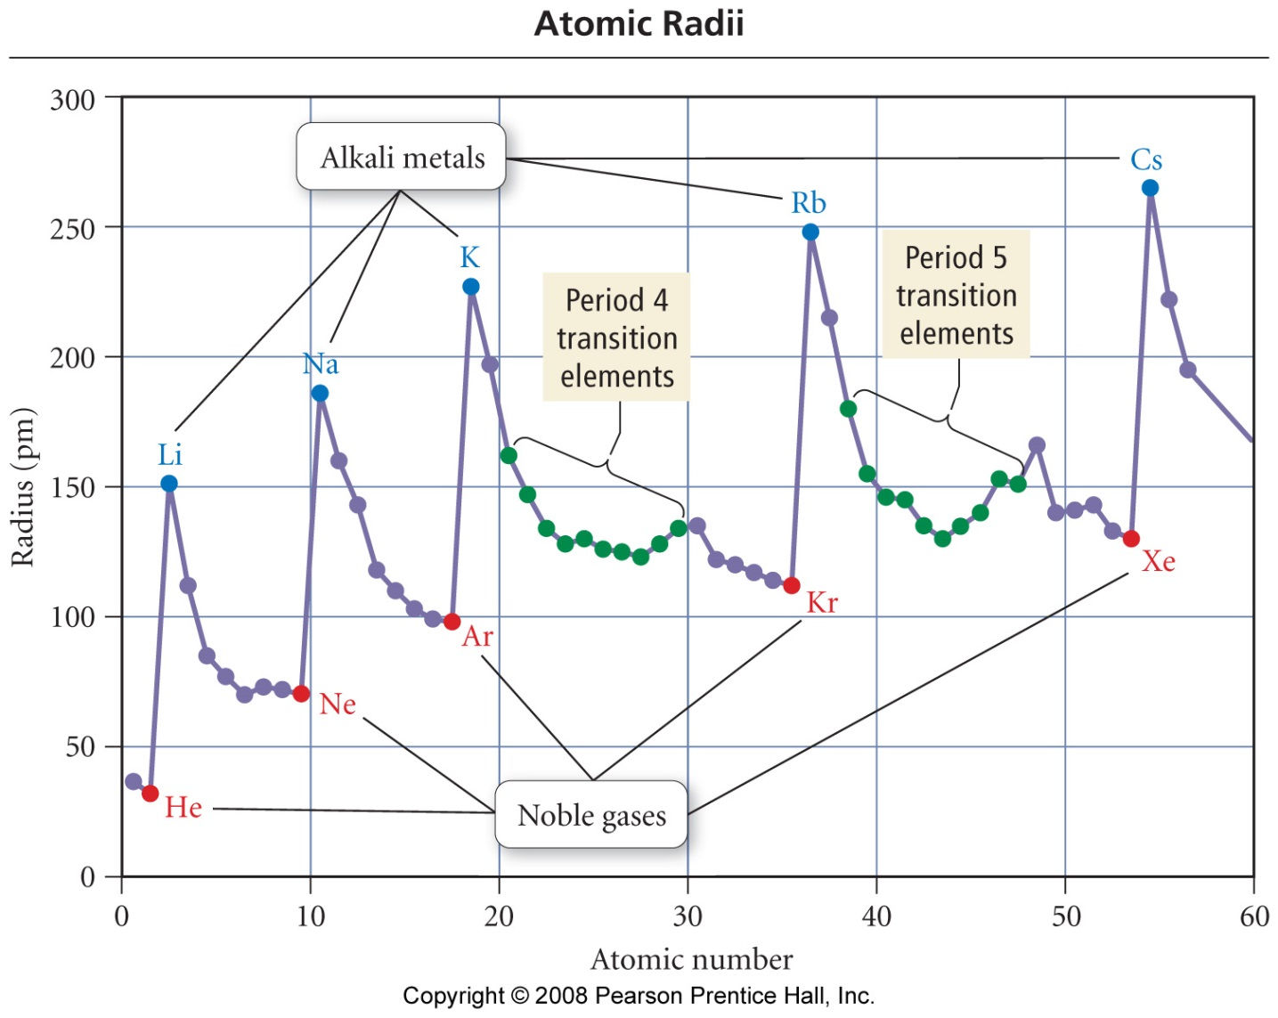

Slide 13
Ionization Energy (IE): energy needed to remove the outermost (least tightly bound) electron from an isolated neutral atom in the gaseous state.
Across row (left to right) ➔ INCREASES
Rationale: Zeff increases the attraction of the nucleus and therefore holds electrons more tightly.
Exceptions between Groups II-III: p electrons don’t penetrate nuclear region as well as s electrons (thus, not as tightly held)
Exceptions between V-VI: Increased repulsion created by the first pairing of electrons outweighs the increase in Zeff.
Down group (top to bottom) ➔ DECREASES
Rationale: Increased number of energy levels (n) increases the distance which the nucleus must pull and thus reduces the attraction for electrons.
Full energy levels provide some shielding between the nucleus and valence electrons.

Slide 14
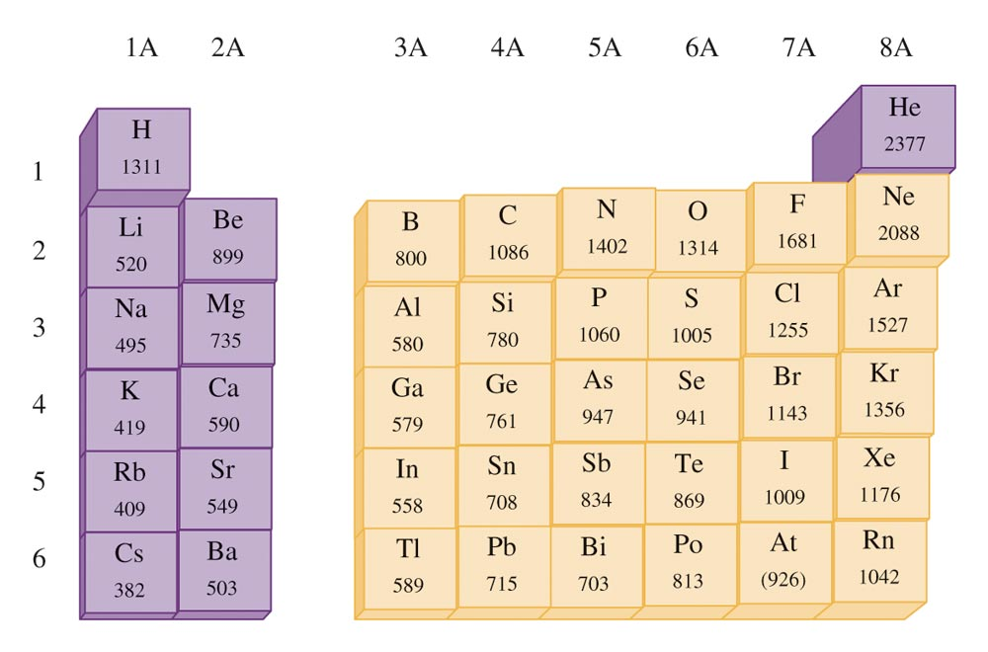

Slide 15
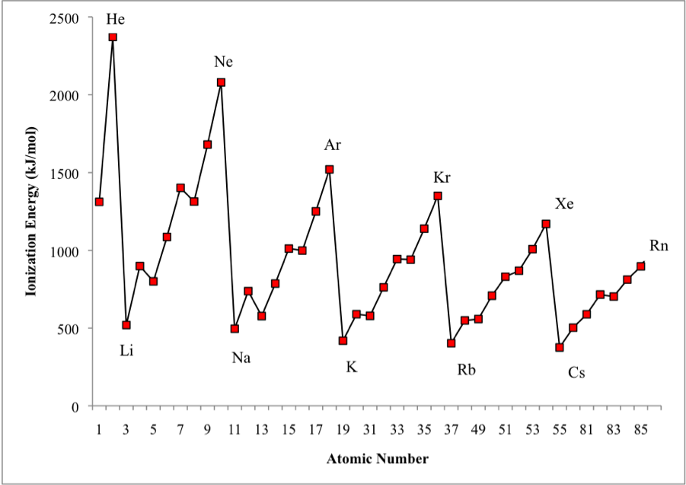
Explain the trend—can you also explain the little “reversals?”

Slide 16
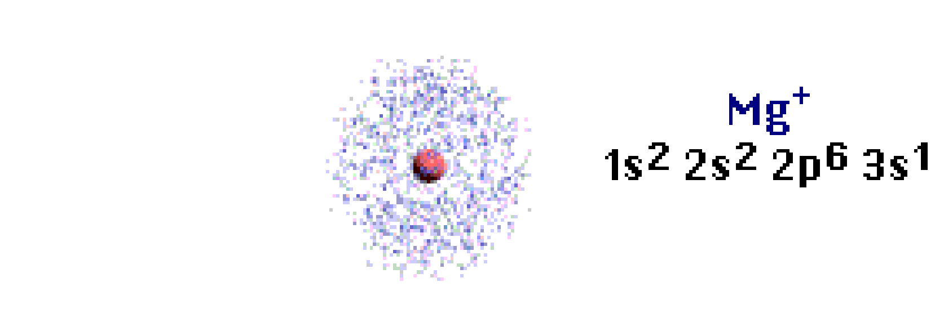

Slide 17
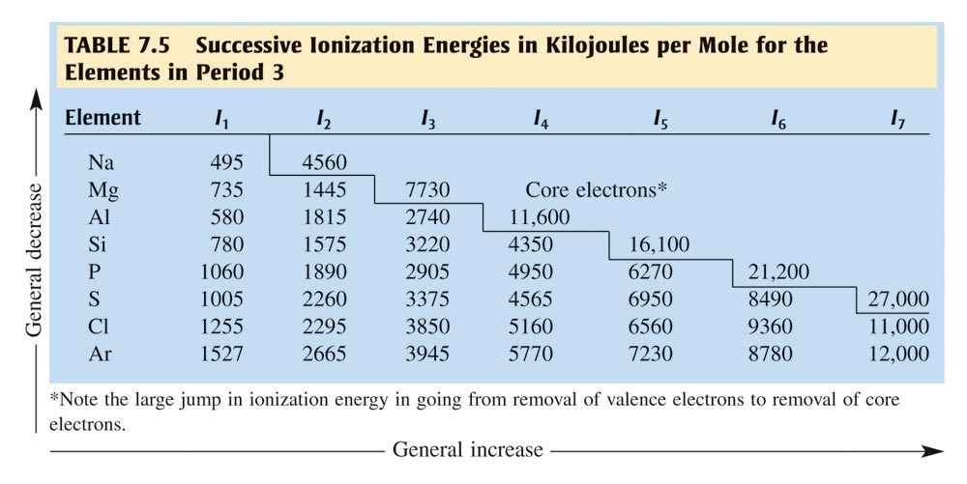
Explain the “big jumps” from Na⁺¹ ➔ Na⁺² or Al⁺³ ➔ Al⁺⁴

Slide 18
Cations
positive charge
electrons lost
radius decreases compared to neutral atom
Anions
negative charge
electrons gained
radius increases compared to neutral atom

Slide 19
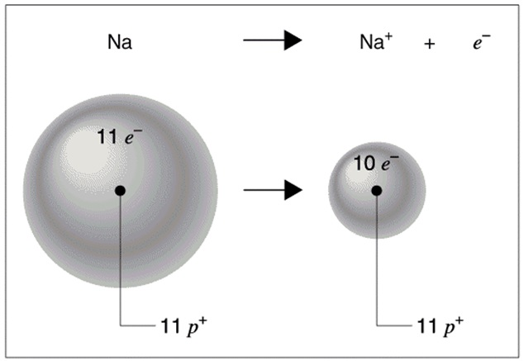
1s²2s²2p⁶3s¹ => 1s²2s²2p⁶

Slide 20
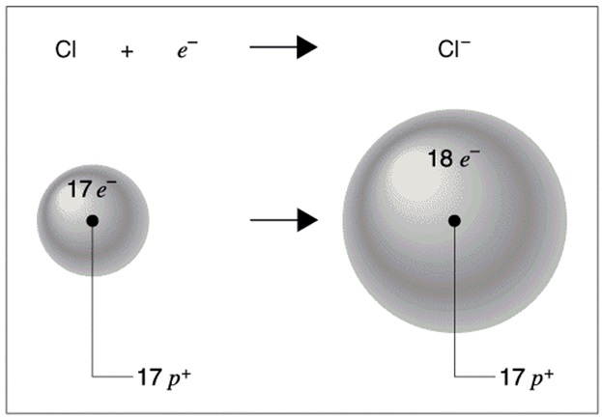
1s²2s²2p⁶3s²3p⁵ => 1s²2s²2p⁶3s²3p⁶

Slide 21
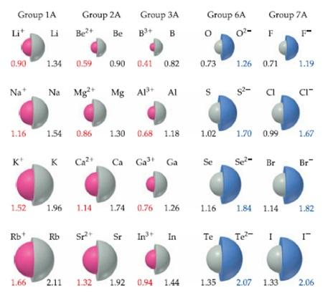

Slide 22
The cation of an atom decreases in size while the anion of an atom increases in size.
Ions of same charge in a family follow same trend as atomic radius (e.g. K⁺¹ > Li⁺¹)
For isoelectronic (same electron configuration), number of protons determines size
Ex: Rank the following from least to greatest size: Ne, Na⁺¹, F⁻¹, Mg⁺²

Slide 23
Electron Affinity: Energy change that occurs when an electron is added to an isolated atom in the gaseous state.
across row (left to right) ➔ INCREASES
Rationale:
down group (top to bottom) ➔ DECREASES
Rationale:
Cl
+ e⁻
Cl⁻
+ EA

Slide 24
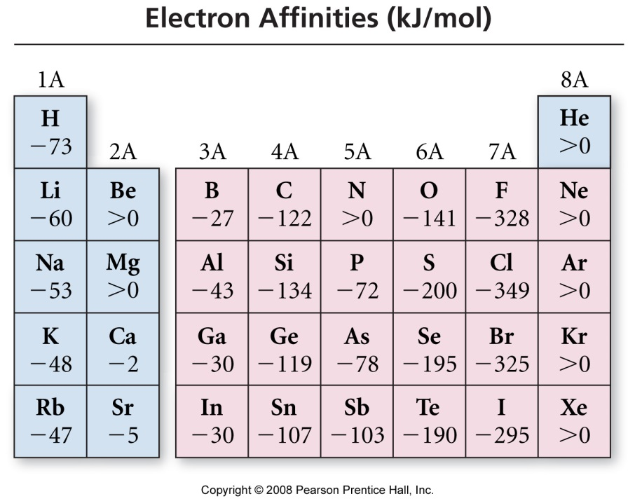
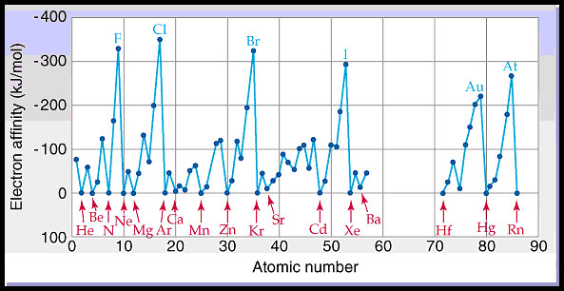
Main take away: nonmetals
have the highest tendency
to form negative ions

Slide 25
Electronegativity: power of an atom in a molecule to attract electrons to itself
across row (left to right): INCREASES
Rationale:
down group (top to bottom): DECREASES
Rationale:

Slide 26
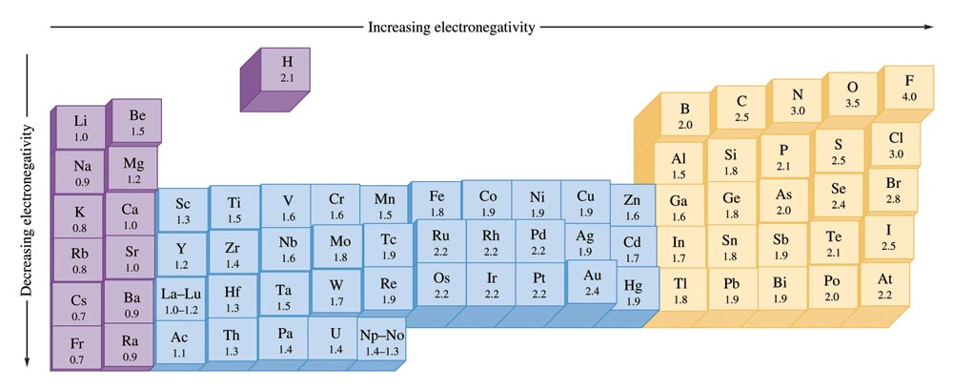
Why are the noble gases missing?

Slide 27
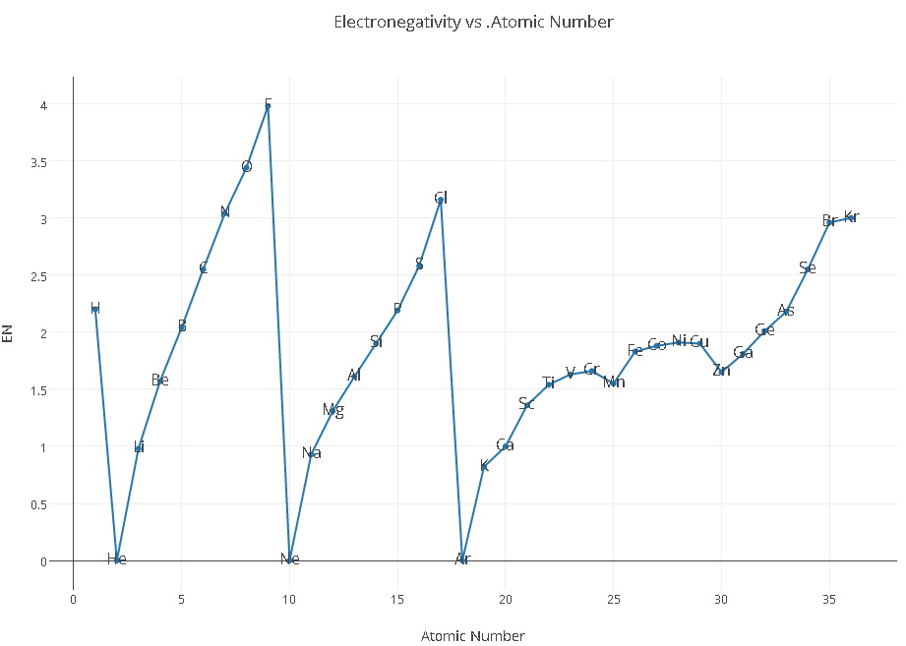

Slide 28
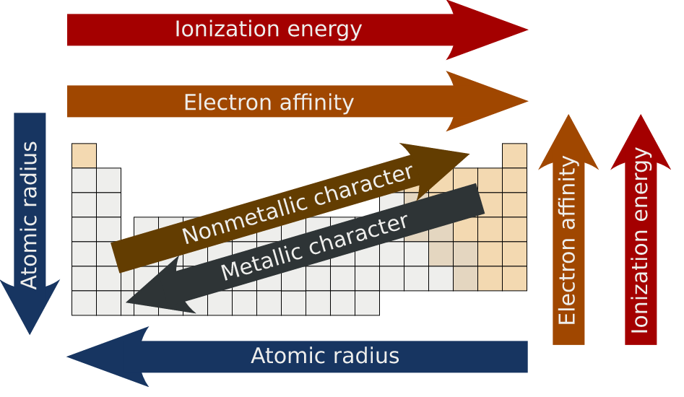

Slide 29
IMPORTANT TIPS FOR THE EXAM
Periodic Trends are typically addressed in the FRQ section. (“In terms of atomic structure, explain why the first ionization energy of selenium is less than that of bromine”)
Often not well answered because students state just the trend (IE increases as you move left)
This does not address the forces at work. A trend is an observation.
DO: Address the forces that create the trend, mention both species
*Always safe to use Coulomb’s Law shows that force of attraction between 2 oppositely charged particles is directly proportional to the magnitude of the charges and inversely proportional to the distance between those charges.
***Justifying all of the trends can be simplified with 2 generalizations:
Use Zeff to justify trends across a period (ex: Zeff increases the attraction of the nucleus and therefore pulls the electron cloud closer to the nucleus, resulting in smaller radius)
Use increased distance (greater value of n) to justify trends down a group.
FOR ALL PERIODICTY QUESTIONS:
Locate both elements on the table and state the principal energy level (n) and the sublevel containing the valence electrons for each element.
Do they have the same or different n values?
If the same n: argue with Zeff; if different n, argue with n vs. n distances.

