Slide 1
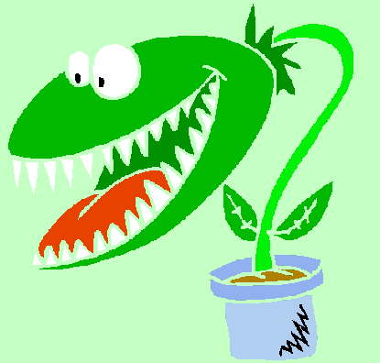
Photosynthesis
Where do all living things get their energy?
Directly or indirectly all organisms get their energy from the sun.
Plants get their energy to make food from the sun.
Notes:
‹#›

Slide 2
Autotrophs- organisms that can make their own food. Example: Plants
Heterotrophs- organisms that cannot make their own food. They obtain energy from food they consume. Examples: Animals; mushrooms get energy from decomposing other organisms
Notes:
‹#›

Slide 3
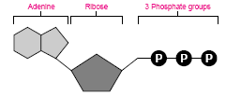
Forms of energy- light, heat, electricity, solar, chemical energy (stored in the bonds of the compound).
ATP (adenosine triphosphate)- The energy compound of living organisms.
Consist of a nitrogen compound called adenine, a 5-carbon sugar called ribose, and 3 phosphate groups.
Notes:
‹#›

Slide 4
How is energy released from ATP?
Energy is stored in the bonds of the phosphate groups→chemical bond breaks→Energy released
When the phosphate group is released , ATP becomes ADP (adenosine diphosphate).
ADP can gain a phosphate group and become ATP. It now is recharged with energy .
Energy released
Notes:
‹#›

Slide 5
Only a small amount of ATP in cells.
One glucose molecule has 90 times the stored energy than ATP.
Cells keep glucose molecules ready to recharge ADP to ATP.
Notes:
‹#›

Slide 6
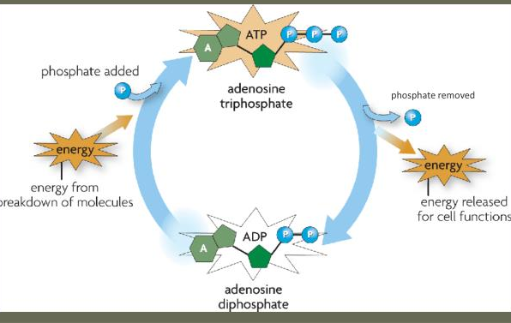
ATP 🡪 ADP Cycle

Slide 7
Overview

Slide 8
Where on the plant does photosynthesis take place?
The Chloroplast in the cells of the leaf is where the reaction of photosynthesis takes place.

Slide 9
Stoma is made of 2 cells called guard cells that that will open and close releasing Oxygen and taking in Carbon dioxide during photosynthesis.

Slide 11
The Chemical Equation of Photosynthesis.
Photosynthesis- the process of using energy of sunlight to convert water and carbon dioxide into oxygen and high energy sugars(Glucose).
Sunlight=The energy to make this reaction to occur
Glucose: sugar
Notes:
‹#›

Slide 12
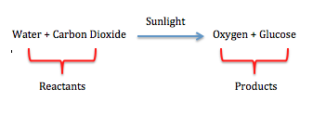
Chemical Equation of Photosynthesis.
Reactants = substances at the beginning of a chemical reaction.
Products = substances produced by a chemical reaction

Slide 13
How is light collected by the plant?
Chloroplast Model
Inside a chloroplast are stacks of membranes called Granum.
The membranes are called Thylakoids.
Contains chlorophyl which is a pigment that absorbs light.
Stroma- space outside the thylakoids
Notes:
‹#›

Slide 14
The Steps of Photosynthesis
Photosynthesis is divided into two stages:
Light dependent reactions – take place in thylakoid membranes
Light independent reactions (Calvin Cycle)- take place in the stroma.
Notes:
‹#›

Slide 15
What is NADP+ & NADPH?
NADP+ is a carrier molecule for energy.
When sunlight charges the thylakoid:
NADP+ picks up 2 electrons(e-) and a hydrogen ion(H+).
It then becomes NADPH.
NADPH carries the energy from light to areas in the chloroplast that need it.
+ + = NADPH
NADP+
e⁻
e⁻
H⁺
Notes:
‹#›

Slide 16
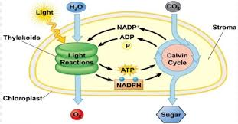
Light Reactions Reactants: sunlight and Water
Calvin Cycle Reactants: CO2, ATP, & NADPH
Light reactions products: O₂ , ATP, & NADPH
Calvin Cycle products: glucose, NADP+, & ADP
Notes:
‹#›

Slide 17
Light Dependent Reactions
Light and water enters the thylakoid.
Water is split to two H+ ions and Oxygen.
Two electrons are produced from chlorophyl absorbing light.
Oxygen is released into atmosphere.
H+ ions and the electrons are picked up by the NADP+ to make NADPH
NADPH is made from NADP+ and ATP is made from ADP.
NADPH and ATP are released into the stroma where the light -independent reactions take place.
Summary: The light reactions convert solar energy to chemical energy
Reactants: Sunlight, water Products: ATP, NADPH, Oxygen
Notes:
‹#›

Slide 18
Light Independent Reactions (Calvin Cycle)
Calvin Cycle occurs in the Stroma.
The Calvin cycle uses ATP and NADPH from the light dependent reactions and CO₂ to produce high-energy sugars (glucose).
The Calvin Cycle starts with six CO₂ molecules and cycles around rearranging the molecule to a 6 carbon sugar (glucose).
It uses the ATP & NADPH to rearrange CO_{2 .} Then ADP & NADP+ are left to go back to the thylakoid to start over.
Notes:
‹#›

Slide 19
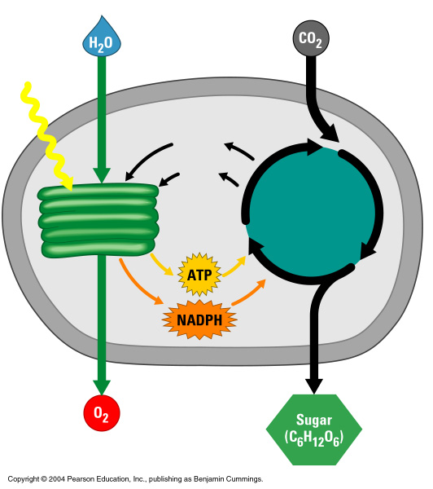
Summary: Light reactions convert solar energy to chemical energy:
Produce ATP & NADPH
Light
reactions
Calvin
cycle
The Calvin cycle makes sugar from carbon dioxide
ATP generated by the light reactions provides the energy for sugar synthesis
The NADPH produced by the light reactions provides the electrons for the reduction of carbon dioxide to glucose
Notes:
‹#›

Slide 20
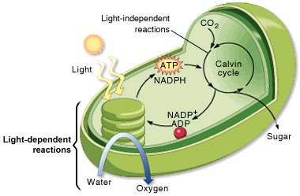
Notes:
‹#›

Slide 21
Factors Affecting Photosynthesis
The amount of water
Temperature (0˚C-35˚C)- the enzymes of photosynthesis work best between these temperatures.
Intensity of light- More intensity increases photosynthesis rate until it reaches too much then it will stop.
Notes:
‹#›

Slide 22
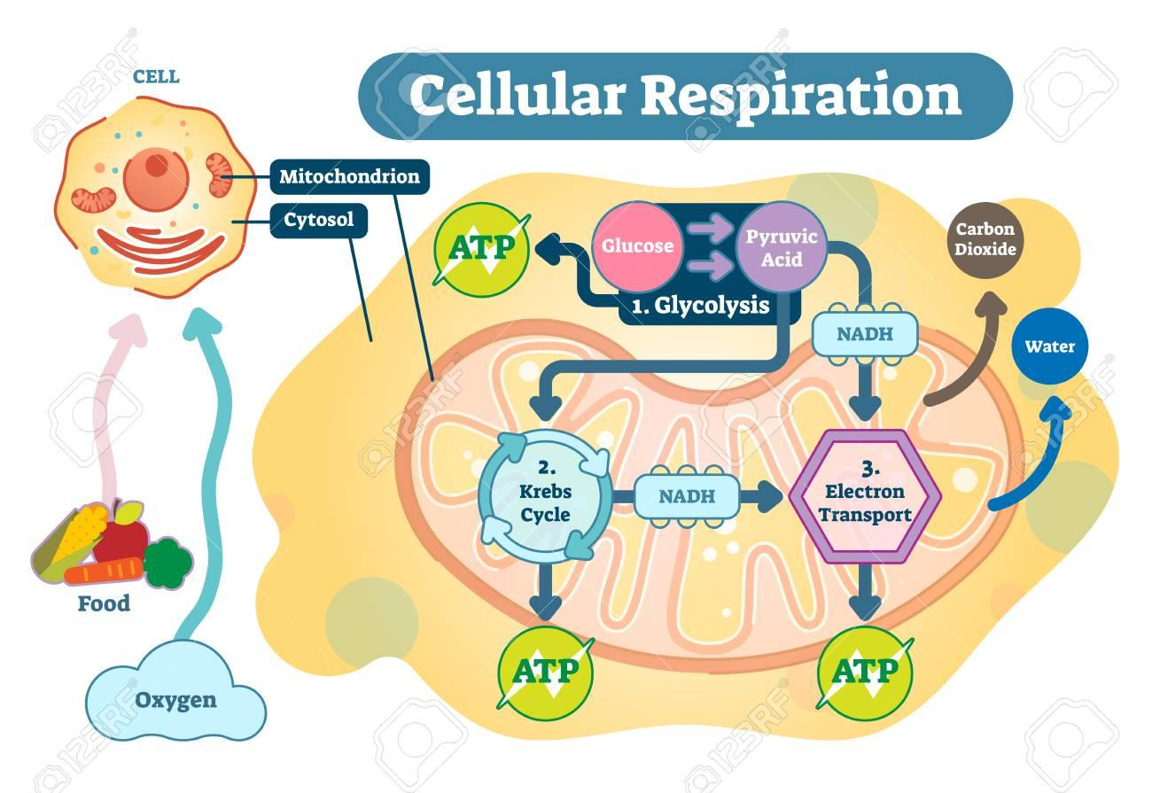
Cellular Respiration
Cells Making Energy

Slide 23
Cell chemical energy comes from food.
Food is where heterotrophs get their energy.
The food is broken down to glucose.
The mitochondrion converts glucose and oxygen to energy.
1g glucose with oxygen releases 3811 calories of heat energy.
Calorie- the amount of energy needed to raise the temperature of 1g of water 1 degree Celsius.
A kilocalorie (C)- 1000 calories. This is the calories that is on food labels.

Slide 24
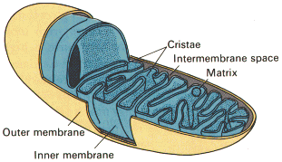
Chemical equation of Cellular Respiration
6O₂ + C₆H₁₂O₆ 6CO₂ + 6H₂O +Energy
Oxygen + Glucose 🡪 Carbon dioxide + water+ Energy
Cellular Respiration must have oxygen to produce energy.
Cells can produce a small amount of energy without oxygen.
Most of Cellular respiration takes place in the mitochondrion.
Anaerobic respiration-respiration with out oxygen
Aerobic respiration- respiration with oxygen

Slide 25
Cellular Respiration
Respiration starts outside the mitochondrion in the cytoplasm in a process called glycolysis.
After glycolysis, the path depends on whether oxygen is present or not.
No
Oxygen
Fermentation
Glycolysis
Electron Transport Chain
Oxygen
Present
Krebs Cycle

Slide 26
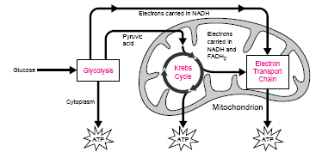
Cellular Respiration: An Overview

Slide 27
Glycolysis
Occurs in the cytoplasm of the cell.
Oxygen is not needed
Series of reactions which break the 6-carbon glucose molecule down into two 3-carbon molecules called pyruvate
Energy is needed to start, so 2 ATP are borrowed to start glycolysis.
4 ATP are made by glycolysis, but the net gain is only 2 ATP because the 2 borrowed must be given back.
Produces an energy carrying molecule called NAD+.
It picks up a pair of high energy electrons becoming NADH. (just like NADP+ becoming NADPH in photosynthesis)
Produces a net of 2 ATP, 2 NADH

Slide 28
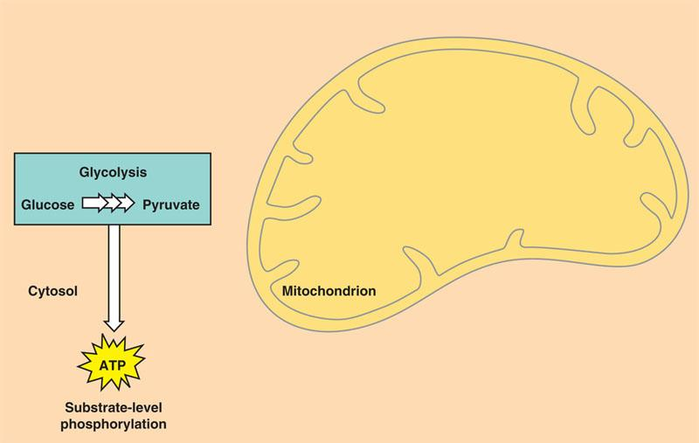
Glycolysis

Slide 29
Glycolysis
2 ATP 2 ADP
4 ADP 4ATP
C
C
C
C
C
C
C
C
C
C
C
C
C
C
C
Glucose
C
C
C
2 Pyruvic acid
2NAD+ 2NADH
These go to the electron transport chain
Net gain of ATP is 2

Slide 30
Anaerobic: No Oxygen present: Fermentation
Fermentation is Anaerobic.
2 ATP- made only
During fermentation, cells recycle the NADH made in glycolysis. This produces a bad waste which is alcohol or lactic acid.
Two kinds of Fermentation: Alcoholic Fermentation & Lactic acid fermentation
Alcoholic Fermentation:
Yeast and some microorganisms use alcoholic fermentation.
Pyruvic acid + NADH Alcohol + CO₂ + NAD⁺
Lactic Acid Fermentation:
Pyruvic acid + NADH lactic acid + NAD⁺
Produced in muscles during rapid exercise when the body cannot supply enough oxygen to the tissues. This causes muscle soreness

Slide 31
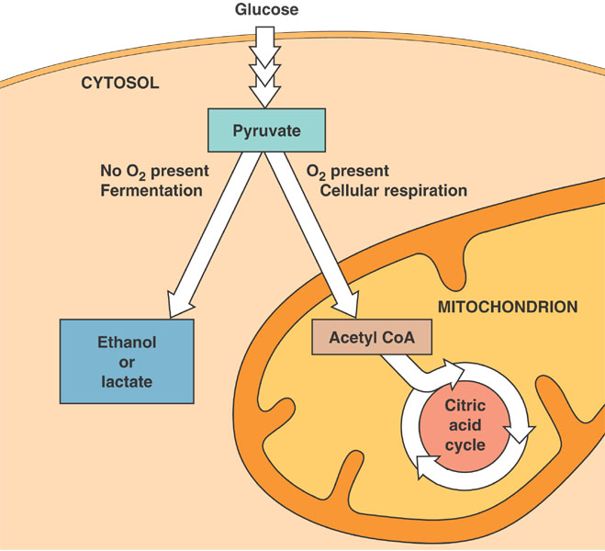
The pathway depends on if there is oxygen present

Slide 32
Aerobic Cellular Respiration
Occurs in the mitochondria.
Requires oxygen
2 reactions occur:
1. Kreb’s Cycle
2. Electron Transport Chain

Slide 33
Krebs Cycle
Pyruvic acid is broken down into CO₂ and energy.
Krebs cycle starts when pyruvic acid enters the mitochondrion.
Before the cycle starts, pyruvic acid is converted to a 6 carbon compound called citric acid.
It cycles around breaking down the molecule releasing carbon dioxide and energy.
Another Energy carrier molecule used FAD which picks up electrons and becomes FADH₂
From one molecule of pyruvic acid the products are 4NADH, 2 FADH_{2,} 2 ATP, 2NADH (from citric acid production)

Slide 34
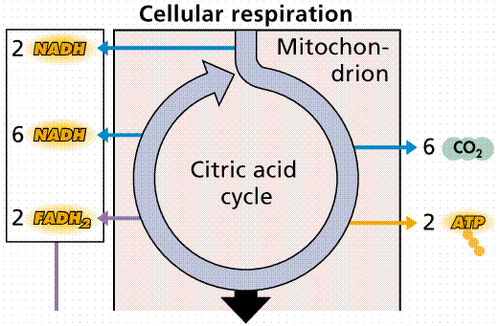

Slide 35
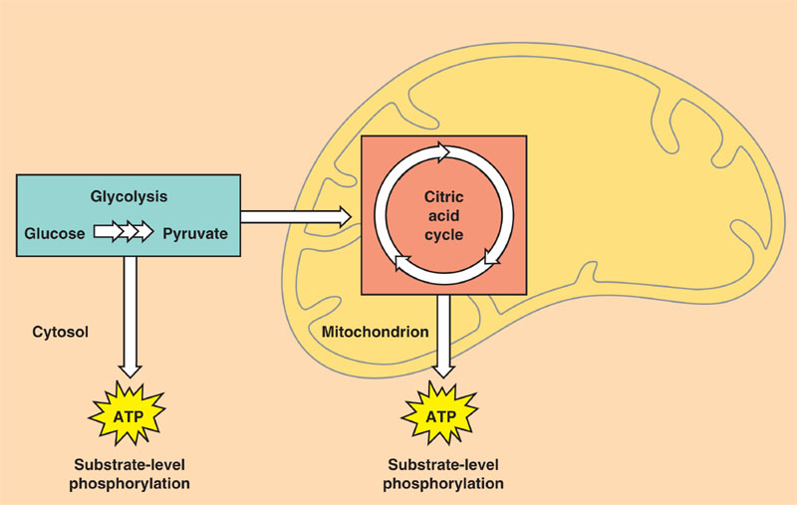
Krebs Cycle

Slide 36
Electron Transport Chain
This occurs in the membrane of the mitochondrion
All NADH and FADH₂ come to the ETC.
Electrons are passed from 1 electron carrier protein to another causing hydrogen ions to move into the mitochondrion.
This causes a build up of H+ ions inside the mitochondrion.
The Hydrogen ions diffuse through ATP synthase converting ADP to ATP

Slide 37
Electron Transport Chain (ETC)
Electron carriers loaded with electrons and protons from the Kreb’s cycle move to this chain-like a series of steps (staircase).
As electrons drop down stairs, energy released to form a total of 32 ATP
Oxygen waits at bottom of staircase, picks up electrons and protons and in doing so becomes water

Slide 38
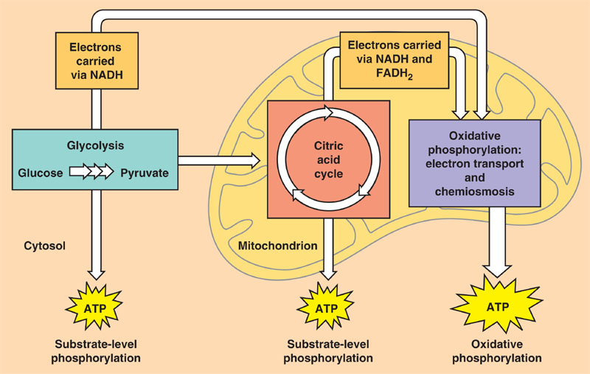
Electron Transport Chain
Electron Transport Chain

Slide 39
The ATP Totals
Glycolysis
2NADH = 4ATP
2ATP = 2ATP
Krebs Cycle
2NADH = 6 ATP
6NADH =18 ATP
2 FADH₂ = 4ATP
2ATP = 2ATP
ETC
36 ATP
Totals

Slide 40
Respiration recycles what is produced by photosynthesis

Slide 41
Comparing Photosynthesis to Respiration
Photosynthesis
Respiration
Produces energy storage molecule (glucose)
Occurs in chloroplast
Reactants = carbon dioxide & water
Products = glucose & oxygen
Equation:
6CO₂ + 6H₂O +Energy 6O₂ + C₆H₁₂O₆
Plant cells do this only
Uses glucose to produce energy release
Occurs in mitochondrion
Reactants= glucose & oxygen
Products= carbon dioxide and water
Equation:
6O₂ + C₆H₁₂O_{6 —>}6CO₂ + 6H₂O +Energy
Plant cells and animals cells do this

