Slide 1
Overview of Bonding
By: Francis W, Ashton W, Edward N, Max S, Janna A
Notes:
swag

Slide 2
Bonding
Atoms bond together to have lower potential energy.
Atoms love to have full valence shells, and bonding is an easy way to achieve this.
There are 3 types of bonding: covalent, ionic, and metallic.
Molecules have specific molecular and electron shape geometry.
Energy is released when bonds are formed and is absorbed when bonds are broken.
The more energy it takes to form a bond, the stronger the bond is.
Notes:
They should know why bonds form, that it takes energy to break and form bonds, and that bonds have different properties

Slide 3
Ionic vs Covalent Bonding
Ionic bonds are formed between oppositely charged ions of two or more different atoms. This would be between metals and nonmetals.
Covalent bonds are formed when electrons are shared between atoms. This bond forms between nonmetals.
Notes:
They should know the difference between ionic and covalent bonds and their basic properties

Slide 4
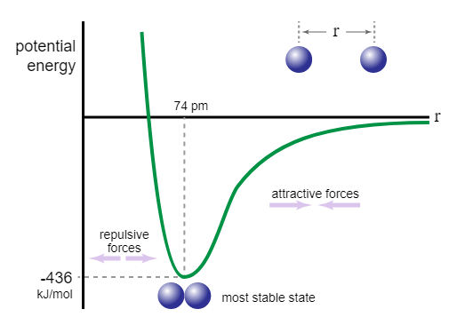
Bond Length and Energy
Bond length is the distance between two atoms when they are bonded.
Dissociation and association energy, or bond energy, is the energy required to break or form a bond.
The larger an atom's atomic radius is, the larger the bond length.
This is a potential energy curve. It shows potential energy vs bond length. When the curve and potential energy is at its lowest, the bond length is the most optimal. The line, r, is the potential energy required for the bond to break.
Notes:
They should know how to read the graph and to understand bond energy and length

Slide 5
Bond Energy Equation
E = kq₁q₂
r²
q is the ionic charge r is the bond length
k is a constant, but the value is not important right now
Bonds have more energy if the bond length is shorter and the ionic charges are greater.
Notes:
They should know what q and r are and the bottom bullet point

Slide 6
Polarity
Polarity is the distribution of electrical charge over the atoms joined in a bond.
A polar bond has an uneven distribution of electron density, this means that in a polar bond, one atom will be more negative or more positive than the others. Ionic bonds are always polar.
In a nonpolar bond, the atoms will have an even distribution of charge. Covalent bonds can be either polar or nonpolar.
Notes:
They should understand when molecules are polar or nonpolar and what it means to be polar/nonpolar

Slide 7
Electronegativity
Electronegativity is a chemical property that describes the ability to attract electrons in a bond toward the nucleus.
Electronegativity is illustrated on a scale, from 4 to 0.7.
Fluorine has the highest electronegativity, 4, and Francium has the lowest, 0.7.
Electronegativity increases in a period and decreases in a family due to atomic radii.
Notes:
They should know what electronegativity is and understand the periodic trend and why it happens

Slide 8
Question Examples
Draw the bond length graph for Se₂, relative to the graph of O₂.
O₂ Bond Length Graph
Notes:
They should know that if the atomic radii is larger, the internuclear distance should also be larger

Slide 9
Question Examples​
Which of these molecules is the most ionic? Which is the most covalent? Explain.
ClF, CaO, LiF, HF
Notes:
They should be able to tell the difference between ionic bonds and covalent bonds and how polar a bond is

