Slide 1
Unit 1: Cells Part II: Cellular Structure and Function
WHY ARE CELLS SO SPECIAL?
Cells provide structure and function for all living things, from microorganisms to humans. Scientists consider them the smallest form of life. Cells house the biological machinery that makes the proteins, chemicals, and signals responsible for everything that happens inside our bodies.

Slide 2
Cell Discovery and Theory
Cellular Structure and Function
The Cell Theory
All organisms are composed of one or more cells.
The cell is the basic unit of structure and organization of organisms.
All cells come from preexisting cells.
2
Notes:
2

Slide 3
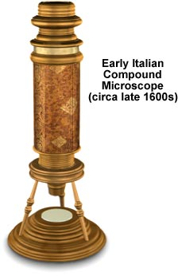
History
History of the Cell Theory: before the invention of the microscope, no one knew that cells existed.
The first “microscopes” were magnifying glasses.
3
Notes:
3

Slide 4
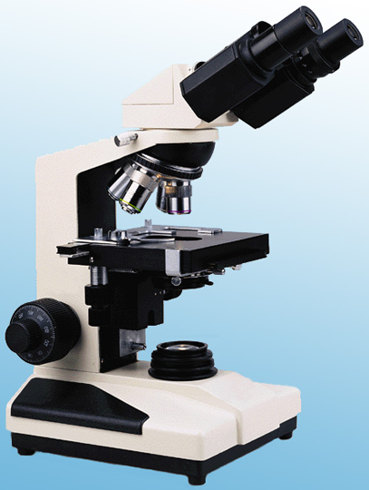
Chapter 7
Cellular Structure and Function
7.1 Cell Discovery and Theory
Light Microscope
Utilizes a series of glass lenses and visible light to magnify an image
Magnifies images up to 1,000 times the actual size
4
Notes:
4

Slide 5
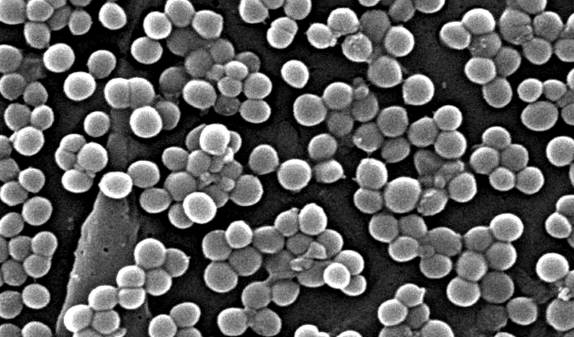
Chapter 7
Cellular Structure and Function
7.1 Cell Discovery and Theory
Electron Microscopes
Utilizes magnets to aim a beam of electrons at
a cell to produce
an image
Magnifies images up to 500,000 times the actual size
9560x
Microscopy Links http://biologygmh.com/
5
Notes:
5

Slide 6
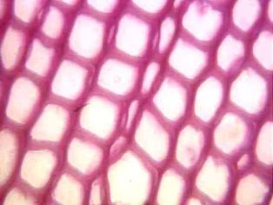
History
In 1674, Anton van Leeuwenhoek was the first to observe tiny living animals (animolecules) swimming in a drop of water using a primitive microscope.
In 1655 Robert Hooke observed thin slices of cork and noticed individual compartments that reminded him of monastery “cells” (small rooms that the monks stayed in). Hence the name cells.
6
Notes:
6

Slide 7
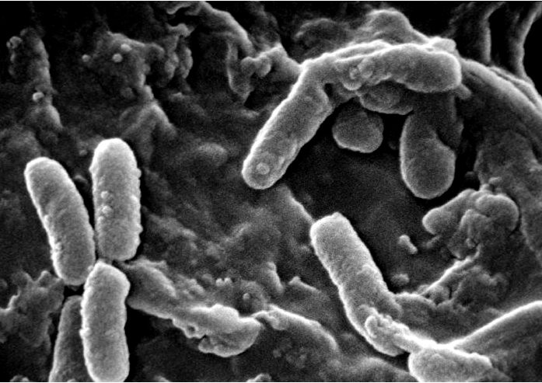
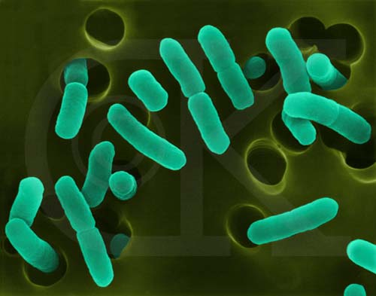
Chapter 7
Cellular Structure and Function
Cell Discovery and Theory
Prokaryotic Cell
Simple in structure
Has a plasma membrane
Does not have membrane-bound organelles
Example: bacteria
11,000x
7
Notes:
7

Slide 8
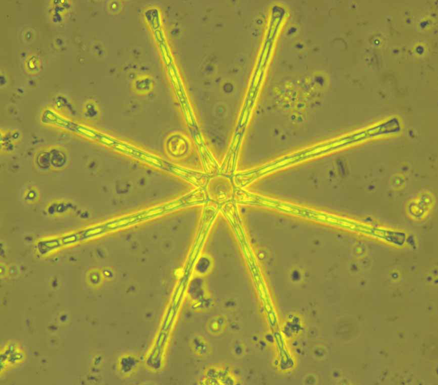
Chapter 7
Cellular Structure and Function
7.1 Cell Discovery and Theory
Eukaryotic Cell
More complex structure
Has a plasma membrane
*Has a nucleus and other membrane-bound organelles
Examples: plant, animal, protist and fungal cells.
400x
8
Notes:
8

Slide 9
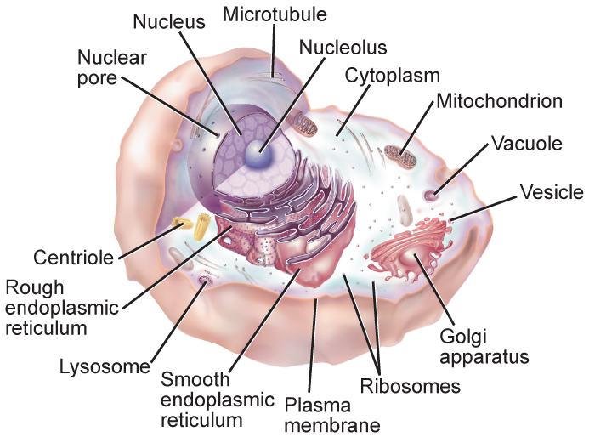
Chapter 7
Cellular Structure and Function
7.3 Structures and Organelles
9
Notes:
9

Slide 10
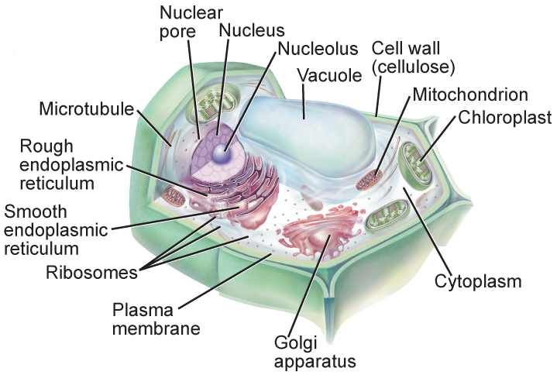
Chapter 7
Cellular Structure and Function
7.3 Structures and Organelles
10
Notes:
10

Slide 11
7.3 Structures and Organelles
Cell Wall: a.Location: outside the plasma (cell) membrane. b.Function: protects and supports the cell. c.Not found in all cells. Found in plant, bacteria, fungus and some protist cells.
11
Notes:
11

Slide 12
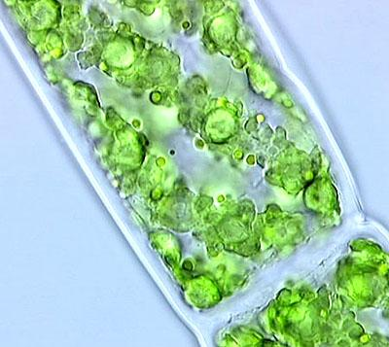
Cell Wall, cont.
12
Notes:
12

Slide 13
2. Plasma (Cell) Membrane
a. Location: surrounds the cell
Function: serves as a boundary that controls what enters and leaves the cell. This maintains homeostasis within the cell. (Support, Protect, Control)
-8 nm thick (8000 membranes to equal a sheet of paper)
c. Found in all cells
13
Notes:
13

Slide 14
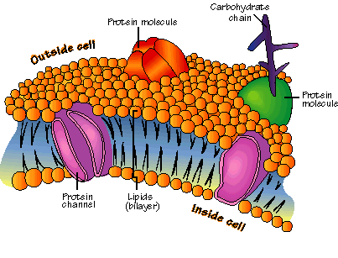
2. Plasma (Cell) Membrane, cont.
14
Notes:
14

Slide 15
3. Nucleus
a. Location: in the cytoplasm
b. Function: controls most cell functions and contains the hereditary material (DNA) and the nucleolus (produces ribosomes)
15
Notes:
15

Slide 16
3. Nucleus
c. Surrounded by the nuclear envelope, a two-layered, porous membrane which controls what enters and leaves the nucleus.
d. Found in all eukaryotic cells.
16
Notes:
16

Slide 17
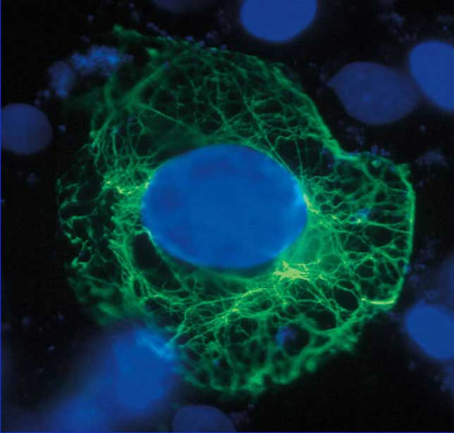
3. Nucleus, cont.
Nucleus of an Epithelial Cell
17
Notes:
17

Slide 18
4. Cytoskeleton
A. Location: in the cytoplasm.
B. Function: helps the cell maintain its shape, involved in cell movement, holds cell parts in place
18
Notes:
18

Slide 19
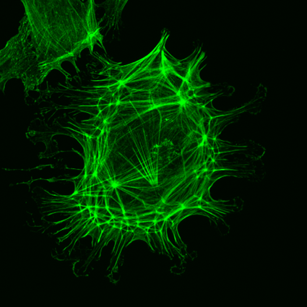
4. Cytoskeleton
c. Composed of: Microtubules: hollow tubes involved in cell division, form cilia and flagella which help a cell move. Microfilaments: long thin fibers
d. Found in all cells.
19
Notes:
19

Slide 20
5. Ribosomes
a. Location: floating free in the cytoplasm or bound to the endoplasmic reticulum.
b. Function: to assemble amino acids into proteins. Free ribosomes produce proteins for use within the cell, bound ribosomes produce proteins to be exported from the cell.
20
Notes:
20

Slide 21
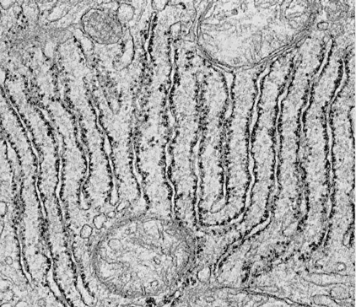
5. Ribosomes, cont.
C. Found in all cells.
21
Notes:
21

Slide 22
6. Endoplasmic Reticulum
a. Types: Rough ER: has ribosomes on it Smooth ER: has no ribosomes on it
b. Function: modify proteins and synthesize (put together) lipids. Also synthesizes cell membrane.
c. Found in all eukaryotic cells.
22
Notes:
22

Slide 23
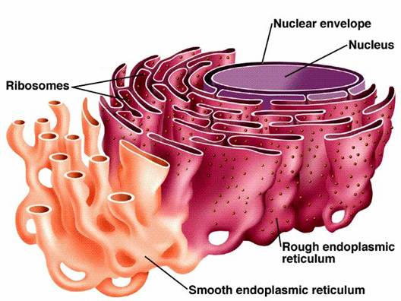
6. Endoplasmic Reticulum, cont
23
Notes:
23

Slide 24
7. Golgi Apparatus
a. A stack of flattened membranes located toward the outer regions of the cell.
b. Function: final preparation of proteins before they are exported from the cell (like the Post Office). Enzymes attach carbohydrates and lipids to the protein.
24
Notes:
24

Slide 25
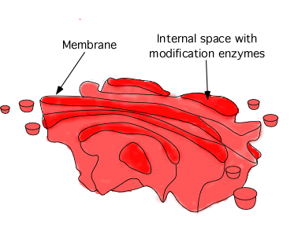
7. Golgi Apparatus, cont.
25
Notes:
25

Slide 26
8. Lysosomes
a. Small cell structures filled with hydrolytic enzymes (these enzymes only work at the pH found in the lysosome. If one accidentally breaks, the pH of the cytoplasm is out of range and it will not work.
26
Notes:
26

Slide 27
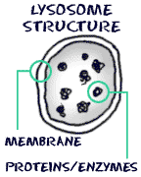
8. Lysosomes
b. Function: break down macromolecules and old cell parts.
c. Also known as “suicide packs” because they can be triggered to release all at once and destroy an old, worn-out or sick cell. (Apoptosis)
27
Notes:
27

Slide 28
9. Vacuoles
a. Sac-like structures used for storage of water, salts, proteins and carbohydrates.
b. Plant cells have a large central vacuole that is used for support and growth of the plant.
28
Notes:
28

Slide 29
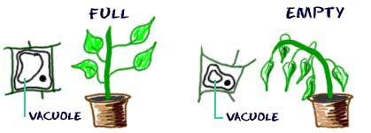
9. Vacuoles, cont.
29
Notes:
29

Slide 30
10. Mitochondria
a. Bean shaped, double membraned organelle. The inner membrane is folded and is called the cristae. The folds increase the surface area for reactions to take place on.
30
Notes:
30

Slide 31
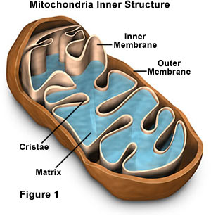
10. Mitochondria
b. Function: convert food energy into ATP by the process of cellular respiration. ATP is used to power cell processes
31
Notes:
31

Slide 32
11. Chloroplasts
a. Double-membrane bound organelle that contains chlorophyll.
b. Function: convert light energy from the sun into glucose during the process of photosynthesis.
c. Found in plant cells and some protists.
32
Notes:
32

Slide 33
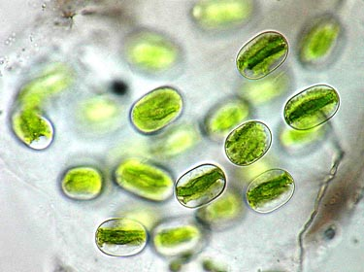
11. Chloroplasts, cont
33
Notes:
33

Slide 34
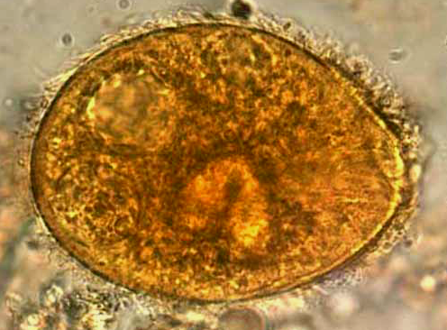
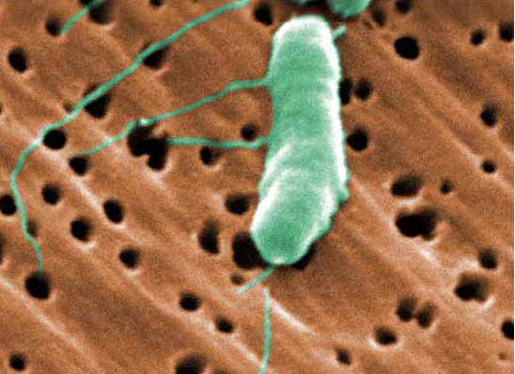
Chapter 7
Cellular Structure and Function
7.3 Structures and Organelles
12. Cilia
Short, numerous projections that look like hairs
13. Flagella
400x
Longer and less numerous than cilia
Create movement with a whiplike motion
26,367x
Summary of Cell Structures
Part 1Part 1 Part 2Part 1 Part 2 Part 3
34
Notes:
34

Slide 35
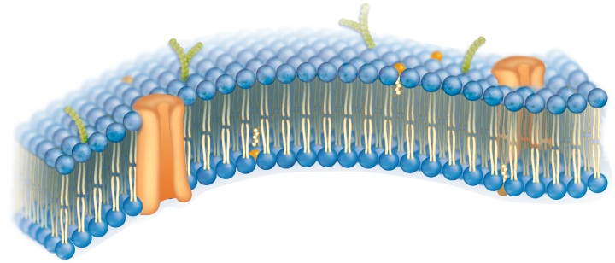
Chapter 7
Cellular Structure and Function
7.2 The Plasma Membrane
Plasma Membrane
Thin, flexible boundary between the cell and its environment
Allows nutrients into and wastes out of the cell
Also known as the cell membrane
35
Notes:
35

Slide 36
Plasma Membrane
Function: regulates what enters and leaves the cell and provides protection and support
Structure: the cell membrane is primarily a phospholipid bilayer. Called that because it is composed of two layers of phospholipids.
36
Notes:
36

Slide 37
Phospholipids
a “regular” lipid is composed of a glycerol and three fatty acid tails.
In a phospholipid one of the fatty acids is replaced with a phosphate group.
37
Notes:
37

Slide 38
Phospholipids, cont.
The result is a polar (hydrophilic) phosphate head and two nonpolar (hydrophobic) tails.
This arrangement causes the tails to turn inward to avoid the water-based cytoplasm and fluid surrounding the cell and the heads to turn outward toward the water.
38
Notes:
38

Slide 39
Not just phospholipids…
In addition, the membrane has protein molecules dispersed throughout the membrane. The function of these proteins is to serve as channels and pumps which help move substances across the membrane that cannot pass directly across it.
39
Notes:
39

Slide 40
Not just phospholipids….
Other proteins have chains of carbohydrates attached to them (glycoproteins) which function in cell to cell recognition.
Cholesterol molecules help keep the membrane “fluid” or flexible. Also prevents freezing.
40
Notes:
40

Slide 41
41
Notes:
41

Slide 42
Chapter 7
Cellular Structure and Function
7.4 Cellular Transport (Passive & Active)
Passive Transport
Movement of particles across the cell membrane without using energy
Three Modes of Passive Transport
Diffusion
Facilitated Diffusion
Osmosis
42
Notes:
42

Slide 43
Diffusion
the movement of substances from an area of high concentration to an area of low concentration. (“Down the concentration gradient”)
this process does not require the cell to use energy, therefore it is called a passive process.
43
Notes:
43

Slide 44
Diffusion, cont.
Substances will continue to diffuse down the gradient until equilibrium is reached. At that point they will continue to move back and forth in a process called dynamic equilibrium.
44
Notes:
44

Slide 45
Diffusion, cont.
Not all substances can diffuse across the membrane because the membrane is selectively permeable which means that some substances can pass and others cannot.
45
Notes:
45

Slide 46
Diffusion, cont.
Substances that CAN diffuse across the membrane are:
*Small & Polar
*Nonpolar, any size
*Noncharged elements
Substances that CANNOT diffuse across the membrane are:
*Large & Polar
*Ions
46
Notes:
46

Slide 47
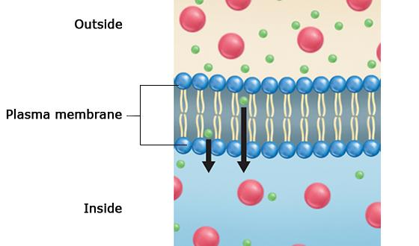
Chapter 7
Cellular Structure and Function
7.4 Cellular Transport
Diffusion in a Cell
47
Notes:
47

Slide 48
Osmosis
the diffusion of water through special openings in the membrane called aquaporins.
water moves from an area of higher water concentration (potential) to an area of lower water concentration (potential).
48
Notes:
48

Slide 49
Fig 7-17 Osmosis
Water molecules
Higher Concentration
of Water
Cell
membrane
Lower Concentration
of Water
Sugar molecules
49
Notes:
49

Slide 50
Osmosis, cont.
The higher the overall SOLUTE concentration the lower the water concentration.
3 osmotic states:
isotonic: when water/solute concentration is equal on both sides of the membrane.
Animal cell: preferred state
Plant cell: causes wilting
50
Notes:
50

Slide 51
Osmosis, cont.
when the water concentration is higher on the OUTSIDE of the membrane than on the inside, causing water to move INTO the cell. (HIPPO)
Animal cell: causes the cell to burst (lyse)
Plant cell: preferred state, makes things crisp (turgid)
51
Notes:
51

Slide 52
Osmosis, cont.
hypertonic: when the water concentration is higher on the INSIDE of the cell than the outside, causing water to move OUT OF the cell.
Animal cell: causes the cell to shrivel (creanate)
Plant cell: causes the cell to die (plasmolyze)
Example: salt on a slug
52
Notes:
52

Slide 53
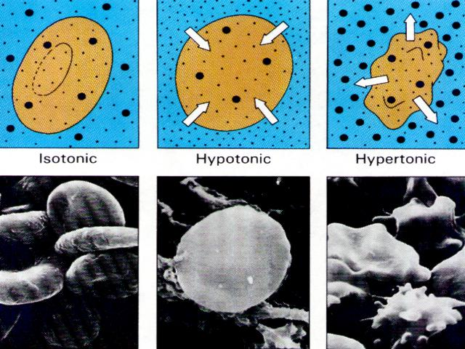
3 Osmotic States of a Cell
53
Notes:
53

Slide 54
Chapter 7
Cellular Structure and Function
7.4 Cellular Transport
Facilitated Diffusion
Movement of materials across the plasma membrane using proteins
54
Notes:
54

Slide 55
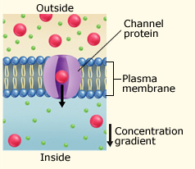
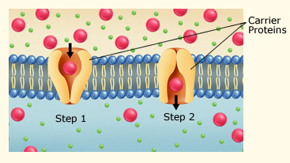
Chapter 7
Cellular Structure and Function
7.4 Cellular Transport
Channel Proteins
Carrier Proteins
Diffusion, Channel Proteins, and Carrier Proteins
55
Notes:
55

Slide 56
Facilitated Diffusion
some molecules cannot diffuse directly across the membrane yet they still are able to enter, how do they do this?
these molecules move across transport proteins called channel proteins
56
Notes:
56

Slide 57
Facilitated Diffusion, cont.
This process is referred to as facilitated diffusion because channel proteins facilitate or help molecules move across the membrane yet movement is still down the concentration gradient so no energy is required.
Ex. glucose (other sugars), salts, ions
57
Notes:
57

Slide 58
Chapter 7
Cellular Structure and Function
7.4 Cellular Transport
Active Transport
Movement of particles across the cell membrane using energy
Active Transport Using Carrier Proteins
58
Notes:
58

Slide 59
Active Transport
movement of substances from an area of low concentration to an area of high concentration (against the concentration gradient). This process requires the cell to use energy.
usually involves transport proteins that either act as channels or change shape.
59
Notes:
59

Slide 60
Active Transport, cont.
*another type of active transport called bulk transport involves taking in materials (endocytosis) by means of infoldings or pockets of the cell membrane.
60
Notes:
60

Slide 61
Active Transport, cont.
phagocytosis is a form of endocytosis in which solids are engulfed, pinocytosis is a form of endocytosis in which liquids are engulfed.
61
Notes:
61

Slide 62
Active Transport, cont.
exocytosis is a type of bulk transport in which a vacuole (or vesicle) fuses with the membrane causing the expulsion of materials from the cell.
62
Notes:
62

Slide 63
Chapter 7
Cellular Structure and Function
7.4 Cellular Transport
Types of Active Transport Pumps
Na⁺/K⁺ ATPase pump
Moves three Na⁺ ions out of the cell and two K⁺ ions into the cell
Sodium-Potassium Pump
63
Notes:
63

Slide 64
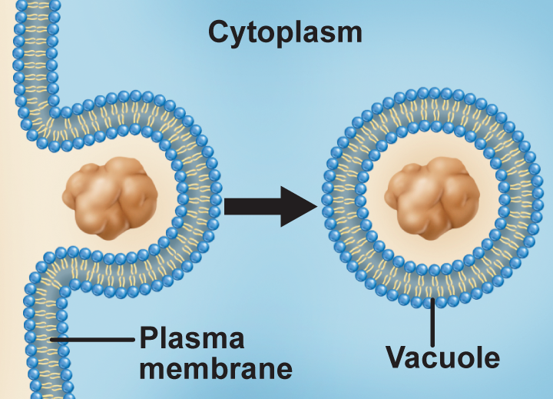
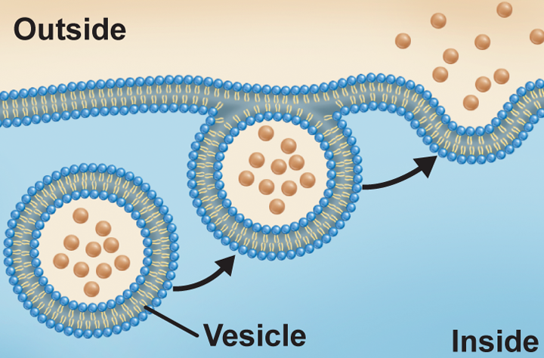
Chapter 7
Cellular Structure and Function
7.4 Cellular Transport
Endocytosis
Process by which the cell surrounds and takes particles into the cell
Exocytosis
Secretion of material out of the plasma membrane
64
Notes:
64

