Slide 1
Unit 2
Chapter 4: Arrangements of Electrons in Atoms

Slide 2
The Dual Nature of Light

Slide 3
Light
The study of light led to the development of the quantum mechanical model.
Light is a kind of electromagnetic radiation.
Electromagnetic radiation includes many kinds of waves
All move at 2.998 x 10⁸ m/s (symbol = c)
c = 2.998 x 10⁸ m/s

Slide 4
Parts of a wave
Crest
(peak)
Wavelength
Amplitude
Trough

Slide 5
Parts of Wave
Crest - high point on a wave
Trough - Low point on a wave
Amplitude - distance from origin to crest
Wavelength - distance from crest to crest
Wavelength - is abbreviated λ Greek letter lambda.

Slide 6
Low energy
High energy
Radiowaves
Micro-waves
Infrared
UV (Ultra-violet)
X-Rays
Gamma Rays
*Low Frequency
*High Frequency
*Long Wavelength
*Short Wavelength
Visible Light
R O Y G B I V

Slide 7
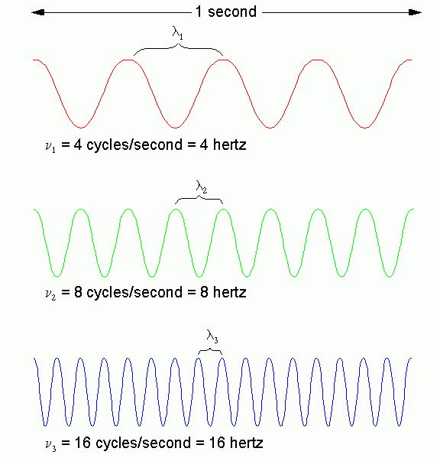
Long
Wavelength
=
Low Frequency
=
Low ENERGY
Wavelength Table
Short
Wavelength
=
High Frequency
=
High ENERGY

Slide 8
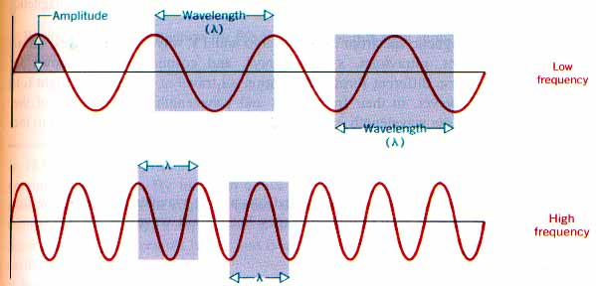
Electromagnetic radiation propagates through space as a wave moving at the speed of light.
c = λν
C = speed of light, a constant (2.998 x 10⁸m/s)
λ = (lambda) wavelength, in meters
= (nu) frequency, in units of hertz (Hz)
Hz is cycles/s

Slide 9
Energy versus Frequency
waves
Frequency is the number of _____________ to pass a point every _________________
Units for frequency are _____________ (Hz)
Energy is ___________________ to frequency:
As frequency goes up: energy goes _____________
As frequency goes down: energy goes____________
second
Hertz
proportional
up
down

Slide 10
Is light a wave?
Wave – light has a measurable _______________ and _______________, just like all other waves
- Light waves can have _________________
- Light is ____________ when it hits a mirror, or __________________ when it hits a lens
frequency
wavelength
energy
reflected
Refracted (bent)

Slide 11
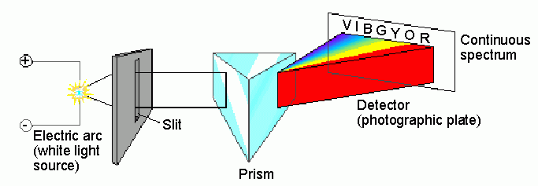
Spectroscopic analysis of the visible spectrum…
…produces all of the colors in a continuous spectrum

Slide 12
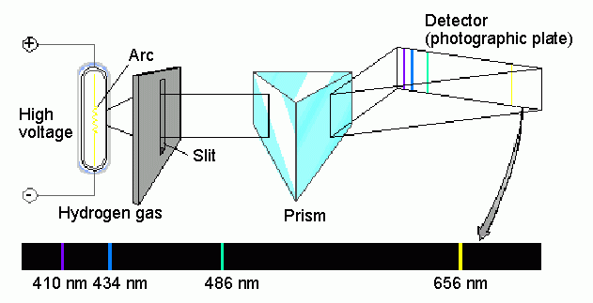
Spectroscopic analysis of the hydrogen spectrum…
…produces a “bright line” spectrum

Slide 13
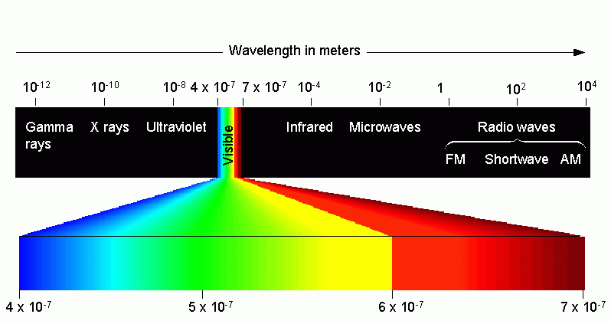
Types of electromagnetic radiation:

Slide 14
Speed of Light
2.998 x 10⁸
6.70 x 10⁸
All light travels at _______m/s or _________mph
Speed varies depending on the ______________
Light travels fastest in a ____________, which contains ________________
Question: What can travel faster than the speed of light? _________________
Another word for “brightness” is _____________, it measures the number of ____________ that pass a given area
medium
vacuum
No particles
NOTHING!!!
intensity
photons

Slide 15
Electromagnetic Spectrum (EMS)
Light is also called electromagnetic radiation (EMR)
Visible light is only a small part of the EM spectrum
The EM Spectrum (EMS) contains radiation of all possible ___________ and ______________
frequencies
wavelengths

Slide 16
High Frequency EMR
Gamma Rays – highest frequency EMR
- they can cause __________.
X-Rays – second highest frequency EMR
Ultraviolet (UV) Light – falls just
above visible light
shorter ____________, but
higher ____________)
this type of light causes
____________. Skin Protection
Factor (_______) tells you
how much UV light
will get blocked!
cancer
wavelength
frequency
sunburn
SPF

Slide 17
Low Frequency EMR
Infrared Radiation – has slightly less energy than visible light. Special devices can be used to detect this form of radiation.
Microwaves – used to cook food. Waves cause food molecules to ______________, moving molecules = _____________ energy
Radio Waves - _______________ wavelengths and smallest ______________ = very low __________
_____________ can be used to track airplanes. It bounces waves off the planes and measures the _____________ it takes for them to come back.
vibrate
kinetic
longest
frequency
energy
RADAR
time

Slide 18
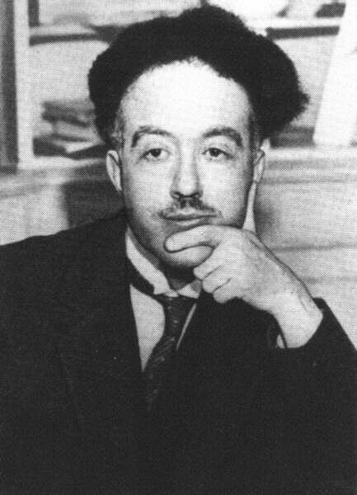
The Wave-like Electron
The electron propagates through space as an energy wave. To understand the atom, one must understand the behavior of electromagnetic waves.
Light is a particle (arrives in “chunks”
Light is a wave (we can measure its wavelength and it behaves like a wave)
Louis deBroglie

Slide 19
Atomic Spectrum
How color tells us about atoms

Slide 20
Prism
White light is made up of all the colors of the visible spectrum.
Passing it through a prism separates it.

Slide 21
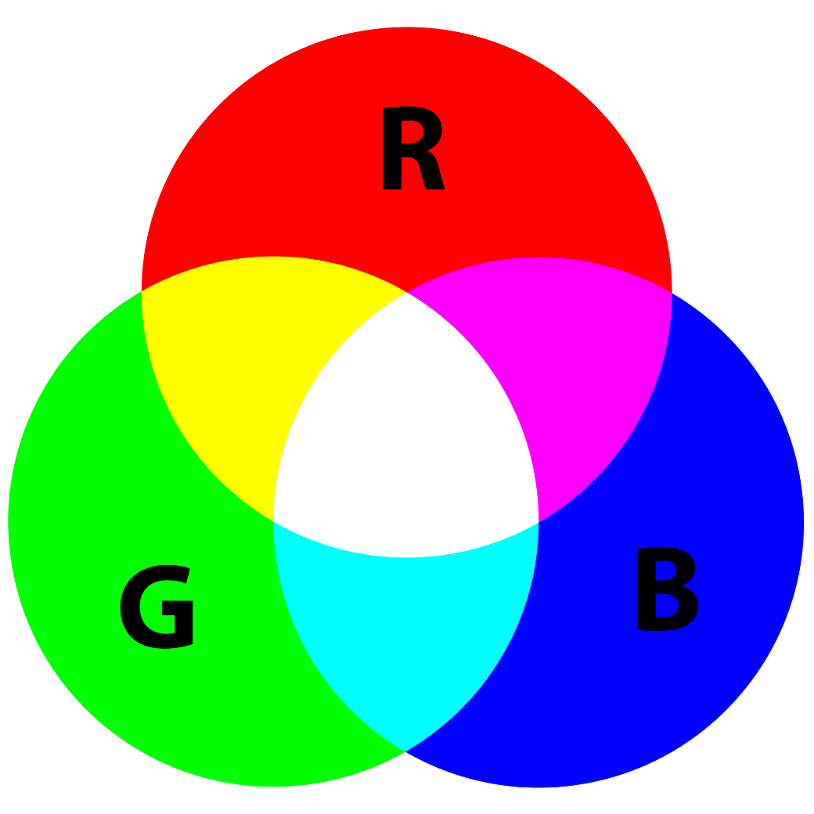
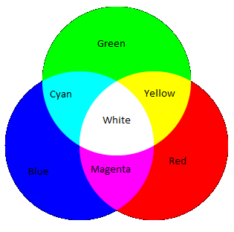
Additive Primary Colors produce new colors by combining different wavelengths of light. These are actual beams of colored light.
This is how a TV or this monitor works.
White is all colors in the spectrum.
Black is the absence of color.

Slide 22
If the light is not white
By heating a gas with electricity we can get it to give off colors.
Photoelectric Effect: Matter absorbs EM radiation→Electron knocked loose
Each particle of light collides with electron and uses its energy to dislodge. Remaining energy transfers to the photoelectron.
Passing this light through a prism does something different.

Slide 23
Atomic Spectrum
Each element gives off its own characteristic colors.
Can be used to identify the atom.
How we know what stars are made of.

Slide 24
These are called the discontinuous spectra (or emission line spectra) and is unique to each element.
Shown here are emission line spectra for 3 different elements. It is what the light being emitted from the elements is really made up of.
Spectral lines are like the atom’s “fingerprint”

Slide 25
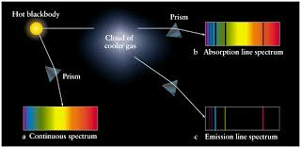
Emission-Line Spectra: Excited atoms emit visible light. This light is passed through a prism and is separated into specific wavelengths

Slide 26
Light as a Particle?
Particle - certain colors (blue) will cause electrons to fly off of a piece of metal while others (red) don’t
Why?_________________________________
Particles of light are called ______________, they have no ______________, but are tiny packets of ________________
Particles of blue light have the right energy/frequency to knock them free!
Photons
mass
energy
The Final Answer: Light
is ____________
a wave and a particle!!!!!
BOTH

Slide 27
Bohr Model of Atom
Planetary Model of atom – put electrons into fixed paths around nucleus called orbits
Assigned electrons to fixed energy levels
Moving from one energy level to another = requires a fixed quantum of energy
Quantum Leap – jump from one step to another

Slide 28
-Atoms excited by energy
-Emit light
-Emitted light is broken into spectrum of discrete frequencies (colors)
-Pattern unique to each element.
Electrons start at lowest energy level (closest to nucleus)= Ground State
Excited state→ Move up energy level
Electron falls back to ground state and gives energy back as light.
Bohr’s planetary model

Slide 29
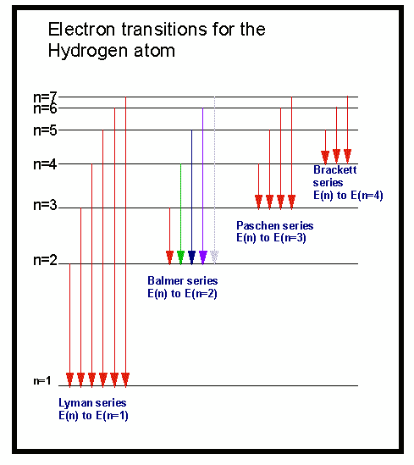
Electron transitions involve jumps of definite amounts of energy.
This produces bands
of light with definite
wavelengths.

Slide 30
Quantum Mechanical Model of the Atom
Attempts to explain why hydrogen gave off specific frequencies of light only led to this new model.
Mathematical laws can identify the regions outside of the nucleus where electrons are most likely to be found.
These laws are beyond the scope of this class…

Slide 31
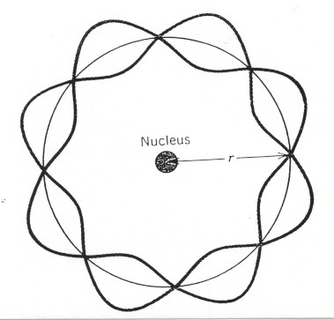
Essentially the model went from
to
Bohr
de Broglie

Slide 32
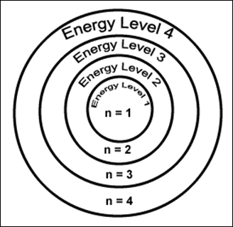
Electron Energy Level (Shell)
Generally symbolized by n, it denotes the probable distance of the electron from the nucleus. “n” is also known as the Principle Quantum number
Number of electrons that can fit in a shell: or simply count them on the periodic table!
2n²

Slide 33
A sublevel is a region within an energy level where there is a probability of finding an electron.
Energy Sublevels (subshells)
Orbital shapes are defined as the surface that contains 90% of the total electron probability.
Make map now.

Slide 34
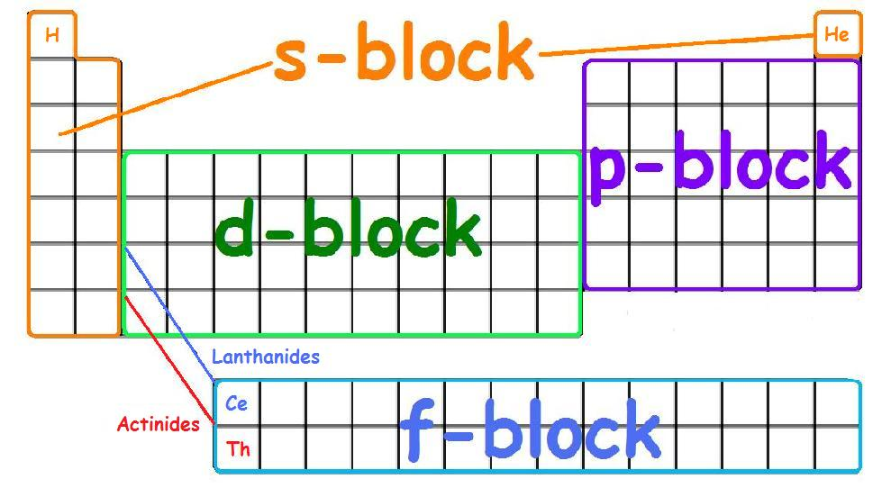

Slide 35
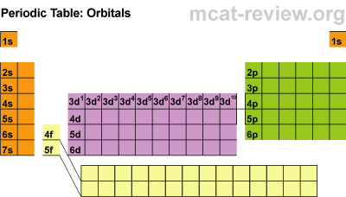

Slide 36
Write the electron configurations (no shortcuts!)
Lithium (Li) - 3 electrons
1s²2s¹
Oxygen (O) - 8 electrons
1s²2s²2p⁴
Neon (Ne) - 10 electrons
1s²2s²2p⁶

Slide 37
Write the electron configurations (no shortcuts!)
Magnesium (Mg) – 12 electrons
1s²2s²2p⁶3s²
Chlorine (Cl) – 17 electrons
1s²2s²2p⁶3s²3p⁵
Scandium (Sc) – 21 electrons
1s²2s²2p⁶3s²3p⁶4s²3d¹

Slide 38
Write the electron configurations (no shortcuts!)
Titanium(Ti) - 22 electrons
Vanadium(V) - 23 electrons

Slide 39
Write the electron configurations (no shortcuts!)
Titanium(Ti) - 22 electrons
1s²2s²2p⁶3s²3p⁶4s²3d²
Vanadium(V) - 23 electrons
1s²2s²2p⁶3s²3p⁶4s²3d³

Slide 40
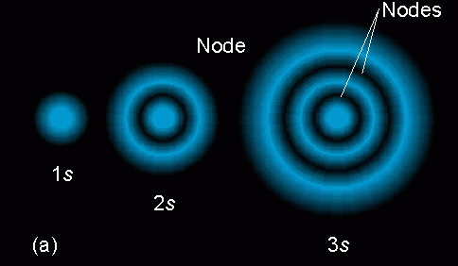
s sublevel
Orbitals of the same shape (s, for instance) grow
larger as n increases…
Nodes are regions of low probability within an orbital.

Slide 41
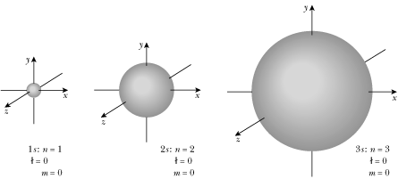
s sublevel shape
The s orbital has a spherical shape centered around the origin of the three axes in space.

Slide 42
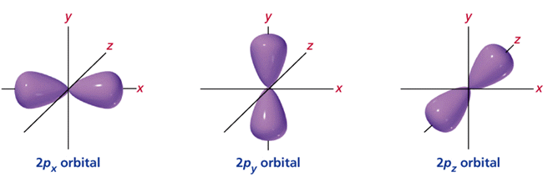
p sublevel shapes
There are three dumbbell-shaped p orbitals in each energy level above n = 1, each assigned to its own axis (x, y and z) in space.

Slide 43
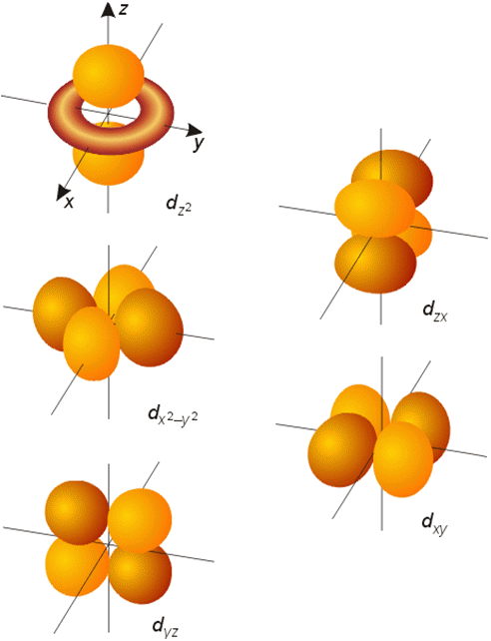
d sublevel shapes
Things get a bit more complicated with the five d orbitals that are found in the d sublevels beginning with n = 3. To remember the shapes, think of “double dumbbells”
…and a “dumbbell
with a donut”!

Slide 44
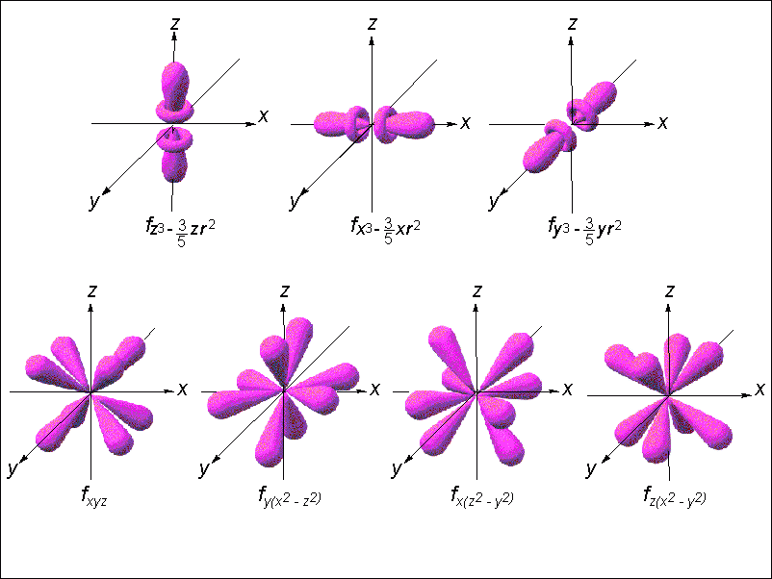
Shape of f sublevel orbitals

Slide 45
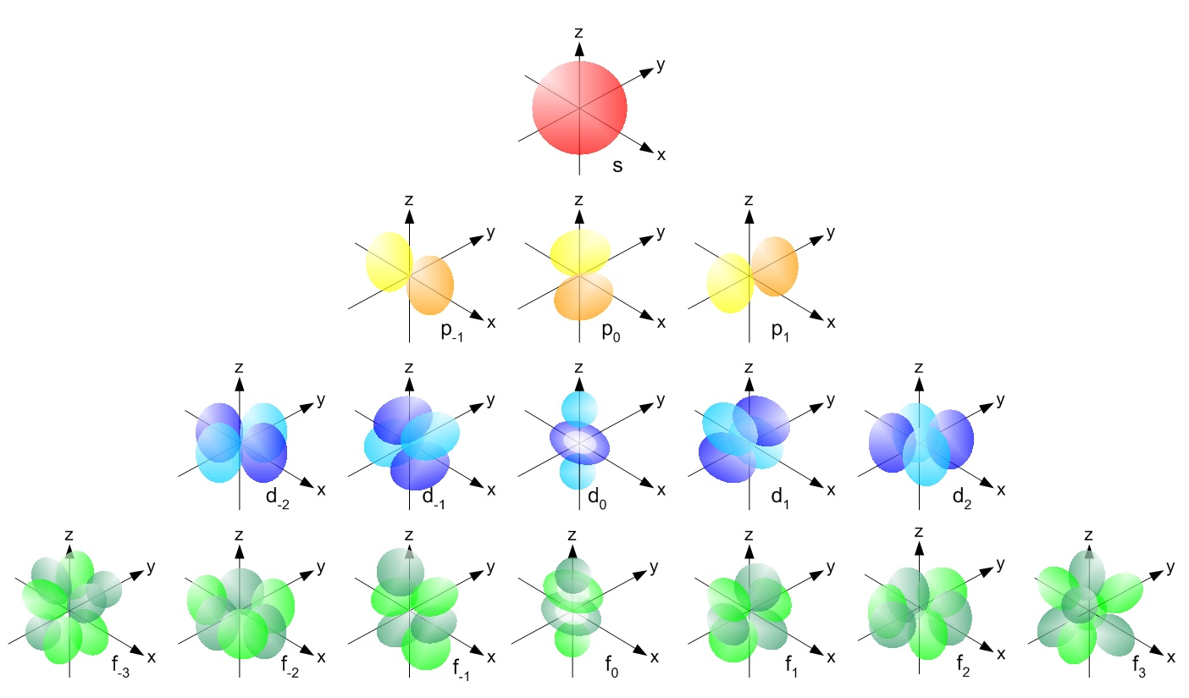

Slide 46
DO NOW In your notebook, write the electron configuration for Iron
1s²2s²2p⁶3s²3p⁶4s²3d⁶

Slide 47
Energy Levels, Sublevels, Orbitals, & Electrons
Energy Level (n) | Sublevel orbital types | Number of orbitals in the sublevels | Number of Electrons in each sublevel | Number of electrons per Energy level (2n²)
1 | s | 1 | 2 | 2
2 | s p | 1 3 | 2 6 | 8
3 | s p d | 1 3 5 | 2 6 10 | 18
4 | s p d f | 1 3 5 7 | 2 6 10 14 | 32

Slide 48
3 Rules for electron configurations:
Aufbau Principle – electrons fill lowest energy level orbitals first (lower energy = more stable!)
The word aufbau is German for “building up”
*Note: Atoms always do things to become the most stable!

Slide 49
2) Hund’s Rule –
Electrons will space out evenly.
Want highest number of unpaired electrons with the same spin.
Electrons want the most space between electrons with same energy!
Why???

Slide 50
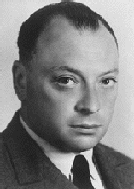
Pauli Exclusion Principle
Each orbital can hold a MAXIMUM of two electrons!
Wolfgang
Pauli

Slide 51
Pauli Exclusion Principle
Two electrons occupying the same orbital must have opposite spins
Wolfgang
Pauli

Slide 52
Electron Spin
Electron spin describes the behavior (direction of spin) of an electron within a magnetic field.
Possibilities for electron spin:

Slide 53
Summarize the 3 rules for electron configuration

Slide 54
Element | Configuration notation | Orbital notation (spin diagram) | Noble gas notation
Lithium | 1s²2s¹ | ____ ____ ____ ____ ____ 1s 2s 2p | [He]2s¹
Beryllium | 1s²2s² | ____ ____ ____ ____ ____ 1s 2s 2p | [He]2s²
Boron | 1s²2s²2p¹ | ____ ____ ____ ____ ____ 1s 2s 2p | [He]2s²2p¹
Carbon | 1s²2s²2p² | ____ ____ ____ ____ ____ 1s 2s 2p | [He]2s²2p²
Nitrogen | 1s²2s²2p³ | ____ ____ ____ ____ ____ 1s 2s 2p | [He]2s²2p³
Oxygen | 1s²2s²2p⁴ | ____ ____ ____ ____ ____ 1s 2s 2p | [He]2s²2p⁴
Fluorine | 1s²2s²2p⁵ | ____ ____ ____ ____ ____ 1s 2s 2p | [He]2s²2p⁵
Neon | 1s²2s²2p⁶ | ____ ____ ____ ____ ____ 1s 2s 2p | [He]2s²2p⁶

