Slide 1
Unit 2 Lecture #2
Modern Atomic Theory

Slide 2
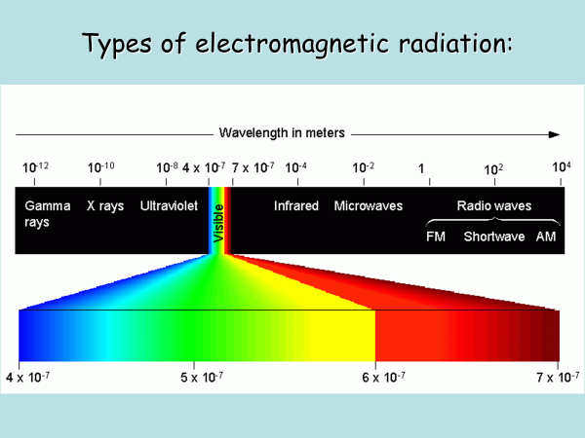

Slide 3
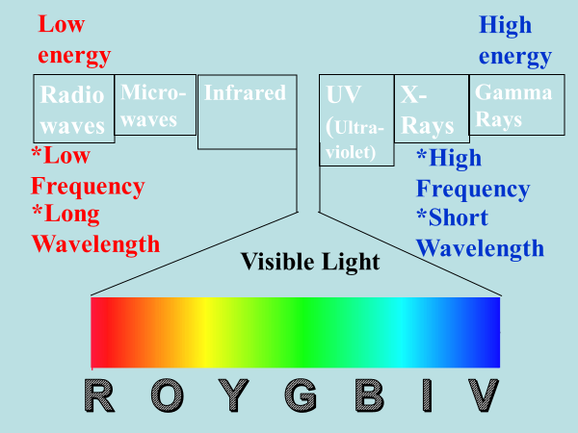

Slide 4
The Study of Light led to the quantum model
Light has a dual nature:
A Wave: measure wavelength and has wave behavior
A Particle: (arrives in “chunks” or quanta)

Slide 5

Why do metals glow when heated?

Slide 6
Models of the Atom
Rutherford’s atomic model could not explain the chemical properties of elements.
    Basically, it couldn’t explain why things change color when heated.

Slide 7
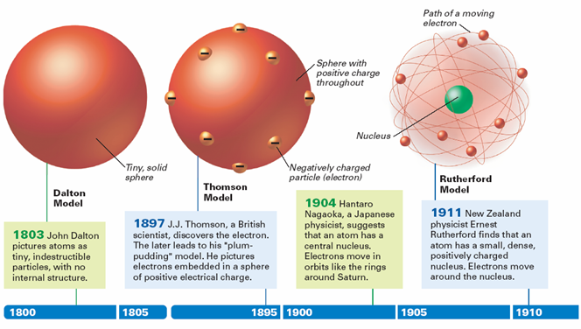
Atomic Model Timeline

Slide 8
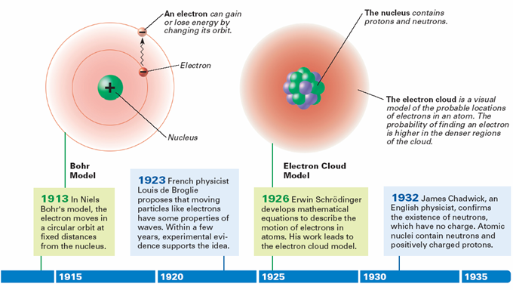
Atomic Model Timeline

Slide 9
The Bohr Model
In 1913, Bohr introduced his atomic model based on the simplest atom, hydrogen (only 1 electron)
  Bohr proposed that an electron is found only in specific circular paths, or orbits, around the nucleus.

Slide 10
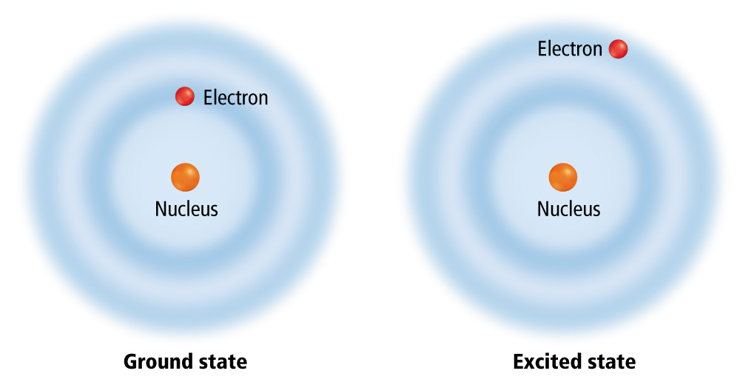
Bohr Model

Slide 11
The Bohr Model
Each electron has a fixed energy = an energy level.
  Electrons can jump from one energy level to another.
  Electrons can not be or exist between energy levels.
A quantum of energy is the amount of energy needed to move an electron from one energy level to another energy level. (Minimum quantity of energy that can be lost or gained by an object) Think Bricks!

Slide 12
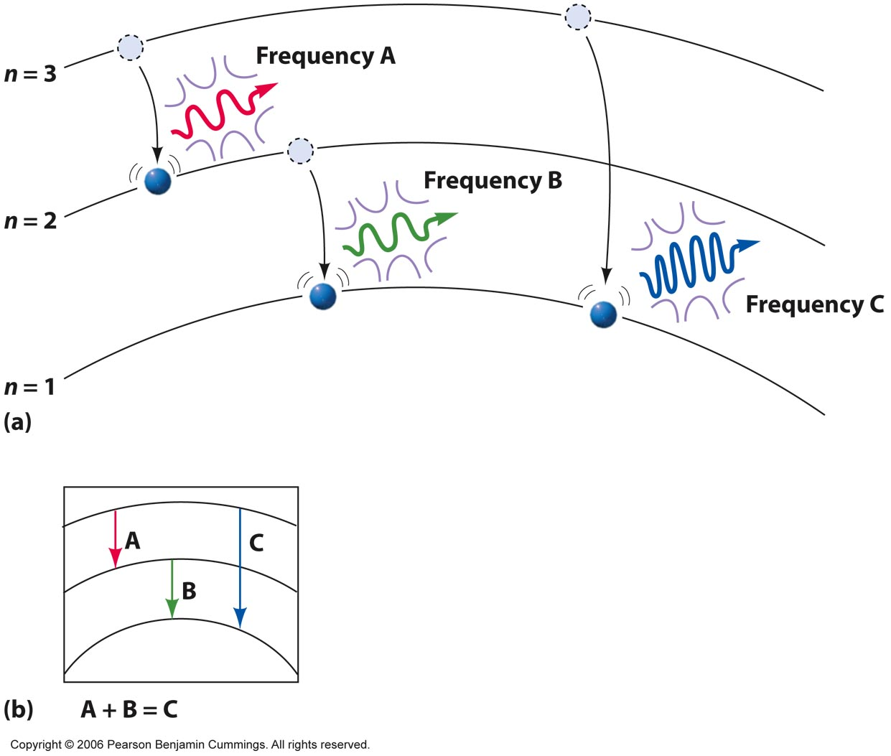
The degree to which they move from level to level determines the frequency of light they give off.
Notes:
Figure 5-14

Slide 13
Bohr Model
To move from one level to another, the electron must gain or lose the right amount of energy.
The higher the energy level, the farther it is from the nucleus.
  Gain energy to move to higher energy levels (away from nucleus)
  Lose energy to move to lower energy levels (closer to nucleus)

Slide 14

The Bohr Model
The amount of energy required to go from one energy level to another is the not same for the electrons.
Higher energy levels are closer together. This means it takes less energy to change levels in the higher energy levels.
The Bohr model was tested with the hydrogen element but failed to explain the energies absorbed and emitted by atoms with more than one electron.

Slide 15
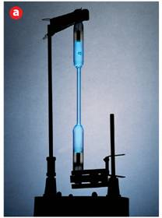
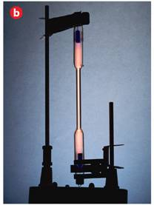
Did you know that an element can be identified by its emission spectra?
  When atoms absorb energy, electrons move into higher energy levels. These electrons then lose energy by emitting light when they return to lower energy levels.
Mercury
Nitrogen

Slide 16
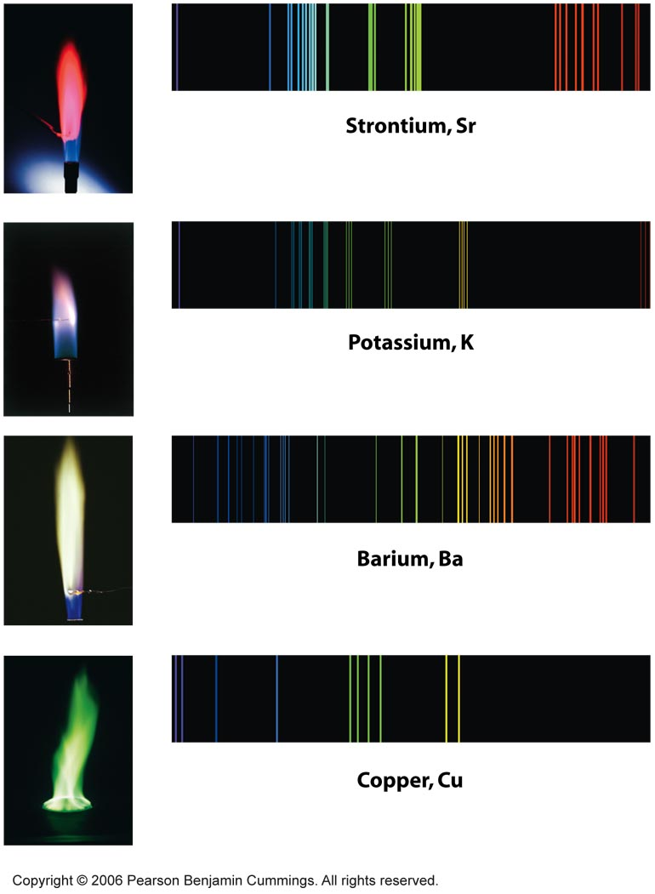
Fingerprints of certain atoms
Notes:
Figure 5-8

Slide 17
Atomic Spectra
5.3
  When atoms absorb energy, electrons move into higher energy levels. These electrons then lose energy by emitting light when they return to lower energy levels.

Slide 18
An Explanation of Atomic Spectra
5.3
    In the Bohr model, the lone electron in the hydrogen atom can have only certain specific energies.
      When the electron has its lowest possible energy, the atom is in its ground state.
      Excitation of the electron by absorbing energy raises the atom from the ground state to an excited state.
      A quantum of energy in the form of light is emitted when the electron drops back to a lower energy level.

Slide 19
An Explanation of Atomic Spectra
5.3
  The light emitted by an electron moving from a higher to a lower energy level has a frequency directly proportional to the energy change of the electron.

Slide 20
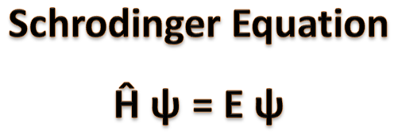
The Quantum Mechanical Model
Rutherford’s and Bohr’s model focused on describing the path of the electron around the nucleus like a particle (like a small baseball).
Austrian physicist Erwin Schrödinger (1887–1961) treated the electron as a wave.
  The modern description of the electrons in atoms, the quantum mechanical model, comes from the mathematical solutions to the Schrödinger equation.

Slide 21
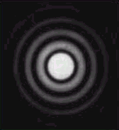

Electrons as Waves
EVIDENCE: DIFFRACTION PATTERNS
VISIBLE LIGHT
ELECTRONS

Slide 22
Heisenberg Uncertainty Principle
It is impossible to determine simultaneously both the position and velocity of an e⁻

Slide 23

The Quantum Mechanical Model
5.1
The propeller blade has the same probability of being anywhere in the blurry region, but you cannot tell its location at any instant. The electron cloud of an atom can be compared to a spinning airplane propeller.
  The quantum model determines the allowed energies an electron can have and how likely it is to find the electron in various locations around the nucleus.
Notes:
The electron cloud of an atom is compared here to photographs of a spinning airplane propeller. a) The airplane propeller is somewhere in the blurry region it produces in this picture, but the picture does not tell you its exact position at any instant. b) Similarly, the electron cloud of an atom represents the locations where an electron is likely to be found.

Slide 24
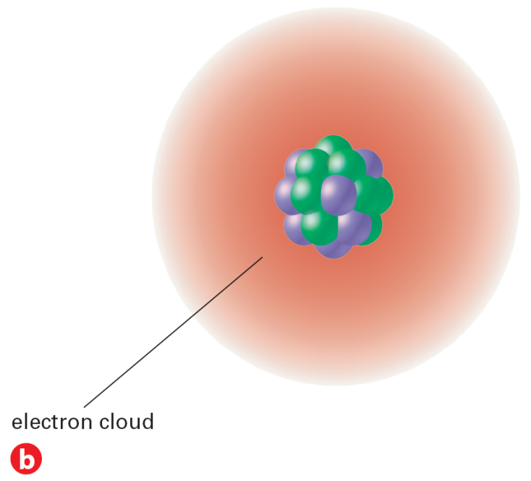
The Quantum Mechanical Model
5.1
The probability of finding an electron within a certain volume of space surrounding the nucleus can be represented as a fuzzy cloud.
  The cloud is more dense where the probability of finding the electron is high.
Notes:
The electron cloud of an atom is compared here to photographs of a spinning airplane propeller. a) The airplane propeller is somewhere in the blurry region it produces in this picture, but the picture does not tell you its exact position at any instant. b) Similarly, the electron cloud of an atom represents the locations where an electron is likely to be found.

Slide 25
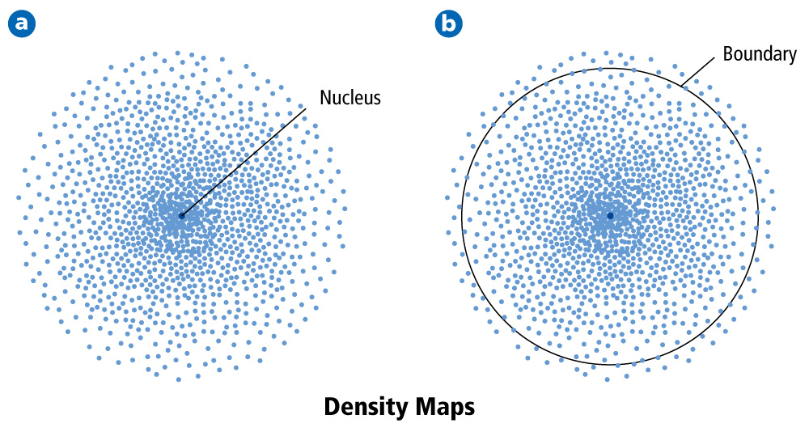
Atomic Orbitals
5.1
(fuzzy cloud) = An atomic orbital is often thought of as a region of space in which there is a high probability of finding an electron.

Slide 26
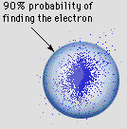
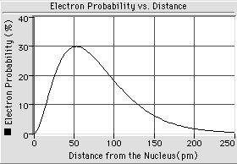
Quantum Mechanics
Orbital (“electron cloud”)
  Region in space where there is 90% probability of finding an e⁻
Orbital
Radial Distribution Curve

Slide 27
Probability cloud

Slide 28
Atomic orbital

Slide 29
Atomic orbital
90%

Slide 30
Larger atom—
More electrons
take up more space.
s-orbitals are
spherically shaped.
Smaller atom
Smaller atom—
Fewer electrons
take up less space.

Slide 31
p-orbitals are
“dumbell” shaped.
z-axis

Slide 32
p-orbitals are
“dumbell” shaped.
x-axis

Slide 33
p-orbitals are
“dumbell” shaped.
y-axis

Slide 34
p-orbitals together
x, y, & z axes.

Slide 35
Shells and Orbitals and Atomic Structure
f
d
p
s
Shells of an atom contain a number of stacked orbitals
4
3
2
1

Slide 36
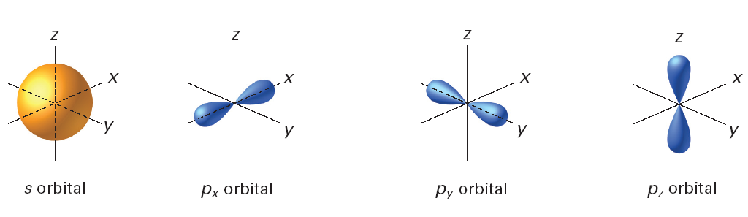
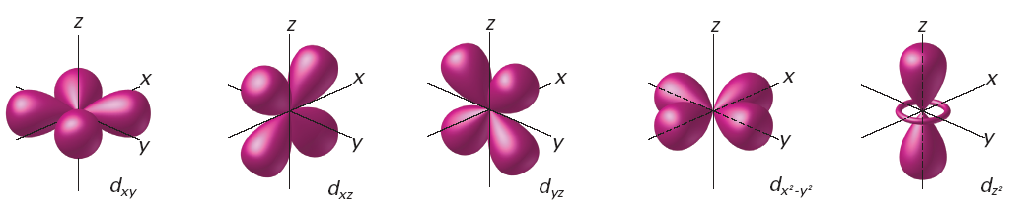
Atomic Orbitals
5.1
Different atomic orbitals are denoted by letters. The s orbitals are spherical, and p orbitals are dumbbell-shaped.
Four of the five d orbitals have the same shape but different orientations in space.
Notes:
The d orbitals are illustrated here. Four of the five d orbitals have the same shape but different orientations in space. Interpreting Diagrams How are the orientations of the d_{xy} and d_{x}² – _{y}² orbitals similar? How are they different?

Slide 37
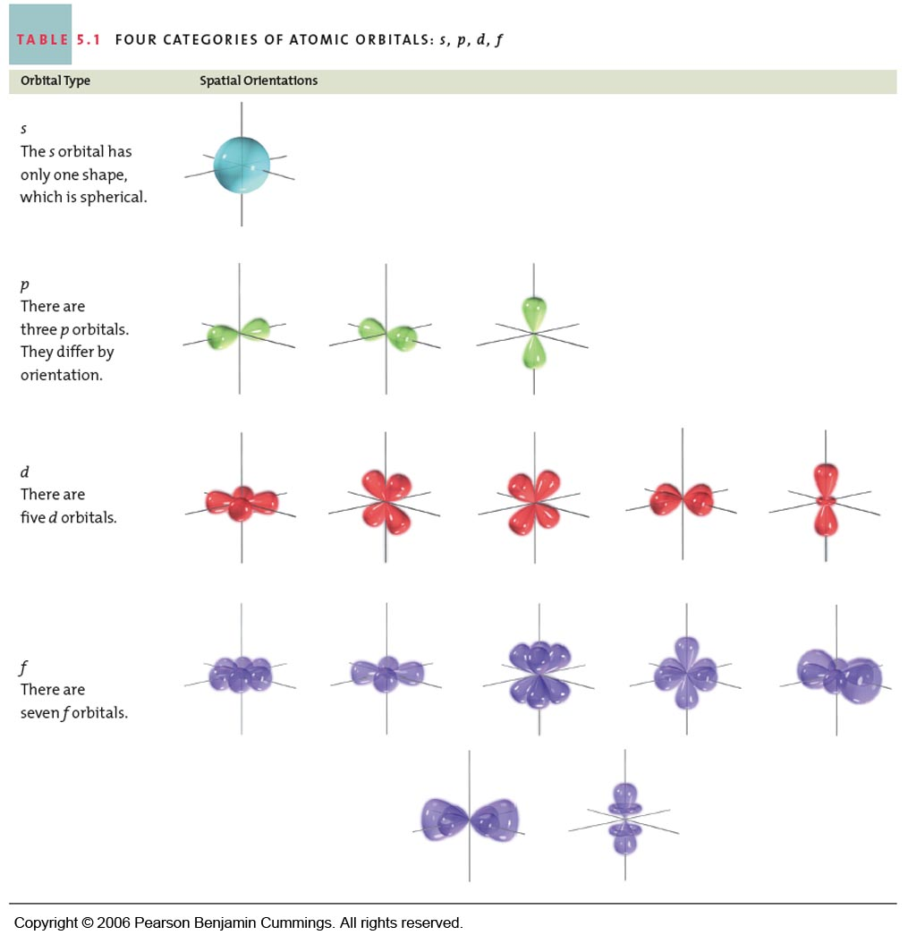
Notes:
Table 5-1

Slide 38
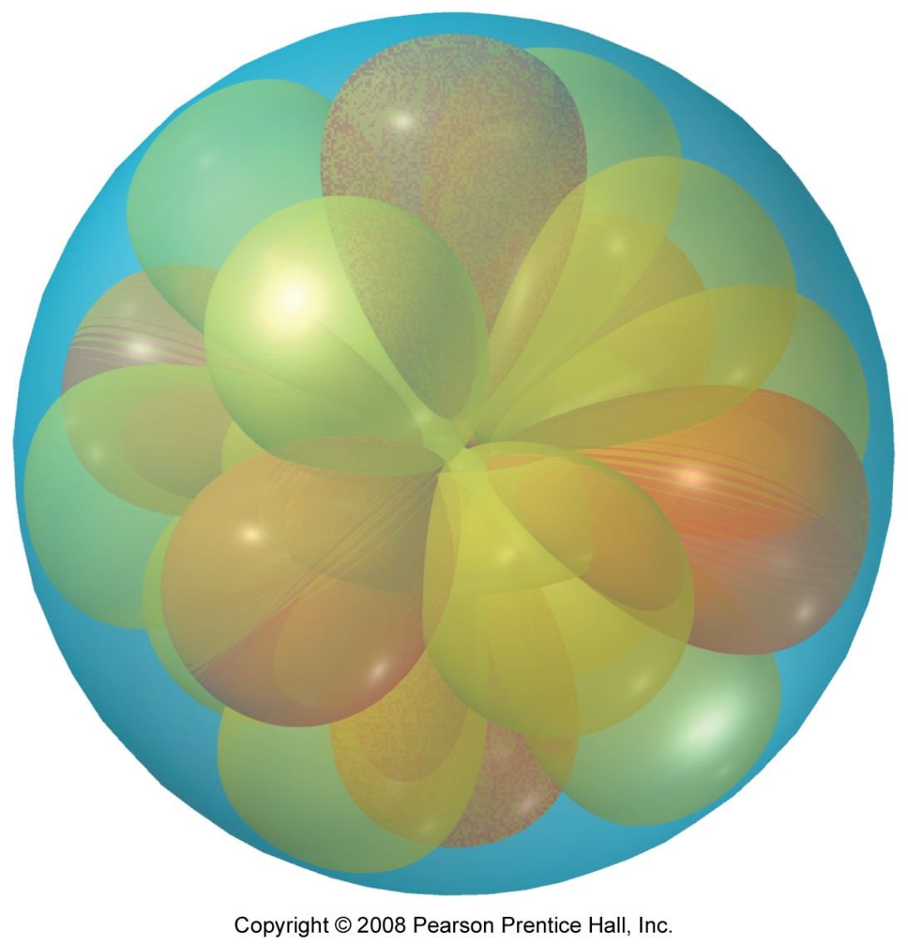
Why are Atoms Spherical?

Slide 39
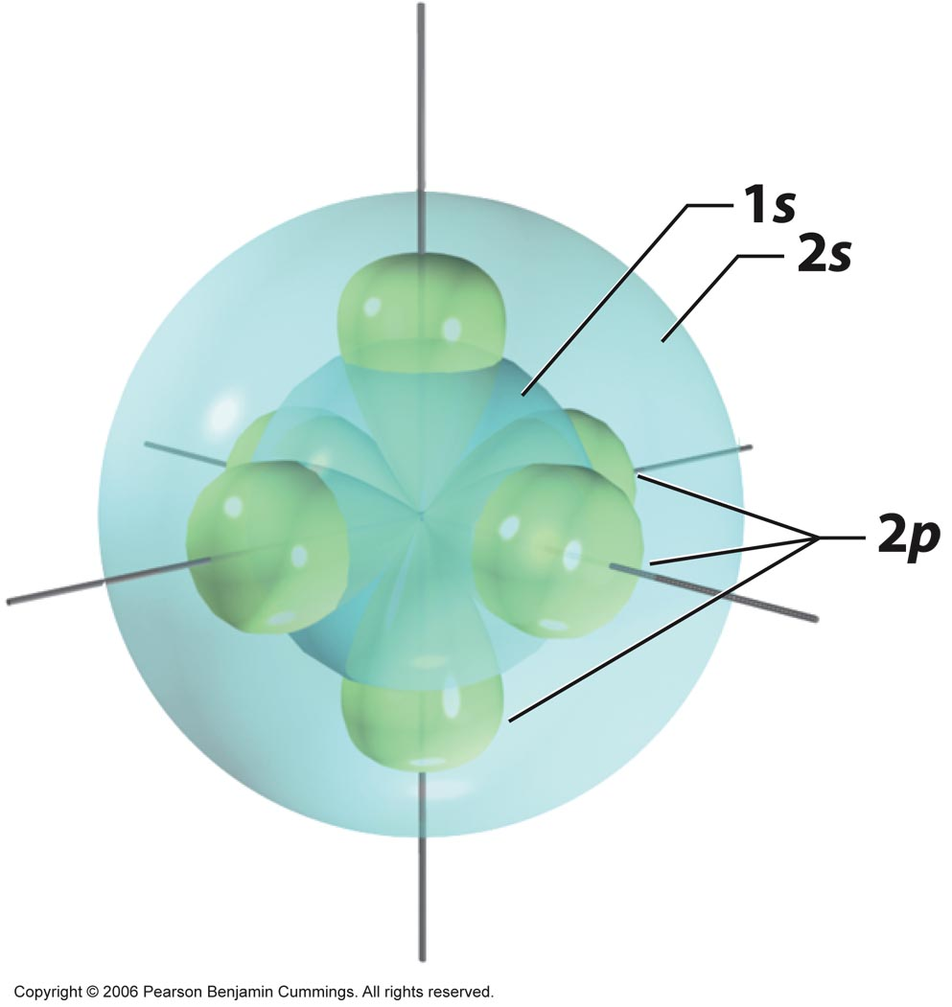
1st and 2nd level s-orbitals
and the p-orbitals all together.

Slide 40
Atomic Orbitals
5.1
The numbers and kinds of atomic orbitals depend on the energy sublevel.
Energy Level, n | # of sublevels | Letter of sublevels | # of orbitals per sublevel | # of electrons in each orbital | Total electrons in energy level

Slide 41
Atomic Orbitals
5.1
The numbers and kinds of atomic orbitals depend on the energy sublevel.
Energy Level, n | # of sublevels | Letter of sublevels | # of orbitals per sublevel | # of electrons in each orbital | Total electrons in energy level
1 | 1 | s | 1 | 2 | 2
2 | 2 | s p | 1 3 | 2 6 | 8
3 | 3 | s p d | 1 3 5 | 2 6 10 | 18
4 | 4 | s p d f | 1 3 5 7 | 2 6 10 14 | 32

Slide 42
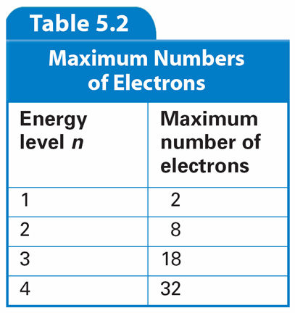
Atomic Orbitals
5.1
The number of electrons allowed in each of the first four energy levels are shown here.
  A maximum of 2 electrons per orbital
Use this to find the # of electrons in an energy level 2n²

Slide 43
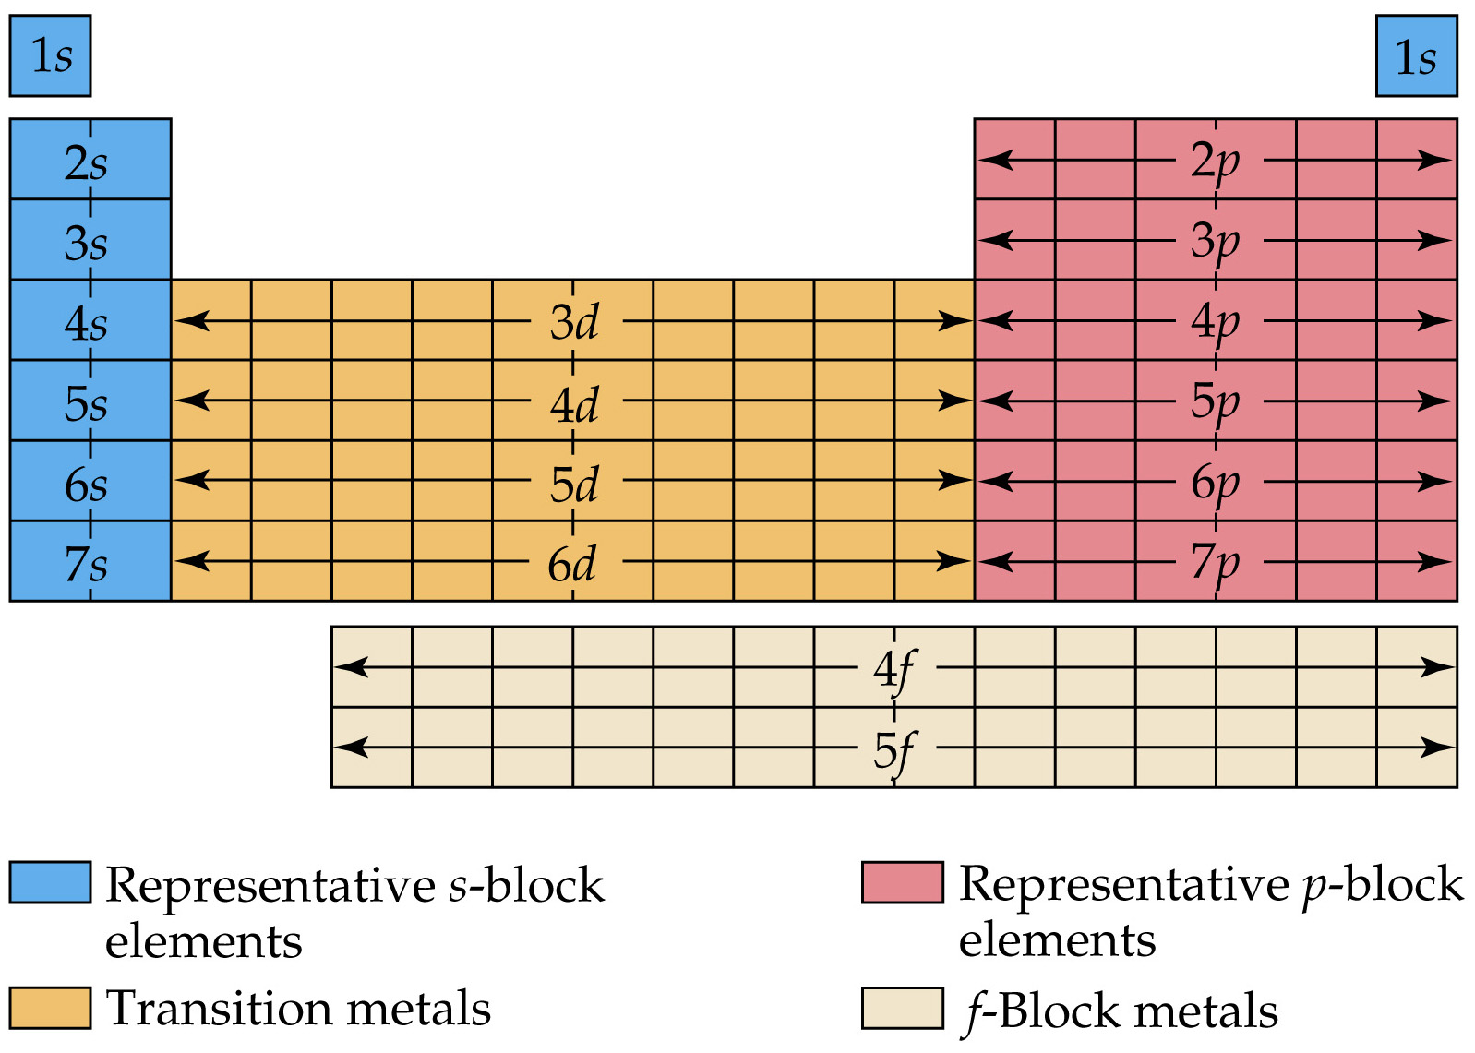

Slide 44
Electron Configurations
5.2
The ways in which electrons are arranged in various orbitals around the nuclei of atoms are called electron configurations.
  Three rules—the aufbau principle, the Pauli exclusion principle, and Hund’s rule—tell you how to find the electron configurations of atoms.

Slide 45
Electron Configurations
5.2
Aufbau Principle
  According to the aufbau principle, electrons occupy the orbitals of lowest energy first. In the aufbau diagram below, each box represents an atomic orbital.
Pauli Exclusion Principle
  According to the Pauli exclusion principle, an atomic orbital may describe at most two electrons. To occupy the same orbital, two electrons must have opposite spins; that is, the electron spins must be paired.
Hund’s Rule
  Hund’s rule states that electrons occupy orbitals of the same energy in a way that makes the number of electrons with the same spin direction as large as possible.
Notes:
This aufbau diagram shows the energy levels of the various atomic orbitals. Orbitals of greater energy are higher on the diagram. Using Tables Which is of higher energy, a 4d or a 5s orbital?

Slide 46
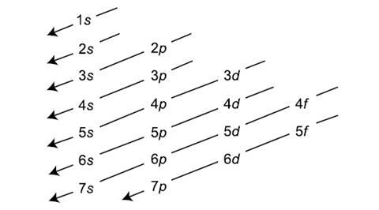
Filling Diagram for Sublevels
Aufbau Principle

Slide 47
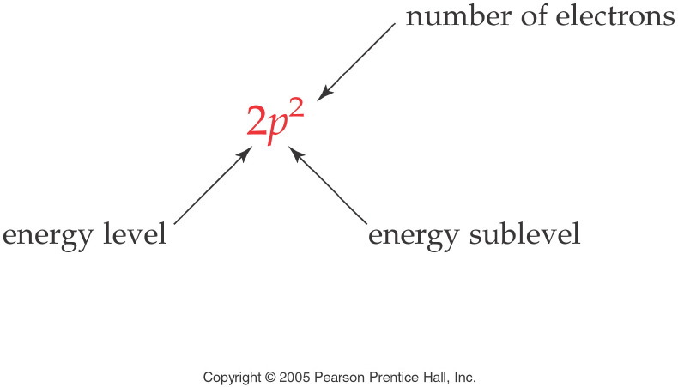
Electron Configurations
The electron configuration of an atom is a shorthand method of writing the location of electrons by sublevel.
The sublevel is written followed by a superscript with the number of electrons in the sublevel.
  If the 2p sublevel contains 2 electrons, it is written 2p²

Slide 48
Writing Electron Configurations
First, determine how many electrons are in the atom. Iron has 26 electrons.
Arrange the energy sublevels according to increasing energy:
      1s 2s 2p 3s 3p 4s 3d …
Fill each sublevel with electrons until you have used all the electrons in the atom:
      Fe: 1s² 2s² 2p⁶ 3s² 3p⁶ 4s² 3d ⁶
The sum of the superscripts equals the atomic number of iron (26)

Slide 49
Electron Configuration Practice
Write a ground state electron configuration for a neutral atom
K
Ne

Slide 50
Electron Configuration Practice
Write a ground state electron configuration for these ions.
O²⁻
Na⁺

Slide 51
Electron Configuration Practice
An excited atom has an electron or electrons which are not in the lowest energy state. Excited atoms are unstable energetically. The electrons eventually fall to a lower level. * is used to indicate an excited atom. For example: *Li 1s² 3p¹. (The ground state for Li is 1s² 2s¹.)
Write an excited electron configuration for the following atoms.
*Al
*K

Slide 52
Electron Configurations and the Periodic Table
The periodic table can be used as a guide for electron configurations.
The period number is the value of n.
Groups 1A and 2A have the s-orbital filled.
Groups 3A - 8A have the p-orbital filled.
Groups 3B - 2B have the d-orbital filled.
The lanthanides and actinides have the f-orbital filled.

Slide 53
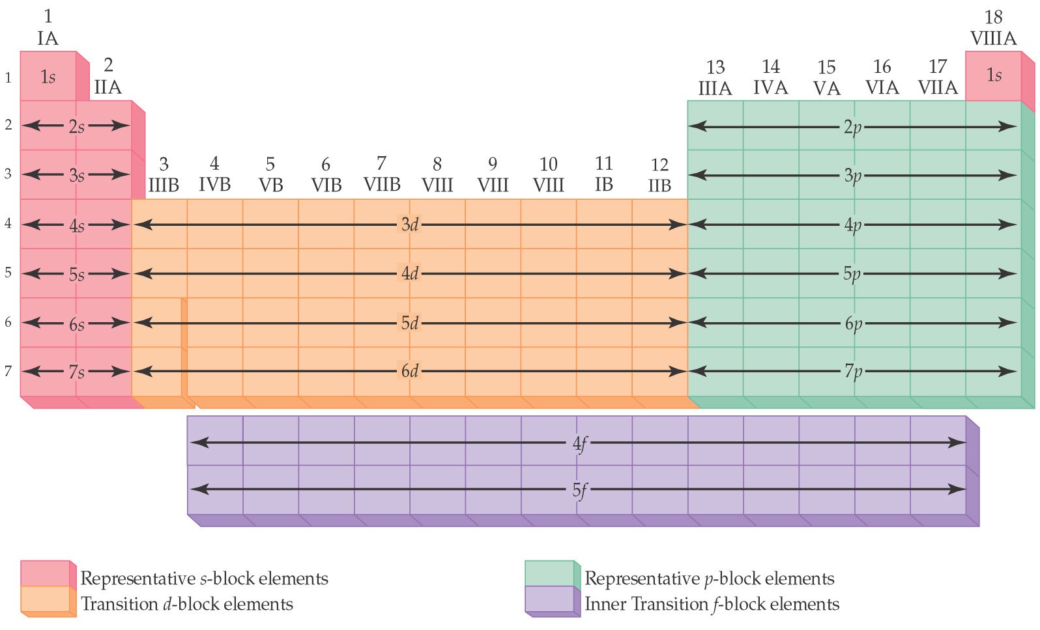
Blocks and Sublevels
We can use the periodic table to predict which sublevel is being filled by a particular element.

Slide 54
Noble Gas Core Electron Configurations
Recall, the electron configuration for Na is:
  Na: 1s² 2s² 2p⁶ 3s¹
We can abbreviate the electron configuration by indicating the innermost electrons with the symbol of the preceding noble gas.
The preceding noble gas with an atomic number less than sodium is neon, Ne. We rewrite the electron configuration:
  Na: [Ne] 3s¹

Slide 55
Electron Configurations
Condensed Electron Configurations
Neon completes the 2p subshell.
Sodium marks the beginning of a new row.
So, we write the condensed electron configuration for sodium as
Na: [Ne] 3s¹
[Ne] represents the electron configuration of neon.
Core electrons: electrons in [Noble Gas].
Valence electrons: electrons outside of [Noble Gas].

Slide 56
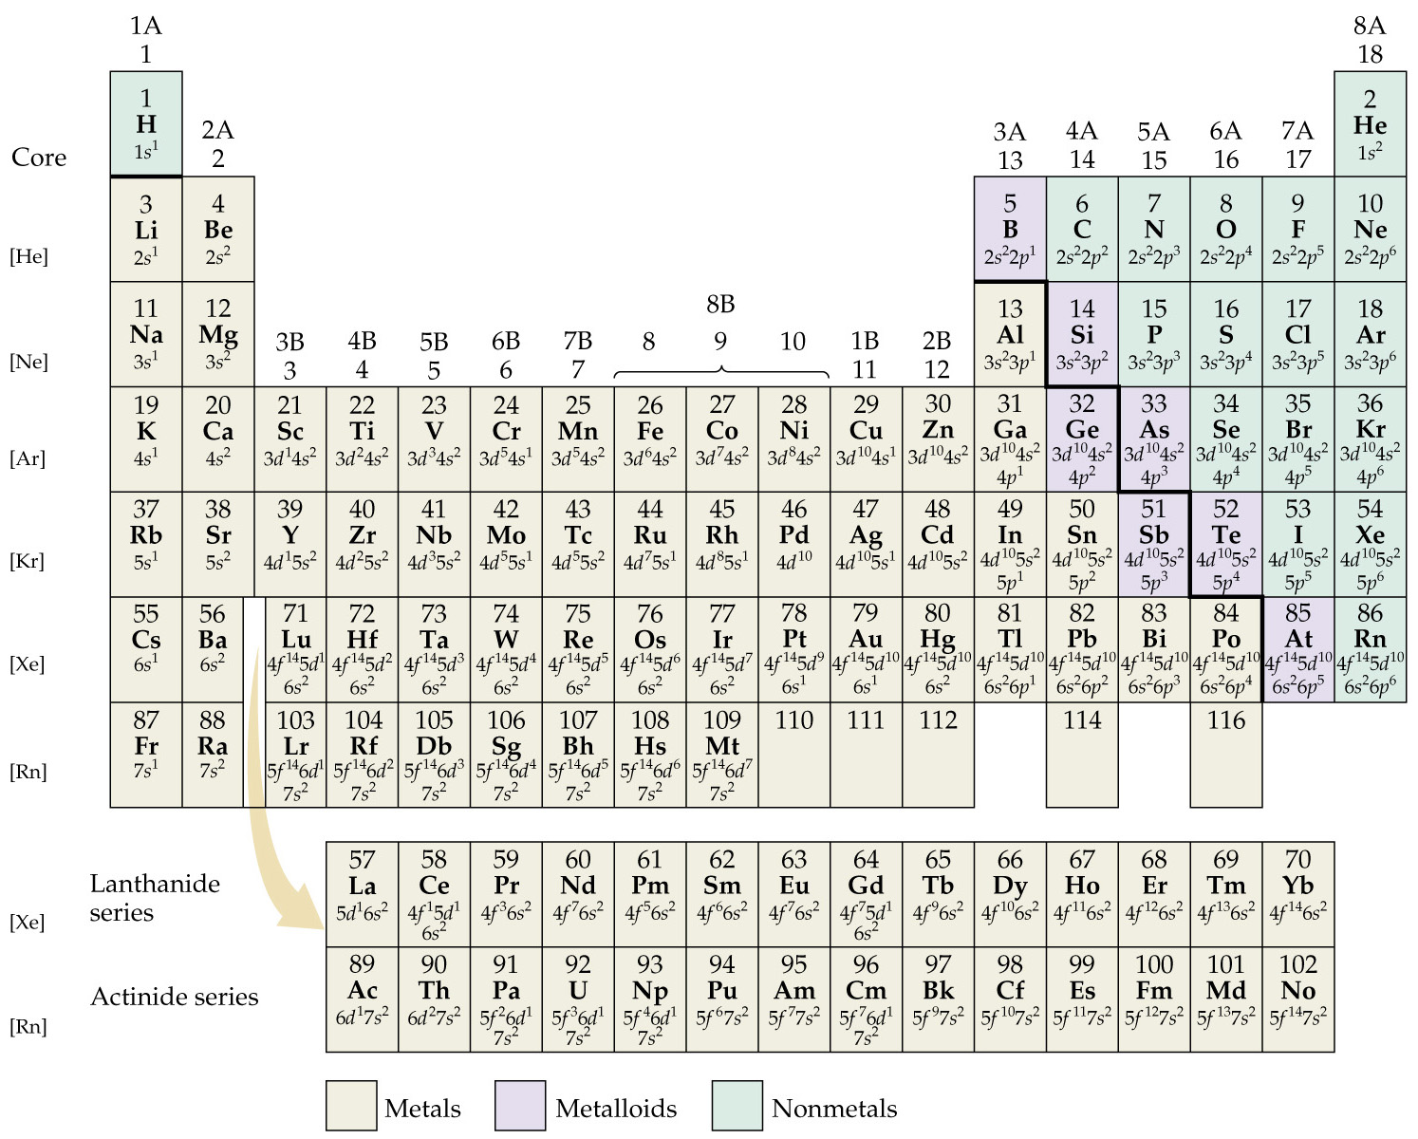

Slide 57
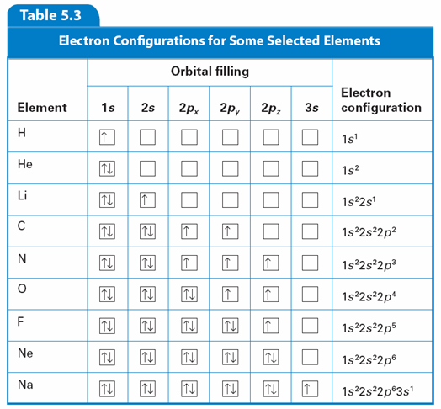
Electron Configurations
5.2
Orbital Filling Diagram

Slide 58
Exceptional Electron Configurations
5.2
Some actual electron configurations differ from those assigned using the aufbau principle because half-filled sublevels are not as stable as filled sublevels, but they are more stable than other configurations.

Slide 59

Exceptional Electron Configurations
5.2
Exceptions to the aufbau principle are due to subtle electron-electron interactions in orbitals with very similar energies.
Copper has an electron configuration that is an exception to the aufbau principle.
Notes:
Copper is a good conductor of electricity and is commonly used in electrical wiring.

