Slide 1
Ionic Bonding

Slide 2
Ionic Bonds
The strength of an ionic bond can be determined by 2 factors:
The charge of the ions, the higher the numerical charge value the stronger the attraction.
The distance of the ions, the closer they are the stronger the bond.
An attraction between anions and cations
Electrons are completely transferred.
A bond between a metal and a nonmetal.
Stronger than covalent bonds.
Commonly called metallic salts.

Slide 3
Octet Rule
The octet rule is an essential part of understanding ionic bonding, it refers to an atom's tendency to have eight electrons in its valence shell. An example of this can be demonstrated with NaCl.
Referring to the octet rule, atoms attempt to get a noble gas electron configuration, which is eight valence electrons. Sodium has one valence electron, so giving it up would result in the same electron configuration as neon. Chlorine has seven valence electrons, so if it takes one it will have eight (an octet). Chlorine has the electron configuration of argon when it gains an electron.
The octet rule could have been satisfied if chlorine gave up all seven of its valence electrons and sodium took them. In that case, both would have the electron configurations of noble gasses, with a full valence shell. However, their charges would be much higher. It would be Na^7- and Cl^7+, which is much less stable than Na+ and Cl-. Atoms are more stable when they have no charge, or a small charge.

Slide 4
Characteristics of Ionic Compounds
They are solids with high melting points (typically >400oC)
Many are soluble in polar solvents such as water.
Most are insoluble in nonpolar solvents.
Molten compounds conduct electricity well because they contain mobile charged particles (ions).
Aqueous solutions conduct electricity well because they contain mobile charged particles (ions).
They tend to be brittle and shatter when hammered.
The formulas are usually given in simplest ratio of elements (empirical)

Slide 5
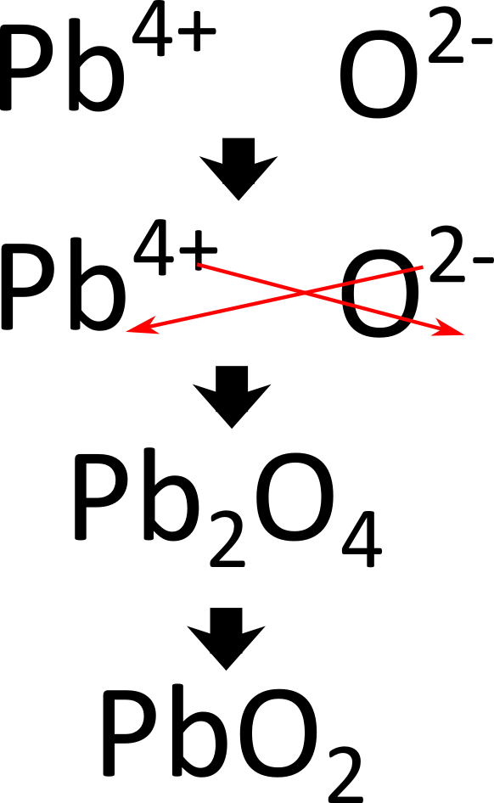
Predicting the Chemical Formula of Elements that Form an Ionic Bond
Step 1: Identify the cation and write down its symbol and charge
Step 2: Identify the anion and write down its symbol and charge
Step 3: Combine the two ions to form an electrically neutral compound

Slide 6
Lattice Energy
The energy required to separate a mole of an ionic solid into gaseous ions.
The magnitude of lattice energy is dependent on two factors which are the charge and ionic radius
This is justified by Coulomb's Law (Fₑ = (q₁q₂)/r²).
LE is directly proportional to the charges of the ions within the compound and inversely proportional to the ionic radius
This means that a stronger interaction will occur with a larger charges and smaller radii.
LE= k(Q1Q2)/R
Q1 charge of first ion ;Q2 charge of second ion
R is the distance

Slide 7
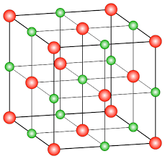
Crystal Lattice
A crystal lattice is a solid, regular array of positive and negative ions.
The strength between the cations and anions is lattice energy.
The structure is a systematic, periodic 3-D array that maximizes the attractive forces among cations and anions while minimizing the repulsive forces.
Its structure includes an alternating pattern between the cations and anions.
This helps to minimizes the repulsive forces because the attraction and repulsion of each.
Their arrangement varies depending on the ions’ sizes or the radius ratio (the ratio of the radii of the positive to the negative ion)
Cations are smaller than a neutral atom
Anions are larger than a neutral atom

Slide 8
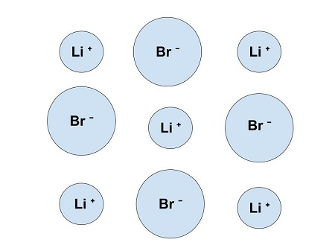
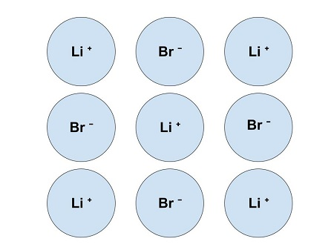
Representing an Ionic Solid with a Particulate Model
Step 1: Identify the cation and anion
Step 2: Estimate relative sizes
Step 3: Arrange them to maximize attractions and minimize repulsions

Slide 9
Practice Problem
Which ionic compound has the highest lattice energy? (a) MgO vs NaF (b) NaF vs KCl
Hint: Using LE= k(Q1Q2)/R will be helpful

Slide 10
Practice Problem
Rank the following in order of increasing lattice energy (Least to most exothermic). SrO, NaCl, MgO

Slide 11
Kahoot :)
https://create.kahoot.it/details/47456d41-7311-44dc-b419-fcdca57cc70a

