Slide 1
AP Chemistry Unit 4: Atomic Structure & Bonding
Lecture #1: Nature of light & matter
Chapter 7: Atomic Structure & Periodicity

Slide 2
The nature of light & electronic structure of atoms
Properties of elements repeat periodically. Why?
Our understanding of electronic arrangement came from our understanding of light.
What is light? Where does it come from?

Slide 3
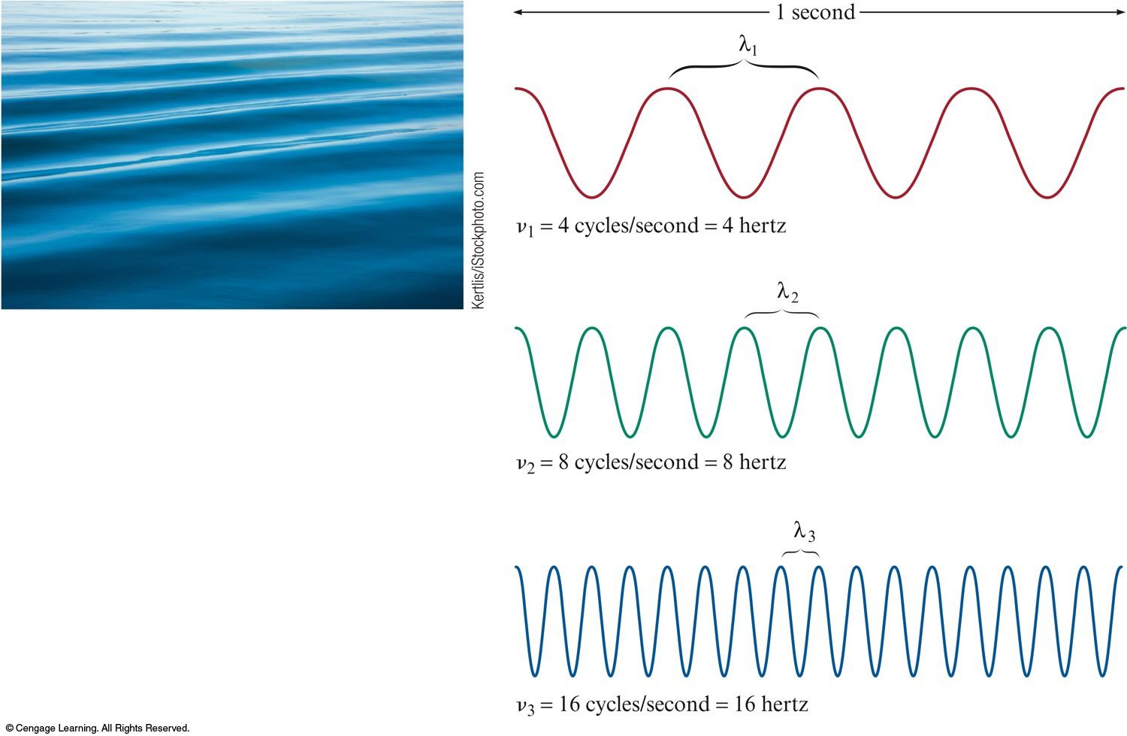
FOR WAVES TRAVELING AT THE SAME VELOCITY, THE LONGER THE WAVELENGTH, THE SMALLER THE FREQUENCY & the smaller the energy Wave Types: -Mechanical (requires medium) -Sound, Seismic, Water -Electromagnetic (No medium required)

Slide 4
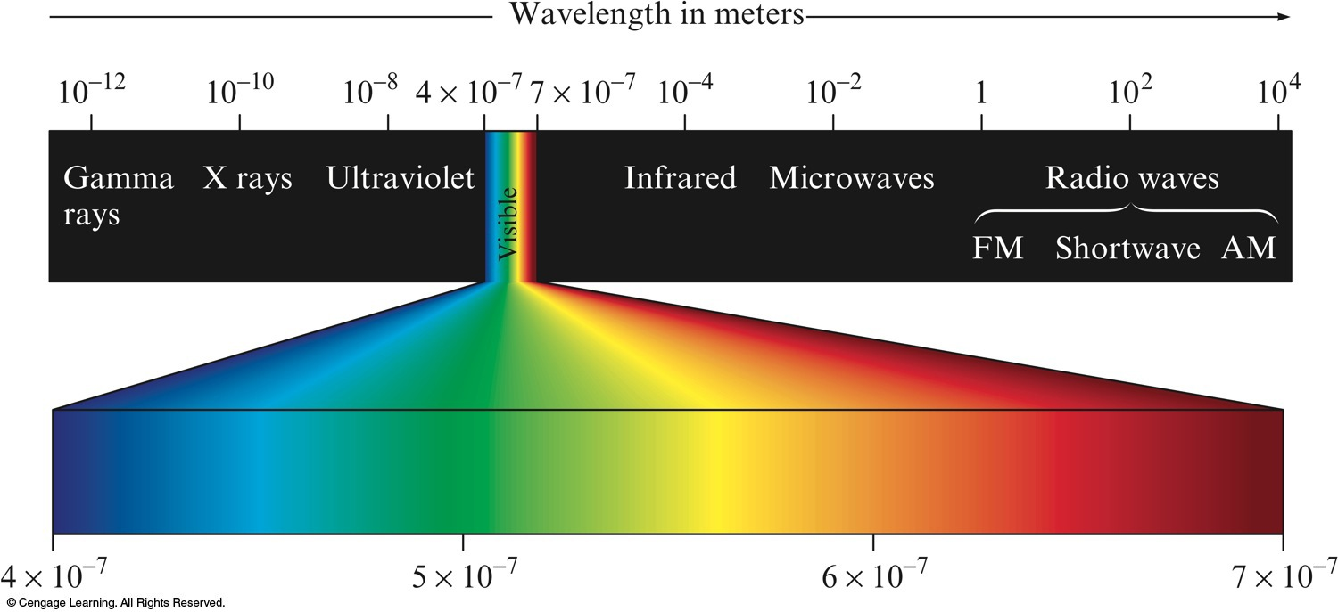
Classification of Electromagnetic Radiation
-Notice the inverse relationship between frequency and wavelength
-450 nm to 750 nm visible light
-Useful metric conversions: kilometer (10^3 m), nanometer (10^-9 m), Angstrom
-Electromagnetic Radiation: Method of energy transfer (ie Sun, Fireplace, AM/FM)

Slide 5
Light as a wave
One of the ways that energy travels through space. Propagates via waves.
Three characteristics:
Wavelength ( ) - distance between two consecutive peaks or troughs in a wave.
Frequency ( ) - number of waves (cycles) per second that pass a given point in space
Measured in Hertz (1/sec)
Speed (c) – speed of light (2.9979×10⁸ m/s); speed of all electromagnetic radiation
“Speed limit of the universe”; Roughly 10 x around Earth per second

Slide 6
Example 1: What is the wavelength in millimeters of a wave with a frequency of 550 kHz?

Slide 7
LIGHT AS A PARTICLE
At the end of the 19th century, matter and energy were distinct
Matter: Consisted of particles, had mass, location specified
Energy: Described as a wave, massless, delocalized
1900: Max Planck (German)
Energy is quantized & occurs only in discrete units of size called quanta.
Energy has particle properties
Energy is lost/gained in whole number multiples of
Planck’s constant = h = 6.626 × 10⁻³⁴ J•s
Thus, if one knows the wavelength of light, you can calculate the energy of one quanta (or packet, chunk, particle) of that light.

Slide 8
Example 2: Calculate the quantum of energy that an object can absorb from yellow light whose wavelength is 589 nm.

Slide 9
Example 3: When you heat Copper Chloride to 1200 degrees C, it emits blue light (450 nm). What is the increment (quantum) of energy emitted at 450 nm by CuCl?
*Can only lose energy in increments of ___________________

Slide 10
1903: Albert Einstein (German)- Energy has mass
Proposed that EM Radiation is quantized; viewed as a stream of particles called photons.
Derived from his analysis of the “Photoelectric Effect”: Electrons emitted from the surface of a metal when struck by light.
EM Radiation consists of photons; A minimum amount of energy is required to move an electron.
Led to realization that Energy and Mass are interrelated→ ENERGY HAS MASS

Slide 11
Planck & Einstein=
Energy is quantized; can only occur in units
Dual nature of light:
Electromagnetic radiation (and all matter) exhibits wave properties and particulate properties.
1923: Louis de Broglie (French): Since light exhibits particle behavior, does matter exhibit wave behavior?
De Broglie’s Equation tested using diffraction patterns to show ALL matter exhibits both particle and wave properties.
Large pieces of matter exhibit predominantly particulate properties (wavelength so small, it’s wave behavior is not observed)
Very small bits of matter (photons) show some particle properties, but mainly wave properties
Intermediate masses (electrons) show both particle and wave properties.

Slide 12
Atomic emission spectra

Slide 13
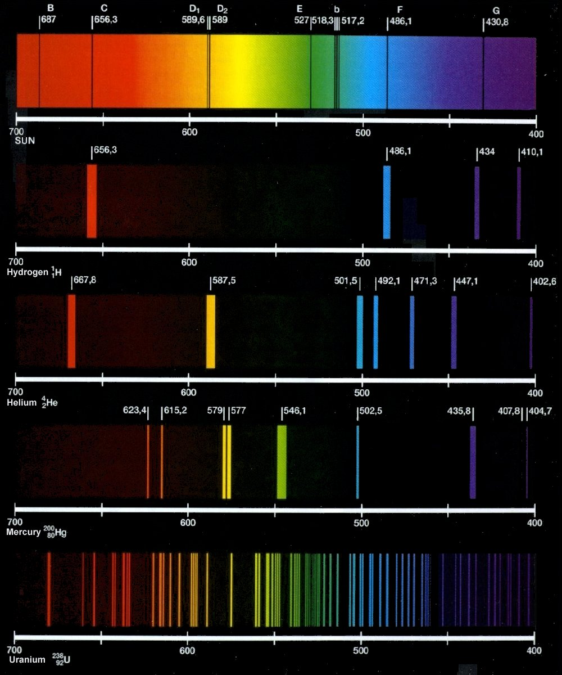
Every substance gives off a signature light.
For atoms and molecules, one does not observe a continuous spectrum (all wavelengths of visible light), as you would see from a white light source.
A Line Spectrum of discrete wavelengths is observed (though our eyes may interpret a single color)
Each wavelength corresponds to specific energy released by electrons jumping between energy levels.

Slide 14
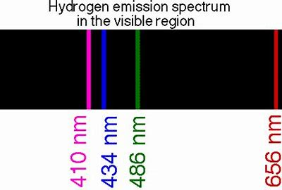
Atomic Emission of Hydrogen Experiments
-Study of light by Hydrogen gas receiving sparks (absorbing energy)
-Atoms become excited (excess energy), which they release by emitting light of various wavelengths to produce unique line spectrum
*Shows only certain energies are possible. If any energy level was allowed, we would see a continuous spectrum.

Slide 15
-Further away from the nucleus means more energy
-There is no in-between energy levels
-Ground State – Lowest Energy state
-Excited State- Higher energy state than ground state.
1913- Niels Bohr develops his model of the atom based on Hydrogen emission spectrum
-proposed that electrons moves around nucleus in fixed circular orbits.
-Bohr’s model allows for the calculation of energy levels available to the electron in Hydrogen atoms & the change in energy when it changes orbits.

Slide 16
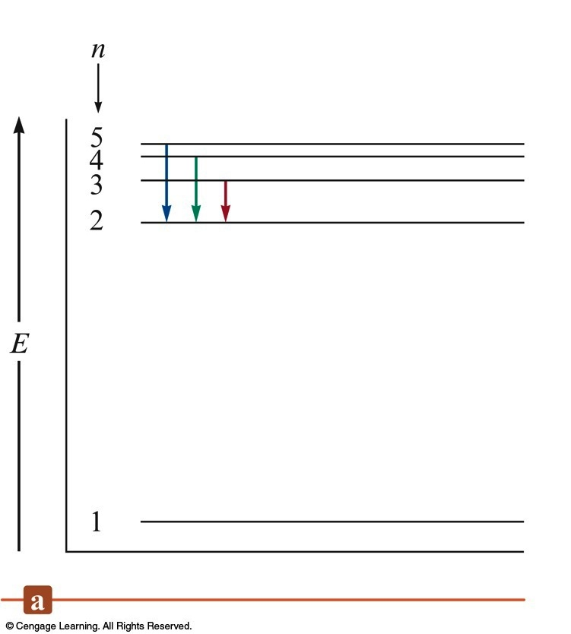
the Bohr Model for the Hydrogen Atom An Energy-Level Diagram for Electronic Transitions Shows different possibilities for light release 1. Electrons in permitted orbits have specific, allowed energies; decides how much light will be radiated from the atom 2. energy is only absorbed or emitted in such a way as to move an electron from one “allowed” energy state to another 3. the energy is defined by planck’s equation energy tells frequency which tells wavelength

Slide 17
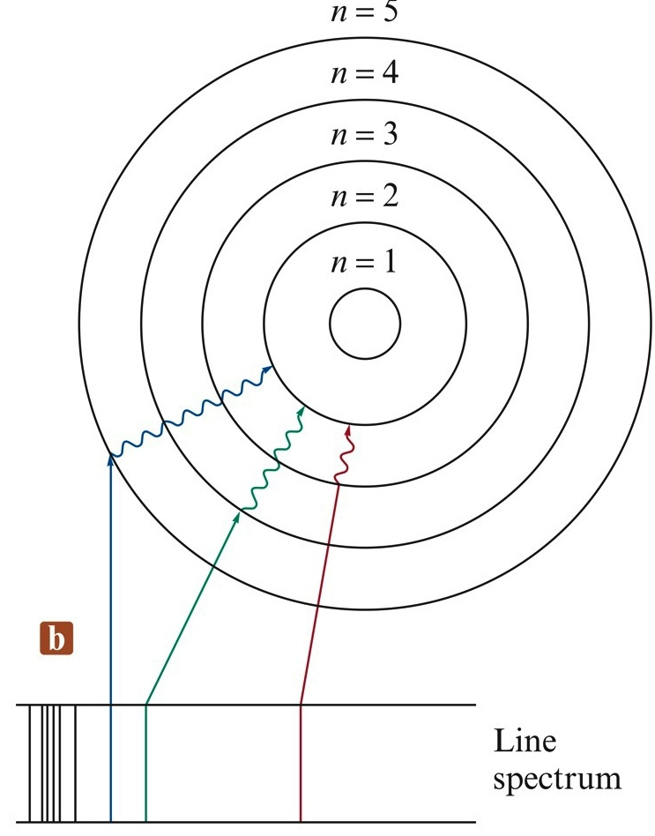
Bohr’s model Orbit-Transition Diagram, Which Accounts for the Experimental Spectrum

Slide 19
Example 3:
Calculate the energy required to excite the hydrogen atom’s electron from n=1 to n=2. Also calculate the wavelength of light that must be absorbed by a hydrogen atom in its ground state to reach that excited state.

Slide 21
For a single electron transition from one energy level to another:
ΔE = change in energy of the atom (energy of the emitted photon)
n_{final} = integer; final distance from the nucleus
n_{initial} = integer; initial distance from the nucleus

Slide 22
EXERCISE!
What color of light is emitted when an excited electron in the hydrogen atom falls from:
n = 5 to n = 2
n = 4 to n = 2
n = 3 to n = 2
Which transition results in the longest
wavelength of light?
blue, λ = 434 nm
green, λ = 486 nm
orange/red, λ = 657 nm
Notes:
For each transition, use ΔE = hc / λ = (–2.178×10^{–18})[(1/n_{f}) – (1/n_{i})]. Solve for λ in each case.
a) blue (λ = 434 nm)
b) green (λ = 486 nm)
c) orange/red (λ = 657 nm)
The longest wavelength of light is from transition n = 3 to n = 2 (letter c).

Slide 23
…Bohr’s Model…
The model correctly fits the quantized energy levels of the hydrogen atom and postulates only certain allowed circular orbits for the electron.
As the electron becomes more tightly bound, its energy becomes more negative relative to the zero-energy reference state (free electron). As the electron is brought closer to the nucleus, energy is released from the system.

Slide 24
…BUT…
Bohr’s model is incorrect. This model only works for hydrogen.
Bohr’s model is important historically because it showed observed quantized energy in atoms could be explained…which paved the way for future theories, including our current theory.
***Our current theory of atomic structure is in NO WAY derived from Bohr’s model. Electrons don’t move around the nucleus in circular orbits.

