Slide 1
AP Chemistry
Chapter 10
Intermolecular Forces, Liquids, and Solids

Slide 2
Review of States of Matter
Gas: Total Disorder; No attractive forces between particles
Liquid: Some disorder; clusters of particles from attractive forces
Solid: Ordered; No freedom of motion relative to each other
Liquid & Solid are called condensed phases
State of a substance at a particular temp and pressure depends on :
Kinetic energy of the particles
Strength of attraction between particles
Ex: 3 states of matter at room temp have same KE…attraction determines the state it is in

Slide 3
Intermolecular Forces (IMF)
Covalent bonds = attractions within molecules
Intermolecular forces = Attractions between molecules
Influences physical properties…Stronger intermolecular force = higher boiling point
IMFs referred to as a group as van der Waals forces
dipole-dipole attractions
hydrogen bonds (strongest)
dispersion forces or London forces (weakest)

Slide 4
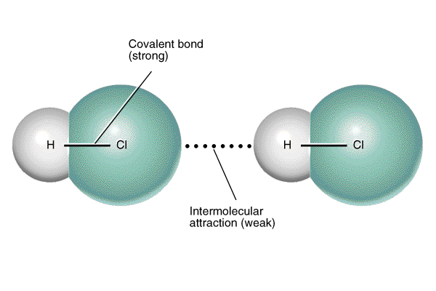
Dipole-Dipole Attractions
Dipole=Polar Molecule (+/- ends)
Occur between polar molecules, only important when molecules are close.
Opposite charges attract
+ ends of molecules attract - ends of other molecules
force increases with increasing electronegativity difference (i.e. greater dipole moment; measured in Debyes (D)= strength of dipole (0.1D vs. 3.9D)
More polar=more attraction=higher boiling point

Slide 5
Dispersion (London) Forces
Occur between any molecules, but most important (i.e. only attractive force!) between non-polar molecules
Molecules collide causing temporary, weak dipoles
sporadic and weak attractions occur
force increases with increasing number of electrons (i.e. greater molar mass) in molecule (POLARIZABILITY!)
Easier to polarize, stronger the force
Long skinny is more polarizable (stronger dispersion force) vs. round (n-penane vs. neopentane) C5H12

Slide 6
Effect of Molar Mass (Dispersion Forces) on Boiling Points of Molecular Substances

Slide 7
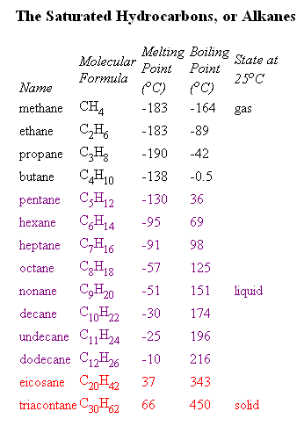
Effect of Molar Mass (Dispersion Forces) on Boiling Points of Molecular Substances II

Slide 8
Greater Effect? Dipole Dipole or Dispersion
If 2 molecules have similar size & shape, dipole-dipole wins out
If molecule is much larger, dispersion forces when out

Slide 9
Boiling Points of Nonpolar vs. Polar Substances

Slide 10
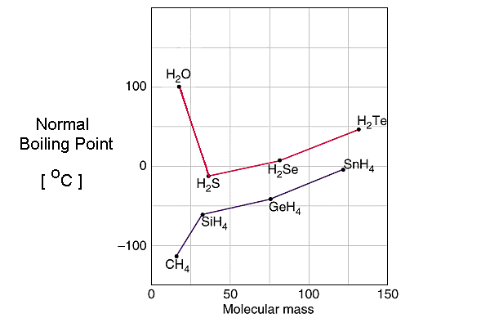
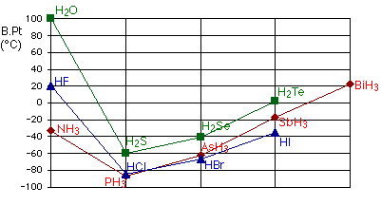
Boiling Point and Hydrogen Bonds

Slide 11
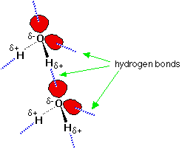
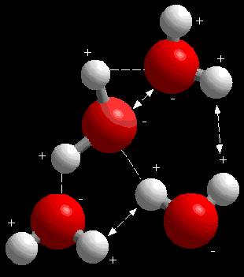
Hydrogen Bonds
Dipole dipole interactions that occur in molecules that have N,O, or F attached to hydrogen
strongest of intermolecular forces (about 5-10% strength of covalent bond)
Very unbalanced distribution of electrons…H, O, F highest EN. -→ Exposed Hydrogen--→ Creates very strong + to attract neighbor.
Hydrogen bonding in ice and why ice floats in water!

Slide 13
EX: Dipole moments of methyl chloride (CH3Cl)= 1.87D and methyl iodide (CH3I)= 1.62 D
Greater dipole-dipole IMF?
Greater dispersion force?
Boiling points: CH3Cl= 249 K & CH3I= 315K
Which as greater IMFs?

Slide 14
Which is Hydrogen Bonding possible? Methane (CH4), Hydrazine (H2NNH2), Methyl Fluoride (CH3F), Hydrogen Sulfide (H2S)

Slide 15
List the substances BaCl2, H2, CO, HF, Ne in order of increasing boiling point

