Slide 1
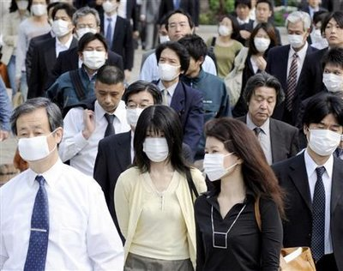
Human Health and Environmental Hazards
“The diseases of the present have little in common with the diseases of the past save that we die of them. ” - Agnes Repplier

Slide 2
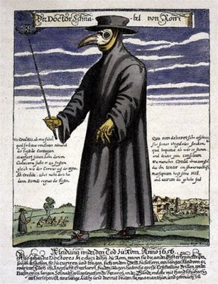
Disease Treatment in History
Many scholars followed the miasma theory of disease, from the middle ages up through the 1800s.
Diseases were caused by a poisonous vapor or mist filled with particles from decomposed matter.
Consistent with the observation that disease was often widespread in areas containing foul-smelling water.
During the Black Death, doctors wore costumes that included masks containing dried flowers, herbs, species, and a vinegar sponge.

Slide 3
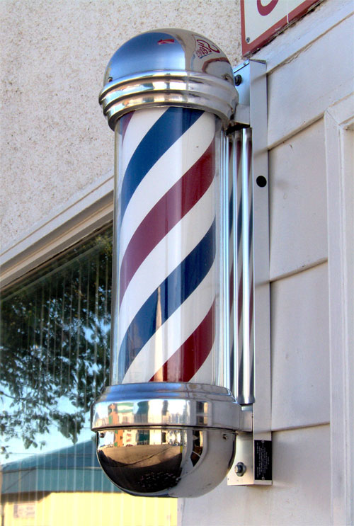
Disease Treatment in History
Other common treatments of disease:
Bloodletting – A practice of bleeding a patient to restore the balance of the four “humours”; blood, phlegm, black bile, and yellow bile.
Water cure – Icy cold water was applied to draw blood away from the injured or affected organs.

Slide 4
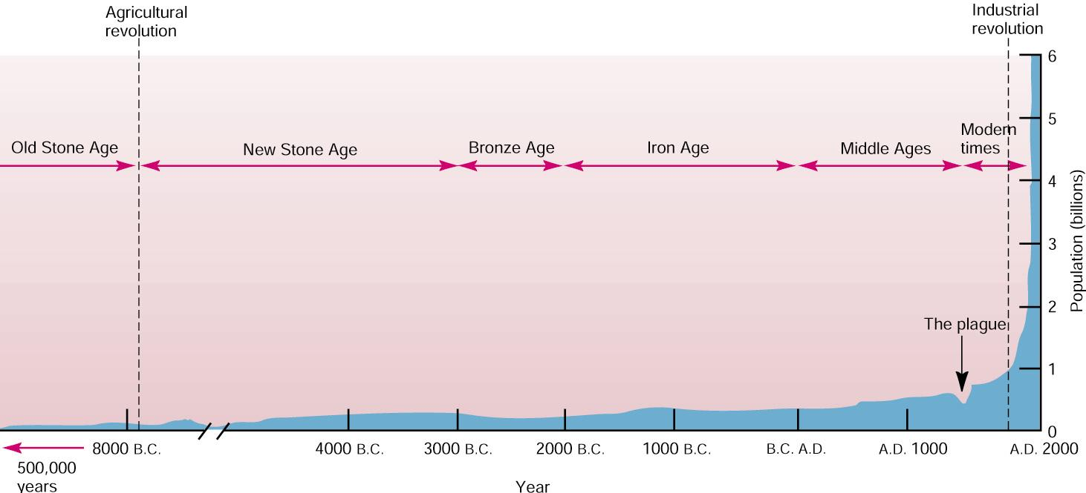
The Medical Revolution
Three major discoveries occurred that drastically changed medical practice:
Germ Theory of Disease (19th century)
Immunizations (19th century)
Antibiotics (1928)
These discoveries coincide with the beginning of exponential human growth.

Slide 5
ENVIRONMENTAL HEALTH HAZARDS
Health - A state of complete physical, mental, and social well-being.
Five major health hazards:
Biological hazards
Disease
Chemical hazards
Synthetic chemicals
Physical hazards
Natural disaster
Cultural hazards
Crime, poor working conditions
Lifestyle choices
Smoking, drinking, overeating

Slide 6
Infectious Disease
Non-transmissible diseases are not caused by living organisms and are not contagious.
Heart disease, cancer, asthma, diabetes
Infectious diseases are caused by living organisms and are usually transmissible.

Slide 7
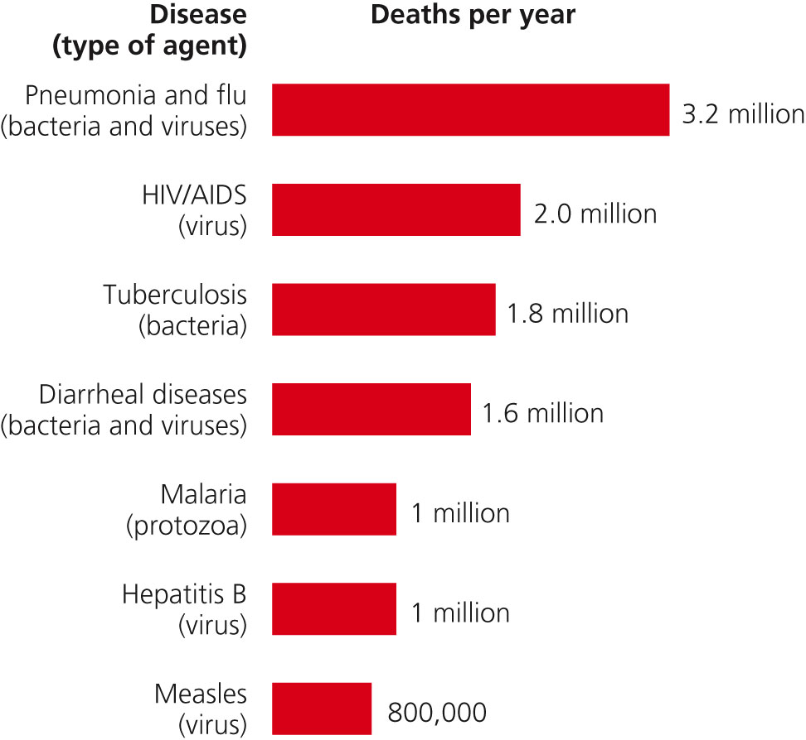
Seven Deadliest Diseases
Source: Miller Environmental Science

Slide 8
Multicellular Infectious Agents
Parasites – Any organism that lives by taking nutrients from its host.
Tapeworm
Trichinella (roundworms)
Plasmodium – Causes malaria; spread by mosquitoes
Fungi – Organisms that are normally decomposers but can also infect living tissue
Athlete’s foot
Ringworm (not an actual worm)

Slide 9
Unicellular Infectious Agents
May be eukaryotic (larger, have organelles, DNA contained in a nucleus) or prokaryotic (smaller, no organelles, DNA free-floating)
Protozoa - Single-celled eukaryotic organisms; able to move independently.
Malaria
Giardia
Bacteria – Single-celled prokaryotic organisms
Food poisoning
Staph infections

Slide 10
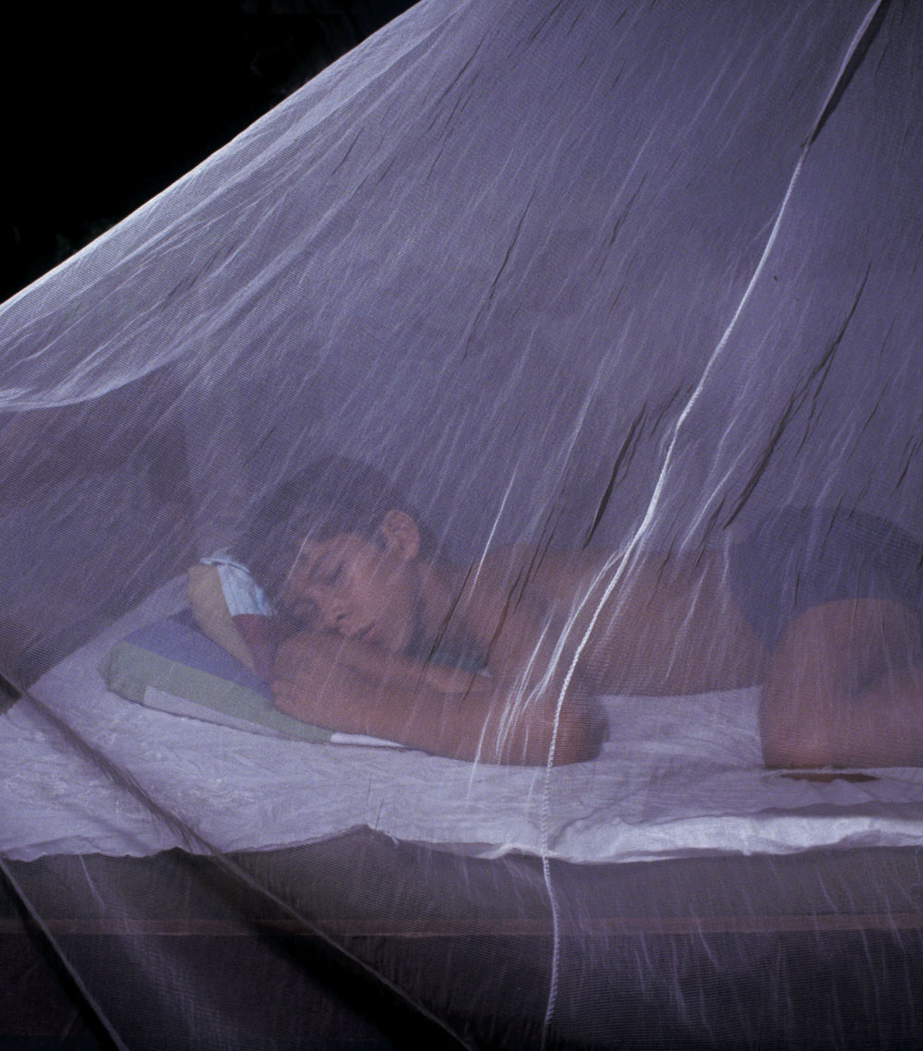
Malaria

Slide 11
Non-Living Infectious Agents
Viruses are non-living particles made from a core of RNA surrounded by a protein coat.
Viruses are very specific and usually only infect certain species.
They are able to mutate very easily due to their small size and rate of reproduction.
Influenza, common cold, AIDS, etc.
Prions are proteins with abnormal shapes.
Convert normal proteins when they come into contact.
Brain tissue is affected, leading to death.

Slide 12
Emergent Diseases
An emergent disease is one not previously known or that has been absent for at least 20 years.
Most emergent diseases originated from a non-human animal species.
Most pathogens are very specific and will not cross the species barrier easily.
There are exceptions, such as rabies.

Slide 13
Zoonosis
Zoonosis, or the transfer of a pathogen from a non-human to a human species, is unusual, but can occur if…
Humans and the host animal live near each other.
There is enough interaction between the host animal and the human population.
- The pathogen usually has to mutate.
The pathogen must be infectious.
There must be enough human movement to spread it to other populations.

Slide 14
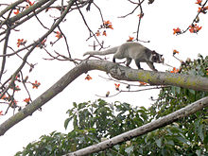
Zoonosis Examples
AIDS (Acquired Immunodeciency Syndrome)
Caused by a virus (HIV)
Believed to have originated from another primate species in Central Africa, likely chimpanzees.
Crossed to humans due to blood contact from native people hunting and eating chimpanzees.
SARS (Severe Acute Respiratory Syndrome)
Caused by a virus
Originated from the hunting and eating of a native species of China called the Masked Palm Civet

Slide 15
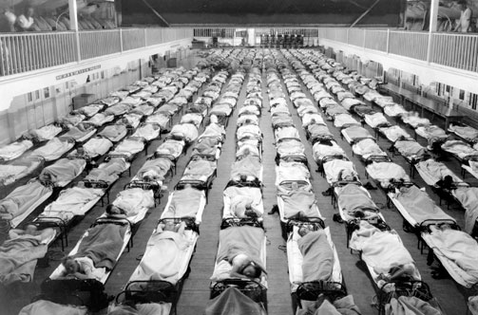
Zoonosis Examples
Influenza H1N1 (Swine Flu)
The virus contained genetic information from both swine influenza and human influenzas.
Outbreak believed to have originated from a swine farm in Mexico.
Spanish Flu of 1918
Killed 50-100 million people worldwide
Origins are unknown; may have arisen from avian or swine sources.

Slide 16
Antibiotic and Pesticide Resistance
Antibiotics are a medication that kill bacteria.
Many bacteria are able to evolve genes that give them the ability to resist certain antibiotics.
Bacteria evolve quickly because of…
Short life spans (duplicate in minutes)
Small amount of DNA
Huge populations (millions of bacteria in a sick person)
People tend to misuse antibiotics.

Slide 17
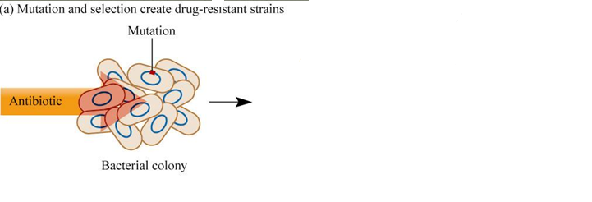
Antibiotic and Pesticide Resistance

Slide 18
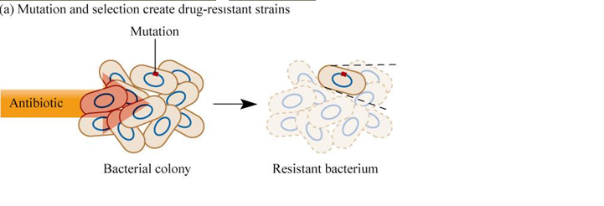
Antibiotic and Pesticide Resistance

Slide 19
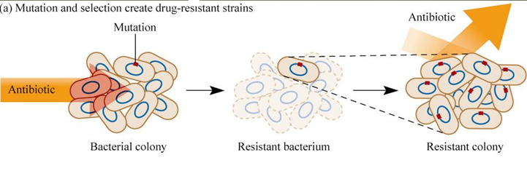
Antibiotic and Pesticide Resistance

Slide 20
Antibiotic Misuse
Many antibiotics (penicillin, amoxicillin) do not work against certain diseases.
Reasons for antibiotic resistance to develop:
Antibiotics used in a viral infection
Antibiotics are given when a health person could recover fully from the disease without them.
Many people do not finish the full prescription.
About half of all antibiotics manufactured in the U.S. are fed to farm animals.

Slide 21
Pesticide Resistance
Insects can also evolve resistance to pesticides.
The protozoan parasite that causes malaria is transmitted by a specific species of mosquito.
That mosquito has developed resistance to many insecticides.
Most common insecticide used – DDT!
DDT has multiple side effects on humans including increased risk of cancer, decreased fertility, birth defects, and it can block male hormones.

Slide 22
Toxicology
A toxic chemical is one that can cause a temporary or permanent harmful effect on human health.
Allergens – Any substance that is normally harmless that activates the immune system.
Sneezing, runny nose, watery eyes, rash, swelling, difficulty breathing
Dust mites excretion, pollen, pet dander, certain foods, perfumes, etc.
Allergies have a genetic basis, but you must be exposed to the allergen to get it.
Neurotoxins - Special class of metabolic poisons that specifically attack nerve cells.
Heavy Metals such as lead and mercury kill nerve cells.

Slide 23
Endocrine Hormone Disrupters
Chemicals that either interrupt or amplify normal hormone functions.
Hormones are chemicals released in blood by glands to regulate development and function of tissues and organs elsewhere in the body.
Most common hormone to be disrupted: estrogens and testosterone.
Many hormone disruptors are found in common plastics.
BPA
Pthalates

Slide 24
Endocrine Hormone Disrupters
Hypothesized link between continuous, low-level exposure to hormone disruptors and these documented reproductive issues in the human population:
Decreased sperm counts
Decreased sperm motility
Increased male birth defects
Increased testicular and breast cancer
No proven links as of now

Slide 25
Toxicology Cont’d
Mutagens - Agents that damage or alter genetic material.
Radiation
Teratogens - Specifically cause abnormalities during embryonic growth and development.
Alcohol - Fetal Alcohol Syndrome
Carcinogens - Substances that cause cancer.
Cigarette smoke

Slide 26
Toxicology Cont’d
Indoor Air Pollution
Indoor air quality is often worse than outdoor, even in a highly populated area.
Poorly ventilated indoor air can be contaminated with:
Bacteria and viruses
Molds
Carbon monoxide from wood burning stoves or car exhaust
Fumes from cleaning supplies

Slide 27
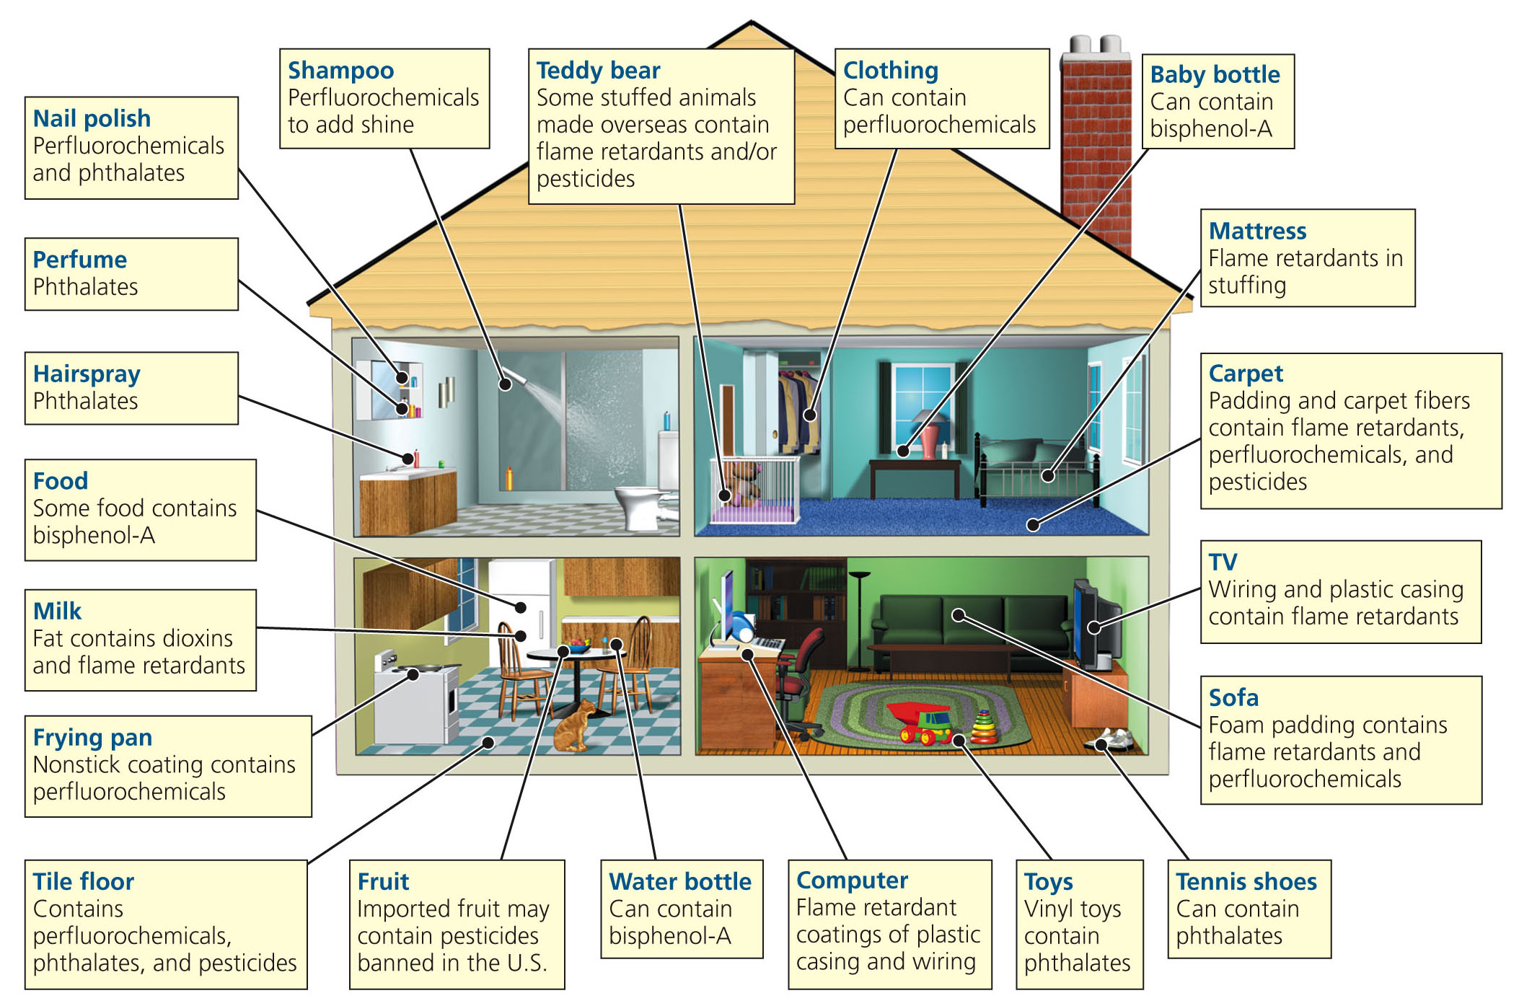
Indoor Air Pollution

Slide 28
Diet
Risk of cardiovascular disease is closely tied to the amount of salt and fat in an individual’s diet.
Highly-processed foods, high fat foods, and high-salt deli meats appear to influence the risk of cancer.
Nearly 2/3 of all Americans are considered overweight.

Slide 29
DISTRIBUTION AND FATE OF TOXINS
Solubility – What substances the chemical can dissolve easily in. Can be either…
Water-soluble
Oil-soluble
Water-soluble compounds move rapidly through the environment, and have ready access to most human cells.
Oil-soluble molecules generally need a carrier to move through the environment.

Slide 30
Bioaccumulation and Biomagnification
Bioaccumulation – Toxins that exist in low levels in the environment can gradually build to dangerous levels inside cells and tissues.
Biomagnification - A large number of organisms containing a toxin at a lower trophic level is accumulated and concentrated by a predator at a higher trophic level.

Slide 31
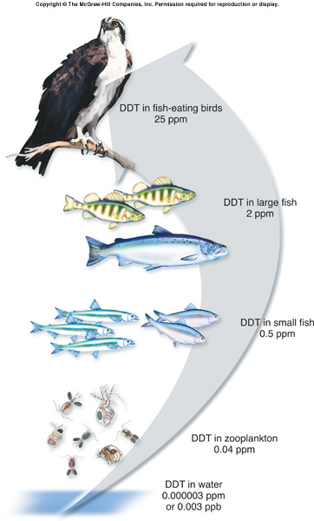
Bioaccumulation

Slide 32
Persistence
Some chemicals are more persistent, which means they do not break down quickly in the environment.
These toxins are a problem because they last a very long time once released.

Slide 33
MEASURING TOXICITY
Animal Testing
Most commonly used and widely accepted toxicity test is to expose a population of laboratory animals to measured doses of specific toxins.
LD50 - Dose at which 50% of the test population is sensitive.

Slide 34
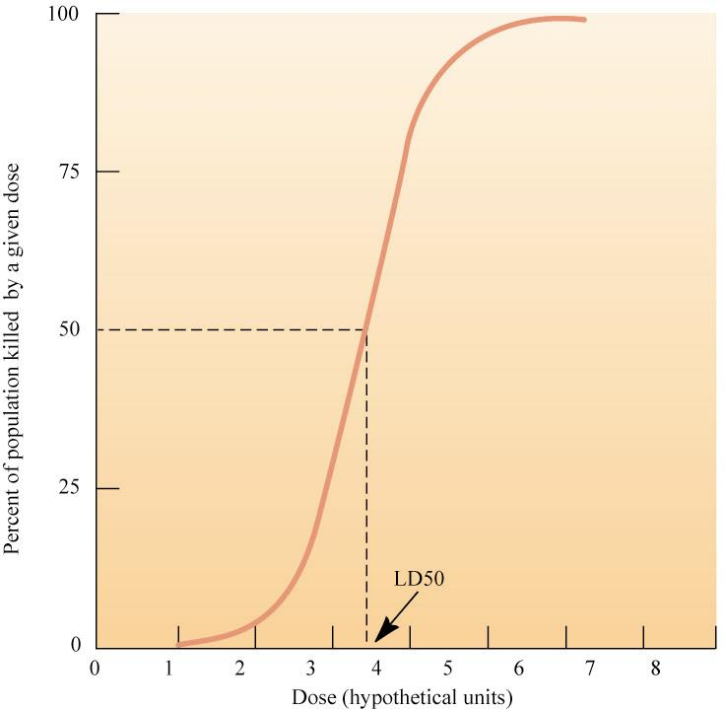
LD50

Slide 35
Acute vs. Chronic Effects
Acute Effects - Caused by a single exposure and result in an immediate health problem.
Chronic Effects - Long-lasting. Can be result of single large dose or repeated smaller doses.
Very difficult to assess specific health effects due to other factors.

Slide 36
Risk Management
Risk – The probability of suffering harm in the form of an injury, illness, death, etc.
Risk Assessment – Estimating the likeliness or severity of a specific hazard to humans.
Can be caused by…
Diet and nutrition
Infectious agents
Toxic chemicals

Slide 37
RISK ASSESSMENT
Factors influencing risk perception:
Political agendas.
Misunderstanding of statistics.
Personal experiences.
News media sensationalizes rare events.
Fear of the unknown.

Slide 38
Accepting Risks
What risks are generally considered acceptable?
High probability of exposure with low severity.
Example: Mercury in seafood (?)
High severity with low probability
Example: Nuclear reactor meltdown (?)
EPA generally assumes 1 in 1 million is acceptable risk for environmental hazards.

Slide 39
ESTABLISHING PUBLIC POLICY
It is not reasonable to demand protection from every potentially harmful contaminant in our environment.
Risks must be prioritized and handled accordingly.
What criteria is used to create these priorities?

Slide 40
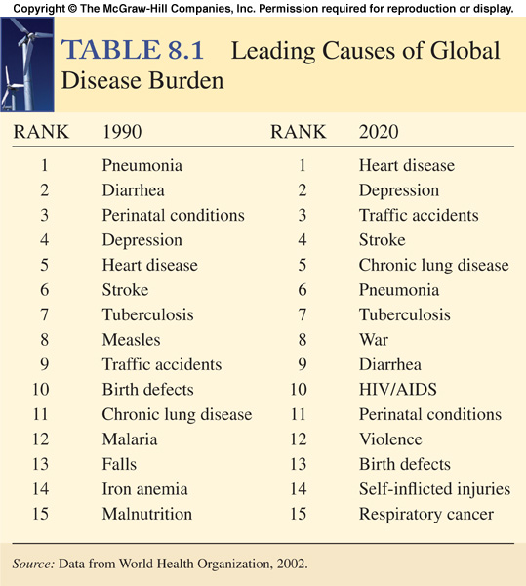
How does this data influence public policy based on risk assessment?

Slide 41
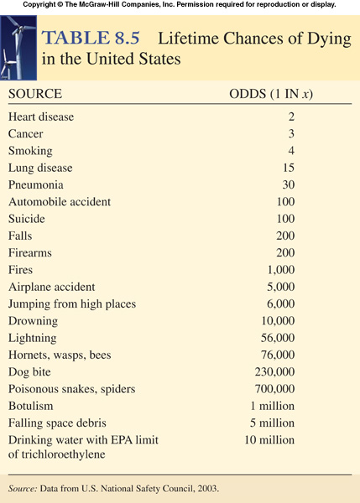
What types of laws and policies would you implement based on this data?
Perspective: The odds of winning the Powerball lottery jackpot: One chance in ~200million

Slide 42
ESTABLISHING PUBLIC POLICY
In setting standards for environmental toxins, these are the main factors considered:
Combined effects of different exposures.
Individual sensitivities within population.
Effects of chronic and acute exposures.

Slide 43
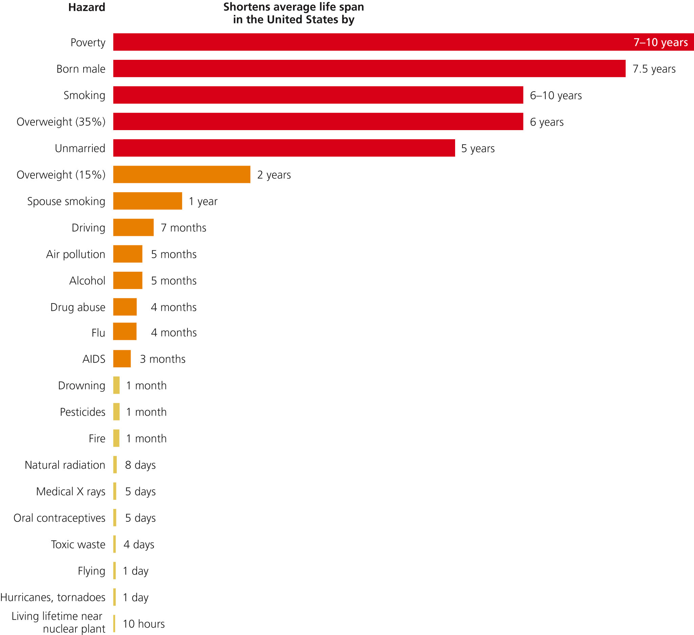
Source: Miller Environmental Science

