Slide 1
Covalent Bonding
Lewis Dot Structure and Octet Rule

Slide 2
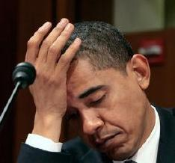
What are Covalent Bonds?
I am so confused

Slide 3
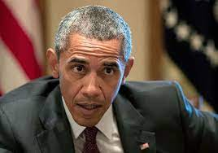
Covalent Bonding
Covalent Bonding: The interatomic linkage that results from the sharing of an electron- pair between two atoms.
Covalent bonding occurs between nonmetals in a sharing of electrons. There are two kinds of covalent bonds formed based on the electronegativity of the nonmetals.
WOW!

Slide 4
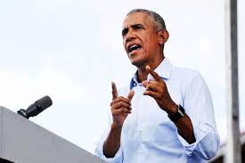
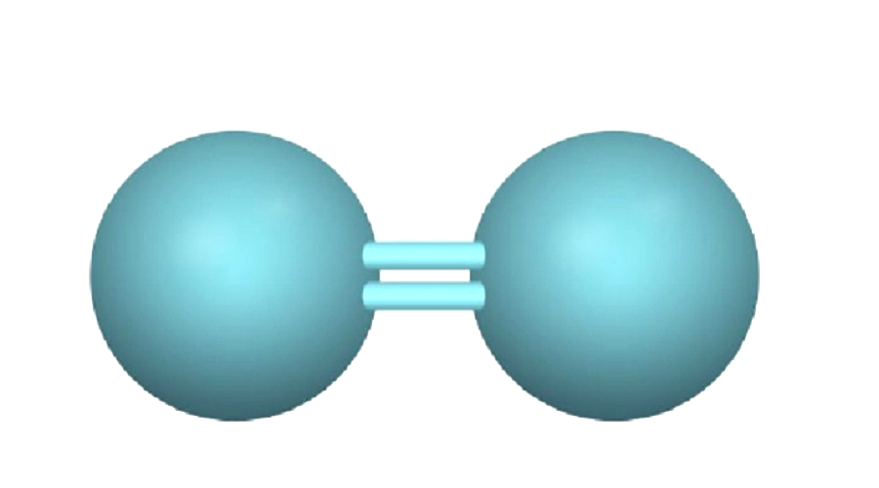
Non-Polar Covalent Bonding
Non-Polar Covalent Bonds: When the electronegativity difference between the nonmetals is between 0.0 and 0.2, the elements will form a bond without a polarity, equally sharing the electron.
An example would be F - F. Both Fluorines have equal electronegativity, allowing them to share the electron.
This is starting to make sense!
F
F

Slide 5
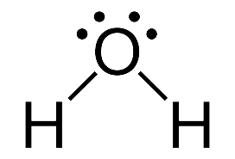
Polar Covalent Bonding
Polar Covalent Bonds: When the electronegativity difference between the nonmetals is between 0.3 - 1.4 this bond is formed.
This bond is characterized by one nonmetal with more attractive force creating a polarity. One example is H2O, Oxygen pulling more than its Hydrogen counterparts.

Slide 6
Octet Rule

Slide 7
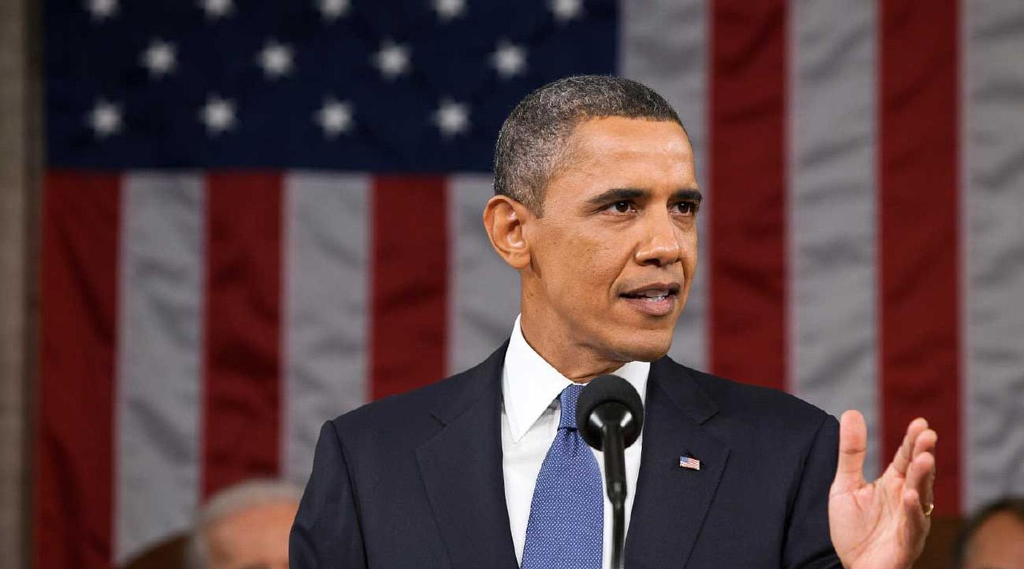
Octet Rule and Exception
Octet Rule is when elements try to gain or lose electrons so all the elements in a compound can achieve an 8 electron shell and the same electron configuration of a noble gas.
While this trend applies to most elements, there are few exceptions. An exception to the Octet Rule is Helium and Hydrogen which only has two valence electrons.
Another exception to this rule or covalent compounds that have an odd number of valence
How Interesting

Slide 8
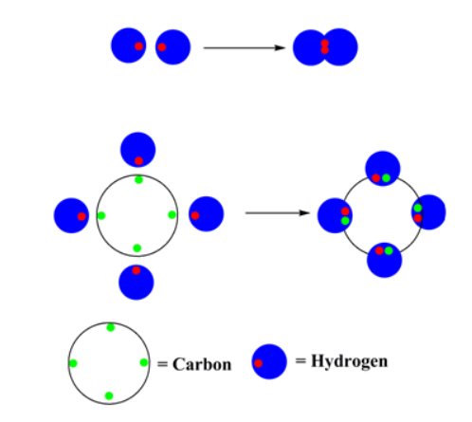
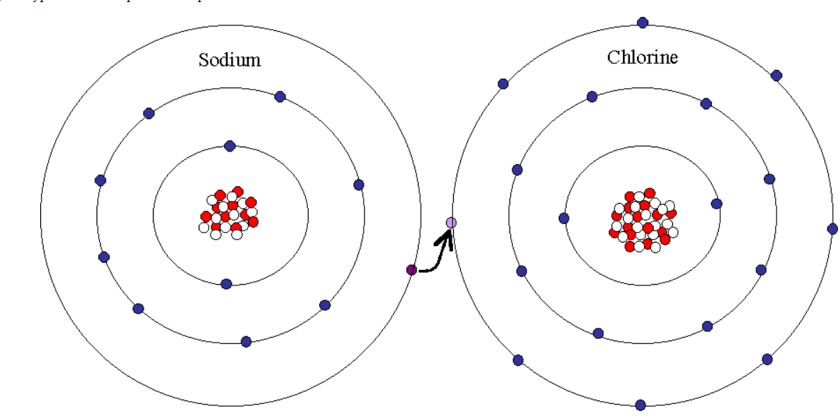
Example of the Octet Rule
CH4
NaCL

Slide 9
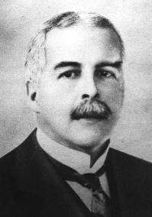
Lewis Dot Structures

Slide 10
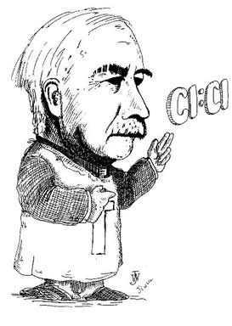
Lewis Dot Structures
Invented by Gilbert Newton Lewis in 1916
Lewis Dot Structures are used to represent covalently bonded molecules

Slide 11
How to make Lewis Dot Structures
1. Set up molecules
H
O
H
2. Sum up valence electron
3. Create bonds
8 valence electrons
4. Place remaining valence electrons to fulfill octet rule
- 4 bonded electrons
4 remaining electrons
Notes:
Set up molecules
Sum up valence electrons
Create bonds
Place remaining valence electrons to fulfill octet rule

Slide 12
TRY IT YOURSELF
Notes:
Give people lesson assignment (PCl3, CN-,

Slide 13
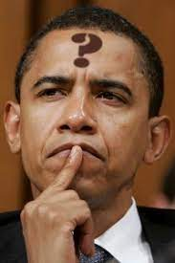
Question:
Create a Lewis Dot Structure showing the bondings of Cyanide (CN-)
2. Create a Lewis Dot Structure showing the covalent bond created by Phosphorus Trichloride (PCl3)
I wonder….

Slide 14
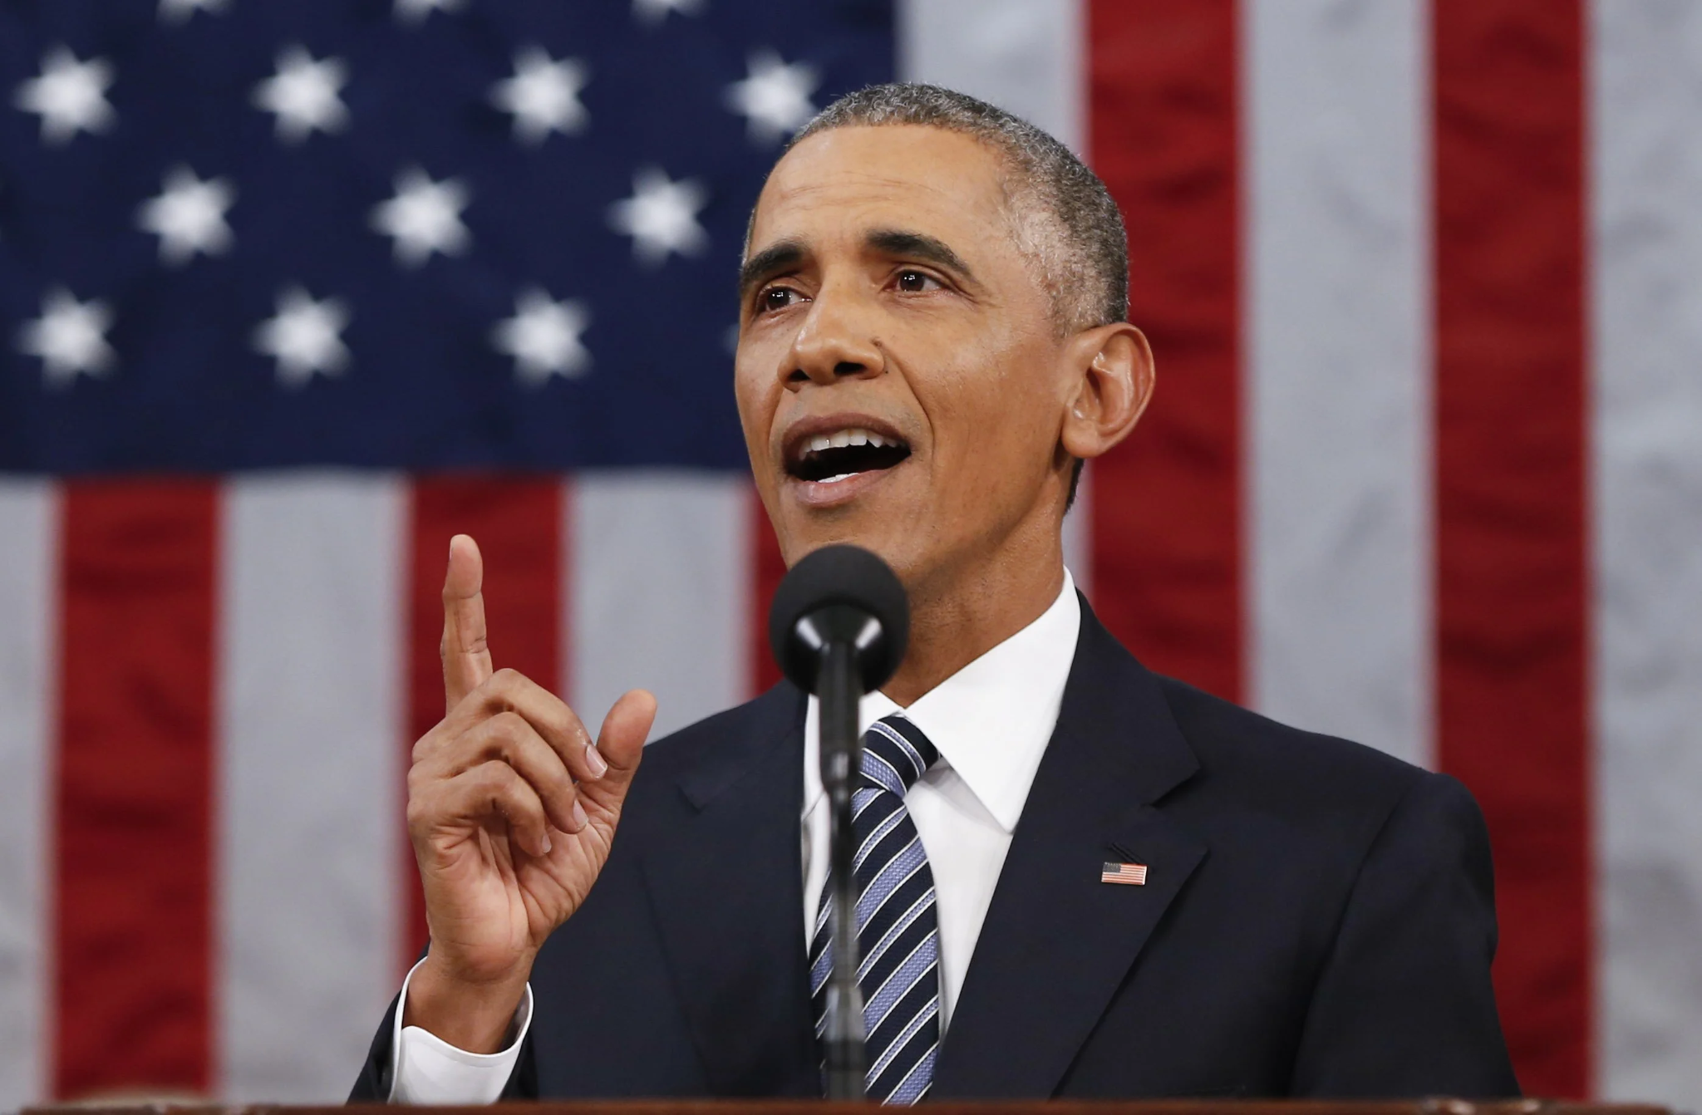
Answer
Create a Lewis Dot Structure showing the bondings of Cyanide (CN-)
2. Create a Lewis Dot Structure showing the covalent bond created by Phosphorus Trichloride (PCl3)
I get it!

Slide 15
Lewis Dot Exceptions
Notes:
NO, BCl3, SF6, XeF4, BeCl2

Slide 16
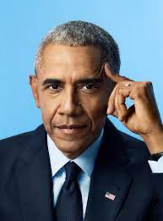
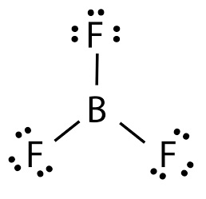
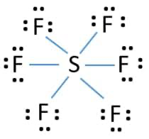
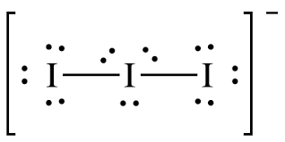
Lewis Dot Exceptions

Slide 17
Credits
Directed by Chase Freckmann
Co-Directed by Chase Freckmann
Edited by Chase Freckmann
Soundtrack by Chase Freckmann
Animation by Chase Freckmann
Illustration by Chase Freckmann
Acting by Chase Freckmann
Co-Acting by Barack Obama
Lighting by Chase Freckmann
Honorable Mentions: Ethan Pensyl, Tony Pham, Rodrigo Pardo

Slide 18
Works Cited
https://pobchemteam.weebly.com/uploads/2/5/7/7/25772138/bonding_and_molecular_structure_fr_worksheet_key.pdf
https://apcentral.collegeboard.org/pdf/ap21-frq-chemistry.pdf

