Slide 1
Biogas
Brianna Rankins
Nyri White
Andre Elam

Slide 2
What is biogas?
Biogas is commonly used to refer to a gas which has been produced by the biological breakdown of organic matter in the absence of oxygen. Methane, hydrogen and carbon monoxide can be combusted or oxidized with oxygen and the resultant energy release allows biogas to be used as a fuel. ☺

Slide 3
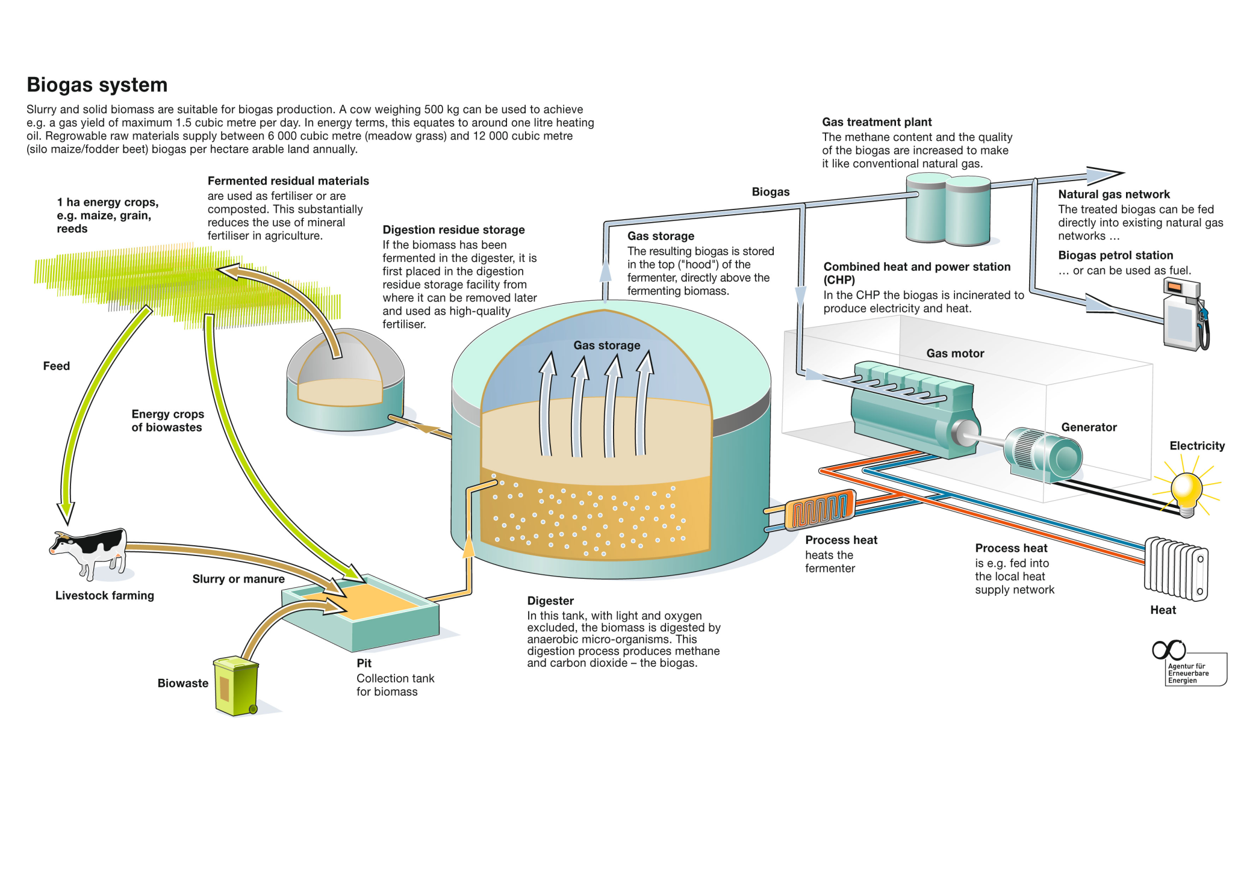

Slide 4
How is biogas created?
Biogas is commonly made from animal manure, settled from wastewater, and at landfills containing organic wastes.

Slide 5
How is biogas renewed?
Conversion of biomass into valuable fertilizers and environmentally friendly biogas. Fertilizers are sent to farmers who spread them on their land. The biogas can be delivered to a combined heat and power plant and used in gas engines for the production of electrical power and heat.

Slide 6
Cost?
Because bio gas comes from waste materials that is readily usable, the cost of fueling biogas machines is very low. Not like oil or coal, rubbish doesn’t require to be found. As an alternative, we have tons of it lying unwanted in dumps, taking up area. Not every type of waste can be used.

Slide 7
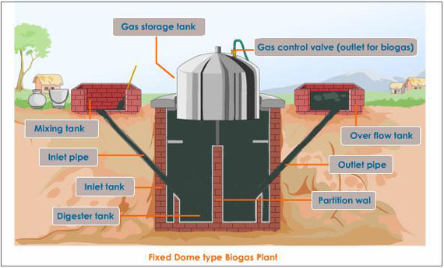

Slide 8
Advantages/Positive Aspects
It is a renewable source.
No additional greenhouse gas emissions meaning it releases and takes in the same amount of carbon dioxide.
Consumes methane that might leak into the atmosphere and increase the greenhouse affect.

Slide 9
Disadvantages/negative aspects
Biogas would encourage deflation of goods prices.
There would be food shortage in countries with limited land for food production.
Loss of organic waste for compose and fertilizer.

Slide 10
How does biogas work?
Organic waste is put into a sealed tank called a digester (or bioreactor) where it is heated. In the absence of oxygen, anaerobic bacteria consumes the organic matter to multiply and produce biogas. ☺

Slide 11
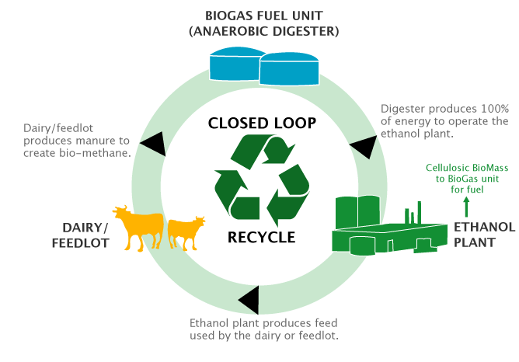

Slide 12
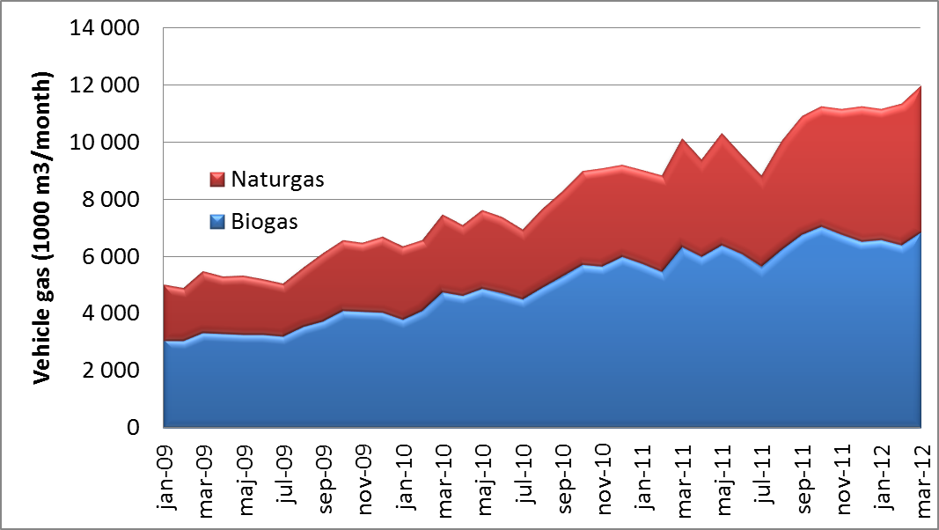
Comparison

Slide 13
Why aren’t we using biogas?
Biogas is being collected and used to generate electricity or steam at many landfills, wastewater plants and breweries. Many opportunities for biogas production are yet to be implemented. Until recently, the low cost of fossil fuels has slowed down implementation of biogas production. There is a limited awareness of the advantages of biogas production by citizens and government officials. More education, demonstration and investment in biogas technology would help overcome this problem.

