Slide 1
AP Chemistry
#2
Nature of Liquids & Structure of Solids

Slide 2
The Nature of Liquids
Molecules in motion, but held by intermolecular forces
Intermolecular forces: attractive forces between molecules (i.e. bonds)
Liquids maintain volume, but take shape of container
Properties of Liquids
Vapor pressure
Boiling point
Surface tension
Viscosity
Capillary Action
solubility

Slide 3
Evaporation (Vaporization)
Conversion of a liquid to a gas or vapor below its boiling point
Fastest moving molecules have highest kinetic energy
Enough energy => break bonds with other molecules and “escape” from liquid
Has a cooling effect on liquid or surface
Evaporation is an endothermic process
E.g. sweating

Slide 4
Evaporation

Slide 5
Evaporation

Slide 6
Liquid –Vapor Equilibrium
Rate of Vaporization = Rate of Condensation
Liquid ⬄ Vapor
Dynamic equilibrium
The pressure exerted by the vapor over the liquid remains constant
If both liquid and vapor are present, vapor pressure is independent of container volume

Slide 7
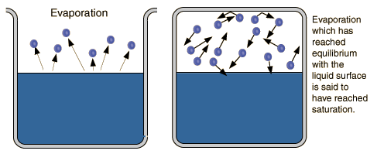
Vapor Pressure
Pressure exerted by vapor in equilibrium with a liquid.
Characteristic of liquid at a given temperature
Independent of container volume as long as both liquid and vapor are present
Measure of tendency of liquid to evaporate at a given temperature

Slide 8
Vapor Pressure Animation

Slide 9
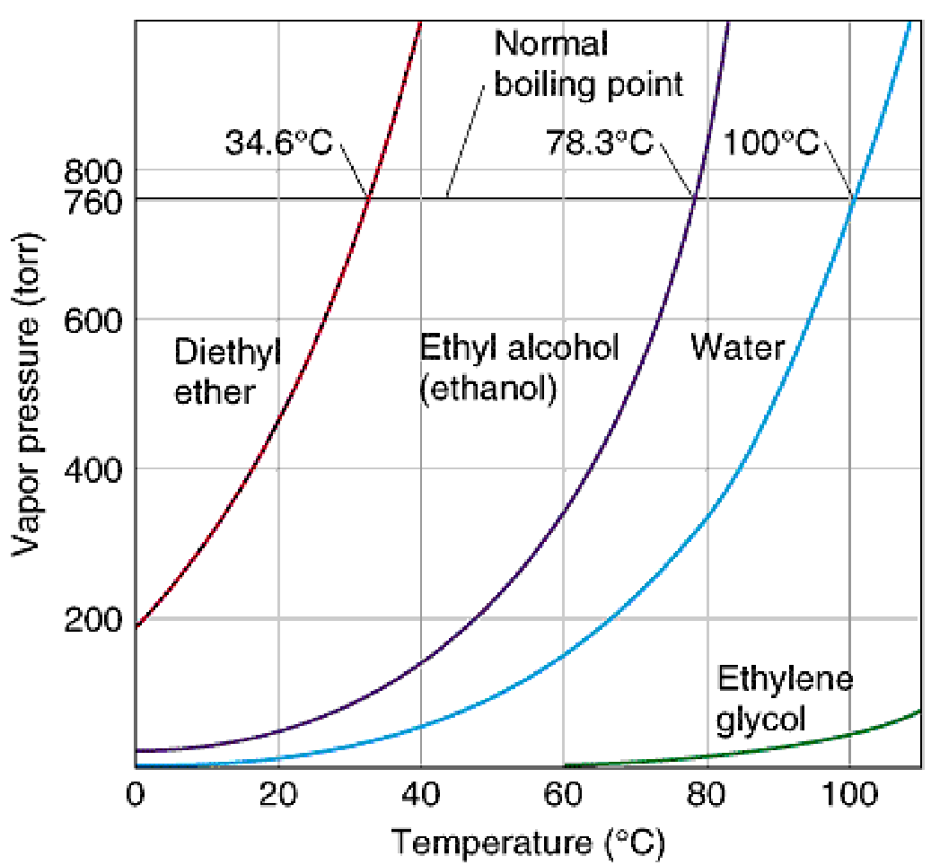
Vapor Pressure vs. Temperature
Vapor pressure curves for various liquids
Determine boiling point for various external pressures.
Determine vapor pressure at various temperatures.

Slide 10
The Boiling Point of a Liquid
Boiling Point: Temperature at which the vapor pressure of a liquid is equal to the external pressure
Normal Boiling Point: Temperature at which the vapor pressure of a liquid is equal to standard atmospheric pressure (101.3kPa)
Vapor bubbles form
Temperature remains constant!
Stronger intermolecular forces = higher boiling point

Slide 11
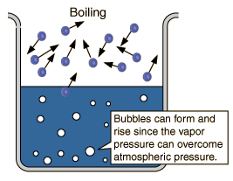
Boiling Graphic

Slide 12
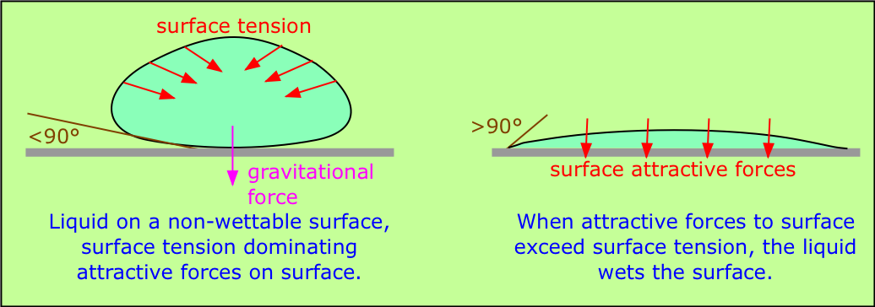
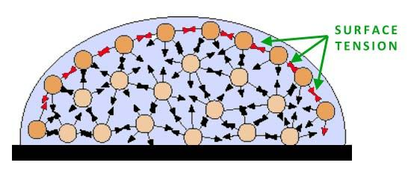
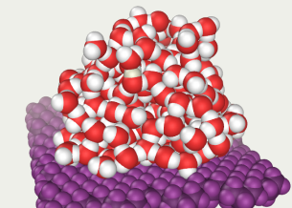
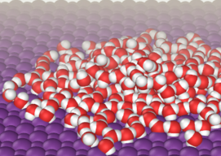
Properties of Liquids: Surface Tension
Surface tension – resistance of a liquid to an increase in its surface area:
Liquids with large intermolecular forces tend to have high surface tensions.

Slide 13
Properties of Liquids: Viscosity
Viscosity – measure of a liquid’s resistance to flow:
Liquids with large intermolecular forces or molecular complexity tend to be highly viscous.
Viscosity YouTube Video

Slide 14
Properties of Liquids: Capillary Action
Capillary action – spontaneous rising of a liquid in a narrow tube:
Cohesive forces – intermolecular forces among the molecules of the liquid.
Adhesive forces – forces between the liquid molecules and their container.

Slide 15
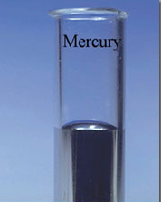
Convex Meniscus Formed by Nonpolar Liquid Mercury
Which force dominates alongside the glass tube – cohesive or adhesive forces?
cohesive forces

Slide 16
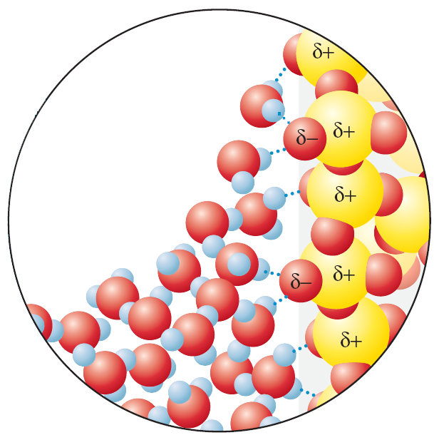
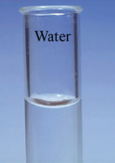
Concave Meniscus Formed by Polar Water
Which force dominates alongside the glass tube – cohesive or adhesive forces?
adhesive forces

Slide 17
The Structure of Solids
Particles are held in fixed positions
Vibrations increase with temperature
Maintain shape and volume (rigid)
Melting Point: temperature at which solid turns to liquid
Vibrations become too “violent” for bonds to hold particles in place

Slide 18
Crystals vs. Amorphous
Crystal: atoms, ions, or molecules are arranged in orderly, repeating 3-d pattern
Unit Cell: smallest group of particles within crystal that maintains geometric shape of crystal
Amorphous Solids: lack ordered, internal structure
Rubber, plastic, asphalt
Glass
Transparent fusion products of inorganic substances (e.g.SiO₂)
Amorphous solids or “super cooled” liquids
Cooled to rigid state without crystallizing
Do not have definite melting point: soften with heat

Slide 19
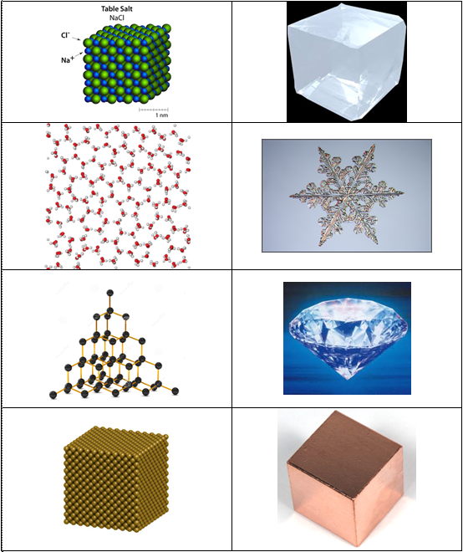
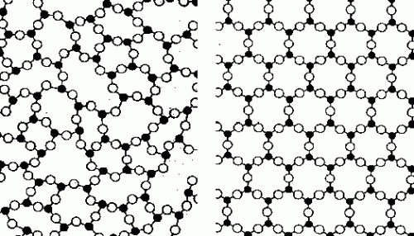
Examples of Crystals
AMORPHOUS VS CRYSTAL

Slide 20
Molecular Solids
Covalently bonded molecules held in solid state by IMFs
Generally low melting and boiling points
Solubility varies with polarity (like dissolves like)
Generally poor conductors of electricity
Generally “soft” materials

Slide 21
Knowledge Bullet Points
Molecular solids consist of nonmetals, diatomic elements, or compounds formed from two or more nonmetals.
Molecular solids are composed of covalently bonded molecules attracted to each other through relatively weak intermolecular forces.
Molecular solids are not expected to conduct electricity because their electrons are tightly held within the covalent bonds of each constituent molecule.
Molecular solids generally have a low melting point because of the relatively weak intermolecular forces present between the molecules.
Molecular solids are sometimes composed of very large molecules, or polymers, with important commercial and biological applications.

Slide 22
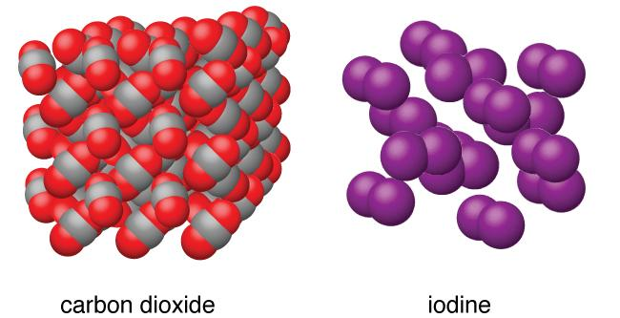
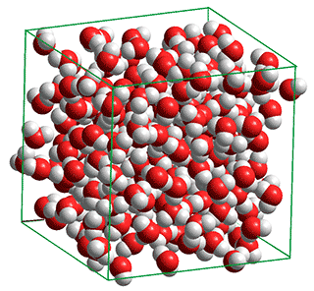
Examples of Molecular Solids

Slide 23
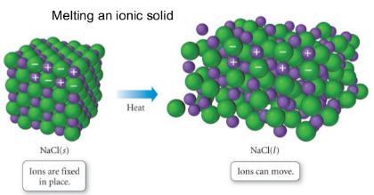
Ionic Solids
Crystalline solids
High Melting Points
ionic bonds are strong!
Brittle
Shatter when struck
Many are water soluble
Dissolve in polar solvents
Do not dissolve in NP solvent
Conductivity
solids do not conduct electricity
liquids do conduct
aqueous solutions also conduct

Slide 24
Ionic Solids Knowledge Bullet Points
The cations and anions in an ionic crystal are arranged in a systematic, periodic 3-D array that maximizes the attractive force among cations and anions while minimizing the repulsive forces.
Coulomb’s Law (recall lattice energy and ionic bond strength!)
higher charges lead to stronger interactions.
smaller ions lead to stronger interactions.
Properties related to structure.
Low vapor pressure due to the strong Coulombic interactions
Brittle: repulsion of like charges when solid deforms under stress
Ionic solids do not conduct electricity: ions not free to move
Ionic liquids do conduct electricity: ions free to move
Ionic solutions (electrolytes) will conduct electricity: ions free to move
Dissolve in polar solvents, but not in nonpolar solvents
Favorable charge interactions

Slide 25
Metallic Solids and Alloys
Generally crystalline solids
Generally high melting points
metallic bonds are also strong!
Malleable: can be pounded into thin sheets
Ductile: can be drawn into wire
Good conductors of electricity
High luster: shiny!

Slide 27
Metallic Solids Knowledge Bullet Points
Metallic bonding: array of positive metal ions surrounded by delocalized valence electrons (i.e. a sea of electrons).
Metals are good conductors: the electrons are delocalized and free to move.
Metals are malleable and ductile: deforming the solid does not change the environment immediately surrounding each metal core.
Metallic mixtures are called called alloys. Some properties of alloys can be understood in terms of the size of the component atoms.
Interstitial alloys form between atoms of different radii, where the smaller atoms fill the interstitial spaces between the larger atoms. The interstitial atoms do not appreciably expand the lattice, so the density is often substantially increased. The interstitial atoms make the lattice more rigid, decreasing malleability and ductility.
Substitutional alloys form between atoms of similar radii, where one atom substitutes for the other in the lattice. The density typically lies between those of the component metals, and the alloy remains malleable and ductile.
Alloys typically retain a sea of mobile electrons and so remain conducting.
In some cases, alloy formation alters the chemistry of the surface. An example is formation of a chemically inert oxide layer in stainless steel.

Slide 28
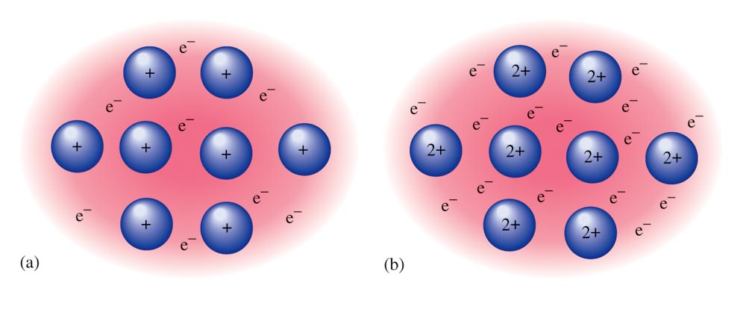
The Electron Sea Model
A regular array of cations in a “sea” of mobile valence electrons.

Slide 29
Metal Alloys
Substitutional Alloy – some of the host metal atoms are replaced by other metal atoms of similar size.
Density between original mixed metals
Can increase strength / chemical resistivity
Interstitial Alloy – some of the holes in the closest packed metal structure are occupied by small atoms.
Density increases
Hardness increases
Malleability decreases

Slide 30
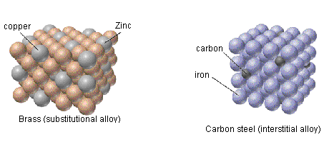
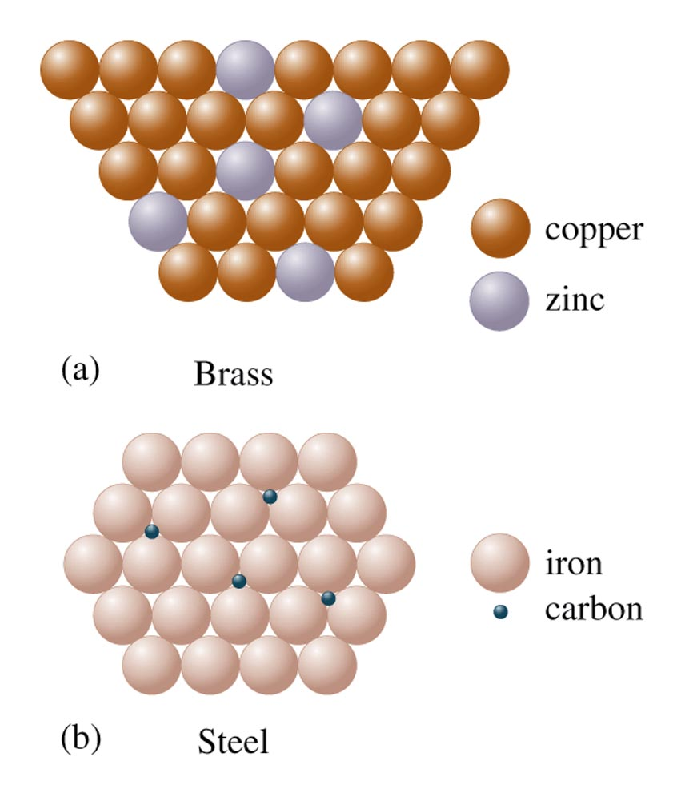
Two Types of Alloys
Brass is a substitutional alloy.
Steel is an interstitial alloy.

Slide 31
Network Covalent Solids
Atoms are covalently bonded together in a continuous two or three dimensional array
Macroscopic molecules!
Examples: diamond and graphite.
classified as 2-dimensional or 3-dimensional.
2-dimensional arranged in layers, with weak attractions between the layers. Generally soft and/or slippery.
3-dimensional is a giant interlocking design; exceptional hardness and a high melting and boiling point.
High Melting Points
Insoluble in common solvents
Poor electrical conductors

Slide 32
Covalent Network Solids Knowledge Bullet Points
Covalent network solids consist of atoms that are covalently bonded together into a two-dimensional or three-dimensional network.
Covalent network solids are only formed from nonmetals;
elemental (diamond, graphite)
two nonmetals (silicon dioxide or silicon carbide).
high melting points: all of the atoms are covalently bonded.
rigid and hard: atoms held in fixed positions
form from elements in the carbon group: ability to form four covalent bonds.
Graphite is an allotrope of carbon that forms sheets of two-dimensional networks.
high melting point: strong covalent bonds within layers
soft: adjacent layers can slide past each other relatively easily; the major forces of attraction between the layers are London dispersion forces.
Good electrical conductor: delocalized electrons in layers
Silicon is a covalent network solid and a semiconductor.
three-dimensional network similar in geometry to a diamond.
conductivity increases as temperature increases.
doping with an element with one extra valence electron converts silicon into an n-type semiconducting (negative charge carrying) material,
doping with an element with one less valence electron converts silicon into a p-type semiconducting (positive charge carrying) material.
Junctions between n-doped and p-doped materials can be used to control electron flow, and thereby are the basis of modern electronics.

Slide 33
Comparison of Diamond and Graphite
DIAMOND
GRAPHITE
Property | Diamond | Graphite
melting point | 3550 ºC | 3675 ºC
boiling point | 4827 ºC | 4200 ºC
density | 3.51 g/cm³ | 2.26 g/cm³
electrical conductivity | Low | High

Slide 34
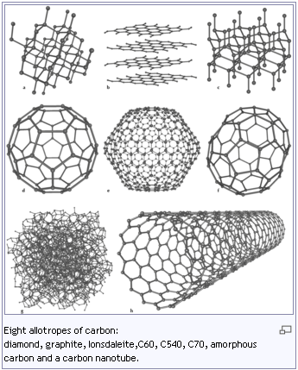
Allotropes
Two or more different molecular forms of same element in same physical state
Examples
Carbon: soot (amorphous), graphite, diamond
Oxygen (O₂) vs. Ozone (O₃)

Slide 35
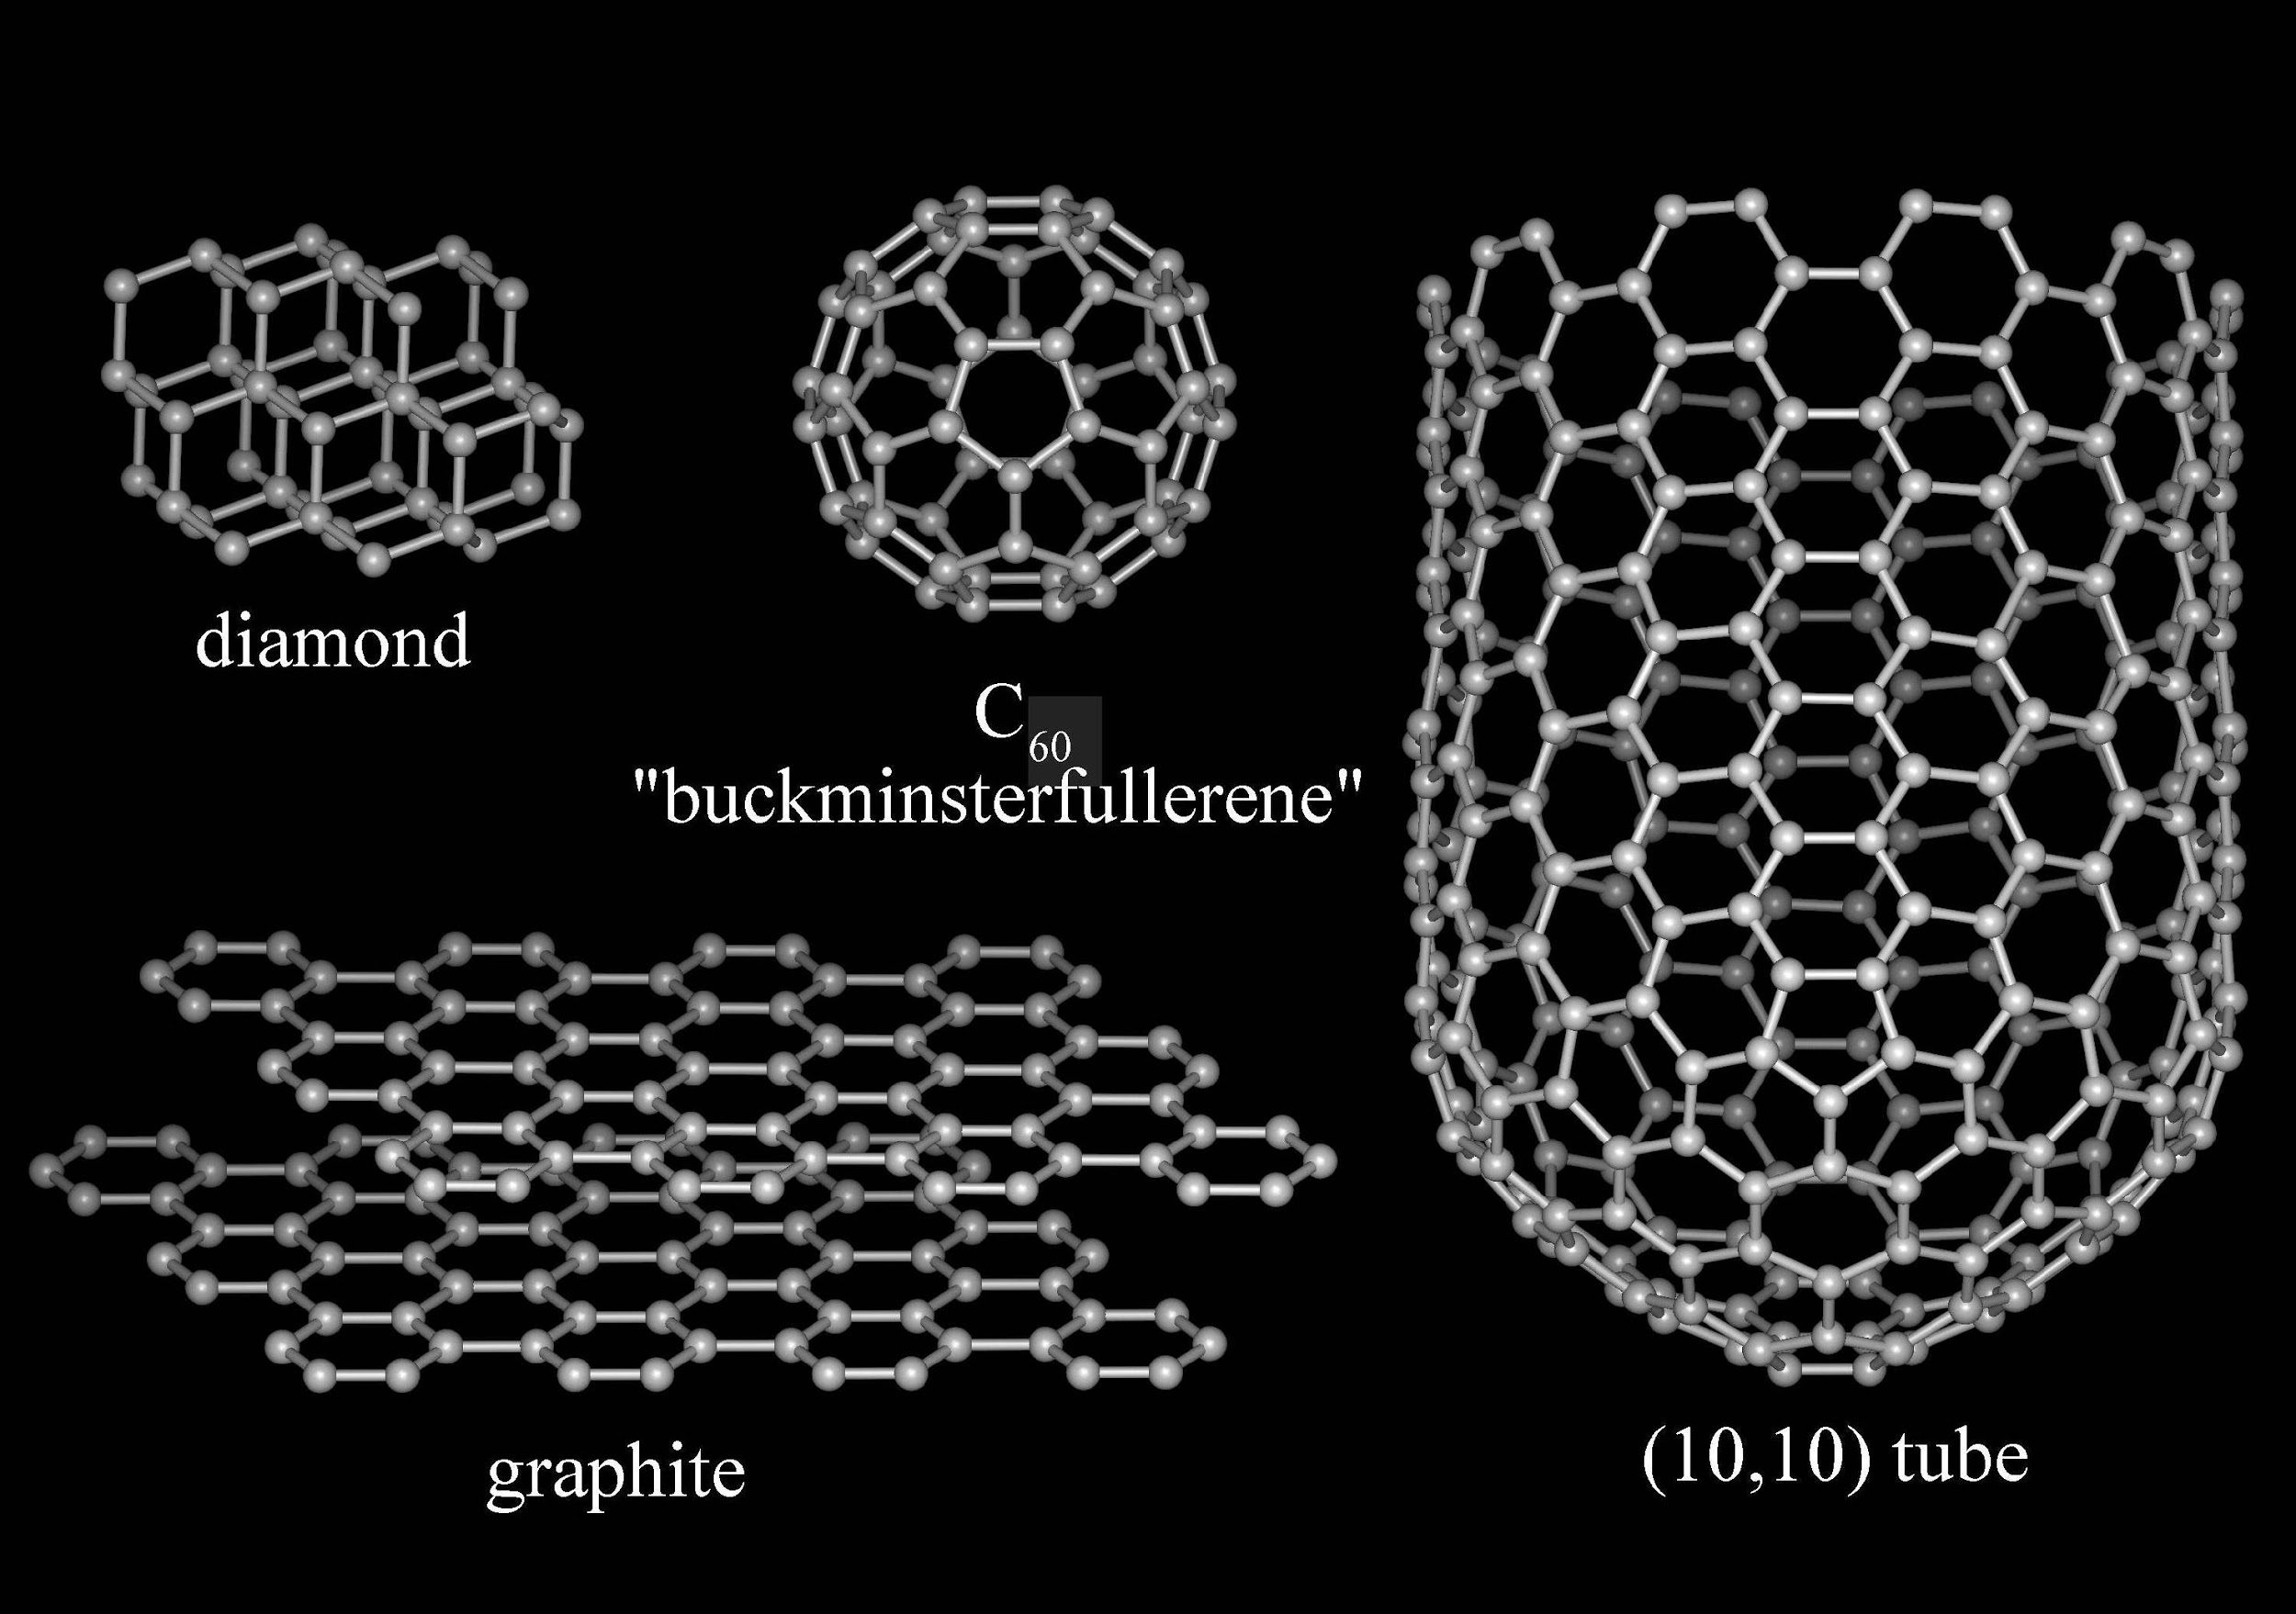
Allotropes

Slide 36
Summary of Crystalline Solids
Type | Intermolecular Forces | Properties | Examples
Ionic | Ionic | High Melting Point, Brittle, Hard | NaCl, MgO
Molecular | Hydrogen Bonding, Dipole-Dipole, London Dispersion | Low Melting Point, Nonconducting | H₂, CO₂
Metallic | Metallic Bonding | Variable Hardness and Melting Point (depending upon strength of metallic bonding), Conducting | Fe, Mg
Network Covalent | Covalent Bonding | High Melting Point, Hard, Nonconducting | C (diamond), SiO₂ (quartz)

Slide 37
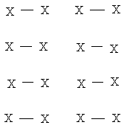
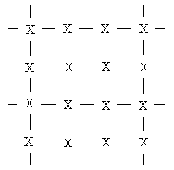
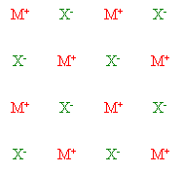
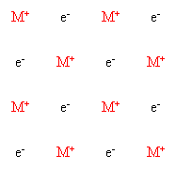
Summary of 4 Types of Substances
Molecular
Network Covalent
Ionic
Metallic

Slide 38
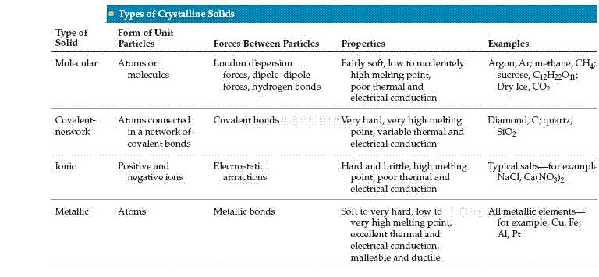
Solids Comparison Chart

Slide 39
Strength of Forces (WEAKEST TO STRONGEST)
London dispersion forces (LDF)
Direct comparison – which has a bigger mass/radius (more polarizable)?
Dipole-dipole forces
Direct comparison – which is more polar?
Hydrogen bonding
Direct comparison – which has more H-bonds?
Ionic compounds – electrostatic forces
Direct comparison – charge first, then size
Network covalent – covalent bonds
Metallic usually somewhere around ionic in terms of strength…
has a somewhat wide range
Know PROPERTIES too (brittle vs. malleable, hardness,
conductivity, etc.) and other small points (alloys)

Slide 40
General overview of strength of forces (WEAKEST TO STRONGEST)
London dispersion forces (LDF)
Direct comparison – which has a bigger mass/radius (more polarizable)?
Dipole-dipole forces
Direct comparison – which is more polar?
Hydrogen bonding
Direct comparison – which has more H-bonds?
Ionic compounds – electrostatic forces
Direct comparison – charge first, then size
Network covalent
Metallic usually somewhere around ionic in terms of strength… has a somewhat wide range
Know PROPERTIES too (brittle vs. malleable, hardness, conductivity, etc.) and other small points (alloys, doping)

Slide 41
Concept Check
As intermolecular forces increase, what happens to each of the following? Why?
Boiling point
Viscosity
Surface tension
Enthalpy of fusion
Freezing point
Vapor pressure
Heat of vaporization
Notes:
Boiling point increases
Viscosity increases
Surface tension increases
Enthalpy of fusion increases
Freezing point increases
Vapor pressure decreases
Heat of vaporization increases

Slide 43
Clausius-Clapeyron Equation
Relates the vapor pressure to the temperature
Allows determination of heat of vaporization experimentally
Allows determination of vapor pressure at any temperature if ΔH_{vap} and vapor pressure at another temperature is known

Slide 44
Plot of ln P vs. 1/T
Us the following data to estimate the heat of vaporization of C₆F₆ (hexafluorobenzene)
(See next slide for plot and solution.)

Slide 45
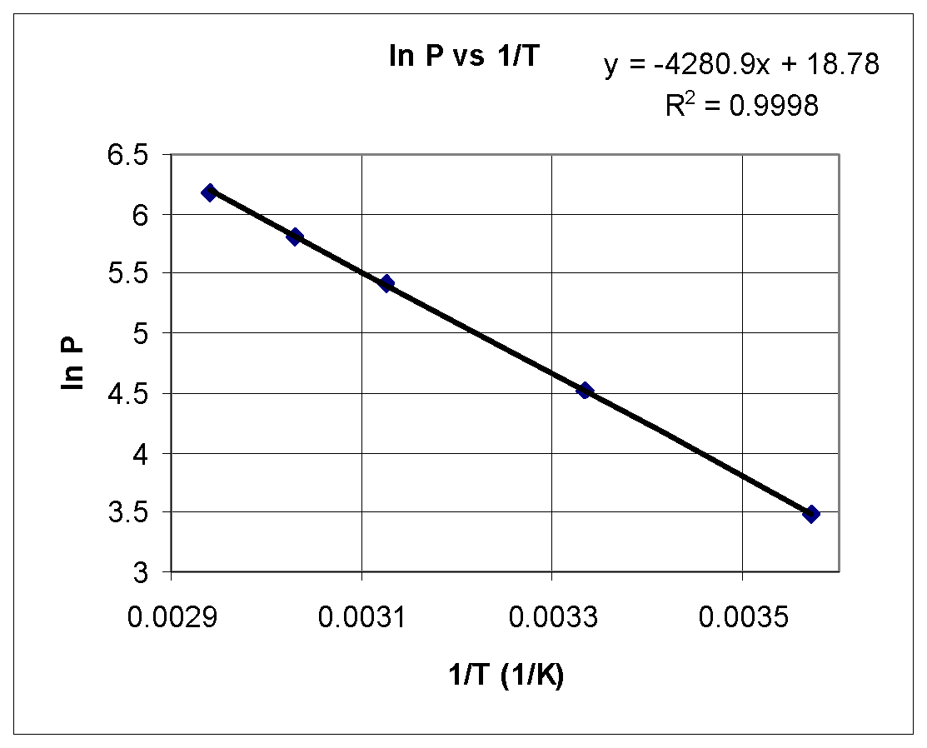
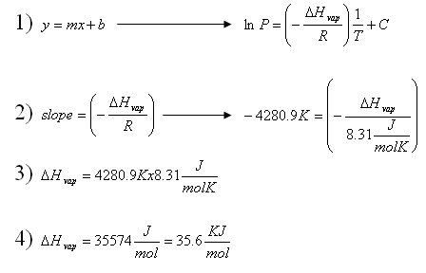
Determination of ΔH_{vap} from Plot of ln P vs. 1/T

Slide 46
Clausius-Clapeyron Examples
The vapor pressure of water is 1.0 atm at 373 K, and the enthalpy of vaporization is 40.7 kJ mol⁻¹. Estimate the vapor pressure at a temperature 383 K.
ANS: 1.4 atm
Predict the normal boiling point of water if it has a vapor pressure of 355 torr at 80ºC. The ΔH_{vap} of water is 40.7 kJ/mol.
ANS: 373 K
An unknown liquid has a vapor pressure of 88mmHg at 45ºC and 39 mmHg at 25ºC. What is its heat of vaporization?
ANS: 32.0 kJ/mol
A 1.00 gram sample of ethanol is introduced into a 5.00L container at 20ºC. The vapor pressure of ethanol at this temperature is 43.9 torr. How much liquid remains at equilibrium? What minimum volume flask would be needed for the entire sample to vaporize?

Slide 47
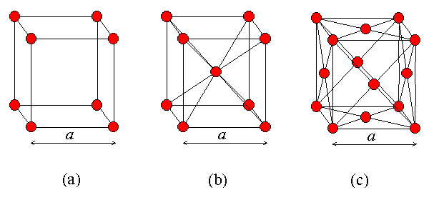
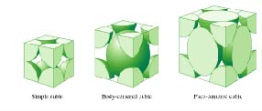
Basic Crystal Structures

Slide 48
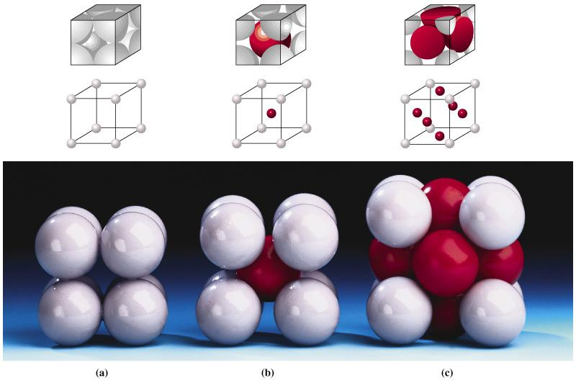
Basic Crystal Structures
SC
BCC
FCC

