Slide 1
QUANTUM MECHANICAL MODEL OF THE ATOM & ELECTRON CONFIGURATION
UNIT 4: LECTURE #2
CHAPTER 7

Slide 2
Recap from Lecture #1:
There is a relationship between energy, frequency, and wavelength of electromagnetic radiation.
The energy of an electron and electronic transitions in the Hydrogen atom are quantized and can be calculated.
Electrons exhibit both wave and particle-like behaviors (Wave-Particle Duality)

Slide 3
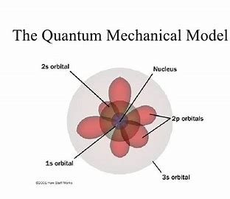
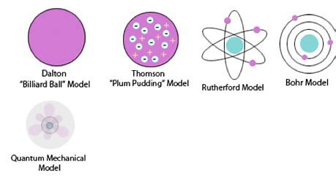
Quantum Mechanical (Wave) Model of the Atom
Mid-1920s: Bohr’s Model limitations were obvious; a new approach was needed
Planck showed energy was quantized
Einstein showed energy (photons) had mass
De Broglie showed that electrons show wave-like properties
QM: Mathematical explanation for atomic structure

Slide 4
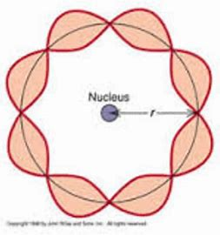
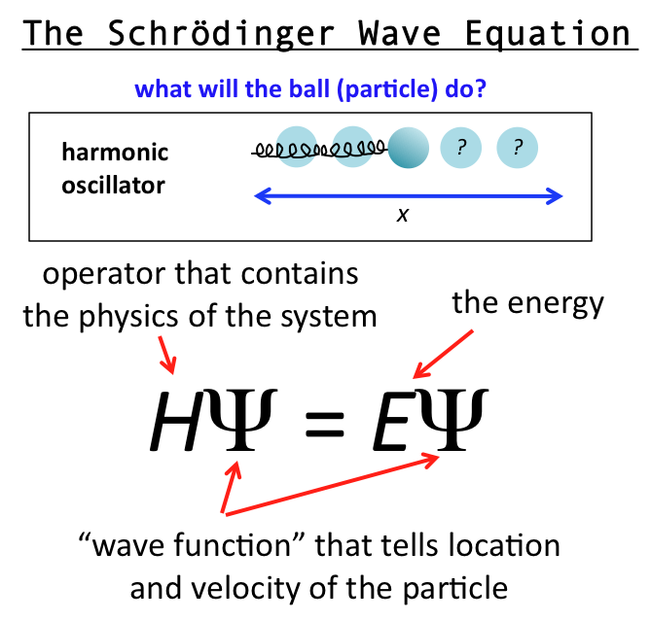
De Broglie & Schrodinger: Electrons move as a standing wave
Erwin Schrodinger (Austria)- 1924-
Electrons are bound to the nucleus similar to a standing wave (does not propagate through space; fixed at both ends.)
Proposed an equation that incorporates both wave and particle behaviors of electrons (QUANTUM MECHANICS)
Solving Schrodinger’s Equation produces Wave Functions whose square provides information about the electron’s location
While we can’t specify the exact location (Heisenberg), we can use the wave functions to represent the probability density or electron density of an electron using ATOMIC ORBITALS (electron clouds)
Orbitals: Visualization of an element’s probable location in space

Slide 5
Schrodinger’s Equation

Slide 7
Heisenberg Uncertainty Principle
There is a fundamental limitation to just how precisely we can know both the position and momentum of a particle at a given time.
The more accurately we know position, the less accurately we know it’s momentum.
To measure either, we must apply a force that will change its position and motion.
Δx = uncertainty in a particle’s position
Δ(mν) = uncertainty in a particle’s momentum
h = Planck’s constant

Slide 8
Physical Meaning of a Wave Function (Ψ)
The square of the function indicates the probability of finding an electron near a particular point in space (ORBITALS)
Probability distribution – intensity of color is used to indicate the probability value near a given point in space.
Using Wave Function math, the probability distribution provides our orbital shapes
Relative orbital size is difficult to define precisely.
Picture an orbital as a three-dimensional electron density map.
Rule of thumb:
Radius of the sphere that encloses 90% of the total electron probability.

Slide 9
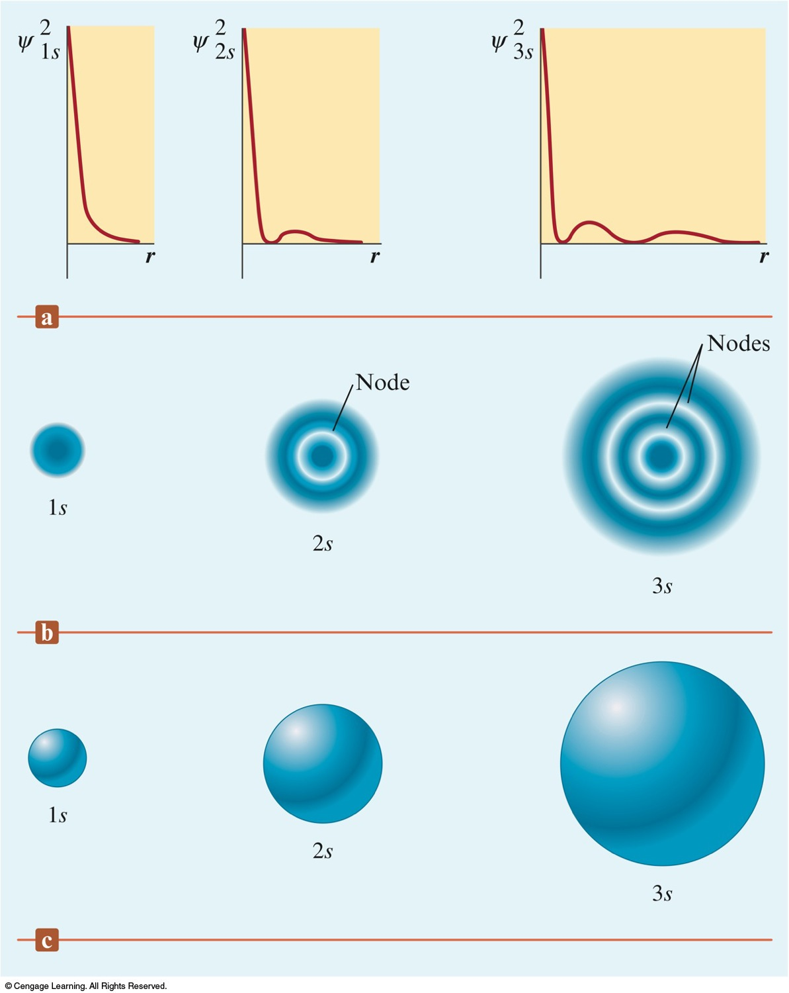
Three Representations of the Hydrogen 1s, 2s, and 3s Orbitals
S-Sublevel
-Spherical shaped orbitals
-1 orbital per sublevel
As energy level increases, the electron density becomes more spread out.

Slide 10
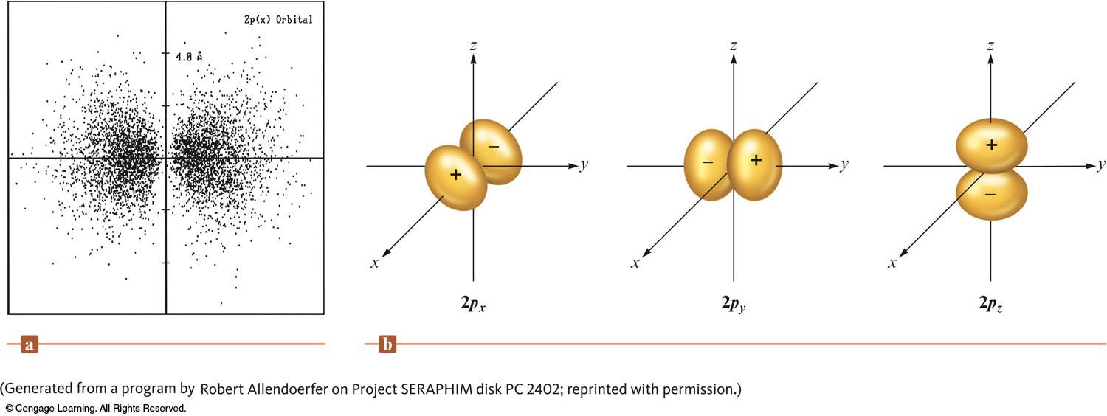
P-Sublevel
-Dumbbell Shaped Orbitals; 2 lobes each orbital; -Concentrated in 2 regions on either side of the nucleus, separated by a node at the nucleus
-3 orientations
-Occurs in levels n=2 & greater

Slide 11
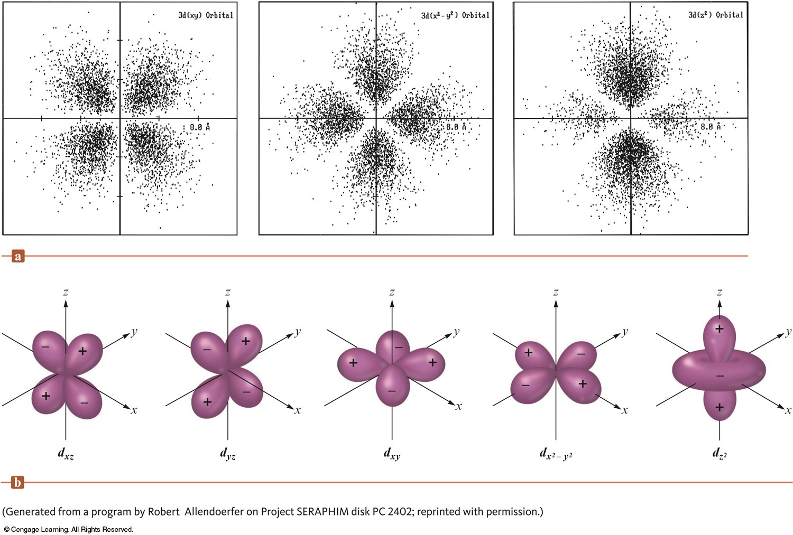
d-Sublevel
-Double Dumbbells with a Donut-Shaped Orbitals
-5 total orbitals; 4 with 4 lobes each & 5th with 2 lobes with a belt centered between.
-Occurs in levels n=3 & greater

Slide 12
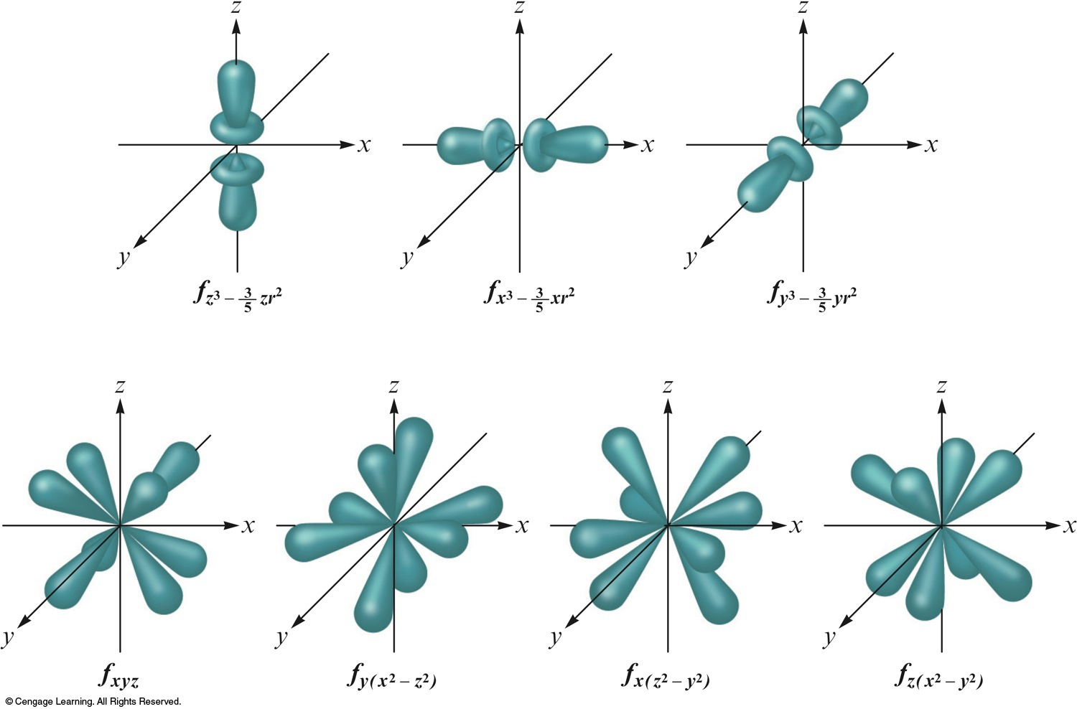
f-Sublevel
-I like to think of F for Flowers & Fingers
-10 total orbitals
-Occurs in levels n=4 & greater

Slide 13
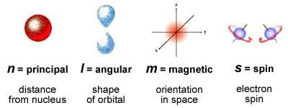
Quantum numbers
Describes the properties of orbitals and Electron configuration
Principal quantum number (n) – size and energy of the orbital.
Increase n→ orbital becomes larger. Indicates probable distance from the nucleus
Higher n also means higher E because electrons are less tightly bound to nucleus
Angular momentum quantum number (l) – shape of atomic orbitals (sometimes called a subshell); l=0 (s), l=1 (p), l=2 (d), l=3 (f)
Magnetic quantum number (m_{l}) – orientation of the orbital in space relative to the other orbitals in the atom.

Slide 14
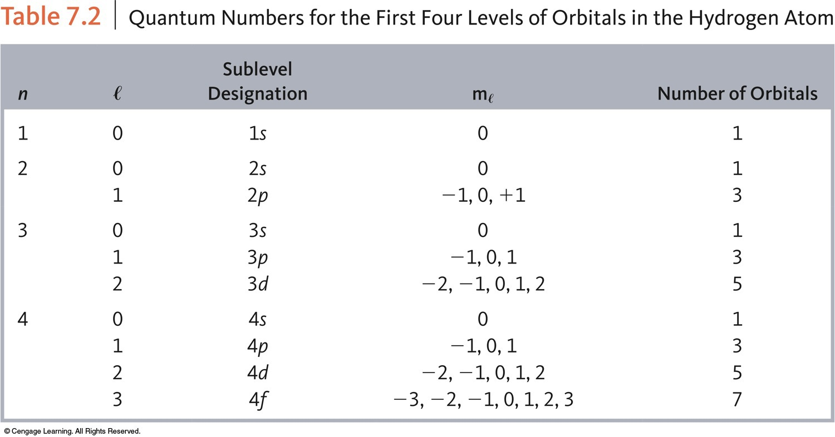

Slide 15
Quantum Mechanical Model & the Periodic Table
Originally constructed to represent the patterns observed in the chemical properties of the elements.
Mendeleev is given the most credit for the current version of the periodic table because he emphasized how useful the periodic table could be in predicting the existence and properties of still unknown elements.
Quantum Mechanical Model of the Atom accounts for the arrangement of the elements.

Slide 16
Electron Configuration
The way electrons are distributed among the various orbitals in an atom.
The most stable configuration (ground state) occurs when electrons are in the lowest possible energy states with valid quantum numbers.

Slide 17
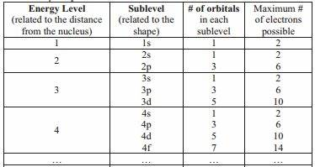

Slide 18
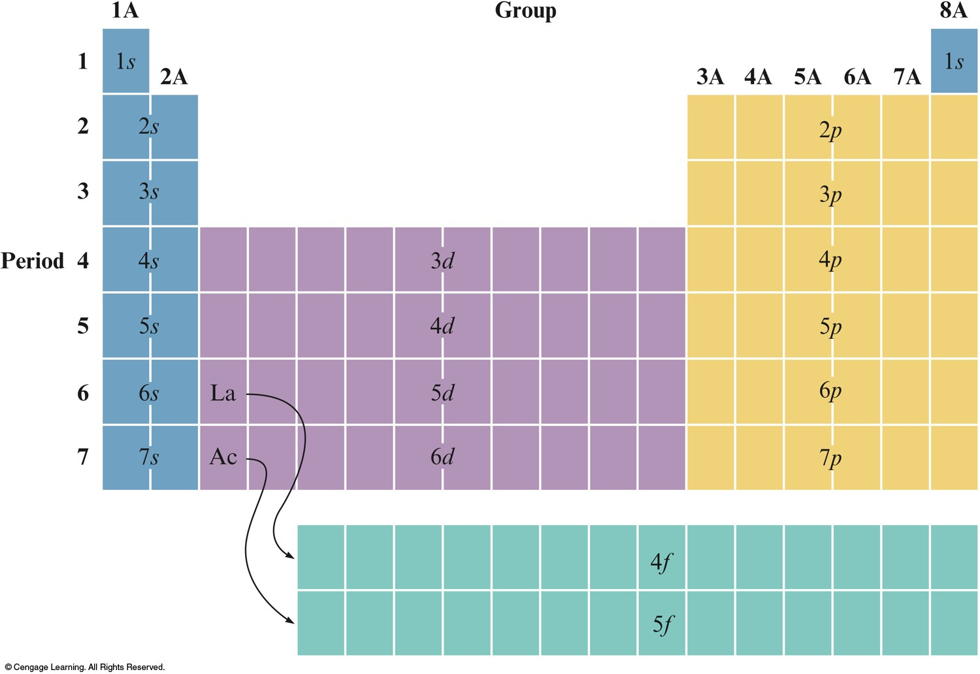
The Orbitals Being Filled for Elements in Various Parts of the Periodic Table

Slide 19
Electron Configuration Rules
Aufbau Principle
As protons are added one by one to the nucleus to build up the elements, electrons are similarly added to hydrogen-like orbitals.
An oxygen atom has an electron arrangement of two electrons in the 1s subshell, two electrons in the 2s subshell, and four electrons in the 2p subshell.
Oxygen: 1s²2s²2p⁴
Hund’s Rule
The lowest energy configuration for an atom is the one having the maximum number of unpaired electrons allowed by the Pauli principle in a particular set of degenerate (same energy) orbitals.

Slide 20
Electron Spin
Electron spin quantum number (m_{s}) – can be +½ or -½.
Pauli exclusion principle - in a given atom no two electrons can have the same set of four quantum numbers.
An orbital can hold only two electrons, and they must have opposite spins.
When electrons are placed in a particular quantum level, they “prefer” the orbitals in the order s, p, d, and then f.

Slide 21
Penetration Effect
A 2s electron penetrates to the nucleus more than one in the 2p orbital.
This causes an electron in a 2s orbital to be attracted to the nucleus more strongly than an electron in a 2p orbital.
Thus, the 2s orbital is lower in energy than the 2p orbitals in a polyelectronic atom.

Slide 22
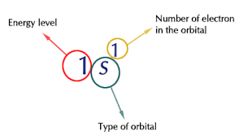
-Ground State Electron Configuration
-Noble Gas Configuration
(Eliminates inner electrons)

Slide 24
Orbital Diagram
A notation that shows how many electrons an atom has in each of its occupied electron orbitals.
Oxygen: 1s²2s²2p⁴
Oxygen: 1s 2s 2p

Slide 25
Valence Electrons
The electrons in the outermost principal quantum level of an atom. (Highest energy level’s s & p orbitals)
1s²2s²2p⁶ (valence electrons = 8)
The elements in the same group on the periodic table have the same valence electron configuration.
In transition metals, the d sublevel is lower in energy than the s sublevel, so the S electrons are removed first.

Slide 26
Paramagnetic vs. Diamagnetic

Slide 27
EXERCISE!
Determine the expected electron configurations for each of the following.
(Complete Ground State Configuration & Noble Gas Notation)
a) S
b) Ba
c) Pb
Notes:
a) 16 electrons total; 1s²2s²2p⁶3s²3p⁴ or [Ne]3s²3p⁴
b) 56 electrons total; [Xe]6s²
c) 63 electrons total; [Xe]6s²4f⁷

